Slide 1
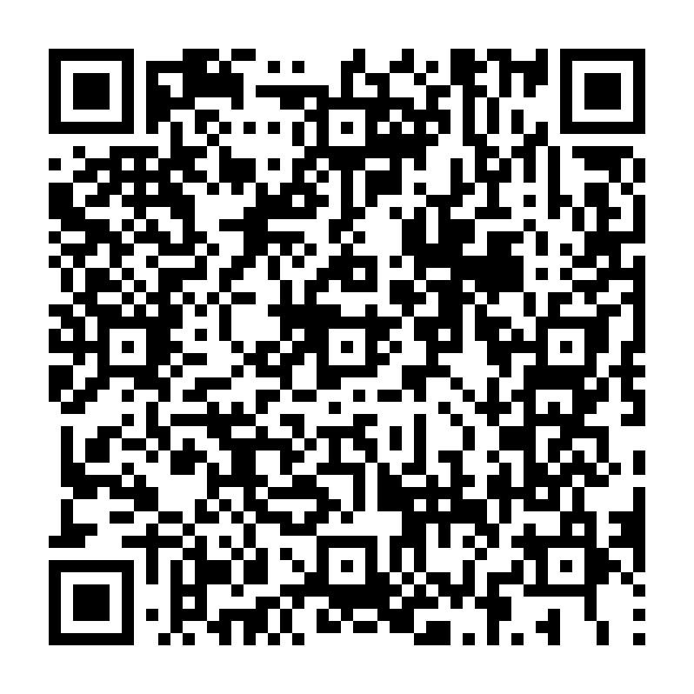
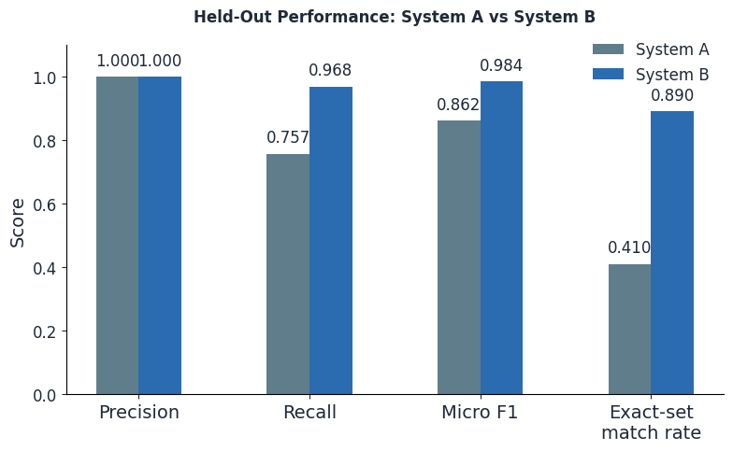
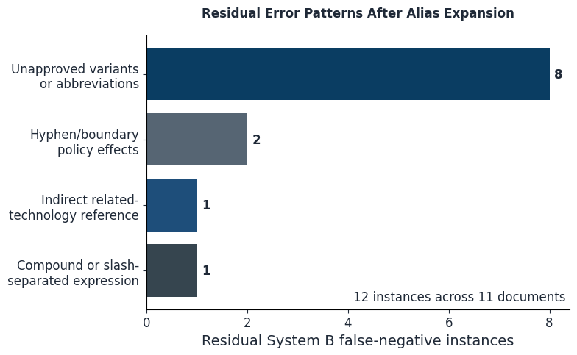
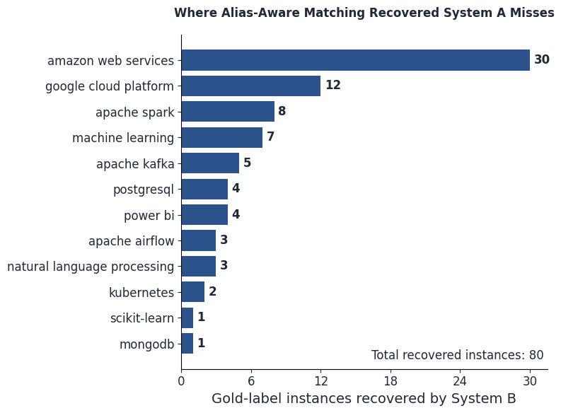
Evaluating Alias-Aware Matching for Technical-Skill Extraction
A held-out comparison of strict canonical matching and reviewed alias expansion in English IT job descriptions
Bhanu Agarwal
Trends in Natural Language Processing, Summer Semester 2026
QR Code: Code, notebooks, frozen artifacts, and reproducible results
On 100 held-out job descriptions, adding 13 reviewed aliases increased micro recall from 0.757 to 0.968 and micro F1 from 0.862 to 0.984, with 0 observed false positives.
QUESTION & METHOD
RESULTS
INTERPRETATIONS & LIMITS
RESEARCH QUESTION
How much and at what precision cost does alias-aware matching improve recall, and F1 compared with strict canonical matching ?
HYPOTHESIS
Reviewed aliases recover alternative forms, yielding higher held-out recall and F1.
BACKGROUND
The same technical concept appears in multiple surface forms in job descriptions, such as AWS, PySpark, PowerBI, and ML. Strict lexicon matching can therefore miss valid mentions even when the canonical concept is in scope.
PRIOR WORK
Experiment is related to skill extraction^{[1]} and job-description entity recognition ^{[2]}.
CONTRIBUTION
This study isolates the effect of reviewed aliases: it evaluates a controlled rule-based comparison using boundary-safe regex matching in which only alias availability changes.
Figure 1. System A and B Comparison
Figure 3. System B error reasons and instances
CONCLUSION
The hypothesis was supported.
Adding 13 reviewed aliases substantially improved recall and F1 without observed false-positives; recovered 80 of 92 System A false-negatives and increased exact-set match from 41% to 89%.
METHODOLOGY
Corpus Setup
Djinni English job-description, filtered into IT Job Postings and split into Development (n=200) and fixed Evaluation sets (n=100)
Lexicon Curation
Development-only review and coverage audit froze 20 canonical labels and 13 reviewed aliases
LIMITATIONS & FUTURE WORK
• Bounded scope: 20 canonical concepts and 100 documents english data-related IT postings only.
• Annotation: One annotator; no inter-annotator agreement.
• Unapproved variants and conservative hyphen handling miss valid forms.
Future: Broader surface-form coverage and carefully tested boundary extensions.
Independent Gold Annotation
Annotation of held-out postings using the frozen 20-label inventory
System Extractors & Evaluation
System predictions and comparison using annotated gold dataset
Figure 2. System A False Negatives Recovery

