Slide 1

Social Network Analysis (Node Classification Using GraphSAGE)
Bhanu Prakash M (1BM22CS067)
Ayman Amjad (1BM22CS061)
Bhanoday Kurma (1BM22CS066)
Ayush Kapoor (1BM22CS064)
Guide: Sheetal V A
Designation: Assistant Professor
Department of Computer Science & Engineering
B.M.S. College of Engineering
Notes:
Arpana

Slide 2
OUTLINE
Introduction
Problem Statement
Literature Survey
References
Notes:
ap

Slide 3
Introduction
What is Social Network Analysis?
Social Network Analysis (SNA) is the process of understanding relation present in society through the use of NETWORKS and GRAPH THEORY. It involves mapping and measuring relationships and flows between people and entities. The nodes in the network represent the individual and the edges represent the relationships between them. SNA is used to uncover patterns of relationships in various contexts such as social media platforms, business networks, communication systems, and biological ecosystems.
Traditional Methods for Social Network Analysis Uses:
Graph Theory, Matrix Representation, Centrality Measures, Community Detection, Ego Networks, Statistical Models
Notes:
Niha

Slide 4
What is Graph Convolutional Networks (GNNs)?
Graph Neural Networks (GNNs) are a type of deep learning architecture designed to operate on graph-structured data, like those commonly found in social networks. They generalize traditional neural networks to graphs by learning representations of nodes, edges, or entire graphs. GNNs have revolutionized the analysis of graph data, especially in social networks, where relationships between entities (nodes) are often complex
Steps to Implement GNN in Social Network Analysis:
Problem Definition
Data Preparation
Choose the GNN Model Architecture
Preprocess the Data
Define GNN Layers
Loss Function and Optimization
Train the Model
Evaluate the Model
Hyperparameter Tuning
Deployment and Interpretation

Slide 5
Cora dataset:
The Cora dataset consists of 2,708 scientific publications (nodes) in computer science, divided into 7 distinct categories or topics:
Case-Based Reasoning (CBR)
Genetic Algorithms (GA)
Neural Networks (NN)
Probabilistic Methods (PM)
Reinforcement Learning (RL)
Robotics (RO)
Theory (TH)
Nodes: 2,708 publications, each with a 1,433-dimensional feature vector.
Edges: 5,429 citation links.
Labels: Each publication is labeled with one of 7 categories.
Related Papers: A paper on "Reinforcement Learning for Robotics" and a paper on "Neural Networks in Robotics" may be closely related because both discuss AI in robotic systems, and they may share keywords like "learning," "robots," "network," etc.
Unrelated Papers: A "Genetic Algorithms for Search Optimization" paper and a "Robotics in Autonomous Vehicles" paper are less likely to be closely related. The first might have keywords like "genetic," "algorithm," "optimization," while the second focuses on "robots," "autonomy," and "vehicle."

Slide 6
Problem Statement
Traditional methods in social network analysis struggle to fully capture non-linear relationships and complex interactions between nodes. As a result, traditional SNA lacks the ability to accurately predict emerging trends, new connections, or changes in user behavior over time.
Description:
Conventional approaches (like centrality measures, clustering, or community detection) rely on manually crafted features or simple heuristics, often missing nuanced multi-hop connections and the influence of node attributes. These methods struggle with scalability and do not generalize well to networks with dynamic or heterogeneous data.
Graph Neural Networks (GNNs) offer a superior solution by learning representations that capture both the structural and feature-based relationships in a network. GNNs propagate information between nodes iteratively, allowing for better modeling of long-range dependencies, enabling tasks like node classification, link prediction, and community detection with greater accuracy, efficiency, and scalability. This makes GNNs ideal for analyzing large, complex, and ever-evolving social networks.
Notes:
Anusree

Slide 7
Literature Survey
Frontiers in Big Data: Deep Representation Learning for Social Network Analysis
The research paper "Deep Representation Learning for Social Network Analysis" offers a comprehensive review of methods for learning low-dimensional network representations using deep learning techniques. It focuses on the application of neural network models to social network analysis tasks such as classification, link prediction, anomaly detection, and clustering.
Key insights:
Network embeddings are crucial for analyzing social networks by encoding the network's structure and attributes into low-dimensional vectors.
Neural network-based models like skip-gram, autoencoders, and GCNs offer powerful tools for capturing complex network patterns.
Future directions emphasize the need to address dynamic networks, hierarchical structures, scalability, and interpretability in network analysis.
https://www.frontiersin.org/journals/big-data/articles/10.3389/fdata.2019.00002/full
Notes:
Pooja

Slide 8
Social Network Analysis Based on GraphSAGE
The research paper titled "Social Network Analysis Based on GraphSAGE" explores the use of GraphSAGE, a graph neural network model, for node classification in social networks. It highlights the limitations of traditional iterative classifiers and random walk-based algorithms that do not fully consider the interaction information between nodes. The paper demonstrates how GraphSAGE can effectively integrate node attributes and structural information, making it a powerful tool for social network analysis. It discusses the model’s parameters, including sampling strategies, and compares GraphSAGE’s performance to traditional methods like Logistic Regression and DeepWalk. Key Insights:
1. Integration of Node Features and Graph Structure: GraphSAGE leverages both the feature attributes of nodes and their structural connections to improve node classification, which traditional methods fail to fully capture.
2. Improved Sampling Techniques: The paper introduces new sampling methods that adaptively select neighbors based on their degree, improving the efficiency and effectiveness of GraphSAGE.
3. Comparison with Baselines: GraphSAGE outperforms traditional models such as Logistic Regression and DeepWalk in node classification tasks, demonstrating its capability to capture more complex interactions in a social network.
https://sci-hub.ru/https://doi.org/10.1109/ISCID.2019.10128

Slide 9
SEMI-SUPERVISED CLASSIFICATION WITH GRAPH CONVOLUTIONAL NETWORKS
Description:
The research explores the use of Graph Convolutional Networks (GCNs) for semi-supervised learning tasks, focusing on node embeddings and classification in graph-structured data. Using Zachary's Karate Club network, the study demonstrates how GCNs leverage graph structure to generate meaningful embeddings, even when initialized with random weights. A semi-supervised setup trains the model using minimal labeled data, achieving clear community separations. Experiments also examine the impact of model depth on classification performance across datasets like Cora, Citeseer, and Pubmed. Results highlight the challenges of training deeper GCNs, such as oversmoothing, and the benefits of residual connections in addressing these challenges.
Key Insights:
Featureless Embedding with GCNs: Even without explicit features, GCNs can generate meaningful embeddings by leveraging graph structure.
Semi-Supervised Learning Efficiency: GCNs achieve high classification accuracy using minimal labeled data by exploiting graph connectivity.
Model Depth and Residual Connections: Deeper GCNs struggle with oversmoothing, but residual connections improve training stability and performance in deeper networks.
https://github.com/tkipf/gcn
https://arxiv.org/abs/1609.02907

Slide 10
Graph Neural Networks for Social Recommendation
The research paper titled "Graph Neural Networks for Social Recommendation" introduces a novel framework called GraphRec for improving social recommendation systems. GraphRec leverages Graph Neural Networks (GNNs) to jointly model user-item interactions and social networks, capturing both the strength of social ties and user opinions in a unified way. It aims to address challenges like aggregating information from two graphs (user-item and user-user graphs) and capturing heterogeneous social relations.
Key insights:
GraphRec effectively models user-item and social graphs by integrating user opinions and social tie strengths, leading to improved recommendation accuracy.
Attention mechanisms are utilized to weigh user interactions and social connections based on their relevance, which enhances the system's ability to make personalized recommendations.
Experimental results show that GraphRec outperforms traditional and neural network-based social recommendation methods on real-world datasets (Ciao, Epinions).
https://dl.acm.org/doi/abs/10.1145/3308558.3313488

Slide 11
SPRINGERLINK: A network analysis-based framework to understand the representation dynamics of graph neural networks
The paper presents a framework that utilizes Network Analysis (NA) techniques to investigate the representation dynamics of Graph Neural Networks (GNNs). It focuses on analyzing learned node embeddings to enhance GNN performance by defining a new loss function based on the differences between the original graph and a reconstructed version derived from the embeddings.
Key Points:
The framework integrates Network Analysis to study GNN learned representations and improve their training.
A new loss function is defined, considering the discrepancies between the input graph and the reconstructed graph from embeddings.
Metrics such as modularity and Jaccard coefficient are used to evaluate community structures and embedding quality.
https://link.springer.com/article/10.1007/s00521-023-09181-w

Slide 12
Graph Neural Networks in Recommender Systems: A Survey
The research paper titled "Graph Neural Networks in Recommender Systems: A Survey" provides a detailed overview of how Graph Neural Networks (GNNs) are applied in recommender systems. It highlights various models tht use GNNs for user-item collaborative filtering, sequential recommendation, social recommendation, and knowledge graph-based recommendation. The paper also identifies challenges in leveraging GNNs for recommendation tasks and outlines potential future research directions.
Key insights:
Graph Neural Networks (GNNs) outperform traditional models in capturing user-item interactions by utilizing the graph structure inherent in recommendation data.
Various GNN-based models like GCN, GraphSAGE, and GAT provide different strategies for learning user preferences, with attention mechanisms and multi-hop relationships improving recommendation accuracy.
Future directions include improving scalability, interpretability, and handling dynamic or heterogeneous data sources in GNN-based recommendation systems.
https://dl.acm.org/doi/full/10.1145/3535101

Slide 13
ELSEVIER: A survey of graph neural network based recommendation in social networks
The paper provides a comprehensive review of graph neural network (GNN)-based recommendation systems in social networks, highlighting their ability to effectively model user preferences and social relationships. It categorizes existing research into general social recommendations and specific scenarios, such as friend and Point-of-Interest recommendations. The findings demonstrate that GNN-based methods significantly outperform traditional recommendation techniques in terms of accuracy.
Key insights:
User Modeling: It highlights the importance of user modeling by aggregating representations from both social graphs and user-item interaction graphs.
Joint Recommendation: The paper discusses the joint recommendation problem, which simultaneously recommends friends and items to users.
Technological Developments: The paper provides a comprehensive review of GNN-based social recommendation methods, categorizing existing research into general social recommendations
https://www.sciencedirect.com/science/article/pii/S0925231223005647

Slide 14
arXiv: A Survey of Graph Neural Networks for Social Recommender Systems
The survey titled "A Survey of Graph Neural Networks for Social Recommender Systems" provides a comprehensive review of 84 papers focused on GNN-based methods for social recommendation systems (SocialRS). It highlights the importance of integrating user-item interactions with user-user social relations to enhance recommendation accuracy, driven by concepts like social homophily and influence.
Key insights:
Novel Taxonomy: The survey introduces a detailed taxonomy for categorizing inputs and architectures in GNN-based SocialRS, aiding researchers in understanding the landscape of existing methods.
Challenges and Limitations: It identifies key challenges in GNN-based SocialRS, such as input representation, encoder design, and training complexities, while suggesting future research avenues.
Benchmarking and Evaluation: The survey reviews 17 benchmark datasets and common evaluation metrics used in the field, providing a foundation for comparing the performance of various GNN-based SocialRS methods.
https://arxiv.org/abs/2212.04481

Slide 15
IEEE Xplore: Dual Graph Neural Networks for Dynamic Users’ Behavior Prediction on Social Networking Services
The paper "Dual Graph Neural Networks for Dynamic Users’ Behavior Prediction on Social Networking Services" introduces a novel approach for predicting user behavior on social media platforms by modeling user interactions and content dynamics using dual graph neural networks (GNNs). Social networking services often deal with dynamic, complex interactions among users and posts, which evolve over time. Traditional models struggle to capture these temporal and relational patterns effectively. The dual GNN approach addresses this by constructing two graphs: one representing user relationships and the other representing interactions between users and content (posts).
Key insights:
Dual Graph Neural Network Architecture: The model employs two interconnected graphs—one for user relationships and the other for user-content interactions, enabling the model to capture the dynamics of both user-to-user and user-to-content relations over time.
Temporal Dynamics: The model is designed to handle the evolving nature of user behavior and social interactions, making it effective for predicting dynamic user behavior in social networking environments.
Improved Behavior Prediction: By leveraging both social relationships and content preferences, the dual GNN model offers enhanced accuracy in predicting user actions, such as post engagement, content consumption, and social interactions.
https://ieeexplore.ieee.org/document/10566603

Slide 16
MCNE: Learning Multiple Conditional Network Representations of Social Networks
The paper "MCNE: Learning Multiple Conditional Network Representations of Social Networks" presents a novel method to capture the diverse and multifaceted nature of user behavior on social networks by learning multiple conditional network representations. Traditional network representation models often assume that a single, unified embedding can represent all user behavior and network dynamics. However, users in social networks exhibit different behaviors based on context, such as different types of interactions (e.g., liking, commenting) and various social roles. To address this, MCNE (Multiple Conditional Network Embeddings) learns multiple embeddings for each user, conditioned on different contexts or interaction types. This enables a richer and more granular representation of user behaviors.
Key insights:
Multiple Conditional Embeddings: MCNE learns several user embeddings based on different interaction contexts (e.g., likes, comments), allowing the model to capture various aspects of user behavior on social networks.
Context-Aware Representation: By distinguishing between different interaction types, the model provides more detailed and accurate predictions of user behavior, enhancing tasks like recommendation systems and community detection.
Improved Prediction Performance: The model's ability to represent the complex and conditional nature of social interactions leads to improved accuracy in predicting user preferences, relationships, and future actions across diverse social networking scenarios
https://github.com/thunlp/GNNPapers

Slide 17
CAGNet: a context-aware graph neural network for detecting social relationships in videos
The paper presents CAGNet, a context-aware graph neural network designed for video social relationship graph generation (VSRGG). This approach aims to detect and analyze social relationships between individuals in videos, such as parent-offspring or friendships, by constructing a social relationship graph (SRG) that captures these interactions over time. CAGNet employs a message-passing mechanism to effectively utilize visual features, incorporating both facial and body attributes, as well as temporal context to enhance relationship predictions. The authors also introduce a new dataset, VidSoR, which consists of 1798 video clips with detailed annotations of social relationships, providing a more challenging benchmark for evaluating VSRGG methods.
Key insights:
CAGNet Architecture: The method utilizes a context-aware graph neural network that integrates person detection, graph proposal, feature extraction, and relationship prediction through a message-passing mechanism.
VidSoR Dataset: A new dataset specifically created for VSRGG, containing 1798 video clips with 5313 annotated relationship instances, offering a more complex evaluation framework compared to existing datasets.
Performance Evaluation: CAGNet shows superior performance in detecting social relationships in videos, achieving higher mean recall and mean average precision compared to traditional methods, particularly those relying solely on image-based analyses.
https://link.springer.com/article/10.1007/s44267-024-00056-9

Slide 18
MDPI: Using Graph Neural Networks for Social Recommendations
The article "Using Graph Neural Networks for Social Recommendations" by Tallapally et al. presents the RelationalNet algorithm, which enhances recommender systems by integrating Graph Neural Networks (GNNs) to model user-item, user-user, and item-item relationships. This approach aims to improve recommendation accuracy, especially in scenarios with sparse data, by leveraging social influence and item similarities. The authors demonstrate that RelationalNet outperforms existing state-of-the-art social recommendation algorithms, particularly in generating accurate top-n recommendations.
Key insights:
RelationalNet Algorithm: The proposed model utilizes GNNs to capture complex relationships among users and items, incorporating user-user and item-item interactions to enhance recommendation accuracy.
Performance Evaluation: Experimental results indicate that RelationalNet significantly outperforms traditional recommendation systems, achieving better metrics in Root Mean Square Error (RMSE), Hit Rate (HR), and Normalized Discounted Cumulative Gain (NDCG).
Application and Future Work: The findings highlight the potential of GNNs in social recommendation systems, with future research directions including exploring different connection mechanisms and improving scalability through subgraph sampling.
https://www.mdpi.com/1999-4893/16/11/515

Slide 19
COMPARRISION BETWEEN TRADITIONAL METHOD AND GRAPH NEURAL NETWORK
Traditional Social Network Analysis (SNA) Neural Network-based SNA
Relies on statistical, graph-theoretical 1. Uses neural networks, especially Graph Neural
and algebraic methods Networks (GNNs) and deep learning models
Adjacency matrices, graph structures, 2. Embeddings: maps nodes/edges into lower-
centrality measures dimensional continuous spaces
Manually designed features like 3. Automatic feature learning using deep learning
degree, betweenness, closeness models
Struggles with large-scale networks, 4. Scales better with large dynamic networks
often limited to static data using parallel processing on GPUs
Limited support for evolving networks 5. Handles temporal dynamics through recurrent
mostly static analysis layers, GNNs, and attention mechanisms
Primarily works on simple graphs 6. Can integrate multimodal data (text, images,
etc.) with graph structures using neural
architectures
Used for descriptive analysis 7. Focuses on predictive tasks (e.g., link
(e.g., identifying influential nodes) prediction, behavior forecasting)

Slide 20
References
Hasan, M., Islam, M.M., Zarif, M.I.I., and Hashem, M.M.A., “Graph Neural Networks for Social Recommendation,” arXiv preprint arXiv:1902.07243, Volume 1, Page no. 1-12, 2019.
Wu, S., Sun, F., Zhang, W., Xie, X., and Cui, B., “Graph Neural Networks in Recommender Systems: A Survey,” ACM Computing Surveys, Volume 37, Article 111, Pages 1-35, 2022.
Fan, W., Ma, Y., Li, Q., He, Y., Zhao, E., Tang, J., and Yin, D., “Graph Neural Networks for Social Networks,” Proceedings of the 25th ACM SIGKDD International Conference on Knowledge Discovery & Data Mining (KDD), Pages 116-124, 2019.
Zhang, Z., Cui, P., and Zhu, W., “Deep Learning on Graphs: A Survey,” IEEE Transactions on Knowledge and Data Engineering, Volume 34, Issue 1, Pages 249-270, 2021.

Slide 21
Wang, X., He, X., Cao, Y., Liu, M., and Chua, T.S., “Neural Graph Collaborative Filtering,” Proceedings of the 42nd International ACM SIGIR Conference on Research and Development in Information Retrieval (SIGIR), Pages 165-174, 2019.
Veličković, P., Cucurull, G., Casanova, A., Romero, A., Lio, P., and Bengio, Y., “Graph Attention Networks,” International Conference on Learning Representations (ICLR), Pages 1-12, 2018.
Ying, Z., You, J., Morris, C., Ren, X., Hamilton, W., and Leskovec, J., “Hierarchical Graph Representation Learning with Differentiable Pooling,” Advances in Neural Information Processing Systems (NeurIPS), Pages 4800-4810, 2018.
Kipf, T.N., and Welling, M., “Semi-Supervised Classification with Graph Convolutional Networks,” International Conference on Learning Representations (ICLR), Pages 1-14, 2017.
Zhou, J., Cui, G., Zhang, Z., Yang, C., Liu, Z., Wang, L., Li, C., and Sun, M., “Graph Neural Networks: A Review of Methods and Applications,” AI Open, Volume 1, Pages 57-81, 2020.
Wu, L., Lin, H., Wang, H., Jiang, W., and Lin, Y., “Learning Social Influence from Graph Neural Networks: A Hypergraph Perspective,” IEEE Transactions on Knowledge and Data Engineering, Volume 32, Issue 10, Pages 1816-1829, 2020.

Slide 22
Traditional Methods Features:
To apply Traditional methods for Social Network Analysis (SNA) using Node2Vec embeddings and Logistic Regression. The goal is to classify nodes in a graph and visualize the embeddings.
Dataset used: Cora citation dataset
Step 1: Loading Graph Data
Function: load_graph_data()
Dataset: Uses the Planetoid dataset loader to fetch the graph.
NetworkX Conversion: Converts the graph to a NetworkX format for easier processing.
Step 2: Generating Node2Vec Embeddings
Function: generate_node2vec_embeddings()
a) Node2Vec:
A technique to learn low-dimensional vector embeddings for nodes.
It captures both local neighborhood and global structural relationships of the nodes in the graph.
b) Hyperparameters:
dimensions=64: Size of the embedding vectors.
walk_length=10: Length of random walks.
num_walks=100: Number of random walks per node.

Slide 23
Step 3: Training Logistic Regression
Function: train_logistic_regression()
Uses the node embeddings as features and node labels as the target.
Train-Test Split: Splits the data into 80% training and 20% testing.
Model: Logistic Regression is used to classify the nodes.
Accuracy: Evaluates the classification performance using accuracy.
Step 4: Visualizing Node Embeddings
Function: plot_embeddings()
Uses t-SNE (t-Distributed Stochastic Neighbor Embedding) for dimensionality reduction.
Visualization:
Projects high-dimensional embeddings to 2D space for better understanding.
Displays two plots:
Embeddings with true labels.
Embeddings with predicted labels.

Slide 24
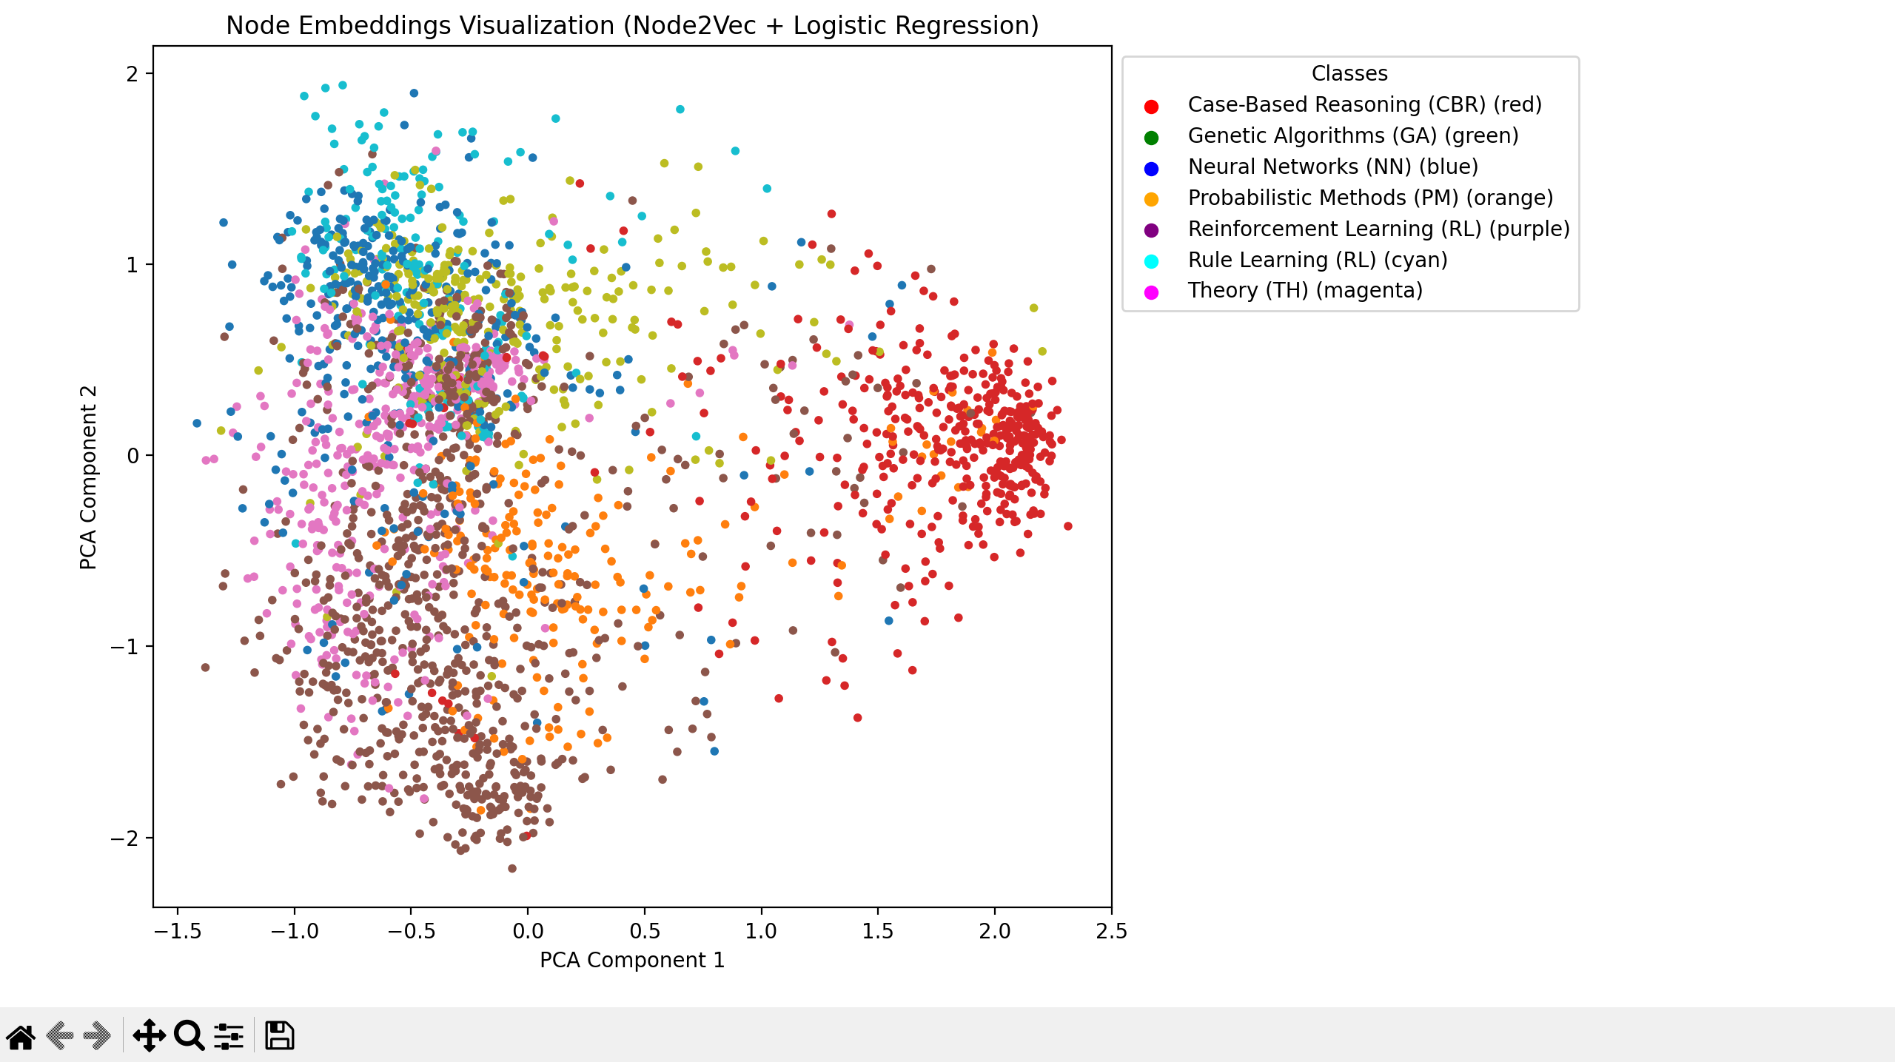

Slide 25
Graph Neural Network For Social Network Analysis (Node Classification and Embedding)
Objective: Use GCNs for node classification in a graph, which is a typical task in Social Network Analysis (SNA).
Dataset: CiteSeer dataset
1. GCN Architecture:
The model consists of two GCN layers:
Input Layer: Takes node features.
Hidden Layer: 16-dimensional, applies ReLU activation.
Output Layer: Produces log probabilities for classification.
Forward Propagation:
Graph Convolution Layers:
H(l+1)=ReLU(GCNConv(H(l),A))
First GCN layer extracts features.
Second GCN layer outputs class probabilities.
Output:
F.log_softmax(x,dim=1)
Outputs log-probabilities for classification.

Slide 26
2. Training and Evaluation
Loss Function: Negative Log-Likelihood Loss (F.nll_loss) applied to the labeled nodes in the training set.
Optimizer: Adam optimizer with:
Learning rate = 0.01
Weight decay = 5e-4
Training Process:
Trained for 100 epochs.
Every 10 epochs, evaluated accuracy on the test set.
Epoch 0, Loss: 1.7899, Test Accuracy: 50.20%
Epoch 50, Loss: 0.0086, Test Accuracy: 67.80%
Epoch 90, Loss: 0.0107, Test Accuracy: 68.00%
3. Node Embedding and Visualization
PCA for Dimensionality Reduction:
Node embeddings are reduced from higher dimensions to 2D for visualization.
Embedding plot shows clusters representing different classes.
Graph Visualization:
The graph is visualized using NetworkX.
Nodes are color-coded based on their predicted class labels.
Helps to visually interpret how well the model separates the categories.

Slide 27
4. Key Functions
train():
Updates model weights using backpropagation.
Returns the loss for each epoch.
evaluate():
Computes the test accuracy by comparing predicted labels to ground truth.
visualize_embeddings():
Visualizes 2D embeddings using a scatter plot.
Color-coded by node labels.
plot_graph_with_labels():
Plots the graph with nodes labeled and color-coded by their classes.
5. Conclusion
1) GCNs effectively handle graph-structured data for node classification tasks.
2) Visualizations aid in understanding the learned embeddings and model behavior.
3) Your project demonstrates a practical application of GNNs in Social Network Analysis, showcasing how graph-based learning models can extract meaningful insights from structured data like citation networks.

Slide 28
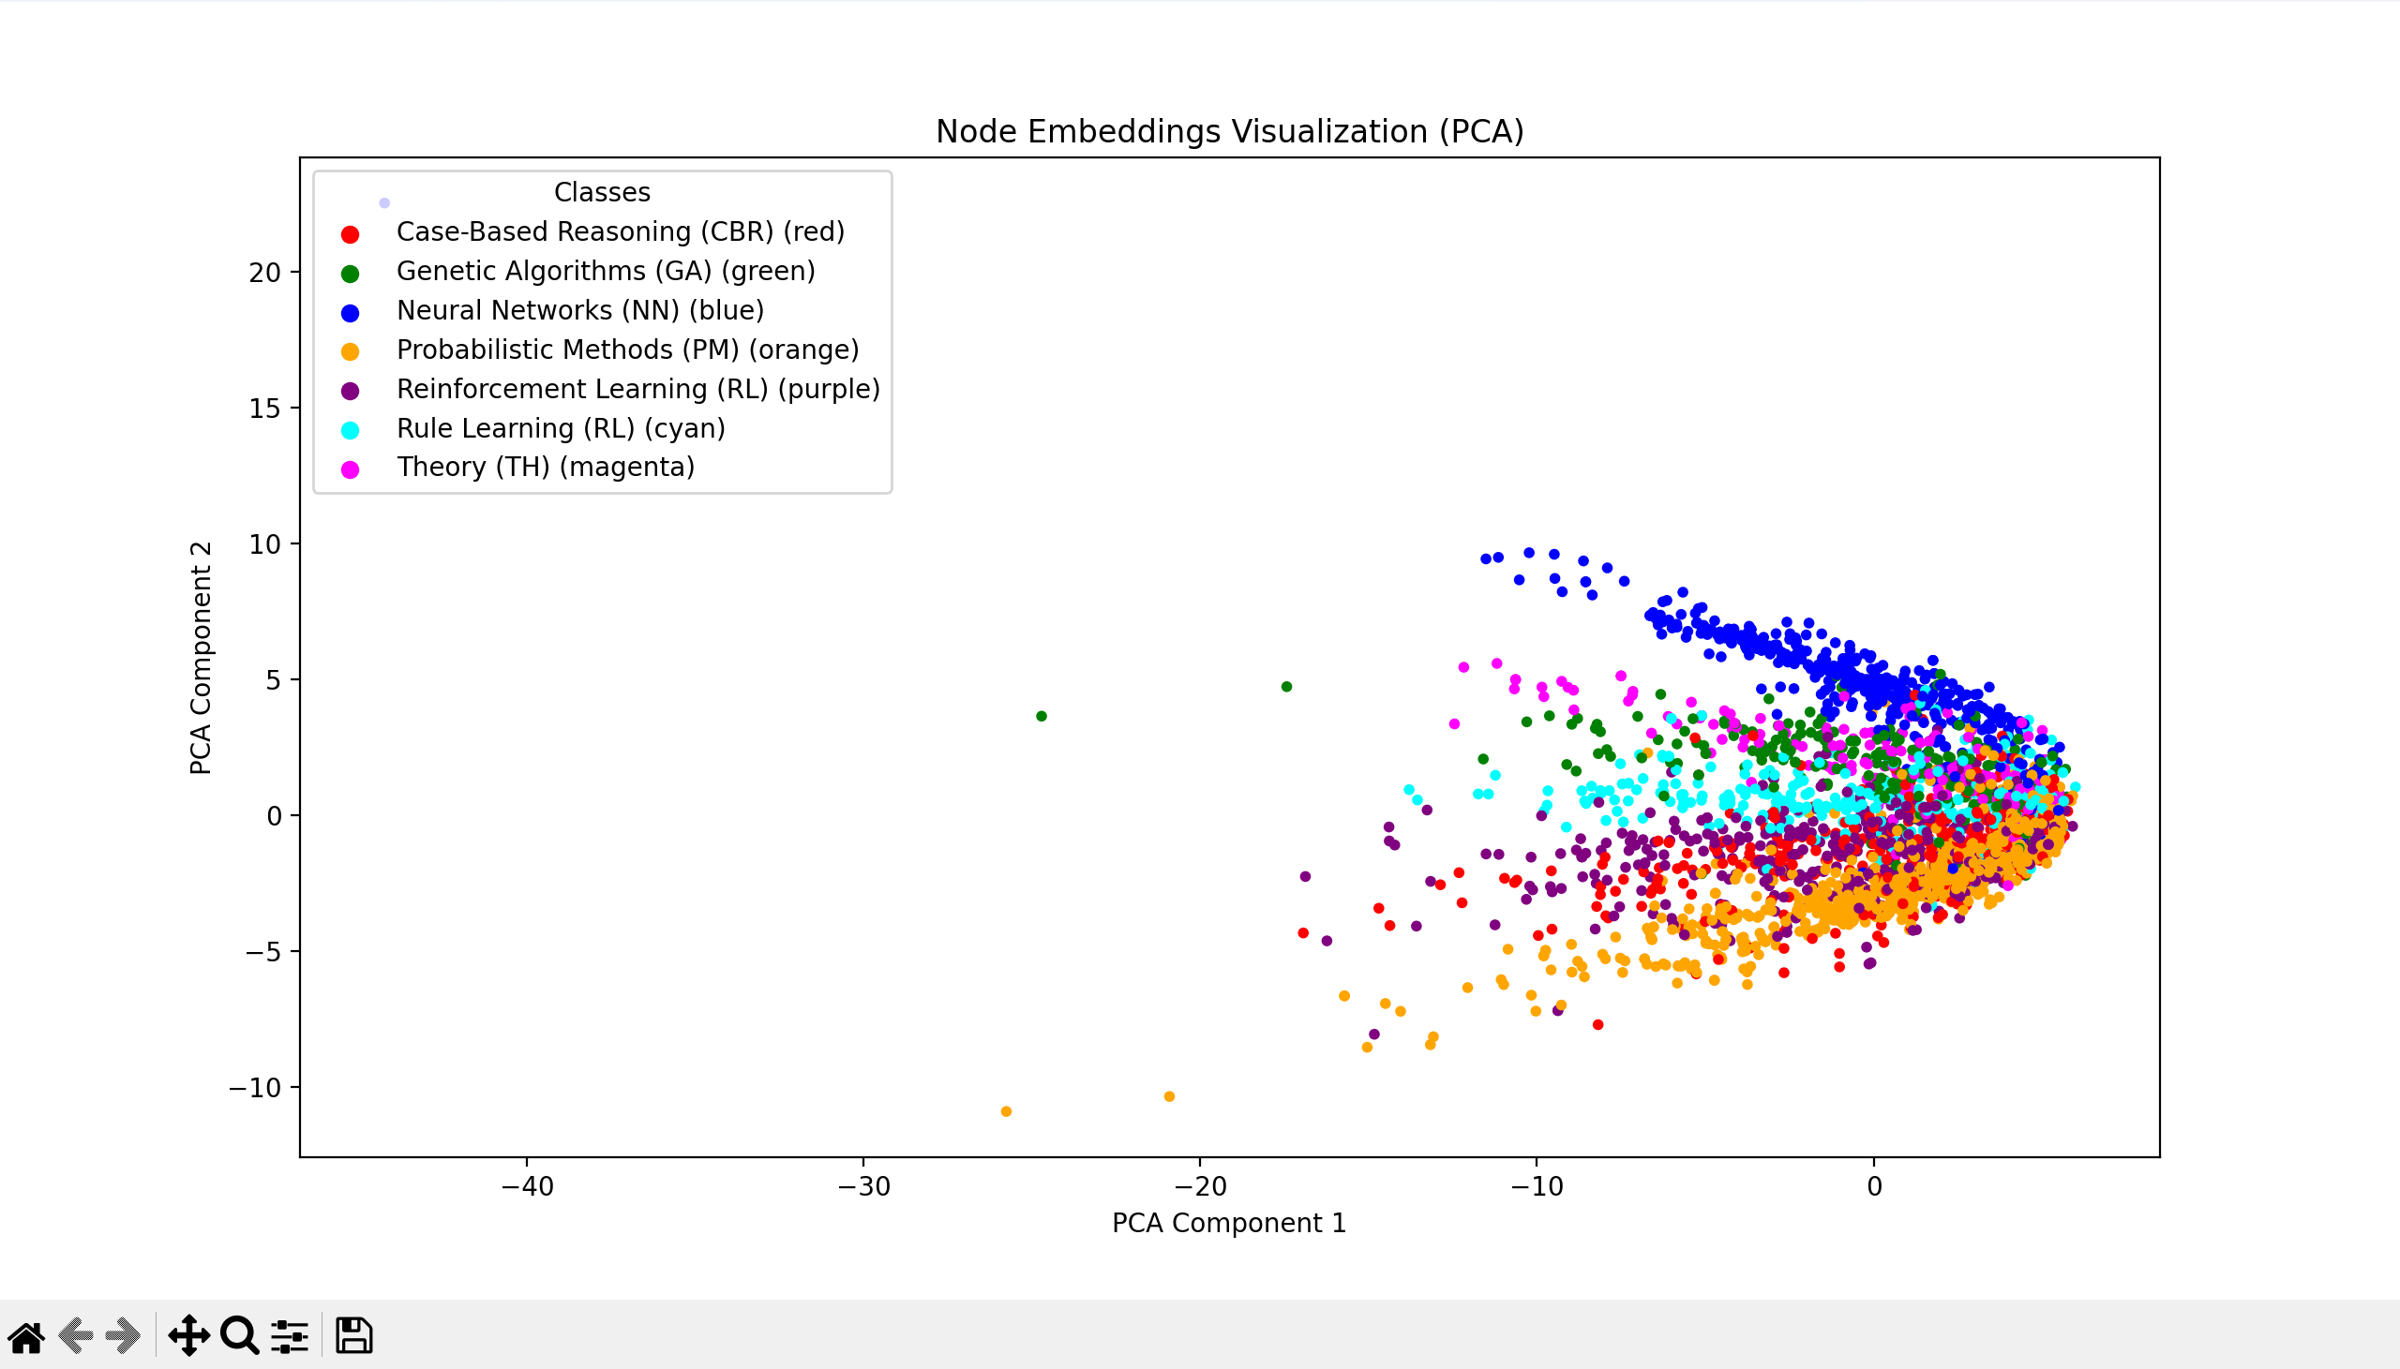

Slide 29
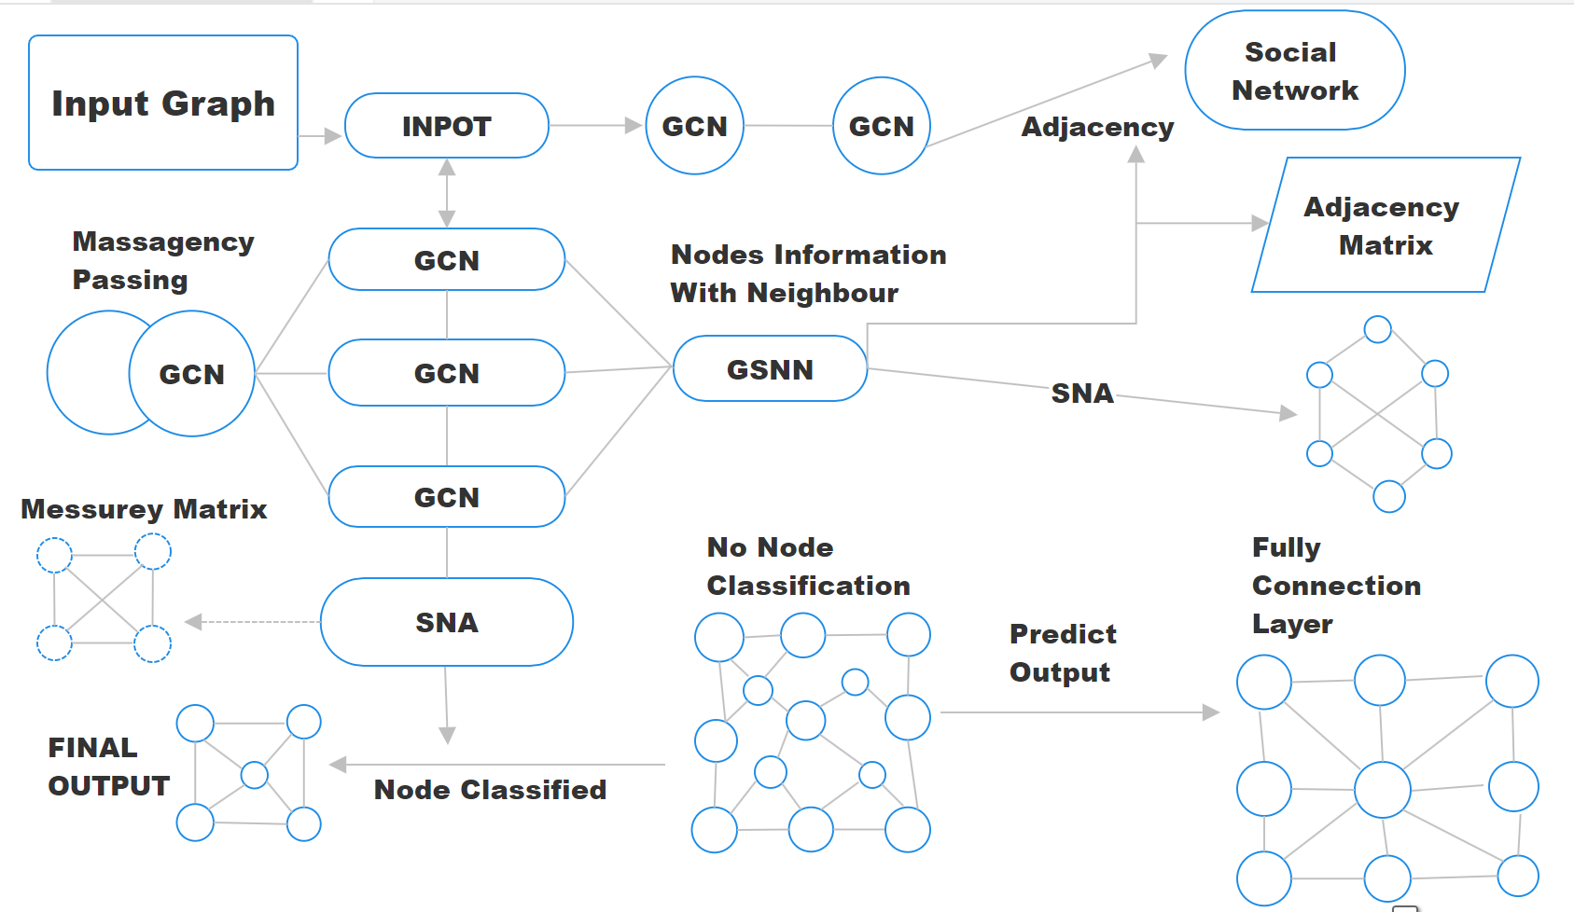
BLOCK DIAGRAM

Slide 30
THANK YOU
Notes:
ap

