Slide 1
IA736001 INTERNET OF THINGS AND CLOUD COMPUTING
Two-Node ESP-NOW Sensor Network
with a ThingsBoard Cloud Gateway
A mesh-ready packet design demonstrated over a single hop
Bhanu Gupta · Roshan Aryal | 9 September 2026
Notes:
~15 s. Do not read the slide.
SAY: "Project one. Two ESP32 boards. One of them has no internet connection at
all, and its readings still reach the cloud - because the other one carries
them for it."
Then move on. The title slide is not where marks are.

Slide 2
WHY THIS EXISTS
The problem
A sensor is somewhere without Wi-Fi coverage, mains power, or both.
- Wi-Fi association costs seconds and milliamps before a single byte moves
- Every node needing its own AP credentials does not scale
- One connected gateway can carry data for several local nodes
So: cheap radio between the nodes, one gateway that owns the cloud link.
Notes:
~40 s.
SAY: "Imagine a sensor somewhere with no Wi-Fi - a basement, a field, a corner
of a building. Connecting it properly is expensive. Every device needs its own
network password and its own setup, and joining Wi-Fi burns battery for several
seconds before a single reading is sent. So we flipped it. One device does the
connecting. The others talk to it cheaply over short-range radio."
IF ASKED why joining is expensive: scan every channel for beacons, authenticate
against the university RADIUS server, associate, then request an IP by DHCP -
all before one useful byte moves. On battery the radio is the largest draw in
the device.

Slide 3
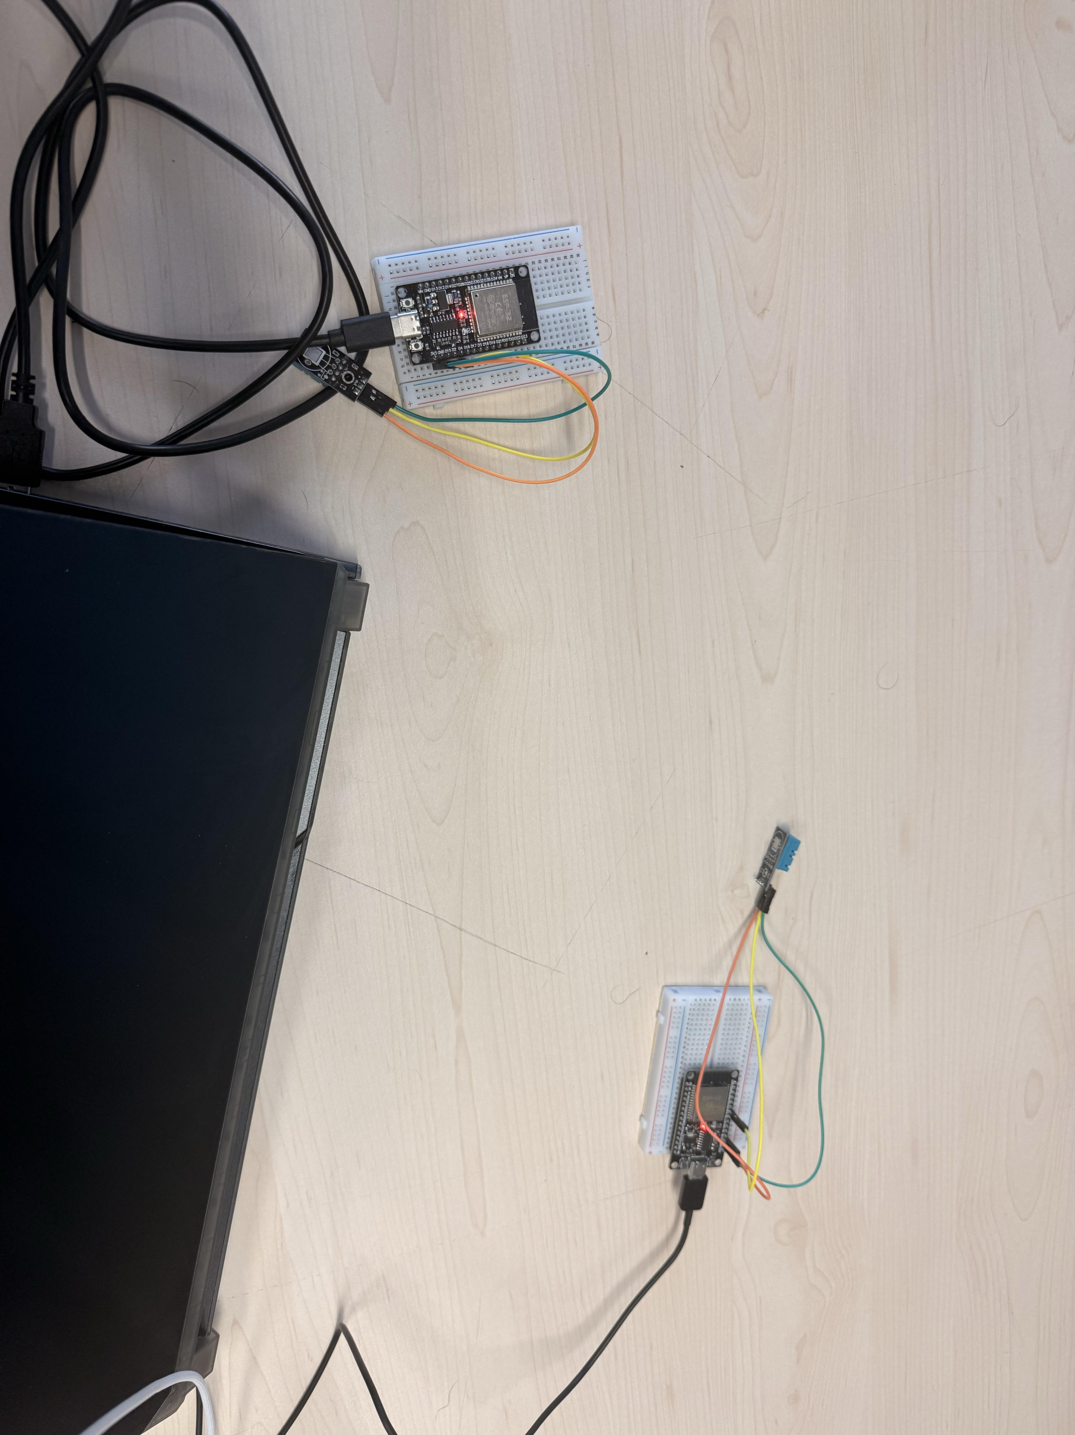
SCOPE
What we built
Board 1 - Remote node
DHT11 on GPIO4. Reads and transmits every 5 s over ESP-NOW. Never joins the access point.
Board 2 - Gateway
DHT11 on GPIO5. Joins eduroam, receives and deduplicates Board 1's packets, merges both readings, publishes to ThingsBoard over MQTT every 10 s.
No wire between the two boards. The only link is a 2.4 GHz radio.
Two-node prototype with a mesh-ready packet design - not a demonstrated multi-hop mesh. Two radios can only ever be one hop.
Notes:
~30 s. Say the limitation FIRST, before anyone asks.
SAY: "Two ESP32 boards, each with a temperature and humidity sensor. Board 1
measures and sends by radio. Board 2 listens, adds its own reading, and
publishes both to the cloud."
THEN: "With only two boards this is one hop - one sender, one receiver. We
designed the message so a third board could pass it along, but nothing is ever
actually forwarded here. It is mesh-ready, not a mesh."
Volunteering your own limits reads as confidence. Being caught out on them does
not.
BACKUP: ESP32-D0WD-V3, dual core 240 MHz, 520 KB RAM, 4 MB flash, one 2.4 GHz
radio. DHT11: 0-50 C plus/minus 2, 20-90 % RH plus/minus 5, 1 Hz max sample
rate. Substituted for the BMP280 in the brief - documented in the report.

Slide 4
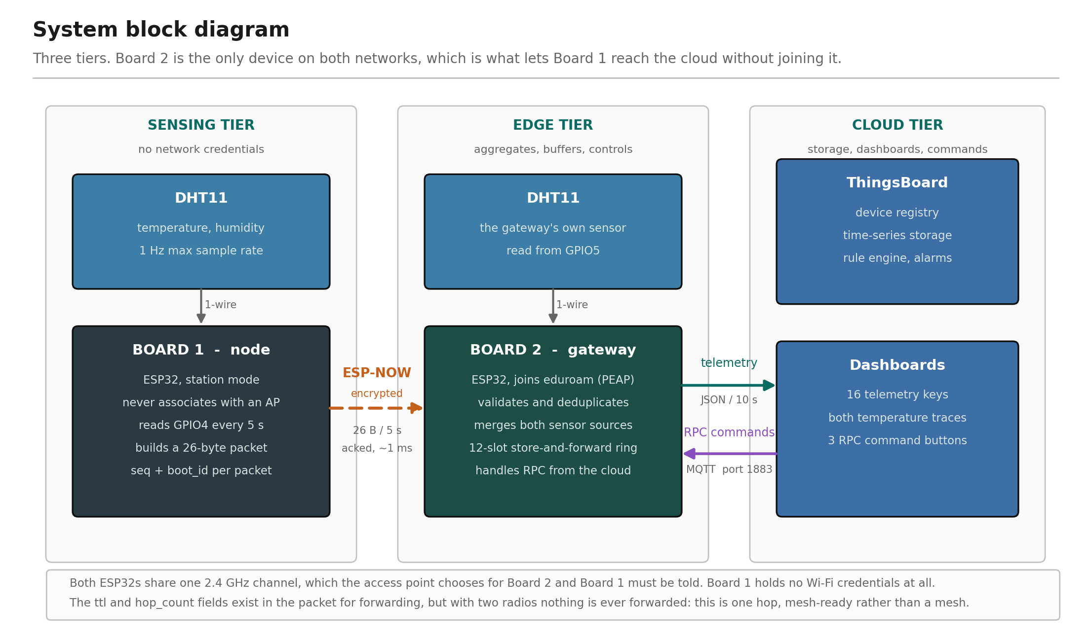
NETWORKING
Architecture
Notes:
~1 minute. This is your strongest slide. Point at the middle column first.
SAY: "Three stages - the sensor, the middleman, the cloud. The one in the middle
is on both networks at the same time: the radio network and the Wi-Fi. That is
the whole trick. It holds both sets of keys, so Board 1 reaches the internet
without ever joining it."
THEN WALK THE THREE ARROWS:
Orange - the radio between the boards. Dashed, because there is no wire.
Green - data going up to the cloud.
Purple - instructions coming back down.
THE LINE WORTH MEMORISING:
"Green means we can watch it. Purple means we can control it."
WHY THREE COLUMNS: the diagram is drawn as columns so the single crossing point
is obvious. That crossing point is the entire argument of the project.
THE THEORY UNDERNEATH: networks are built in layers. ESP-NOW works at the link
layer - no IP address, no routing, no concept of "somewhere else". It can only
reach a radio it can physically hear. MQTT works at the application layer, on
top of TCP and IP. Because the two protocols sit at different layers, one device
can bridge them. A bridge between layers is what the word "gateway" means.
IF ASKED why two arrows for MQTT: because that is the difference between a
device you can watch and a device you can operate. One connection, two
directions.
FOOTNOTES ON THE SLIDE protect you: the access point chooses the channel, and
ttl and hop_count exist but nothing is ever forwarded.

Slide 5
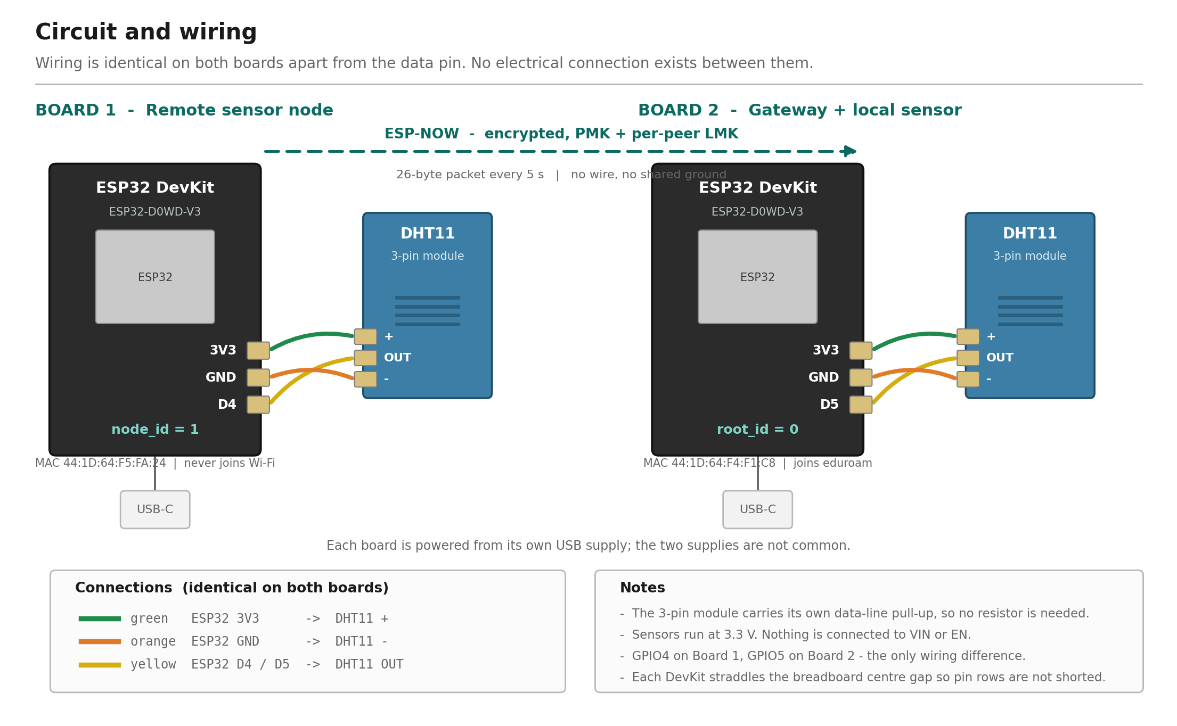
WIRING
Circuit
Notes:
~40 s. The circuit diagram answers a different question from the block
diagram: block is what moves, circuit is which pin connects to which.
SAY: "Three wires per board - power, ground, and data. Identical on both boards
apart from which pin the data goes into: GPIO4 on one, GPIO5 on the other.
Notice there is no wire between the two boards. Separate USB supplies, separate
grounds. Nothing crosses between them except radio."
WHY THE PINS DIFFER: they were wired at different times and nothing required
them to match. That is the honest answer - do not invent a reason.
IF ASKED where the pull-up resistor is: "These are three-pin breakout modules -
the resistor is already on the module. A bare DHT11 would need about 10 k on the
data line."
IF ASKED about the dashed line: that is ESP-NOW, encrypted with a shared key
pair. It is drawn dashed precisely because it is not a wire.

Slide 6
THE GOVERNING CONSTRAINT
One radio, one channel
An ESP32 has a single radio, so it is on exactly one channel at a time.
The gateway must join Wi-Fi for the cloud - and the access point decides which channel that is.
So the channel is discovered at runtime, never chosen at design time.
- The node is pinned to that channel by hand, and reads it back to confirm
- The node never associates - association would let the two boards drift apart
- Gateway must be flashed and running before the node can even be configured
Notes:
~45 s. This slide shows engineering judgement rather than coding.
SAY: "A radio can only listen on one channel at a time. Board 2 has to join the
campus Wi-Fi to reach the cloud, and the Wi-Fi network decides which channel
that is. We do not get to pick it - we find out at runtime and tell Board 1 to
match. That decides the whole setup order: you cannot configure Board 1 until
Board 2 tells you where it landed."
THEN THE HONEST PART: "It also means that if the Wi-Fi moves us to a different
channel, our link breaks silently. Wi-Fi and the cloud still look perfectly
healthy - only the radio link is dead. It happened three times during
development, so we check before every demonstration."
WHY IT IS SILENT: every indicator a casual observer checks still passes. The
gateway keeps publishing its own sensor. Only the node's data stops.
BACKUP: eduroam runs access points on channels 1, 6 and 11. We observed the
gateway on all three.

Slide 7
26 BYTES
Packet design
version, msg_type protocol evolution
src_id, dst_id addressing, not broadcast
boot_id random per power-up
seq ordering within a session
ttl, hop_count carried, never decremented
temperature, humidity the payload
uptime_ms sender liveness
Why no checksum?
802.11 already CRC-checks every delivered frame. A checksum would duplicate hardware work - and would not authenticate anything.
static_assert(sizeof == 26)
Pins the size in both sketches. It constrains layout but does not prove field agreement - fields could be reordered and still pass.
Notes:
~30 s.
SAY: "Every message is 26 bytes. It carries a version, who it is from and to, a
sequence number, and the two readings. Small on purpose - the radio protocol
allows 250 bytes, and we use 26."
WHY VERSION AND TYPE: so the format can change later without both boards
silently disagreeing about what the bytes mean.
BACKUP: a compile-time assertion locks the structure at exactly 26 bytes, so the
two sketches cannot drift apart without the build failing.

Slide 8
SOFTWARE
Deduplication
Key: (src_id, boot_id, seq)
Strict last-sequence-wins. Anything not newer than the highest already accepted in this session is a duplicate.
boot_id is randomised every power-up.
Without it, a node restart looks identical to a replay: every packet arrives with a sequence below the stored baseline and is rejected forever. The node never comes back.
A forward jump is a gap, not a duplicate - those packets were lost, not repeated. A receiver demanding contiguous sequences would deadlock on the first loss.
Notes:
~45 s. This is a genuinely subtle piece of design - take the time.
SAY: "Every message is numbered so we can spot repeats. But each board also
picks a random ID when it powers on, and that part is essential."
THEN THE WHY: "Without it, a board restarting looks exactly like an attacker
replaying old messages. The numbers start low again, we would reject every one
of them, and the board would never come back - and nothing would look broken."
THREE CASES the logic distinguishes:
new packet - accept
duplicate - reject
gap (loss) - accept, do not wait
A jump forward is a gap, not a duplicate. If we demanded consecutive numbers we
would deadlock on the first lost packet, waiting forever for something that is
never coming.
BACKUP: key is the triple (src_id, boot_id, seq). The comparison is wrap-aware -
unsigned subtraction then a signed compare - so it stays correct when a 32-bit
counter overflows.

Slide 9
THREAT MODEL
Security
Defended
+ Length, version, type, addressing, range validation
+ Replay rejection via sequence numbers
+ ESP-NOW encryption + sender auth - PMK + per-peer LMK
+ Sender MAC filtering (defence in depth)
+ Credentials excluded from version control
Not defended
- MQTT without TLS - token in clear text
- RADIUS certificate not validated
- Credentials readable from flash over USB
The interesting finding
src_id is a claim, not proof. A forged packet with a high sequence number under the live boot_id advances the dedup baseline - after which every genuine packet is rejected until the node reboots. Replay protection becomes the attack surface. Fixed by encrypting the link: a MAC filter was not enough, because the attacker controls the value being filtered on.
Notes:
~90 seconds. Worth 25 marks. Slow down. Tell it as a story.
SAY: "At first, anyone with a matching radio nearby could send us a fake
reading. The message says who it is from, but that is just a claim - anyone can
write anything in that field."
"Our first fix was to check the sender's hardware address. Someone reviewed it
and pointed out the flaw straight away: an attacker can simply set that address
to whatever they like. We were checking a value the attacker controls. That is a
name badge, not a passport."
"So we encrypted the link instead. Both boards share a key. Now a message only
works if the sender actually has that key. That is the difference between
claiming who you are and proving it."
THEN CLOSE THE LOOP HONESTLY, before they ask:
"The cloud connection is still unencrypted - the access token crosses in plain
text. That is the most serious weakness left, and the fix is TLS on port 8883."
THE RULE UNDERNEATH IT: you cannot authenticate using a value the attacker
supplies. That is the whole lesson and it generalises far beyond this project.
WHAT THE ATTACK ACTUALLY DID: not a wrong temperature on a dashboard. A forged
packet carrying a very high sequence number advances the duplicate-detection
baseline, and after that every genuine packet from the real sensor is rejected
as a duplicate until the board reboots. One forged frame silences the real
sensor. It is a denial of service delivered through the integrity mechanism
itself.
BACKUP: a primary master key protects the per-peer key during setup; the
per-peer key encrypts the payload. The receiver also needs a peer entry, or the
driver discards the frame before any application code runs - a silent failure
with no error at all.

Slide 10
MEASURED
Results
634 packets received and validated
82 duplicates rejected
0 invalid packets - both boards agree on the 26-byte layout
14 / 14 acceptance criteria evidenced
Node offline detection latches at 20 s; last known value keeps publishing while node1_online carries the truth about freshness.
Notes:
~30 s.
SAY: "634 messages received and validated. 82 repeats caught and rejected. Zero
corrupted - both boards agree on the format. Fourteen out of fourteen acceptance
criteria evidenced."
ON THE OFFLINE BEHAVIOUR: "When the node goes quiet we keep publishing its last
known temperature, so the chart stays continuous - but a separate flag says the
data is stale. We do not put 'unknown' in the data field. We put it in a status
field."
That is a design decision worth defending if asked: nobody is misled, and the
chart stays readable.

Slide 11
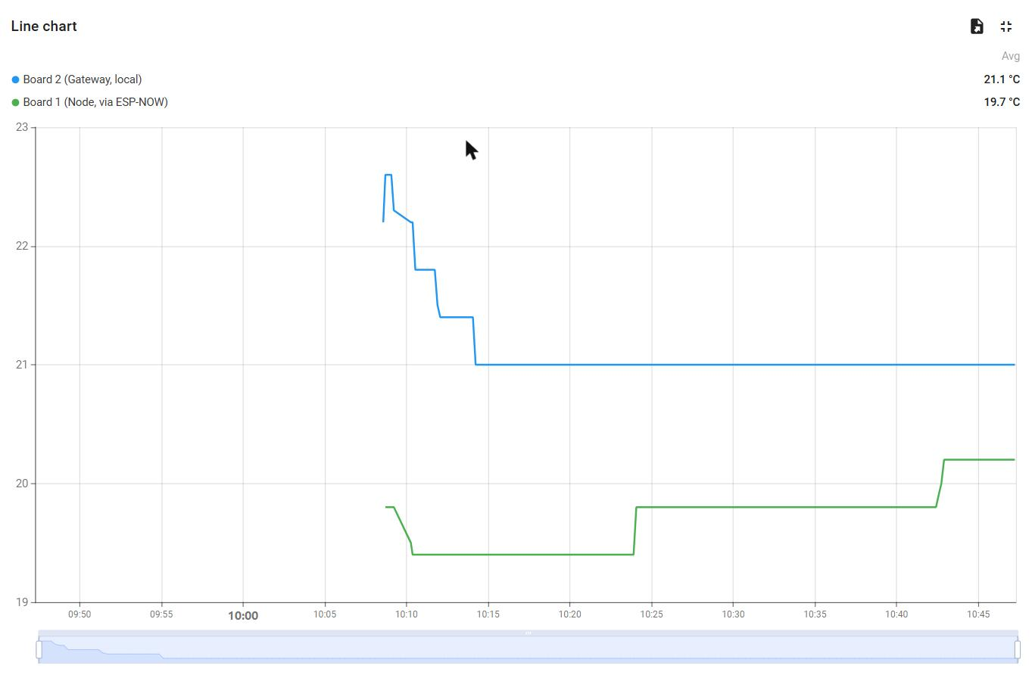
CLOUD
Edge aggregation, visualised
Blue: gateway local sensor. Green: remote node, via ESP-NOW. Stepped traces are DHT11 quantisation, not a frozen sensor.
Notes:
~40 s.
SAY: "Two physically separate sensors appear in the cloud as one device and one
data stream, because the merge happens on Board 2 before anything leaves the
building. Blue is the gateway's own sensor. Green is the remote node, arriving
by radio."
WHY MERGE AT THE EDGE: less traffic, less power, and the cloud does not have to
correlate two separate streams. Two 26-byte frames every five seconds become one
publish every ten. And the remote node needs no cloud credentials at all.
IF THE TRACE LOOKS STEPPED: that is the DHT11's one-degree resolution, not a
frozen sensor. Say it before they wonder.

Slide 12
BOTH DIRECTIONS
Control and resilience
Telemetry alone makes a device observable. It does not make it manageable.
The gateway subscribes to v1/devices/me/rpc/request/+ and replies on the matching response topic. Three methods: getStatus, setPublishInterval, resetCounters.
Verified end to end - a dashboard button produced the request in the gateway log, the applied change, and the new interval back in the next telemetry message. The round trip, not just the request.
setPublishInterval range-checks and rejects rather than clamping. Silently applying a value the operator did not ask for would leave them believing something untrue about the device.
Unsent payloads go to a twelve-slot ring buffer and flush oldest-first on reconnect. Measured: 4 buffered, 4 flushed, 0 dropped.
Notes:
~40 s.
SAY: "Telemetry alone makes a device observable. It does not make it
manageable. These three buttons send commands from the cloud down to the
device - change how often it reports, reset its counters, ask for its status."
THE KEY POINT: "And the device reports the change back in its own telemetry. So
we are not just seeing that the command was sent - we are seeing that it
arrived and took effect. The round trip is confirmed at both ends."
ON VALIDATION: out-of-range values are refused rather than quietly adjusted.
Silently applying something different from what was asked would leave the
operator believing something untrue about the device.

Slide 13
SWITCH TO HARDWARE
Live demonstration
1. Board 1 serial: no Wi-Fi association, and a real link-layer ack
2. Board 2 serial: the same packet arriving, validated, deduplicated
3. ThingsBoard: the same numbers, in the cloud
4. Warm the sensor by hand and watch the chart move
5. Unplug Board 1: node1_online goes false after 20 s
Roughly 21 C to 28 C in fifteen seconds - it proves the whole chain, sensor to cloud, in one gesture.
Notes:
3 MINUTES. Most of the marks are here. Stop presenting, start operating,
and keep talking while you do it.
BEFORE YOU BEGIN: three windows visible at once - Board 1 serial, Board 2
serial, ThingsBoard. The argument only lands if all three are on screen.
1. BOTH TERMINALS
"Left is Board 1 sending. Right is Board 2 receiving. Same sequence number,
one millisecond apart."
If pressed on why that matters: the acknowledgement is from the receiving
radio, not the application. It proves the bytes arrived, not that they were
accepted. The arrival line on the other board proves acceptance. Together
they prove both - which one port alone cannot.
2. THUMB ON THE SENSOR
"Watch the temperature climb."
WAIT. Let them see it move. This proves the entire chain - sensor, radio,
gateway, internet, dashboard - in about fifteen seconds. It is the single
most convincing thing you can do.
3. PRESS "FAST PUBLISH (2 s)"
"That button sends an instruction from the cloud down to the device. It
changes how often it reports - from ten seconds to two."
Then show the value returning: "And there is the device confirming it. Not
just that we sent it - that it arrived and took effect."
4. UNPLUG BOARD 1 - keep talking, do not stand in silence
"The gateway keeps publishing its own reading. Give it twenty seconds and it
will mark the other board offline - but it keeps showing the last known
temperature so the chart does not gap. The status flag carries the truth
about freshness."
5. PLUG IT BACK IN
"New random ID, numbering restarts, accepted cleanly. No flood of rejected
duplicates."
IF THE LINK IS DEAD: it is the channel. Read it off Board 2's boot banner, put
it in sketch 04, re-upload to Board 1. Two minutes. Do not guess.

Slide 14
HARDWARE SUBSTITUTION
DHT11 instead of BMP280
The brief specified BMP280. The available hardware was DHT11.
Lost
- No I2C experience - DHT11 is single-wire bit-banged
- Lower resolution, hence the stepped chart traces
Gained
- Humidity responds to a hand in seconds; indoor pressure would be flat for hours
- Everything above the sensing layer is unchanged - the packet carries two floats and does not care what they represent
Notes:
~30 s.
SAY: "The brief specified a BMP280. The hardware available was a DHT11. That
changes what we measure - humidity instead of pressure - but not the
architecture we are demonstrating. It is documented in the report rather than
glossed over."
Owning a substitution is stronger than hoping nobody checks.

Slide 15
HONESTLY
Limitations
- One hop only - two radios cannot demonstrate multi-hop forwarding
- ttl and hop_count are designed for but unexercised
- MQTT without TLS - the radio leg is encrypted, the cloud leg is not
- Credentials compiled into firmware, recoverable over USB
- Manual channel configuration - a gateway roam silently breaks the link
- Single remote node - dedup state is one slot, not an array
Notes:
~45 s. Name your own limits. It reads as maturity, not weakness.
SAY: "One hop only - two radios cannot demonstrate forwarding. The cloud
connection is not encrypted, so the access token crosses in clear text.
Credentials are compiled into the firmware and recoverable over USB. And the
channel is set by hand, so a Wi-Fi roam breaks the link silently."
DO NOT list ESP-NOW encryption as a limitation. It is implemented - a primary
master key plus a per-peer key, and the receiver authenticates the sender. That
is a feature you built, not a gap.

Slide 16
MEASURED, NOT ASSUMED
What we found
Port 1883 is open outbound on eduroam
Proved by the MQTT return code: state=5 is a reply from the broker, so the packets crossed the firewall. state=-2 would have meant no TCP connection at all.
WPA2-Enterprise costs ~97 KB of flash
915,267 bytes with PSK against 1,012,651 with PEAP. Enterprise auth is not free.
eduroam routes by RADIUS realm, not email domain
user@student.<institution> failed; user@<institution> worked. The failure is silent - the same status code as a wrong password.
Notes:
~30 s.
SAY: "We tested the assumptions rather than trusting them. Port 1883 is open
outbound on eduroam - we verified that rather than assuming it. The realm for
authentication turned out to be the university domain, not the student mail
domain, and enterprise Wi-Fi gives you no error that distinguishes a wrong
username from a wrong password or being out of range. We found it by changing
one thing at a time."
That story answers "what was the hardest part" before it is asked.

Slide 17
WHAT WOULD COME NEXT
Further work
1. A third node - actually exercise ttl and hop_count
2. MQTT over TLS on port 8883
3. Credentials provisioned into NVS at first boot, not compiled in
4. Automatic channel recovery instead of a manual re-upload
5. Persist the buffer to NVS so it survives a reboot, not just a reconnect
Notes:
~30 s.
SAY: "Next steps, in order of value: a third board so the forwarding fields are
actually exercised. TLS on the cloud leg, which is the most serious remaining
exposure. Credentials provisioned at first boot rather than compiled in. And the
node scanning for the gateway instead of being told the channel by hand - that
would have prevented three outages during development."
Each item maps to a limitation on the previous slide. That symmetry is
deliberate - show it.

Slide 18
Questions
Two ESP32 boards. No wire between them. Two sensors, one cloud stream.
Code, evidence and full report: github.com/bhanuGupta1/esp32-espnow-thingsboard-gateway
Notes:
Questions - 5 minutes.
"HOW DOES IT WORK?" - One board measures and radios it across. The other adds
its own reading and sends both to the cloud.
"WHY NOT WI-FI ON BOTH?" - Both would need credentials, setup and battery to
join. One gateway carrying several nodes scales better.
"IS IT SECURE?" - The radio link is: encrypted, keys on both ends, and the
receiver rejects anything that does not decrypt. The cloud link is not. That is
the honest gap.
"IS IT A MESH?" - Mesh-ready. Two radios can only do one hop. The format carries
a hop counter; we simply never forward.
"WHY QoS 0?" - Telemetry every ten seconds. A lost sample is superseded ten
seconds later. QoS 1 costs round trips and a queue for data with a very short
shelf life.
"ISN'T THE ACKNOWLEDGEMENT PROOF ENOUGH?" - No. It comes from the radio, not the
application. It proves the bytes arrived, not that they were accepted. That is
why we captured both boards against one clock.
"WHAT WAS THE HARDEST PART?" - Not the code, the campus network. Enterprise
Wi-Fi gives no useful error, so a wrong username looks identical to a wrong
password or being out of range.
"WHY DHT11?" - It is what was available. It changes what we measure, not the
architecture.
IF YOU DO NOT KNOW: "I don't know off the top of my head - it is in the report
and I can check." That costs almost nothing. Guessing and being wrong costs a
great deal.

