Slide 1

AI-AUGMENTED
Paper Submission
& Peer-Review System
Taking an old course project and rebuilding it with Generative AI
Bhanu Gupta
IA730151 Year Three Special Topic (GenAI) · GenAI Assessment
Notes:
Hey. Quick context. I had a paper-submission website from a previous course. It worked, but it was basic and a bit broken. Now I am rebuilding it with AI features so it can actually be used by a real conference. The deck walks through the original project, what was missing, what I am adding, and the tools and ethics behind it. Each slide has a TASK label in the top right showing which assessment task it covers.

Slide 2




The original project
TASK 1
Context, objectives, methodology, results
Context
Objectives
A coursework assignment in a previous web-development paper. The brief was to build a working peer-review platform that handles the full submission to publication flow.
Show full-stack web skills: user accounts with roles, file uploads, a structured review workflow, and an Excel export so an editor can report on submissions.
Methodology
Results
Built iteratively in Node.js with Express, EJS pages, and a small SQLite database. Tested by clicking through every flow in the browser. Submitted as one repo.
Working five-role website (author, reviewer, editor, admin, reader) with seven sample manuscripts and five sample reviews. A public reader page lists accepted papers.
Bottom line
It is a website where authors upload research papers, reviewers leave feedback, an editor decides what gets accepted, and the public can read accepted papers.
2
Notes:
Original project context. It is a peer-review website. Authors upload papers, reviewers give feedback, editors decide. Built with Node.js and SQLite. Result was a working five-role site. It worked, but only just barely.

Slide 3


Challenges, limitations, and gaps
TASK 1
An honest audit of the original codebase
Buggy login system
Random reviewer pick
No integrity checks
The login glue code had bugs. Sessions misconfigured, wrong field used to find the author. Some pages would silently fail to load anything.
When a paper came in, the system picked a reviewer at random. A real journal never works this way. It needs topic matching.
No plagiarism check. No way to spot duplicate submissions. No flagging of AI-generated text. A real conference would not accept that.
Reviews too unstructured
Authors got zero help
No tests, no Docker
Reviewers got one giant text box. No scores, no recommendation field, no way for the editor to compare two reviews side by side.
Authors typed their abstract into a box and hit submit. No spelling check, no title suggestions, no way to know if their abstract was strong.
One giant file, hardcoded passwords in the code, two leftover database files. Would not survive a real code review.
Bottom line
The original works, but it would never be used by a real journal. Each gap above is something AI can directly fix.
3
Notes:
Six things that bothered me. Login bugs. Random reviewer picking, which is silly. No plagiarism check. Reviews were one giant text box. Authors got no help. The code itself was messy. Each gap maps directly to something AI can fix.

Slide 4
Revised scope & business questions
TASK 2
The questions the new system needs to answer
NEW SCOPE
Stop being a basic upload-and-track tool. Start being a smart helper that gives authors writing feedback, gives editors topic-matched reviewer suggestions, and gives reviewers a structured starting point — without ever taking the human out of the decision.
Q1
How can authors get useful feedback on their abstract before submitting, without paying a copy editor?
Q2
How do we match each paper to the right reviewer instead of choosing at random?
Q3
How do we screen submissions for near-duplicates and AI-generated text without falsely accusing anyone?
Q4
How do we make peer reviews structured and comparable so editors can aggregate them?
Q5
How do we keep cost at zero today while leaving a clean upgrade path to a paid AI later?
Bottom line
Five plain-English questions. Each one becomes a feature. Every feature in the new system answers exactly one of these.
Notes:
The new scope is straightforward. Stop being a basic upload tracker. Start being a smart helper. Five questions drive the work. Question one is author feedback before submitting. Two is topic-matched reviewers. Three is integrity screening. Four is structured reviews. Five is keeping it free today but upgradeable later. Every feature in this deck answers one of these five questions.

Slide 5


What Generative AI can actually do
TASK 3
Concepts, models, and techniques relevant here
Concepts
Models
Techniques
Generative vs scoring
Large language models
TF-IDF baseline
Generative AI writes new text. Scoring AI just rates or compares. I use both.
Claude, GPT-4, Gemini. The big AI writers. Best for drafting reviews and rewriting abstracts.
A classic, free, explainable way to find similar documents. Works without any AI calls.
Embeddings
Embedding models
Retrieve then generate
Turn a sentence into a list of numbers. Sentences about similar topics end up near each other.
Smaller models that turn text into numbers. Used for matching reviewers to papers by topic.
First find the relevant info, then ask the AI to write about it. Keeps the AI grounded in real data.
Prompt engineering
Stylometric checks
Provider switch
Carefully writing instructions for the AI so the output is reliable and in the format I need.
Simple math that looks at writing style to flag text that looks AI-generated. Not perfect, just a flag.
Code is built so swapping AI providers is one line. Free local AI today, paid Claude tomorrow.
Bottom line
AI can write text, find similar things, and combine the two. Some tasks need the big paid AI. Many tasks just need the free local one.
Notes:
GenAI breaks into three columns. Concepts on the left, the ideas. Models in the middle, the actual products. Techniques on the right, how you combine them. The key idea, two of my features need real writing so they use language models like Claude. Two need topic matching, which a free local technique called TF-IDF handles fine.

Slide 6



Four planned AI features
TASK 3
Each one answers one of the five questions
Author writing helper
Q1 · LLM
Smart reviewer matching
Q2 · Embeddings
Polishes the abstract, suggests better titles, pulls out keywords. Author still edits and accepts.
Looks at each reviewer's expertise and ranks them by how well they match the paper. Editor still picks.
Plagiarism + AI-text flag
Q3 · Embeddings
AI reviewer helper
Q4 · LLM
Compares each new paper to existing ones and gives a "looks AI-written" score. Always a flag, never a verdict.
Drafts a structured first-pass review (summary, strengths, weaknesses, scores). Reviewer edits before submitting.
Bottom line
Two features write text (need a big AI). Two features find similar things (use a free local technique). The human is still in charge in all four.
6
Notes:
Four features. Each one answers a question from the previous slide. Author writing helper for question one. Smart reviewer matching for question two. Plagiarism and AI-text flag for question three. AI reviewer helper for question four. Two use big AI models, two use free embeddings. The clean question to feature mapping is what makes this defensible.

Slide 7
How the system fits together
TASK 3
Reading the architecture left to right
Browser
(what users see)
Server
Routes → Logic → Database
handles security and login
reviewerMatcher
plagiarism
aiReviewer
writingAssistant
embeddings
matches reviewers
similarity check
drafts reviews
polishes abstracts
shared text vectors
THE AI PROVIDER SWITCH
local AI (default)
Claude (when key set)
Free, runs on your laptop, ships today
Anthropic Claude Sonnet 4.6, one-line upgrade
Bottom line
left to right: user opens website, server handles security, code calls the right service. The yellow-bordered area is the magic part — switch the AI provider with one setting.
Notes:
How to read the diagram. User opens the website on the left. The server in the middle handles security and login. Code on the right runs the AI services. The big navy box at the bottom is the most important architectural choice. By default the local free AI runs. Flip one setting and Claude takes over. Same code. Every AI call is logged so we can review usage later.

Slide 8
Where I am right now
TASK 3
Honest status: done, half-done, planned
Capability
Status
Plain English notes
MVC project structure
DONE
Clean folder layout. Routes, controllers, services, models, views all separated.
Login + roles for 5 user types
DONE
Author, reviewer, editor, admin, reader. Helmet, rate-limit, secure sessions.
Smart reviewer matching
DONE
Working today. Visible in the editor dashboard with a score for each suggestion.
Plagiarism similarity score
DONE
Runs on every submission. Compares the new paper to all existing ones.
AI-text flag (writing-style check)
DONE
Shows how AI-generated the text looks, with the reasoning visible.
AI reviewer drafts (local fallback)
HALF-DONE
Draft button works today using local logic. Switches to Claude once a paid key is added.
Author writing helper (local fallback)
HALF-DONE
Polish, titles, keywords work locally. Same one-line upgrade to Claude.
Claude API integration
PLANNED
Code is ready. Just waiting until the budget is approved to flip the switch.
Sentence-transformer matching
PLANNED
Roadmap upgrade. Replaces TF-IDF when corpus grows past a few hundred papers.
User study + benchmark
PLANNED
Planned for the follow-up phase. The audit log is already collecting the data.
Bottom line
Green is fully working today. Yellow is the wiring is done, just needs a paid AI key to flip on. Navy is next milestone.
Notes:
Honest status. Green is fully working today. Yellow is half-done, the wiring is there, just needs the API key turned on. Navy is planned for the next phase. So matching, plagiarism, AI-text flag are running. Claude integration is one line of config away.

Slide 9


Tools chosen for the project
TASK 4
Why each one fits, and what to watch out for
Anthropic Claude
TF-IDF embeddings
sentence-transformers
claude-sonnet-4-6 (paid)
free, pure JavaScript
@xenova/transformers (free, local)
Used for: drafting reviews, polishing abstracts, suggesting titles, extracting keywords.
Used for: matching papers to reviewers and checking similarity against existing papers.
Used for: planned upgrade when the corpus grows past TF-IDF's sweet spot.
WHY THIS FITS
WHY THIS FITS
WHY THIS FITS
Strongest writer of the big three AI models. Follows JSON format reliably so the draft drops cleanly into the review form. GPT-4 hallucinates more on long context, Gemini is cheaper but less consistent. For peer review, quality beats cost.
At workshop scale (under 1000 papers) you do not need a billion-parameter model. Free, runs in milliseconds, and explainable. I can show the editor which words triggered a match. A neural model is a black box. Editors want to see the reasoning.
Captures meaning, not just word overlap. Words like "attention" and "transformers" sit close in vector space. Runs locally in Node, so the system stays free and nothing leaves the machine. Same trust, better matching.
WATCH OUT FOR
WATCH OUT FOR
WATCH OUT FOR
Costs money per call (~$3 per 1M tokens). Sends data to Anthropic, so abstract leaves the trust boundary. Latency 2-10 seconds, not real-time. Can hallucinate citations if not constrained. Output is a black box.
Bag-of-words: ignores word order and context. Treats synonyms as separate ("attention" vs "transformers"). Falls apart on paraphrasing. Sensitive to vocabulary as the corpus grows. Lexical overlap only, no semantic understanding.
Loads a ~80MB model into memory. ~10x slower per query than TF-IDF. Quality depends on the pre-trained model picked. Multilingual coverage is uneven. Hard to retrain without ML infrastructure.
Bottom line
Each tool earns its place but has trade-offs. Choosing right means knowing where each one breaks.
Notes:
Three tools, each with both why it fits and where it falls short. Claude wins on writing quality but costs money and sends data outside. TF-IDF wins on speed and explainability but only handles literal word overlap. Sentence-transformers fixes the synonym problem but uses more memory. The pattern is, no tool is universal, the choice depends on the job.

Slide 10


AI tools I used to build this
TASK 4
And why each one made me faster
Claude
Whisper Flow
Cursor
Sonnet 4.6 (chat + code)
voice → text dictation
AI-native code editor
Used for: architecture decisions, generating most of the code, writing all documentation, and building this deck.
Used for: dictating prompts to the AI instead of typing them.
Used for: inline AI completions while editing code by hand.
WHY THIS MADE ME FASTER
WHY THIS MADE ME FASTER
WHY THIS MADE ME FASTER
Claude's coding is a step ahead of GPT-4 right now. It catches design issues during planning, not after the bug shows up. It follows long instructions without losing context. For a 36-file rebuild, that consistency is the difference between a few days of work and a few weeks.
Typing slows down thinking. Whisper Flow lets me speak prompts at full speed. When I am iterating on architecture, getting from idea to prompt in five seconds versus sixty seconds compounds fast. I can have ten useful AI conversations in a day instead of one.
Cursor reads the whole project so when I edit one file it suggests the right import paths and matching patterns from the rest of the codebase. Tab to accept. Saves me typing on the 80 percent of code that is mechanical, so my attention goes to the 20 percent that actually needs thought.
Also used: ChatGPT for second opinions · GitHub Copilot for repetitive code · Excalidraw for diagrams
Notes:
Disclosure required by the assessment. This is how I built it, not what runs inside. Claude is the main coding partner. Whisper Flow lets me prompt by voice. Cursor handles inline edits. The point is, this is not a thing I built in a week. It is a thing I built in days because I knew which AI tools to chain together.

Slide 11




Ethical considerations
TASK 5
Bias · privacy · fairness · reliability
Bias and fairness
Privacy and data minimisation
Big AI models inherit bias from their training data. They may favour mainstream research traditions over niche ones. The system mitigates this by letting editors override AI suggestions and logging every AI call for later audit.
Default mode is local. When the paid AI is on, only the title and abstract leave the machine, never the full paper. Every external call gets logged. A future revision will add an explicit consent checkbox before any external call.
Accountability
Reliability and limitations
AI drafts. Humans submit. The reviewer is still on the hook for the final review. Whether AI was used gets recorded so authors and editors know. The model never autonomously approves anything.
The AI-text score is a flag, not a verdict. Real detectors fail on non-native English speakers (Liang et al., 2023). Plagiarism similarity does not catch paraphrasing. Both are decision-support, never used to block a submission on their own.
Bottom line
AI helps, humans decide. Nothing important is automatic. Everything AI does gets logged so we can check it later.
11
Notes:
Four ethics points. Bias, models inherit bias, mitigated by editor override and audit trail. Privacy, only the abstract leaves the machine, and only when the paid AI is on. Accountability, AI drafts and humans submit. Reliability, the AI-text score is a flag, not a verdict. Real detectors fail on non-native English writers. We say so in the UI.

Slide 12


Reflection on integration
TASK 6
Where AI helps, where it shares the load, and where it could go wrong
Enhances
Complements
Challenges
Reviewer matching becomes topic-based, not random. Better feedback per submission.
Authors get pre-submission feedback that previously cost a copy editor.
Reviews are structured and comparable. Editors can aggregate scores meaningfully.
Public reader page surfaces accepted work with AI-extracted keywords.
AI generates first drafts. Humans always make the final call.
Free local techniques surface signals. Editors verify before acting.
Audit log captures every AI call, so reviewers and editors can defend decisions.
Local AI and Claude complement each other across cost and quality tiers.
AI-text detectors misclassify non-native English writing. Risk of unfair flagging.
AI bias may favour mainstream research traditions over niche subfields.
Authors may over-trust the writing helper and let style become homogeneous.
Cost of the paid AI at large scale could become a problem without careful caching.
Bottom line
Green: AI clearly helps. Gold: AI and humans share the work. Red: things to watch out for.
Notes:
Three columns. Enhances, what AI clearly improves. Complements, where AI and humans share the work. Challenges, the honest risks. The point is being clear-eyed about what AI changes and what it does not.

Slide 13
Live demo: the recreated version
DEMO
Five role-aware dashboards with AI features
1
Author submit page
TO RUN LOCALLY
Three AI buttons next to the abstract: polish, suggest titles, extract keywords.
$ cd paper-submission-system-v2
$ npm install
$ npm run setup
$ npm start
→ http://localhost:3000
Demo accounts (Password123!):
alice / bob — author
reviewer_ml / db / se
editor — manual + AI matching
admin — audit dashboard
reader — public feed
2
Editor dashboard
Top-3 AI-ranked reviewers per paper with scores, plus manual override and final decision.
3
Reviewer review
"Generate AI draft" fills in summary, strengths, weaknesses, scores, recommendation.
4
Public reader feed
Newspaper-style grid of accepted articles with full-text search and public download. No login needed.
Bottom line
All five roles work today on a free local AI. Add a paid Claude key in one line of config to unlock the better drafts.
Notes:
Quick demo plan. Author submits a paper, three AI buttons sit next to the abstract. Editor sees AI-ranked reviewers with scores and can override. Reviewer hits Generate AI draft to start. Reader gets a public newspaper-style feed. Same password for everyone, Password123!

Slide 14
Roadmap to the next milestone
ROADMAP
Five steps from today through the follow-up submission
1
2
3
4
5
Submission
Codebase live · local AI covers all four features end-to-end · audit log collecting usage data
Activate Claude · benchmark draft quality vs local on 10 sample papers · cost & latency telemetry
Replace TF-IDF with sentence-transformers (local) · re-evaluate matching precision
Add conflict-of-interest detector (institutional + co-authorship) · automated regression tests
Small user study comparing reviewer thoroughness with versus without the AI draft helper
Bottom line
Every next-phase experiment has the wiring already in place. The codebase is the platform, not the prototype.
Notes:
Five steps. Now we have the platform. Next two weeks I activate Claude and benchmark it. Then upgrade matching to sentence transformers. Then add a conflict-of-interest detector. By submission, a small user study comparing reviewer thoroughness with and without AI assistance.

Slide 15


Slide 16
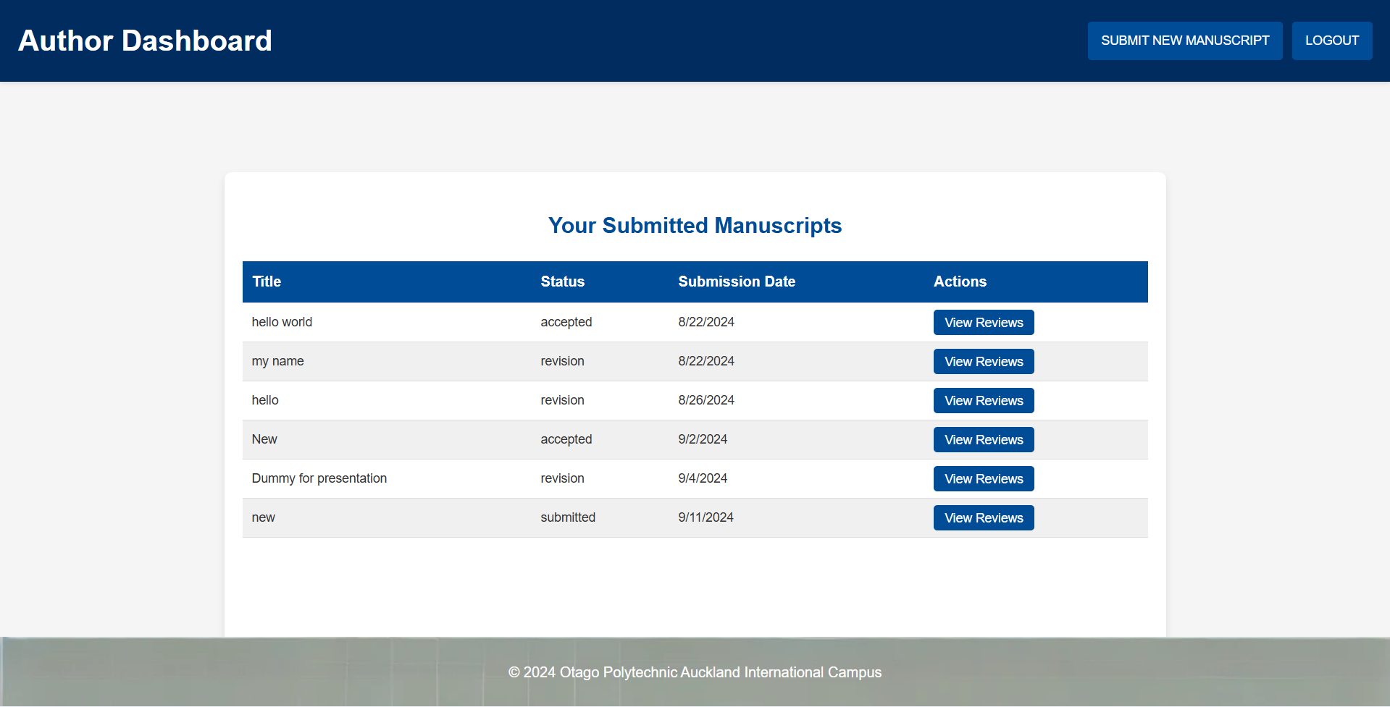

Slide 17
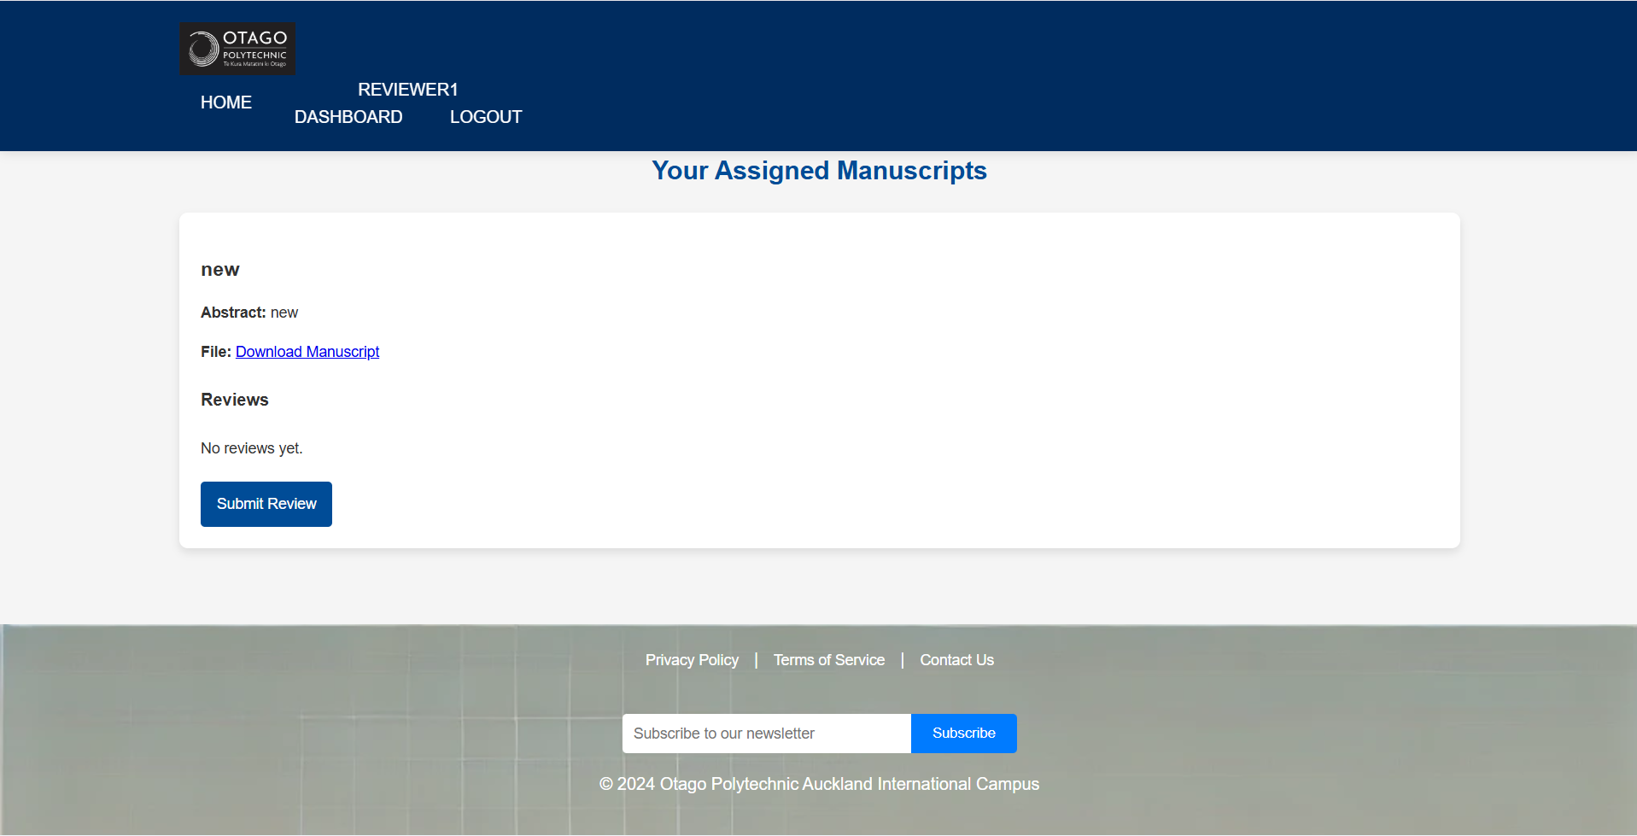

Slide 18
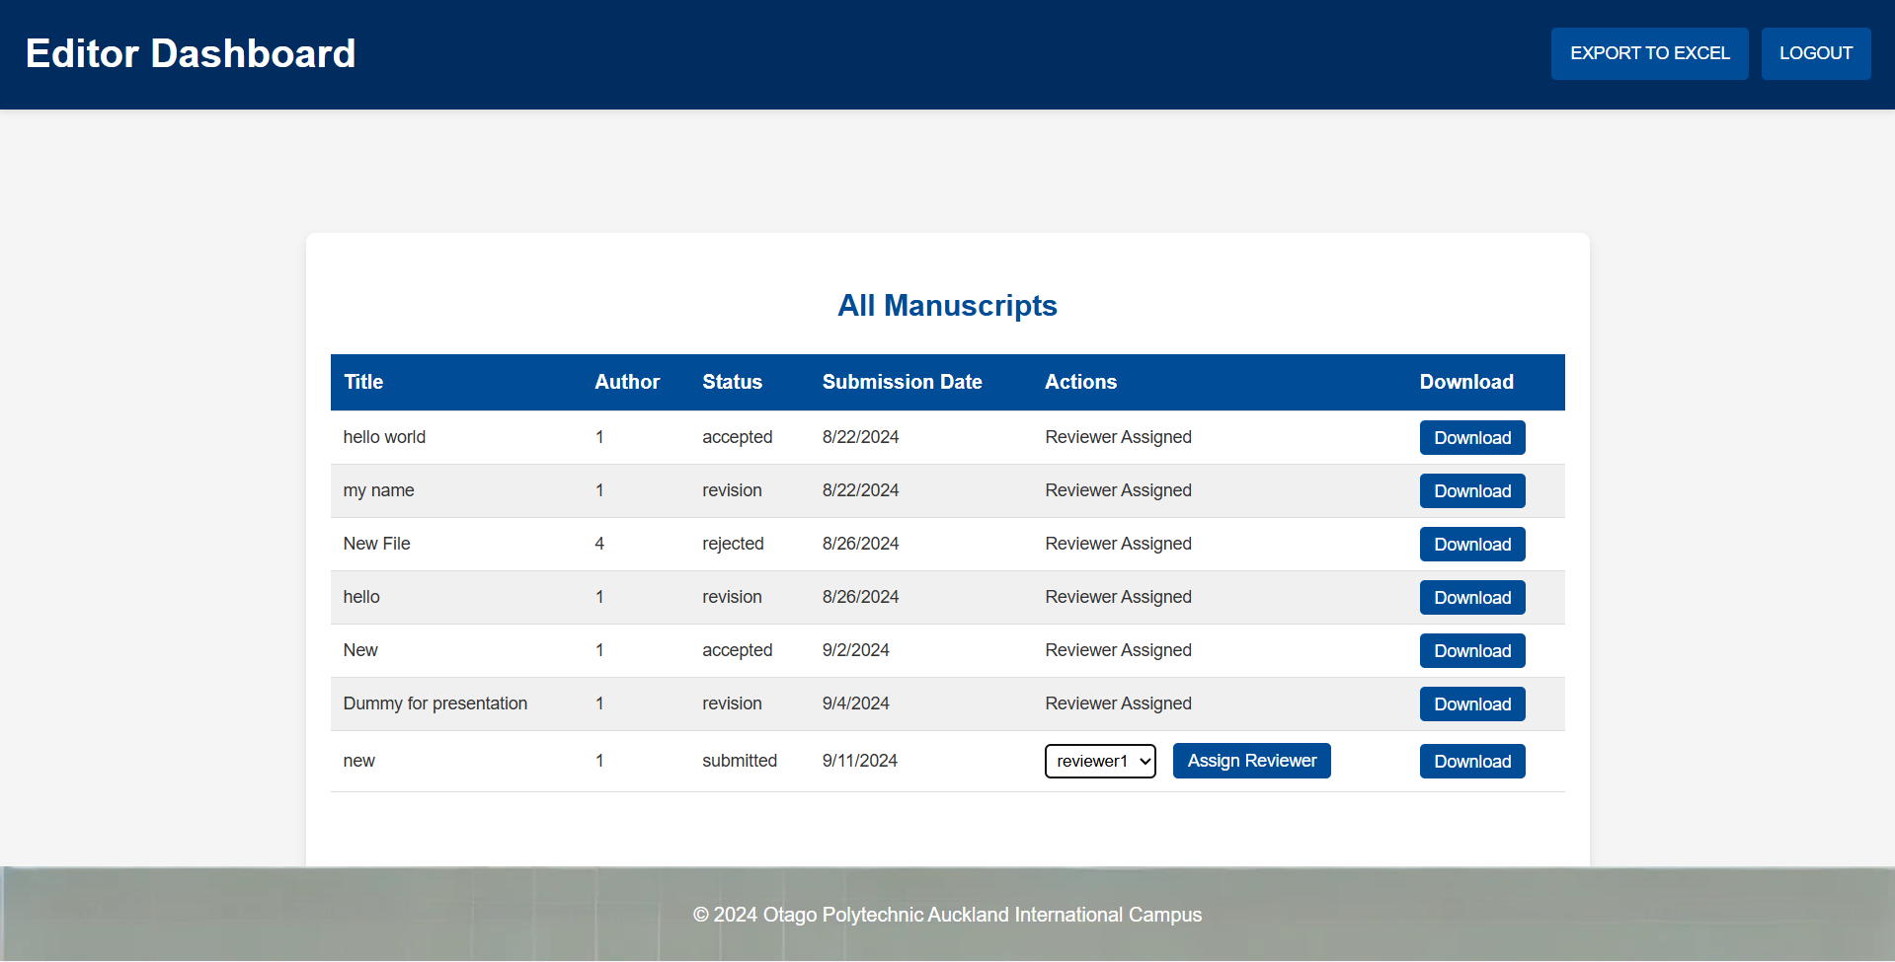

Slide 19
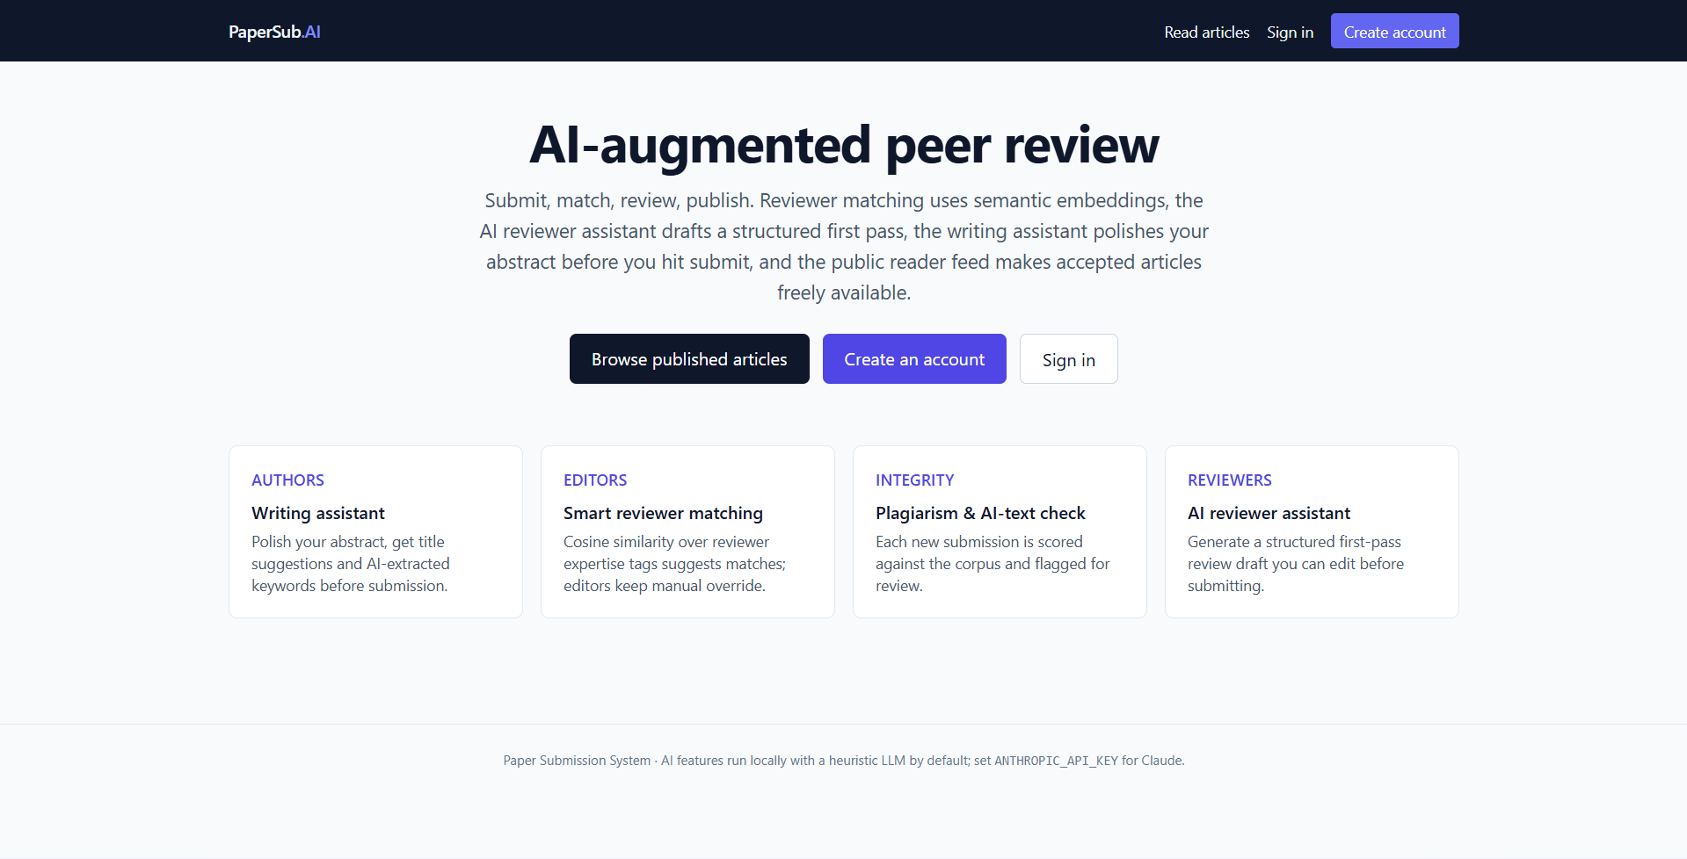

Slide 20
Sources I cited
TASK 7
Selected APA 7 references — full list in the appendix
1
Anthropic. (2025). Claude documentation. https://docs.claude.com
2
Bender, E. M., Gebru, T., McMillan-Major, A., & Shmitchell, S. (2021). On the dangers of stochastic parrots. FAccT '21, 610-623.
3
Brown, T. B., et al. (2020). Language models are few-shot learners. NeurIPS, 33, 1877-1901.
4
Liang, W., Yuksekgonul, M., Mao, Y., Wu, E., & Zou, J. (2023). GPT detectors are biased against non-native English writers. Patterns, 4(7), 100779.
5
Reimers, N., & Gurevych, I. (2019). Sentence-BERT: Sentence embeddings using Siamese BERT-networks. EMNLP-IJCNLP, 3982-3992.
6
Salton, G., & Buckley, C. (1988). Term-weighting approaches in automatic text retrieval. Information Processing & Management, 24(5), 513-523.
7
Vaswani, A., et al. (2017). Attention is all you need. NeurIPS, 30.
8
Weidinger, L., et al. (2022). Taxonomy of risks posed by language models. FAccT '22, 214-229.
Bottom line
Eight foundational papers covering transformers, embeddings, AI bias, and the limits of AI-text detection.
Bhanu Gupta · GenAI Assessment
15
Notes:
Eight key sources. Vaswani 2017 is the original transformer paper. Brown 2020 is GPT-3. Reimers and Gurevych is sentence-BERT. Salton 1988 is TF-IDF, the technique I use today. Bender 2021 and Weidinger 2022 are the canonical bias and risk taxonomy papers. Liang 2023 is the one that matters most for ethics, AI detectors are biased against non-native English writers. Anthropic is the model documentation.

Slide 21
THANK YOU
Questions, suggestions, or
budget approvals welcome.
Bhanu Gupta
IA730151 Year Three Special Topic (GenAI)
Notes:
That's it. Questions welcome. I'd rather get picked apart now than build the next phase with the same gaps.

