Slide 1
TRUCK FLEET BIG DATA ANALYTICS
Group 11:
Neelanshu Shrivastava
Bhanu Prakash Tadepalli

Slide 2
OVERVIEW
PROBLEM STATEMENT
Accidents caused by large trucks are among the leading causes of injuries and deaths in the United States.
BUSINESS OBJECTIVE
Identify dangerous commercial truck drivers nationwide by analyzing truck fleet data and creating visual presentations to benefit decision-makers.

Slide 3












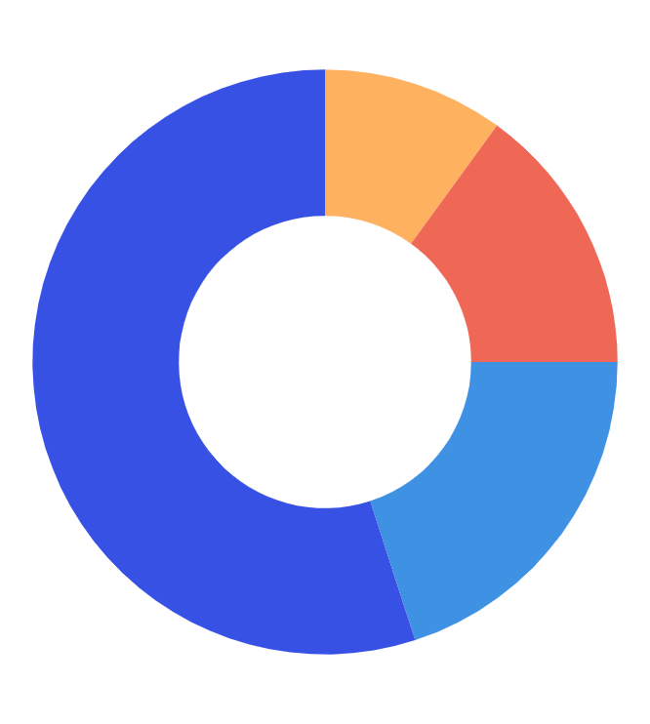

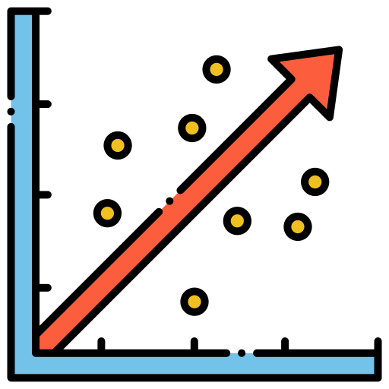

WORKFLOW
Download the data to local server. (geolocation.csv, trucks.csv, trucks_mg.csv) and move them to VMware local system using scp in Command Prompt.
Step 01
Load this data from local directory into HDFS (Cloudera VM)
Step 02
Step 03
Create tables in HIVE and load the data into it from HDFS. Using PIG to load data in Riskfactor table
Step 04
Import the data into Impala.
Step 05
Integrate HDFS with Tableau via JDBC drivers for Impala. Integrate R and Tableau.
Step 06
Exploratory Data Analysis : Identify patterns on Tableau through visualisations and get insights into the data
Build a predictive model using Linear Regression to predict the risk factor.
Step 07

Slide 4
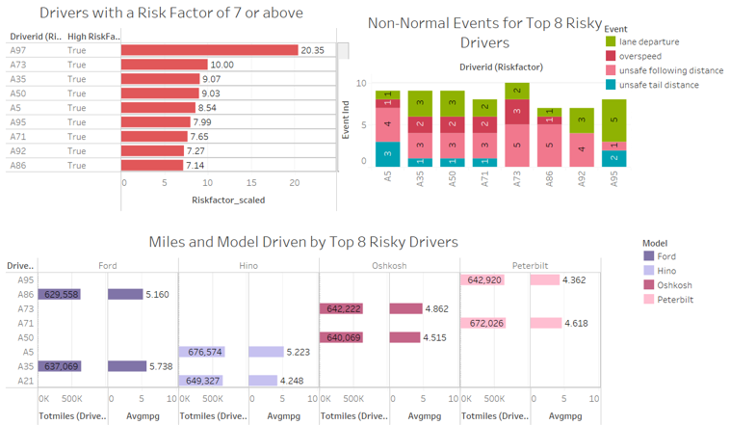
Story 1 : Truck Driver with Highest Risk Factor
A97 is the outlier
A73 is the truck driver with highest factor factor of 10 after excluding the A97
A73
Truck Model: Oshkosh
Avg mpg: 4,862
Totil Miles: 642,222
Violations:
Unsafe following distance:5
Occurrences of overspeeding:3
Occurrences of lane departure:2

Slide 5
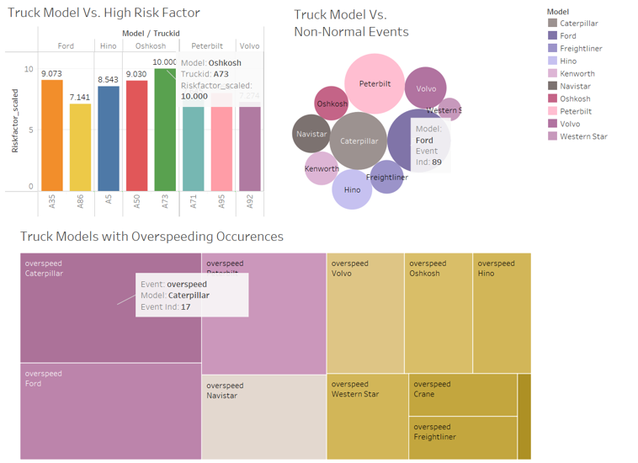
Story 2 : Truck Model with Highest Risk Factor
Highest Risk Factor:
Oshkosh: 10
Highest Number of Events:
Ford: 89
Highest Number of Overspeeding
Occurrences:
Caterpillar: 17

Slide 6
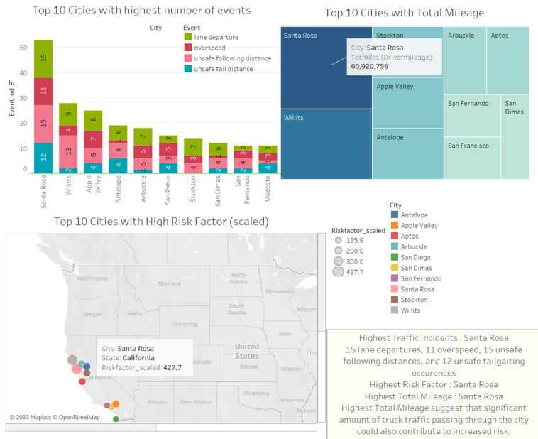
Story 3: Top 10 Cities with High Risk

Slide 7
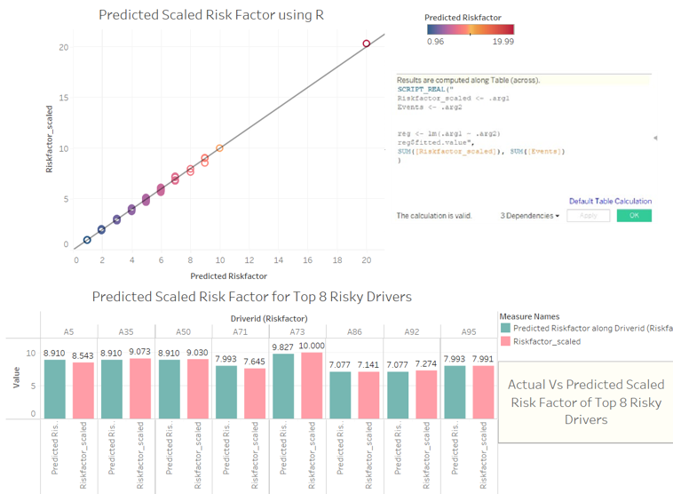
Story 4 : Predicting Risk Factor using -R regression

Slide 8
CHALLENGES
A lot of team members had trouble with Impala where the default folder in Impala was not showing up.
R-integration was new and hence we had to do additional research to under the process.

Slide 9
CONCLUSION
Summary of findings
    A73 is the truck driver with highest risk factor
    Santa Rosa is the city with highest risk
    Oshkosh is the truck model with highest risk factor
Recommendations for decision-makers to improve safety and reduce risk
Have truck driver A73 take additional CDL courses
Come up with additional regulations especially for sensor violations in the city of Santa Rosa
Future steps for refining the analysis and expanding the scope
Perform a study for all 50 states instead of just one state.

Slide 10
Thanks!
Do you have any questions?

