Slide 1

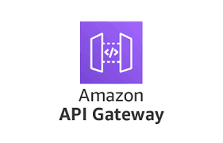
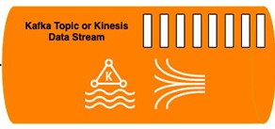



Producer App -1
Image Decoding
&
Collection
Producer App -2
Image Stream Generation
EC2
Input / Users
Custom S3 Feeder
Custom Processing Applications
S3 Custom
Metrics Repo
Output / BI

