Slide 1

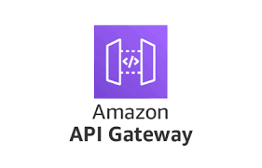

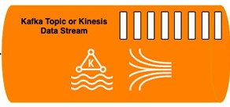

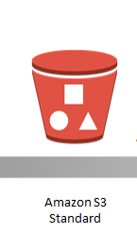

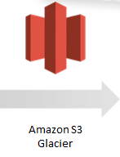
Producer App -1
Image Decoding
&
Collection
Producer App -2
Image Stream Generation
Input / Users
Custom S3 Feeder
Custom Processing Applications
Archival after 7 days
Custom Metrics
Repo

Slide 2
Assumptions
Assuming the Web Applications are Hosted on the AWS Cloud and the User Authentication is not being done by the Web App/Producer App-1
As it is mentioned that there is already some code for Image processing, Assuming the Image Processing application is hosted on the AWS Cloud
Assuming that the BI Application will be Hosted on the AWS Cloud

