Slide 1
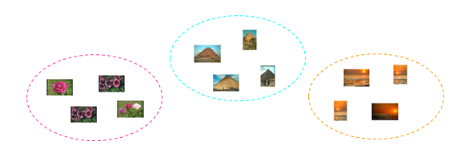
Coverpage
Image Clustering
distributed approach
Team Members
Bhanu Bhakta Sigdel [065/BCT/508]
Pradeep Bista [065/BCT/523]
Rameshwor Parajuli [065/BCT/533]
Sandip Pandey [065/BCT/538]

Slide 2
Expectation
Last week: Expectation
1> Data Collection and distribution
>>store as Hbase file in HADOOP file system.
2>Creating GMMs of Images
Image Clustering: distributed approach
Notes:
>>such that set of classes provide essentially the same prediction, or information, about the image archive as the entire image set collection.

Slide 3
Achievements:
Achievements
Data collection:
> dataset of 1000 images collected
Data Distribution:
>Collected data is inserted to Hbase Table
GMMs creation
>GMM of Images were created and successfully inserted to Hbase Table
Image Clustering: distributed approach

Slide 4
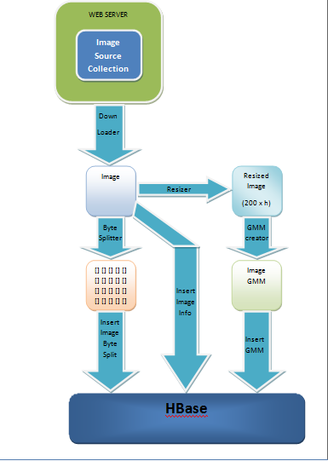
Methodology
Methodology
Image Clustering: distributed approach

Slide 5
Methodology
Methodology
Image Archive1
Image 1
Image 1
GMM
Cluster1
Image Archive2
Image 2
Image 2
GMM
AIB
Cluster2
Huge Image Archive
Image Archive3
Image 3
Image 3
GMM
.
.
.
.
.
.
.
.
.
.
.
.
Cluster p
Image Archive n
Image m
Image m
GMM
n computing nodes
Images within each node
Gaussian Mixutre Model
p Clusters
Image Clustering: distributed approach

Slide 6
Implementation Plan
Overall Implementation Plan
1> Data Collection and distribution
>>store as Hbase file in HADOOP file system.
2>Grouping pixels into GMMs
3> Agglomerative IB algorithm
4>Development of Image browsing environment
>>Web Interface
Image Clustering: distributed approach

Slide 7
Plan
Plan for next week
Agglomerative IB algorithm
>Calculation of Information Loss
>Merging of GMMs
>Agglomerative Clustering
Image Clustering: distributed approach

