Slide 1

Neural Network Approach to Predicting Congestion at Key Junctions

Slide 2

Group Member Information
Athinarapu Raju Sagar - 700760049
Lakkimsetti Bhanu Chandrika - 700747439
Manasa Vathumilli - 700745467
Eekshitha Gujjala - 700741491

Slide 3
Role/Responsibilities and Contribution in project
Athinarapu Raju Sagar Data collection and preprocessing. Managed the datasets from metropolitan intersections, ensuring data quality and consistency for model training.
Lakkimsetti Bhanu Chandrika Model development and training. Led the creation and training of the GRU model, implementing neural network algorithms to forecast traffic congestion.
Manasa Vathumilli Analysis and validation. Focused on exploratory data analysis and validation of the model against new datasets to optimize prediction accuracy.
Eekshitha Gujjala Worked on integrating the trained model into existing traffic management systems and,

Slide 4

Motivation
Key Issues Addressed:
Escalating urban traffic congestion causing economic and environmental concerns.
Inefficiencies in traditional traffic management systems due to reliance on fixed and outdated data.
Lack of adaptability in existing systems to handle dynamic and complex urban traffic patterns.
Why Neural Network ?
Potential to utilize real-time data for dynamic traffic management.
Ability to learn and adapt to changing traffic conditions over time.
Enhances traffic flow and reduces environmental impact by predicting congestion levels more accurately.

Slide 5

Objectives
Develop a Predictive Model: Use recurrent neural network, specifically Gated Recurrent Units (GRUs), to accurately predict traffic congestion at key urban intersections.
Enhance Traffic Management: Apply model insights to improve real-time traffic control strategies, such as adaptive traffic signal timings and lane management.
Environmental Impact Reduction: Reduce idle times and emissions by improving traffic flow through advanced predictive analytics.
Scalability and Adaptation: Create a model that can be easily adapted and scaled to various urban environments and integrated with existing traffic management systems.
Data-Driven Decision Making: Enable urban planners and traffic authorities to make informed decisions based on robust data analysis and predictions.

Slide 6

Related Work
Comparative Analysis
GRUs noted for handling time-series data effectively, better suited for dynamic traffic patterns compared to models like CNNs and LSTMs.
Recent trends show promising results by combining neural network algorithms with traditional traffic management systems to improve accuracy and responsiveness.
Review of Existing Approaches
For Traditional Methods fixed-time traffic signals, manual monitoring, and pre-determined route pricing. Generally inefficient due to lack of real-time responsiveness.
Studies showing integration of neural network in traffic systems enhancing prediction accuracy and management flexibility.

Slide 7

Problem Statement
Challenges in Urban Traffic Management:
High variability and unpredictability in traffic patterns.
Inefficiency of traditional models in real-time response and adaptation.
Economic and environmental impact of persistent congestion.
Need for Improved Solutions:
Existing systems fail to address rapid changes and complex dynamics of urban traffic.
Requirement for real-time, data-driven, and adaptive traffic management strategies.

Slide 8

Proposed Solution
Utilization of Gated Recurrent Units (GRUs):
Model Architecture: Implementing GRUs to handle time-series data effectively, capturing temporal dependencies in traffic patterns.
Data Handling: Comprehensive data collection from selected urban intersections, followed by meticulous preprocessing to ensure quality inputs for the model.
Integration into Traffic Systems:
Real-Time Application: Deploying the model in real-time traffic management systems to adjust traffic controls based on predictive insights.
Adaptive Controls: Utilizing predictions to dynamically manage traffic light timings and lane usage, reducing congestion peaks.
Environmental and Economic Benefits:
Reduction in Idle Times: By improving traffic flow, reducing the time vehicles spend idling, leading to lower emissions.
Economic Efficiency: Enhancing traffic management to reduce time lost in traffic, boosting productivity and reducing fuel consumption.

Slide 9
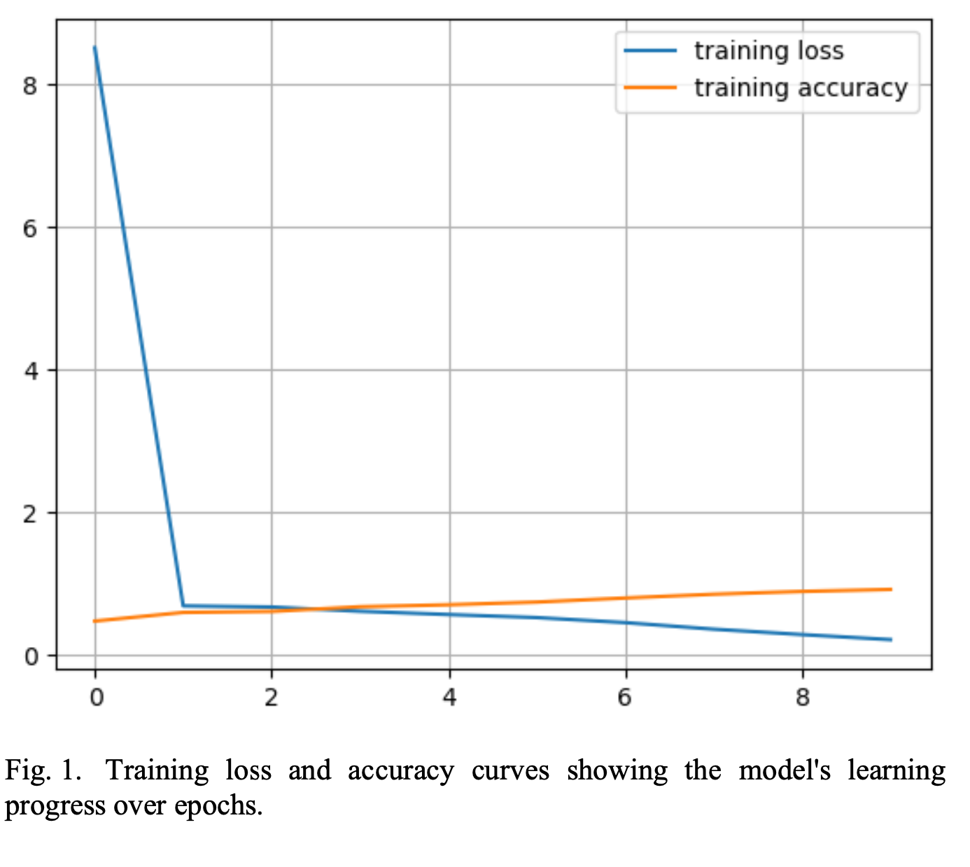
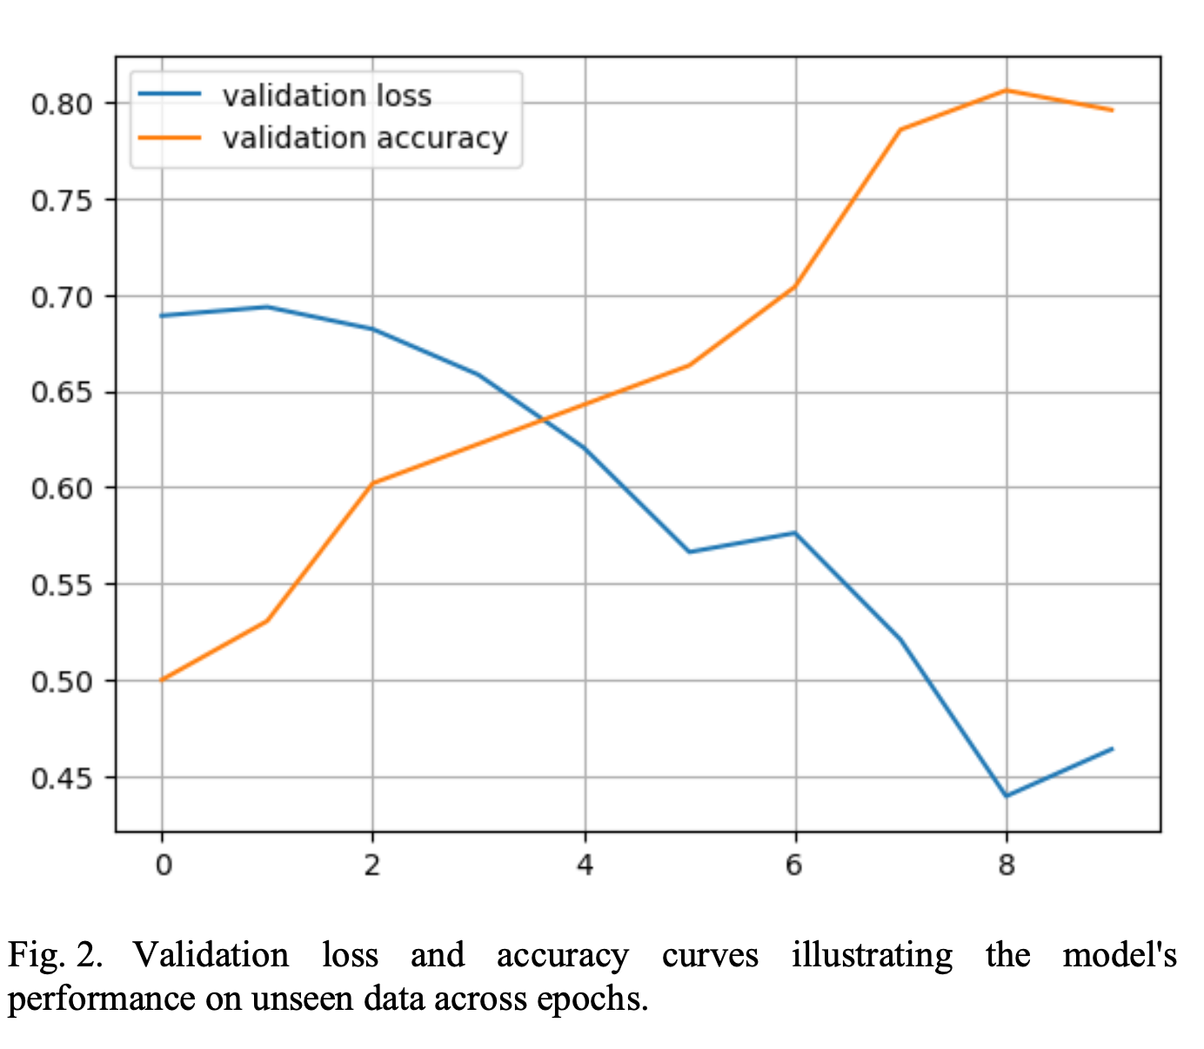
Results/Simulations
Model Training and Validation:
Accuracy Metrics: Employing RMSE, MAE, and MAPE to evaluate model performance, ensuring robustness in predictions.
Performance Over Time: Analysis of model's ability to learn and adapt to new data, maintaining accuracy across different traffic scenarios.
Real-World Implementation Insights:
Case Studies: Demonstrating successful deployment in selected intersections, noting improvements in traffic flow and reduction in congestion.
Feedback for Refinement: Collecting user and system feedback post-deployment to refine and optimize the model continuously.
Future Prospects and Scalability:
Expansion Plans: Potential to scale the model to additional intersections and broader geographic areas.
Continuous Improvement: Ongoing development to integrate more comprehensive data sets and advanced neural network techniques.

Slide 10
References
F. M., G. Meraj, S. A. Khader, M. Farooq, S. Kanga, S. K. Singh, P. Kumar, and N. Sahu, "Management of Landslides in a Rural–Urban Transition Zone Using Machine Learning Algorithms—A Case Study of a National Highway (NH-44), India, in the Rugged Himalayan Terrains," Land, vol. 11, no. 6, p. 884, 2022, doi: 10.3390/land11060884.
Chahal, P. Gulia, N. S. Gill, and I. Priyadarshini, "A Hybrid Univariate Traffic Congestion Prediction Model for IoT-Enabled Smart City," Information, vol. 14, no. 5, p. 268, 2023, doi: 10.3390/info14050268.
K. Lakshmanna, X. Xing, X. Li, and Y. Zhai, "GRU-CNN neural network method for regional traffic congestion prediction serving traffic diversion demand," Wireless Communications and Mobile Computing, vol. 2022, p. 8164105, 2022, doi: 10.1155/2022/8164105.
M. Kanchana, G. PV, M. B, and B. V. Nirmala, "Machine Learning-Based Dynamic Signal Switching: A Promising Solution to Traffic Congestion," in 2023 International Conference on Innovative Computing, Intelligent Communication and Smart Electrical Systems (ICSES), Chennai, India, 2023, pp. 1-8, doi: 10.1109/ICSES60034.2023.10465532.
W. Cheng, J. L. Li, H. C. Xiao, and L. N. Ji, "Combination predicting model of traffic congestion index in weekdays based on LightGBM-GRU," Scientific reports, vol. 12, no. 1, p. 2912, 2022, doi: 10.1038/s41598-022-06975-1.
C. Chaoura, H. Lazar, and Z. Jarir, "Predictive System of Traffic Congestion based on Machine Learning," in 2022 9th International Conference on Wireless Networks and Mobile Communications (WINCOM), 2022, pp. 1-6, doi: 10.1109/WINCOM55661.2022.9966448.
Y. Xing, X. Ban, X. Liu, and Q. Shen, "Large-Scale Traffic Congestion Prediction Based on the Symmetric Extreme Learning Machine Cluster Fast Learning Method," Symmetry, vol. 11, p. 730, 2019, doi: 10.3390/SYM11060730.
S. Sun, J. Chen, and J. Sun, "Traffic congestion prediction based on GPS trajectory data," International Journal of Distributed Sensor Networks, vol. 15, 2019, doi: 10.1177/1550147719847440.
Hussain, M. Taher, O. Mahmood, Y. Hammadi, R. Alkanhel, A. Muthanna, and A. Koucheryavy, "Urban Traffic Flow Estimation System Based on Gated Recurrent Unit Deep Learning Methodology for Internet of Vehicles," IEEE Access, vol. 11, pp. 58516-58531, 2023, doi: 10.1109/ACCESS.2023.3270395.
N. Mahmoud, M. Abdel-Aty, Q. Cai, and J. Yuan, "Predicting cycle-level traffic movements at signalized intersections using machine learning models," Transportation Research Part C: Emerging Technologies, vol. 124, p. 102930, 2021, doi: 10.1016/J.TRC.2020.102930.
W. Chen, J. Fang, Z. Liu, and M. Xu, "A Key Path-Based Deep Learning Approach for Urban Traffic Speed Prediction," Journal of Physics: Conference Series, vol. 1972, 2021, doi: 10.1088/1742-6596/1972/1/012095.
T. Kyaw, N. Oo, and W. Zaw, "Predicting On-road Traffic Congestion from Public Transport GPS Data," International Journal of Advances in Scientific Research and Engineering, 2020, doi: 10.31695/ijasre.2020.33771.
P. Sun, A. Boukerche, and Y. Tao, "SSGRU: A novel hybrid stacked GRU-based traffic volume prediction approach in a road network," Comput. Commun., vol. 160, pp. 502-511, 2020, doi: 10.1016/j.comcom.2020.06.028.
Y. Gao, J. Zhao, Z. Qin, Y. Feng, Z. Yang, and B. Jia, "Traffic Speed Forecast in Adjacent Region between Highway and Urban Expressway: Based on MFD and GRU Model," Journal of Advanced Transportation, 2020, doi: 10.1155/2020/8897325.
N. Zafar, I. Haq, H. Sohail, J. Chughtai, and M. Muneeb, "Traffic Prediction in Smart Cities Based on Hybrid Feature Space," IEEE Access, vol. 10, pp. 134333-134348, 2022, doi: 10.1109/ACCESS.2022.3231448.
G. Dai, C. Ma, and X. Xu, "Short-Term Traffic Flow Prediction Method for Urban Road Sections Based on Space–Time Analysis and GRU," IEEE Access, vol. 7, pp. 143025-143035, 2019, doi: 10.1109/ACCESS.2019.2941280.
S. Feng, J. Huang, Q. Shen, Q. Shi, and Z. Shi, "A Hybrid Model Integrating Local and Global Spatial Correlation for Traffic Prediction," IEEE Access, vol. 10, pp. 2170-2181, 2022, doi: 10.1109/ACCESS.2021.3139934.
M. Bin and Z. Lin, "GCN model combined with Bi-GRU for traffic prediction," in Proc. SPIE, vol. 12259, 2022, pp. 122592F-122592F-6, doi: 10.1117/12.2641062.
J. Zhao, Y. Gao, Z. Yang, J. Li, Y. Feng, Z. Qin, and Z. Bai, "Truck Traffic Speed Prediction Under Non-Recurrent Congestion: Based on Optimized Deep Learning Algorithms and GPS Data," IEEE Access, vol. 7, pp. 9116-9127, 2019, doi: 10.1109/ACCESS.2018.2890414.
H. Yang, X. Zhang, Z. Li, and J. Cui, "Region-Level Traffic Prediction Based on Temporal Multi-Spatial Dependence Graph Convolutional Network from GPS Data," Remote. Sens., vol. 14, p. 303, 2022, doi: 10.3390/rs14020303.
K. Zhang, Z. Chu, J. Xing, H. Zhang, and Q. Cheng, "Urban Traffic Flow Congestion Prediction Based on a Data-Driven Model," Mathematics, 2023, doi: 10.3390/math11194075.

