Slide 1
Coursera Capstone project
Opening a new shopping mall in Hyderabad, India

Slide 2
Business problem
Locating of the shopping mall is one of the most important decisions to determine if the shopping mall will be a success or a failure.
The main objective of this project is to determine to best locations to open a shopping mall in the city of Hyderabad, India.
This project will be useful in answering the question to which area a new shopping mall can be opened in Hyderabad by considering different locations.

Slide 3
Data
List of neighborhoods in Hyderabad, India.
Geographical coordinates and data of the city Hyderabad and the surrounding neighborhoods.
Venue data which is related to shopping malls.
Sources of Data:
List of neighborhoods data from (https://en.wikipedia.org/wiki/Category:Neighbourhoods_in_Hyderabad,_India).
Python packages
Foursquare API

Slide 4
Methodology
Scraping Wikipedia page for neighborhood list
Getting geographical information from Geocoder package
Using Foursquare API for venue data
Grouping the neighborhoods
Performing K means clustering
Deciding the best cluster

Slide 5
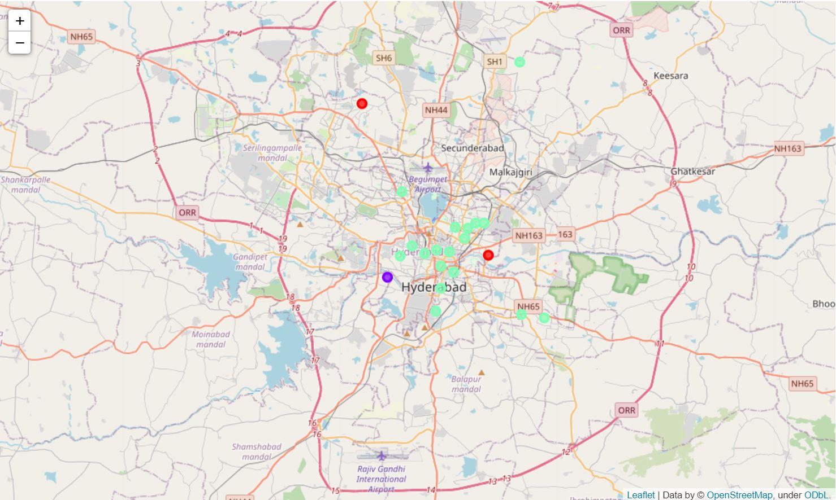
Results
As we are using 3 clusters in the K means algorithm the following results are generated.
Cluster 0: This cluster consists the neighborhoods with moderate number of shopping malls.
Cluster 1: This cluster contains the zero to low number of shopping malls.
Cluster 2: This cluster contains the high number of shopping malls.

Slide 6
Conclusion
As we can see that there are many shopping malls in the middle of Hyderabad city. The highest number in the cluster 2 shows us the information. Also we can see from Cluster 1, it has only one number.
We can see that in the cluster 2 there are many shopping malls and there will be more competition in that area. So, we can try to think about opening a new shopping mall in the region of Cluster 1 as there will be little competitors.
We can also try to look at the area of Cluster 0 in addition with Cluster 1 to open in new areas.
This helps in deciding the location to open a new shopping mall in Hyderabad.

Slide 7
thankyou

