Slide 1
Python Programming for Data Science – 2024
Python for Everyone.
Keep Learning...

Slide 2
Python Basics

Slide 3
Introduction to Python
Python language is first introduced by Mathematician “Guido Van Rossum” in the year 1991
National Research Institute for mathematics and computer science
The location is in the Netherlands
The development of python language started in late 1980s
At that time “Guido Van Rossum” working for the “ABC” language at “Centrum Wiskunde & Informatica” situated in Netherlands
The “ABC” language works fine on the ‘exception handling’
Hence, the idea of python language is taken from that
Python language consists all the features of “ABC” language.

Slide 4
Python:
High level programming language
General purpose programming language
It is high level, interpreted, interactive and object oriented scripting language
It uses English keywords frequently
Python is processed at the run time by the interpreter, we don’t need to compile our program before executing it
Build anything
Can build packages for data science

Slide 5
Basics of Python for Data Analysis
Open source – free to install
Very easy to learn
Python is an interpreted and compiled language

Slide 6
Features of Python:
Software quality
Developer productivity
Support various libraries
Easy to understand
Very flexible

Slide 7
Applications of Python:
Web Applications
Desktop Applications
Database Applications
Data Analysis
Computer vision for image and video processing
Interactive Web Visualization
Web Scraping
Object Oriented Programming(OOPs concept)

Slide 8
Configuration:
If you are going to purchase a new Laptop:
Processor:
1. Windows min. Intel 5 - latest generation – 13th Gen
2. AMD (ryzen 5 or ryzen 7)
3. Macbook – Silicon chips (M1, M2 and M3)
RAM:
help to carry multiple process parallel
Minimum requirement: 8GB, if you are using 16GB that’s fine
There are two types of RAM here: DDR4 & DDR5
ROM:
prefer SSD – min. 256GB
HDD – min. 512GB
Cores:
Octa – Octa(8) means Octa core processor
Thread:
Multithreaded
GPU:
min. 4GB
Operating system:
Windows – Windows 10 min. – Paid OS
Linux - ubuntu 16 or ubuntu 18 – Free OS
Mac – MacOS – Ventura – pre installed in mac
Chrome book – not recommended (based on Linux)

Slide 9
How to install Python and it’s supporting libraries?
Let’s understand...
Python Framework:
Steps to Install Python Framework in our system:
Step 1: Go to Google Chrome/Mozilla Firefox/Microsoft Edge/Safari any browser
Step 2: Type/Search for ‘anaconda’ on your web browser
Step 3: Click on website: https://www.anaconda.com
Step 4: Redirect the new web page
Step 5: Once the page open, you can see the “Free Download” for Windows as well as for Mac users
Step 6: Simply click on it. It will start downloading the ‘Anaconda’
Step 7: Size of the file is 899 MB: Anaconda 3
Step 8: Click on “Get Additional Installers” – if you are using Mac / Linux
Step 9: After downloading the file, visit the folder and click on it
Step 10: After click on the file, you will the see the first file: Setup Page of “Anaconda” application
Step 11: Click on “Next”, Click on “I agree”, Click on “Just Me(recommended), then Click on “Next”
Step 12: After this you see “Destination folder” which you want to keep the setup and Click on “Next” The space required to install “Anaconda” is 4.9 GB, Do not change the Destination of file.
Step 13: After, Do not select any option from your side, then Click on “Install”.
Step 14: After Clicking on Install button, it will begin the installation it takes couple of minutes to install the “Anaconda” in your system
Step 15: Once the installation of Anaconda is completed, Click on “Next” button, then again Click on “Next” button
Step 16: After that, if see some options, uncheck them and Click on “Finish”

Slide 10
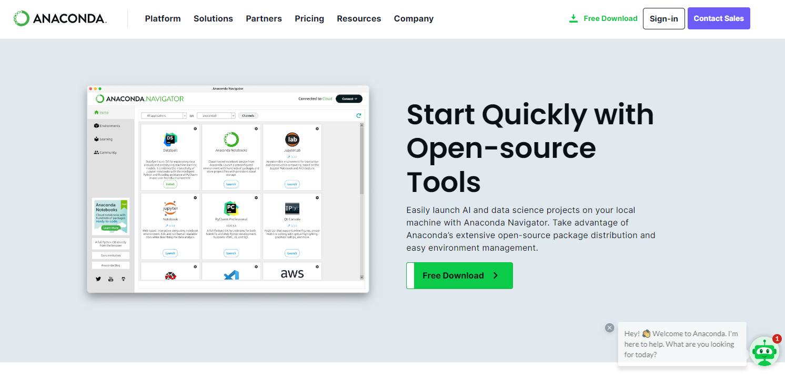

Slide 11
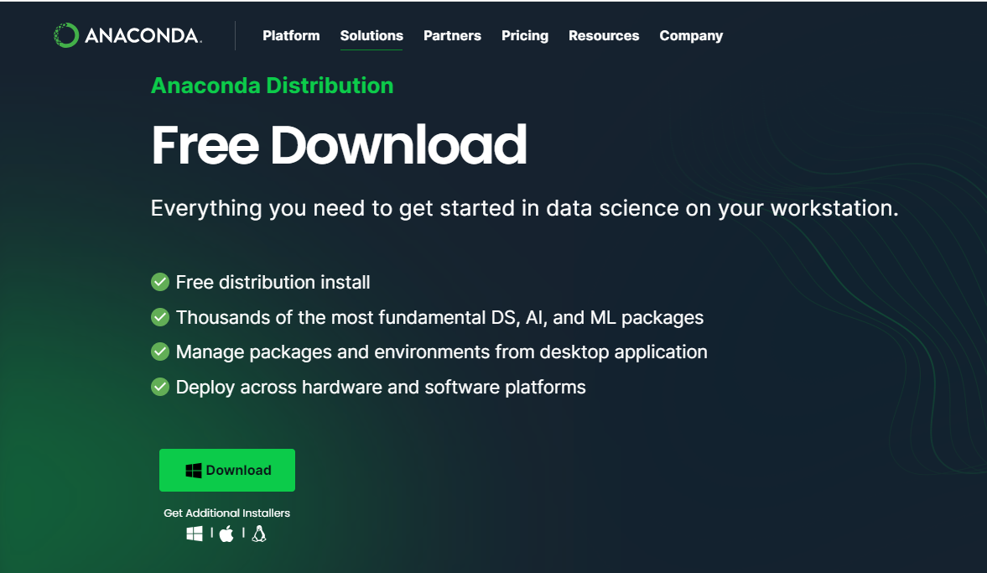

Slide 12
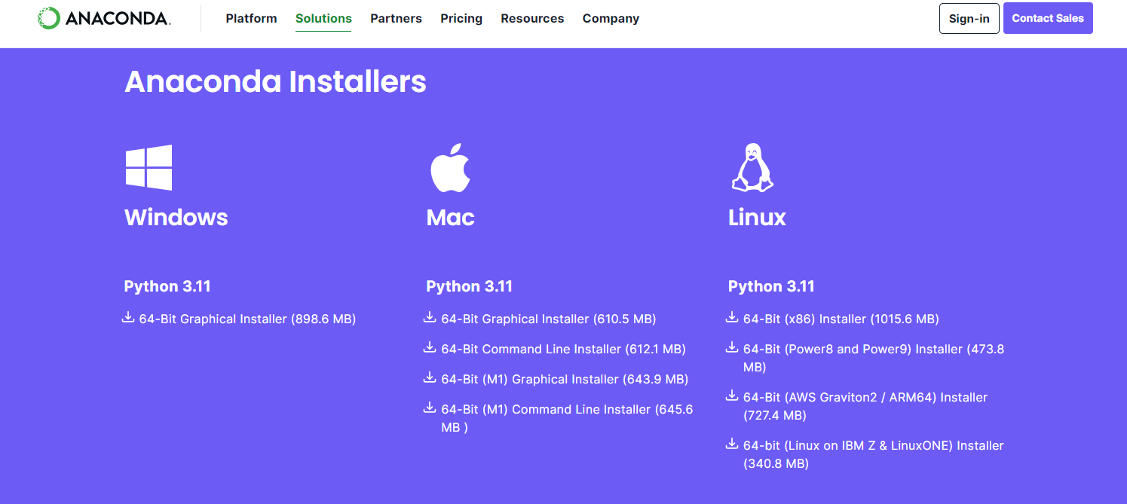

Slide 13
Anaconda??
Anaconda
Anaconda is an application/package that contain everything required for Data Science
Anaconda is a package that contains every required applications related to Data Science modules
We are using Anaconda to work for Python programming and Machine learning models, Machine learning and Deep learning related projects
As we know, all the applications are already present in Anaconda package
So there is no need to download any applications separately
Also, Most of the companies using “Anaconda” application to work on Machine Learning and Python
So We are going to use “Anaconda” application in the Data Science
So, that’s why we are downloading the Anaconda application

Slide 14
Opening “Anaconda” application
For Windows User: Go to search button, type “Anaconda Navigator App” and double click to open
For Mac User: Go to Finder/Spot light search, type “Anaconda Navigator App” and double click to open
Note: Do not Login / Sign up any where in Anaconda App.

Slide 15
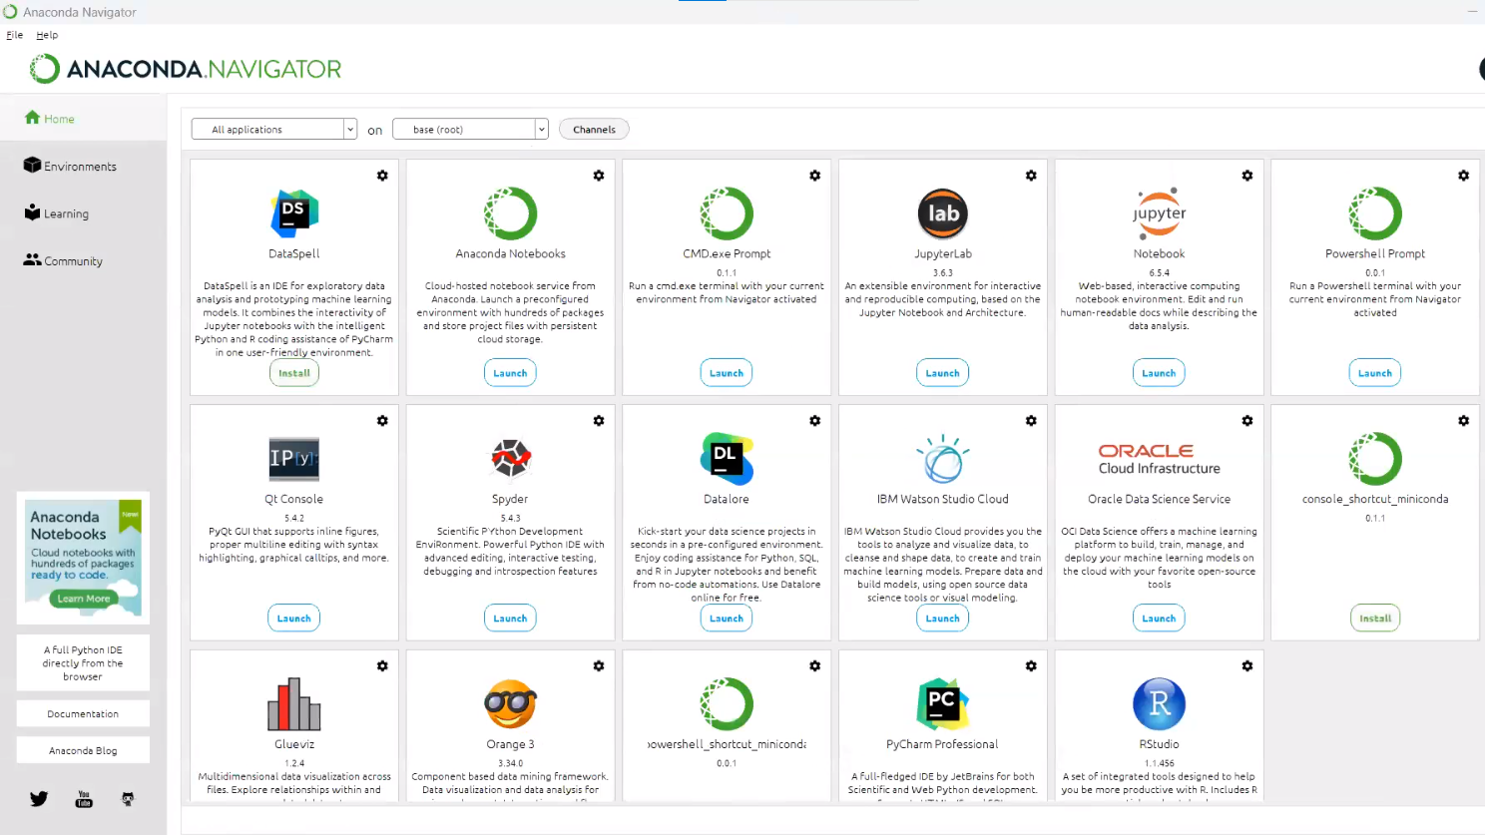
Anaconda Navigation Page Dashboard

Slide 16
Anaconda Navigator – Dashboard
Various applications are already installed in “Anaconda App”:
DataSpell
jupyter Notebook
ORACLE cloud infrastructure
Datalore
Orange 3
PyCharm Professional and many more.....

Slide 17
As you can see that,
There is a “jupyter” Notebook, click on the launch button
We are going to use this “jupyter” notebook to work on: Python programming language as well as Machine Learning related tasks.
Click on “New” and then select “Python 3 (ipykernel)”
You will be redirected a new page.
That’s your “jupyter” notebook looks like
Remember: The extension of the “jupyter” Notebook is (.ipynb)

Slide 18
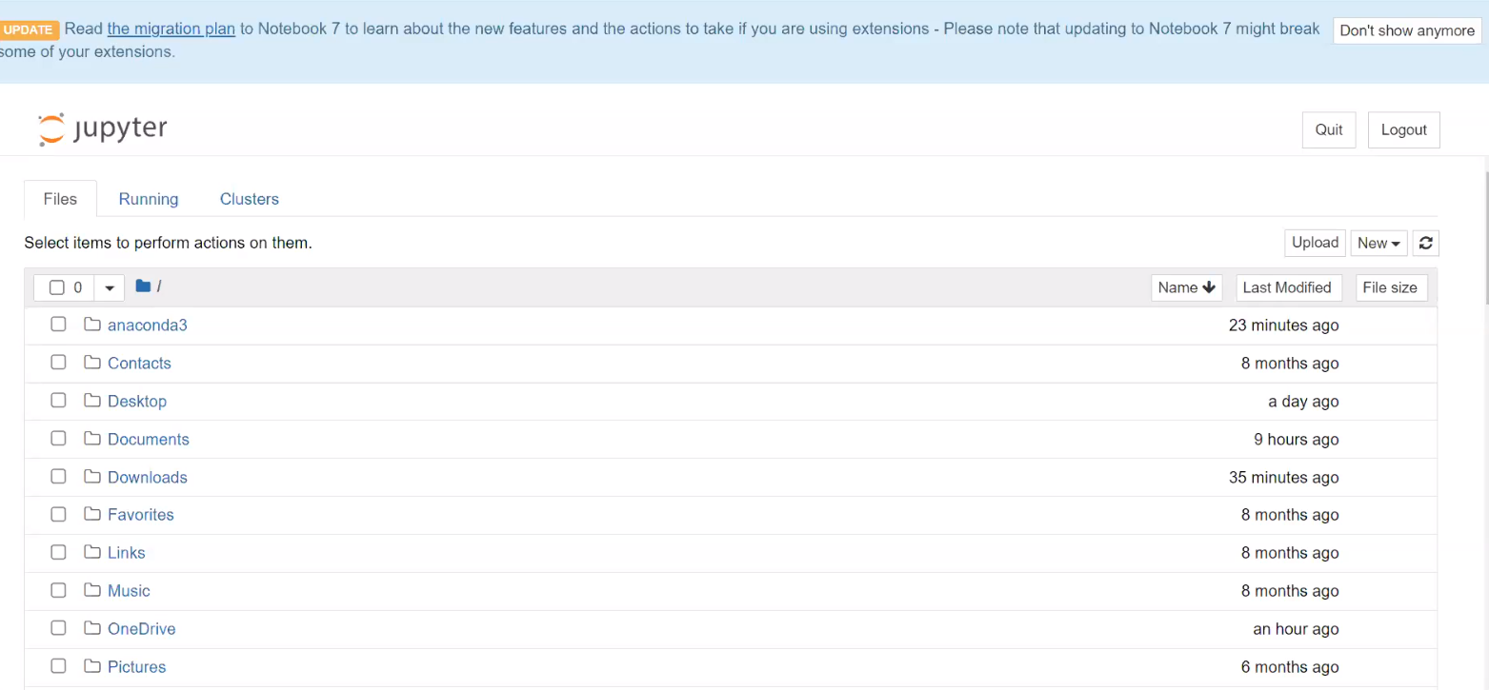
Jupyter Notebook Dashboard

Slide 19
More about: jupyter Notebook
Jupyter notebook has many number of cells
You can insert as many as cells you want
You can write Python code in that cells
You want to execute the code: click on “Run” button or use “Ctrl+Enter”
Add cell on above any cell, we click “Esc+A”
Add cell on below any cell, we click “Esc+B”
Delete any particular cell, first select the cell, press “esc” button and press 2 times D: “Esc+D+D”
? Why we are using the Python programming language
Because this is the widely used programming language in ‘Data Science’ field
It is very easy to learn and understand
It is case-sensitive language
It gives a lots of flexibility to write a code
For example, I want to print my name by writing the code, just write code like; print(“Rajesh Singh”)
It is like a English language
If you say, what is 10+15? we know the answer is 25
In the same way, we can write the code in python as: 10+15, we get the result/output as: 25, you can see the output
If we want to divide and multiply numbers, in the same way we can write the code in python using jupyter notebook
You can write the comments / any notes in cell, we use “Markdown” option
If you want give heading, we use “Heading” option

Slide 20
Remember:
Python is a case sensitive programming language. For example, HELLO and hello are two different words/variables
Python is an Object Oriented Programming language
Python is Dynamically, implicitly typed. So, we don’t have to explicitly declare variable data types
Python is Strongly typed. You can’t concatenate a string and a integer
Python files extension: .ipynb
We use “jupyter” notebook to write python code for Data Science and ML learning models
We use “print” statement to see the output of the code

Slide 21
Python Basic Syntax:
>>> 3+4
7
>>> 4*4
16
>>> 5-2
3
>>> 8/2
4.0
>>> a=9
>>> b=2
>>> c=a+b
>>> print(c)
11

Slide 22
Python calculator:
>>> print(8+2)
print(5 + 5)
print(5 - 5)
# Multiplication, division, modulo, and exponentiation
print(3 * 5)
print(10 / 2)
print(18 % 7)
print(4 ** 2)

Slide 23
Python: print statement/string
>>> print ('hello world')
hello world
print(“hello welcome to python world”)
hello welcome to python world

Slide 24
Python: Keywords
There are many keywords useful in python, having in-built keywords
To see those keywords, we need to import them in our jupyter notebook
import keyword
print(keyword.kwlist)
..........
..........
Output:

Slide 25
Python - Boolean Expressions
We have only two Boolean expressions/words:
True and False
Boolean expressions are created with the keywords: and, or, not, is.
1) and:
True and False
>> False
Here, ‘and’ is a keyword, for and “both the conditions should satisfy means if both are True, then only output becomes True otherwise it become False
2) or:
True or False
>> True
Here, ‘or’ is a keyword, for or “either one of the conditions should satisfy means if at least one condition is True, then only output becomes True
3) Comparing things:
‘b’ == ‘c’
here, == sign indicates comparison
In python, we use == sign for compare
For example:
Input Output
10 == 15 >>>>> False
10 == 12 >>>>> False
5 == 5 >>>>>> True
8 == 19 >>>>> False
10 == 10 >>>> True

Slide 26
Python Basic Operators
>>> 9 + 5 # Addition
14
>>> 8 - 5 # Subtraction
3
>>> 2 * 6 # Multiplication
12
>>> 12 / 3 # Division
4.0
>>> 7 % 3 # Modulus (returns the remainder from division)
1
>>> 3 ** 2 # Raise to the power 9

Slide 27
Python Mathematical Operators:
Using Boolean expressions:
True means 1
False means 0
True + True >> 2
True + False >> 1
False + False >> 0
True – False >> 1
True and False or True >>>> True

Slide 28
Variables and Data Assignment:
Variables are containers for data.
The syntax to declare them is:
variable_name = variable_value.
a = 20
b = 30
c = 100
Here, a, b, c are variable
20, 30, 100 are data
a = 20 means >>> data assignment
Single = sign means assign the data
Now,
c = 100
RHS: 100 is your data
LHS: c is your variable_name

Slide 29
Variables Example:
num 1 = 50
num 2 = 100
Result=num 1 +num 2
>>> 150
First = 45
Second = 5
Third = First + Second
>>> 50

Slide 30
GitHub
Go to “github.com”
Click on that link – www.github.com
GitHub is basically an application
GitHub is an application/a service that is basically handled by Microsoft
Why they are using this, because GitHub is basically a “Cloud-Platform” for Data Scientists/Developers/IT professionals
Like as we use “Google Drive” to share the files/store the files/access the files any time
In the same way, GitHub is there, it is basically a cloud platform where different IT professional/Developers/Data Scientists they used to share/upload their codes, so that they can collaborate with other persons, and they can work together on any projects
So that’s why we are using the GitHub
Now, if you have already have an Account, Go to “Sign in” and enter your email address and Sign in to your GitHub account
If you don’t have an Account, Click on “Sign up” button, Asking for email address, Enter your email and create password to get GitHub account, Click on Continue >> Enter username as per your choice and process further

Slide 31

GitHub Dashboard

Slide 32
Python Basics Over.
THANK YOU !

