Slide 1


Design and Implementation of an NP-Complete Problem Visualizer and Solver Using Efficient Algorithmic Techniques CSA0608-Design and Analysis Of Algorithm
SUPERVISED BY: Dr. Sriramya
PRESENTED BY: V. Teja Sree(192411211)
P. Bhanu Prakash (192425263)
K. Sharlie Gifta (192324191)

Slide 2
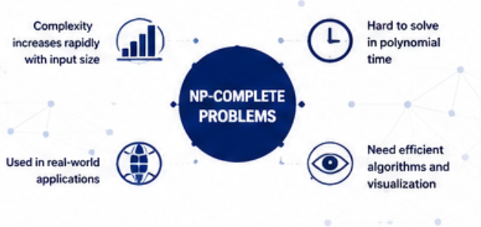
INTRODUCTION
NP-Complete problems are among the most challenging computational problems.
Finding an exact solution requires significant computational resources.
These problems appear in routing, scheduling, network optimization, logistics, and AI.
This project provides an interactive system to visualize problem-solving steps and compare algorithm performance.

Slide 3
PROBLEM STATEMENT
Many NP-Complete problems become computationally expensive as input size increases.
Existing tools often:
Do not clearly visualize algorithm execution.
Lack performance comparison.
Provide limited educational understanding.
The project develops a visual solver that demonstrates algorithm execution while evaluating efficiency.

Slide 4
OBJECTIVES
Accept different NP-Complete problem inputs.
Validate and preprocess datasets.
Solve problems using efficient algorithms.
Visualize execution steps.
Compare execution time and memory usage.
Analyze computational complexity.

Slide 5
LITERATURE SURVEY
Author(s) & Year | Research Title | Methodology | Limitations | Proposed Improvement
Romera-Paredes et al. (2023) | AI-Based Optimization | LLM-based algorithm generation | No visualization | Add interactive visualization
Bodlaender et al. (2024) | Parameterized Graph Algorithms | Efficient graph techniques | Mostly theoretical | Include practical analysis
Krajewski et al. (2024) | Graph Traversal Methods | Optimized search algorithms | Limited problem support | Support multiple NP problems
Xu et al. (2025) | Hybrid Optimization Algorithm | Evolutionary + mathematical optimization | Problem-specific approach | Develop generalized solver
Efrat et al. (2025) | Graph Visualization Techniques | Advanced graph visualization | No performance evaluation | Integrate metrics analysis

Slide 6
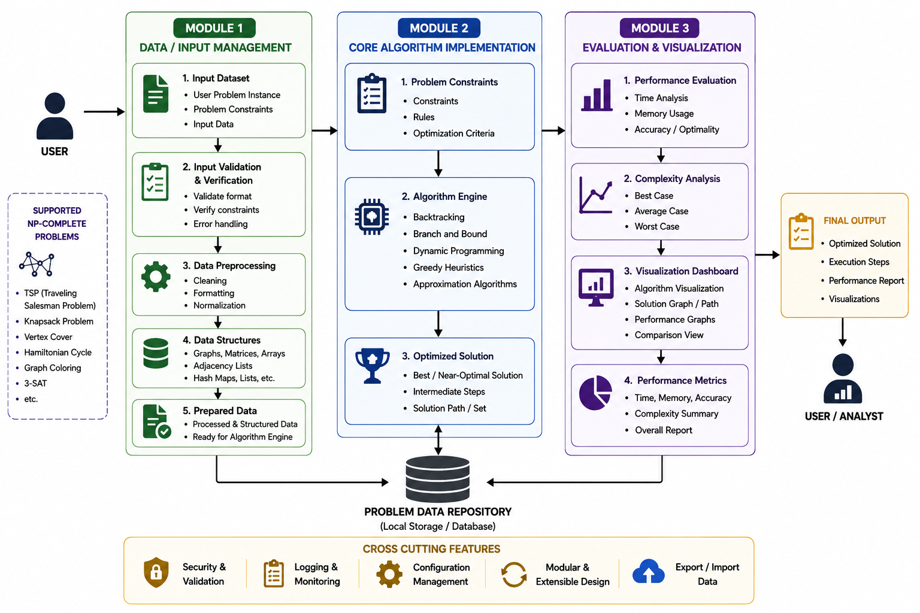
SYSTEM ARCHITECTURE

Slide 7
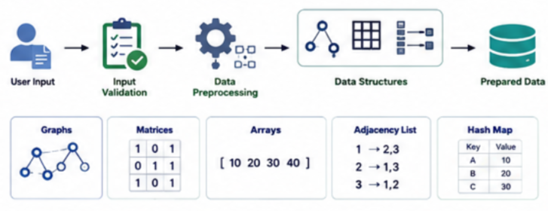
MODULE 1 Problem Input And Data Management
Inputs
User problem instance
Dataset
Constraints
Processing
Input validation
Data preprocessing
Data structure creation
Data Structures
Arrays
Graphs
Matrices
Adjacency Lists
Hash Maps

Slide 8
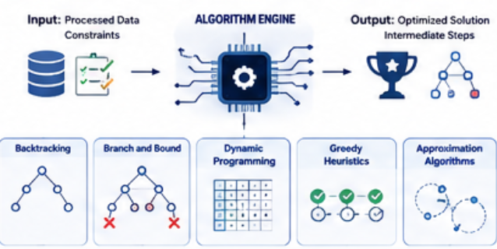
MODULE 2 Core Algorithm Implementation
Inputs
Processed data
Constraints
Algorithms
Backtracking
Branch and Bound
Dynamic Programming
Greedy Heuristics
Approximation Algorithms

Slide 9
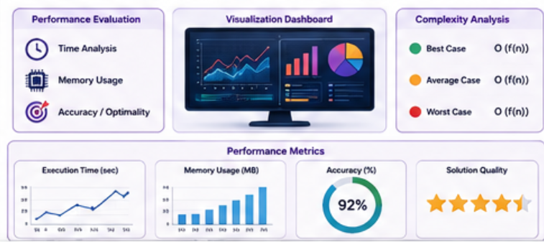
MODULE 3 Evaluation and Visualization
Performance Evaluation
Execution Time
Memory Usage
Solution Accuracy
Computational Complexity
Visualization
Algorithm execution steps
Search tree visualization
Solution comparison
Performance graphs

Slide 10
ALGORITHMS USED
Backtracking
Explores every possible solution while pruning invalid paths.
Branch and Bound
Reduces unnecessary searches using upper and lower bounds.
Dynamic Programming
Stores repeated computations to reduce execution time.
Greedy Heuristics
Makes locally optimal choices for faster approximate solutions.
Approximation Algorithms
Produces solutions close to the optimum within acceptable time.

Slide 11
ADVANTAGES & APPLICATIONS
Advantages
Easy visualization of complex algorithms
Educational learning tool
Performance comparison
Efficient optimization
Supports multiple NP-Complete problems
Applications
Vehicle Routing
Task Scheduling
AI Planning
Network Design
Logistics
Resource Allocation

Slide 12
FUTURE SCOPE
AI-assisted algorithm selection.
Cloud-based computation.
Parallel processing implementation.
Support for additional NP-Hard problems.
Real-time visualization.
Machine Learning–based optimization.

Slide 13
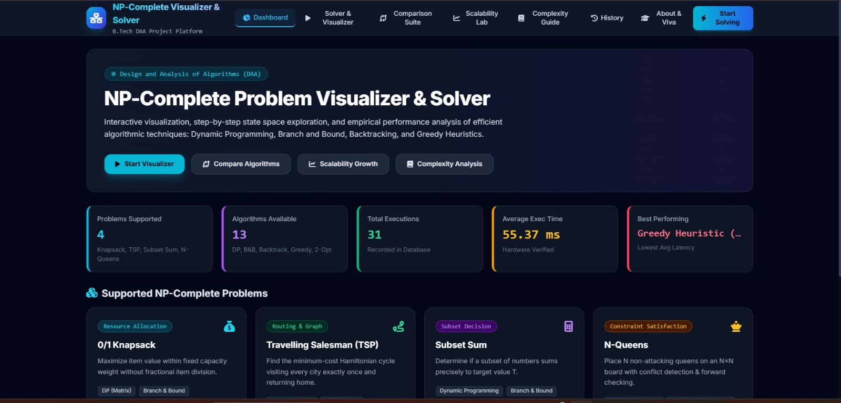
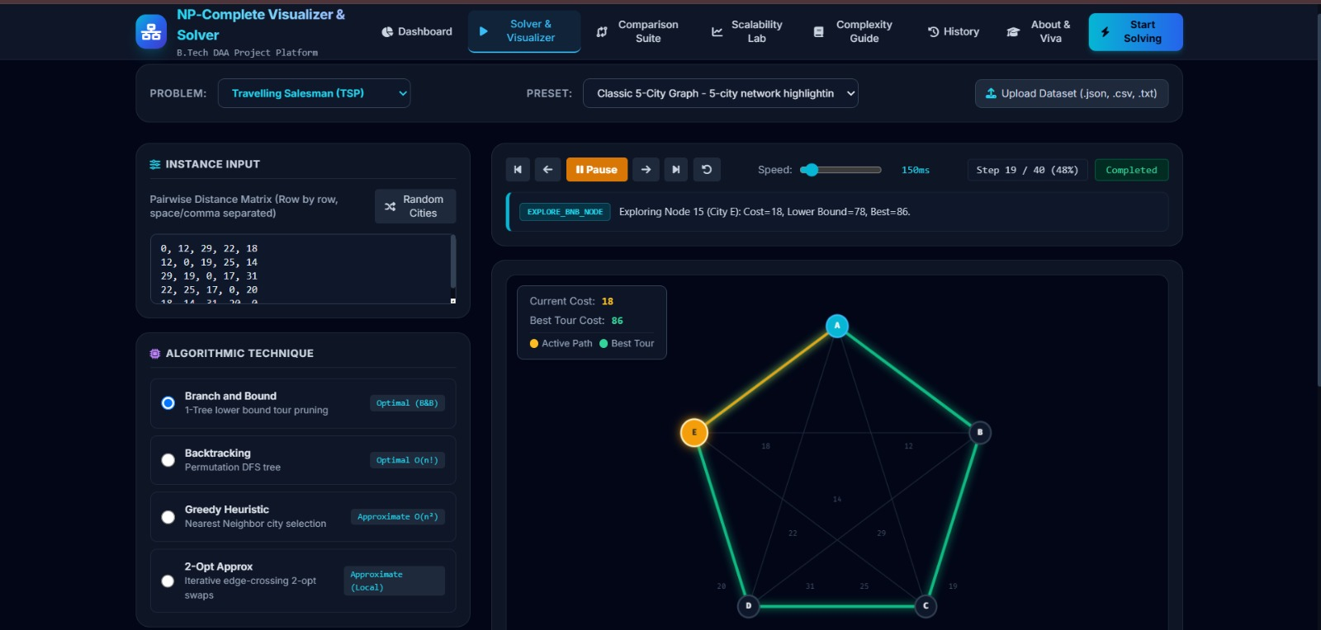
IMPLEMENTTION

Slide 14
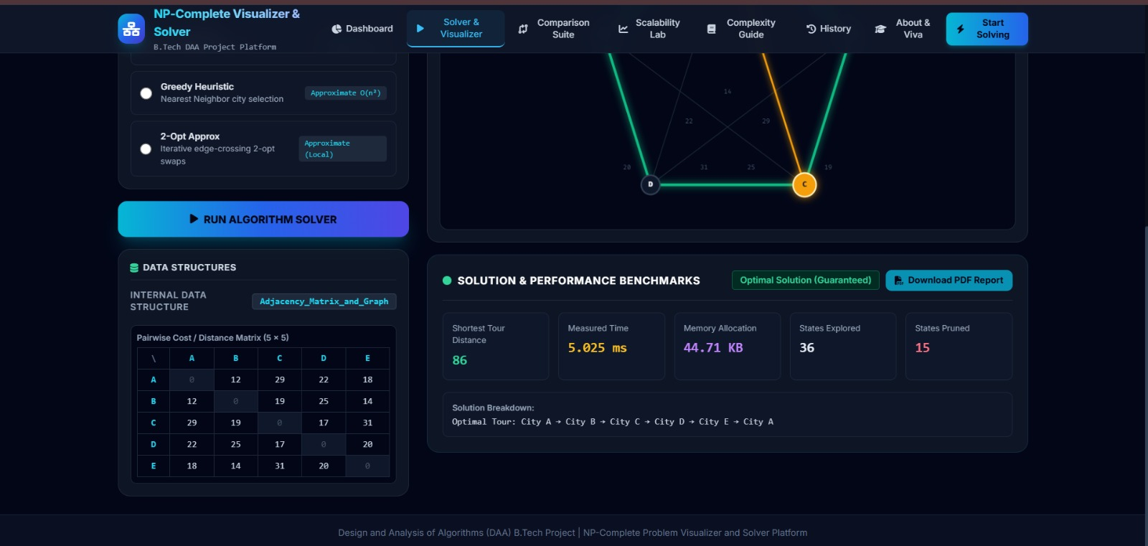
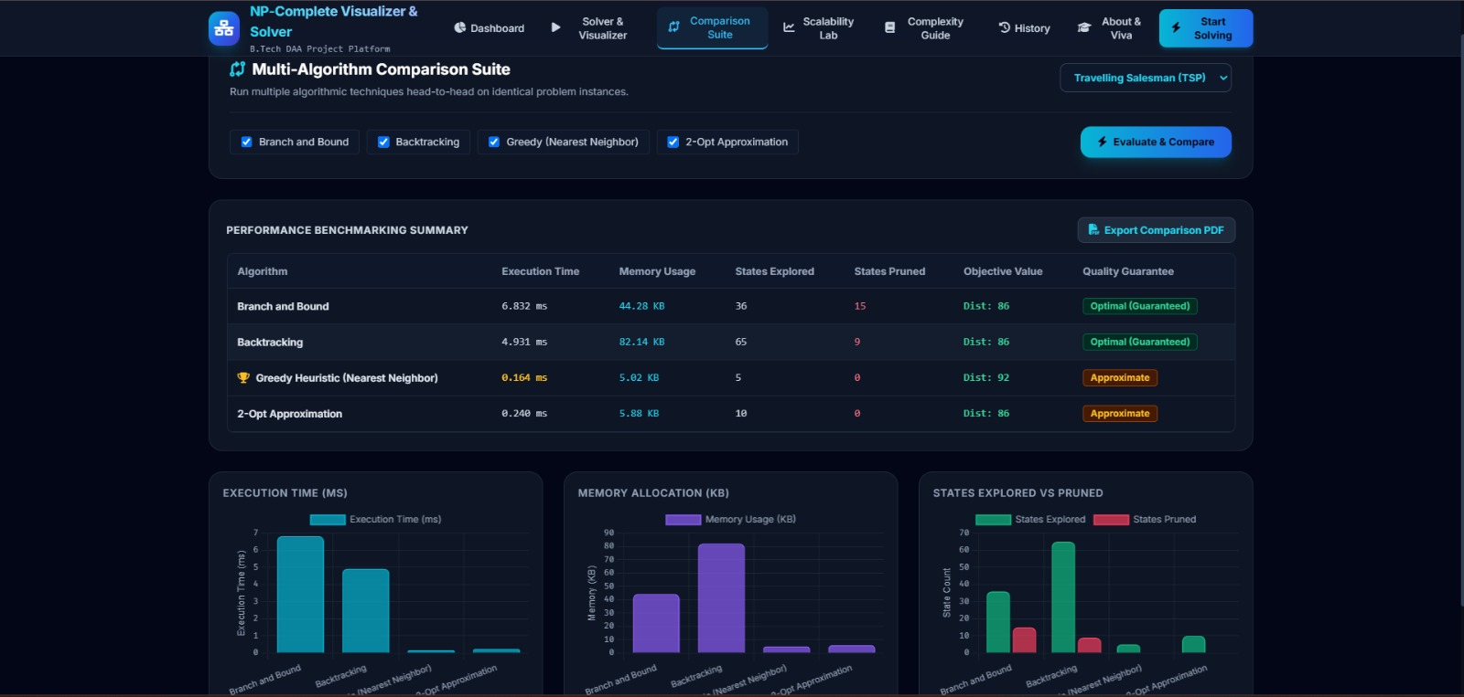

Slide 15
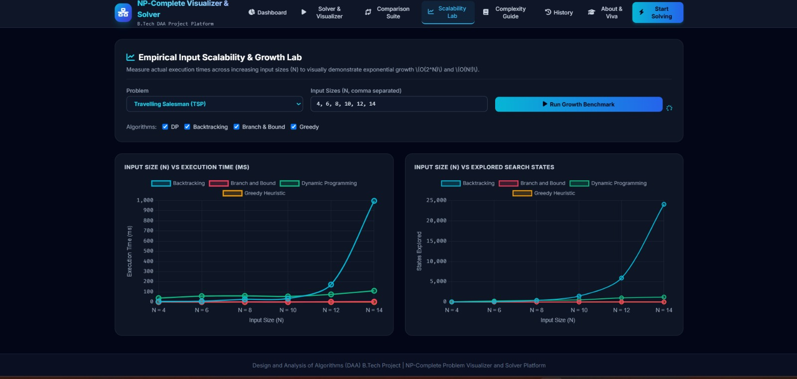
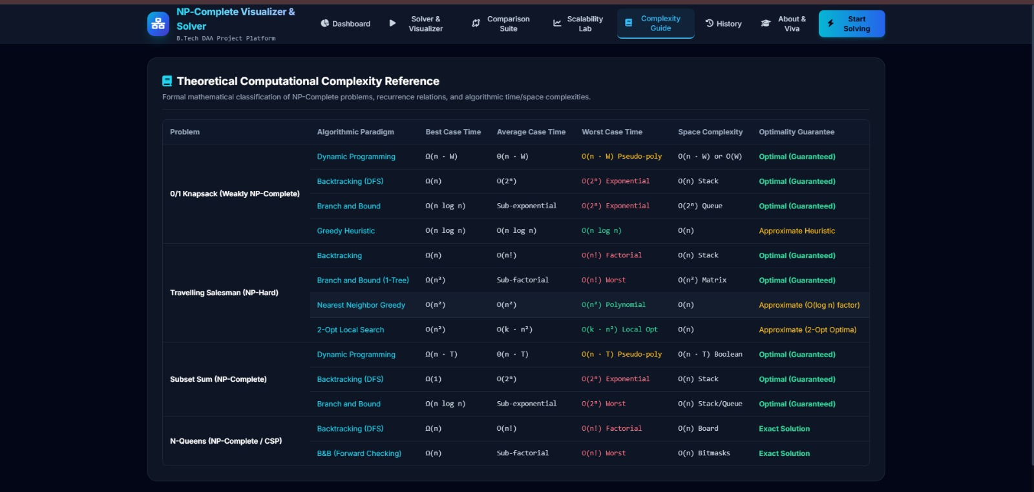

Slide 16
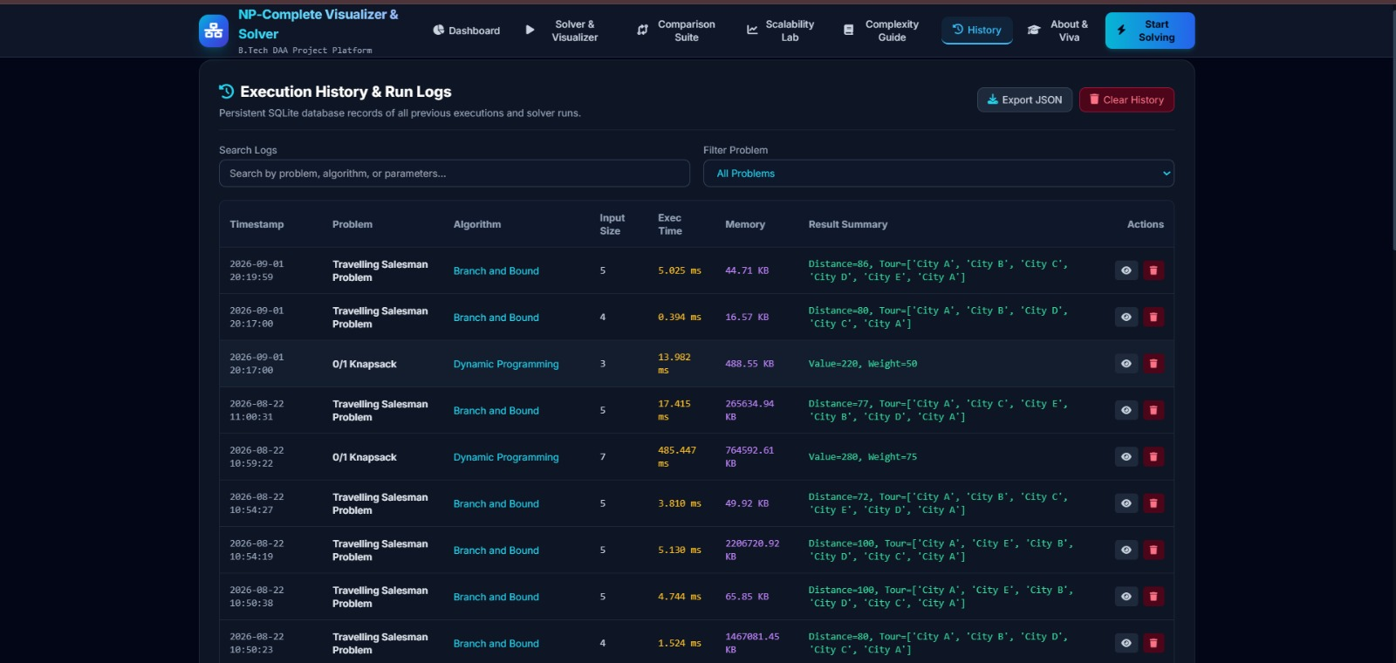

Slide 17
CONCLUSION
Developed an interactive NP-Complete Problem Visualizer and Solver.
Demonstrated efficient implementation using multiple DAA algorithms.
Evaluated execution time, memory consumption, and solution quality.
Improved understanding of complex optimization techniques through visualization.
Provides a scalable platform for research and education.

