Slide 1

Dataset Description
Our "TrashType_Image_Dataset" comprises 3177 files, totalling 62.33 MB, categorizing waste into eight distinct classes, including hazardous, medical waste, cardboard, glass, metal, paper, plastic, and general trash.
This comprehensive dataset offers a detailed perspective on waste recycling, unlike traditional sets, facilitating fine-grained classification critical for streamlining recycling processes and significantly increasing household waste recycling rates.
The dataset's granularity proves instrumental in advancing environmental conservation efforts by enabling effective garbage sorting and enhancing recycling practices.

Slide 2
Objective
Develop and implement a machine learning-based garbage classification system.
Achieve high-precision classification of paper, plastic, glass, metal, cardboard, and non-recyclable trash (Al Duhayyim et al., 2022).
Streamline waste sorting processes to enhance recycling efficiency.
Evaluate and compare the performance of four machine learning models: StandardScaler, Logistic Regression, Random Forest, and KNN.
Identify the most effective model for garbage classification in terms of accuracy and efficiency.
Facilitate sustainable waste management practices through automated garbage classification.
Contribute to environmental conservation by reducing waste sent to landfills and promoting resource recovery.

Slide 3
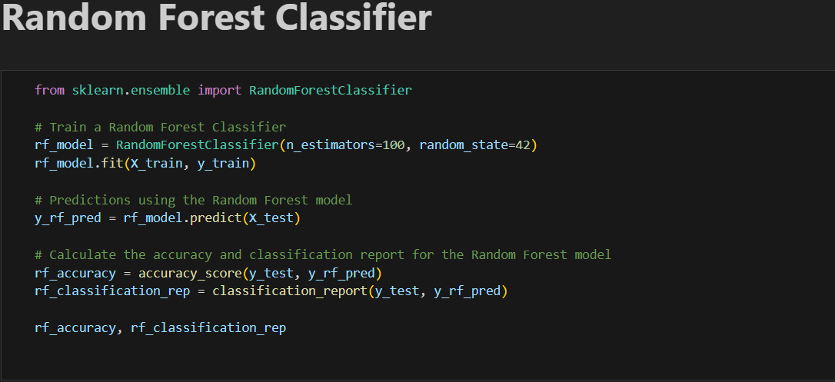
Methodology
In this section, we present the methodology followed for garbage classification using four learning models: StandardScaler, Logistic Regression, Random Forest, and KNN. The objective is to develop an efficient system for classifying different types of garbage, such as paper, cardboard, plastic, metal, trash, and glass.
Data Preparation
Exploratory Data Analysis
Splitting Dataset
Model Evaluation
Accuracy Comparison

Slide 4
Results
In summary, the results demonstrate that Model 2 (Random Forest Classifier) outperformed the other models, achieving the highest accuracy for most categories.
Therefore, for the task of garbage classification, Model 2 (Random Forest Classifier) appears to be the most effective and robust solution, offering a reliable and accurate system for automated waste sorting (Ahmed et al., 2023).
Model | Overall Accuracy
StandardScaler | 63.34%
Random Forest Classifier | 73.11%
Logistic Regression | 62.26%
KNN | 64.46%

Slide 5
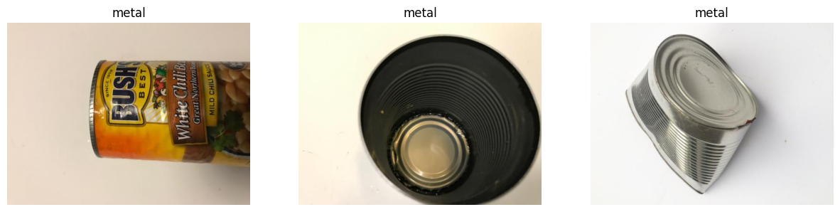
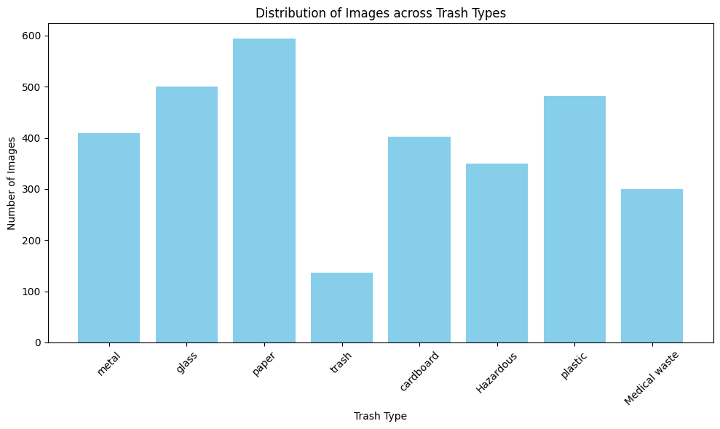
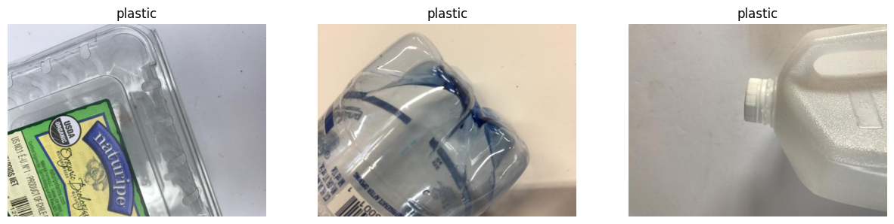
Outcomes

Slide 6
Discussion
The primary objective of this study was to develop a robust system for classifying garbage into distinct categories, such as paper, cardboard, plastic, metal, glass, and trash etc. The four machine learning models, StandardScaler, Logistic Regression, Random Forest Classifier, and KNN were trained and evaluated for this task.
Model Performance:
Model 2 (Random Forest Classifier) emerged as the top performer, achieving the highest categorical accuracy of 73.11%. It also exhibited excellent performance on most categories, making it a reliable solution for waste classification.

Slide 7
Conclusion
In conclusion, the application of machine learning models in garbage classification presents a promising and innovative solution for waste management.
The study's exploration of four different models, StandardScaler, Logistic Regression, Random Forest, and KNN, has yielded valuable insights into their performance and potential impact on waste sorting processes
Model Complexity: StandardScaler (Model 1) stood out as the most lightweight and efficient model, making it suitable for deployment on resource-constrained devices. It provided good performance with relatively fewer parameters.

Slide 8
Reference
Ahmed, M. I. B., Alotaibi, R. B., Al-Qahtani, R. A., Al-Qahtani, R. S., Al-Hetela, S. S., Al-Matar, K. A., ... & Krishnasamy, G. (2023). Deep Learning Approach to Recyclable Products Classification: Towards Sustainable Waste Management. Sustainability, 15(14), 11138. https://www.mdpi.com/2071-1050/15/14/11138
Al Duhayyim, M., Mohamed, H. G., Aljebreen, M., Nour, M. K., Mohamed, A., Abdelmageed, A. A., ... & Mohammed, G. P. (2022). Artificial Ecosystem-Based Optimization with an Improved Deep Learning Model for IoT-Assisted Sustainable Waste Management. Sustainability, 14(18), 11704. https://www.mdpi.com/2071-1050/14/18/11704

Slide 9
THANK YOU

