Slide 1
RAINFALL PREDICTION USING MACHINE LEARNING
Team Members:
Sai Krishna Reddy Chevutukur 700743830
Dinesh Gummadidala 700741247
Bhanu Prakash Reddy Gangu 700733069
Namburi Venkata Gopala Krishna Swamy 700719027

Slide 2
Role/Responsibilities and Contribution in Project
Description: Researching the data and Identification of Proper Dataset as well as working on the Logistic Regression.
Person Assigned: Sai Krishna Reddy Chevutukur
Description: Choosing a Proper Machine Learning model which helps to predict the most accurate prediction result based on the chosen dataset.
Person Assigned: Bhanu Prakash Reddy Gangu
Description: Verifying the best accuracy of predicted model with other models.
Person Assigned: Dinesh Gummadidala
Description: Working on Documentation and contributing in coding.
Person Assigned: Namburi Venkata Gopala Krishna Swamy

Slide 3
INTRODUCTION
Predicting the amount of rainfall is one of the most challenging endeavors possible since it is very unpredictable and has far-reaching repercussions for human civilization.
It is essential to have an accurate method of forecasting rainfall due to the strong correlation that exists between precipitation and potentially catastrophic natural events including landslides, flooding, mass movements, and avalanches.
The goal of this work is to offer the entirety of the machine learning life cycle, beginning with the preparation of the data and finishing with the implementation and assessment of the model.

Slide 4
MOTIVATION
The primary objective is to detect patterns and associations in the data in order to gain access to hidden but potentially useful information.
Rainfall is the most important climatic event because it sustains human life. Its regularity and amount on multiple scales are crucial to the survival of human civilization.
To predict the occurrence of rainfall, to explore its seasonal variability, and to forecast annual amount of rain over some geographical area, numerous probability models have been attempted.

Slide 5
Objectives
This research presents a series of studies that employ popular machine learning methods to construct algorithms that predict whether or not it will rain the next day in major Australian cities, given meteorological data for the day in question.
It is common knowledge that precipitation has an effect on a wide variety of economic sectors, including agriculture, construction, the generation of electricity, forestry, and even tourism.

Slide 6
Related Work
This research presents a logistic Regression-based rainfall forecast model for use with the Indian dataset (MLR).
Logistic Regression, Neural Networks, Random Forest, Naive Bayes, and other machine learning models are used to forecast precipitation.
This study demonstrates how to estimate rainfall using logistic regression as well as neural networks, as well as how to select crops using the Decision Trees technique.
Precipitation forecasting and estimating are achieved by the use of a combination of factual processes and machine learning techniques.

Slide 7
PROBLEM STATEMENT
Due to the intricacy of atmospheric processes that create rainfall.
The huge variety of variations across a wide range of scales in space and time.
Rainfall is among the most complicated and challenging parts of the hydrological cycle to comprehend and analyze.

Slide 8
PROPOSED FRAMEWORK
Logistic regression
Neural Networks
Decision Tree
Random Forest
Extreme Gradient Boosting

Slide 9
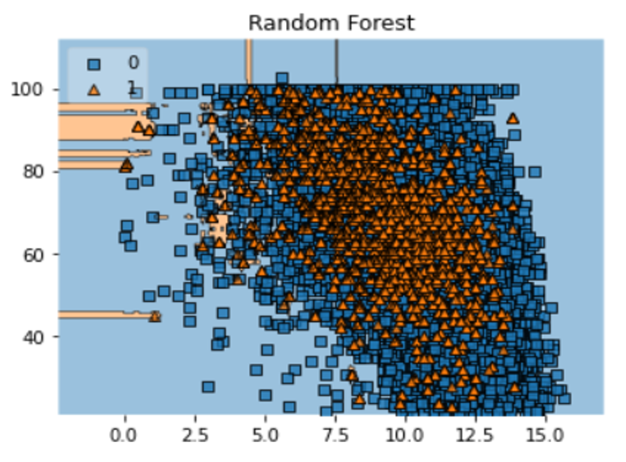
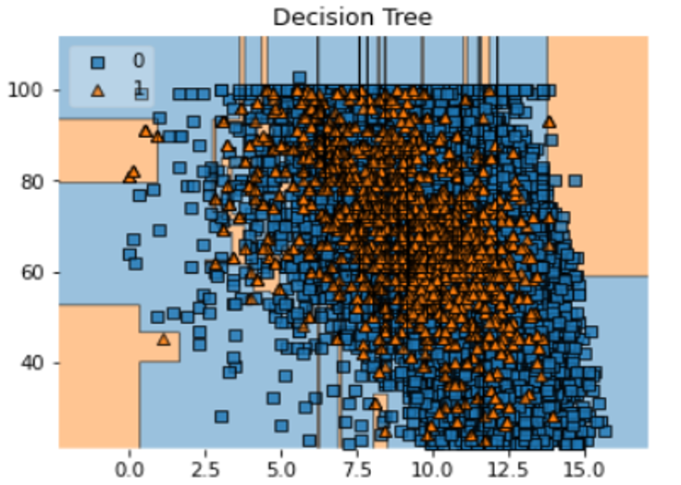
RESULTS/SIMULATION

Slide 10
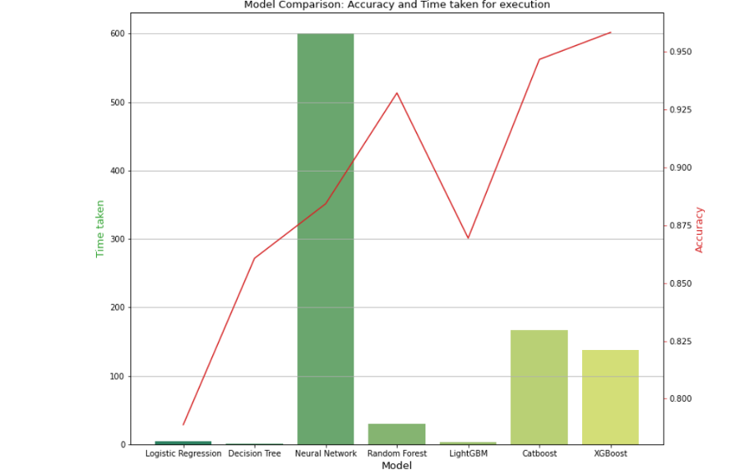
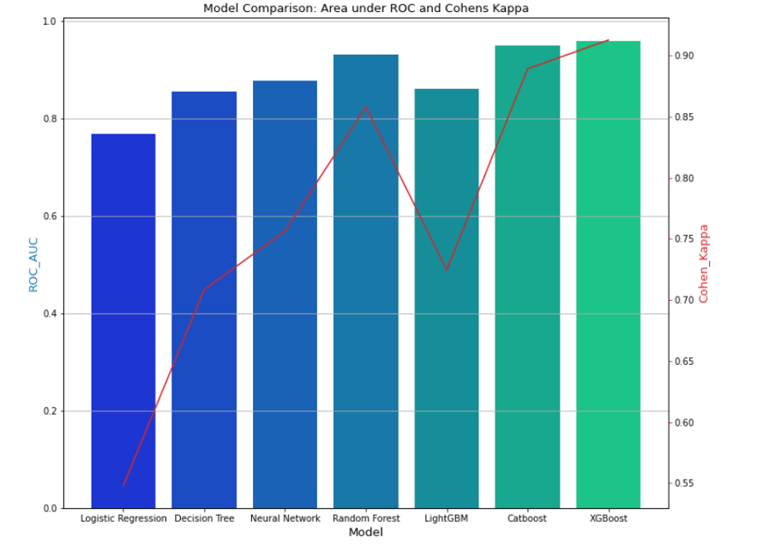
RESULTS/SIMULATION

Slide 11
REFERENCES
[1] Schultz, M.G., Betancourt, C., Gong, B., Kleinert, F., Langguth, M., Leufen, L.H., Mozaffari, A. and Stadtler, S., 2021. Can deep learning beat numerical weather prediction?. Philosophical Transactions of the Royal Society A, 379(2194), p.20200097.
[2] Van Klompenburg, T., Kassahun, A. and Catal, C., 2020. Crop yield prediction using machine learning: A systematic literature review. Computers and Electronics in Agriculture, 177, p.105709.
[3] Kashinath, K., Mustafa, M., Albert, A., Wu, J.L., Jiang, C., Esmaeilzadeh, S., Azizzadenesheli, K., Wang, R., Chattopadhyay, A., Singh, A. and Manepalli, A., 2021. Physics-informed machine learning: case studies for weather and climate modelling. Philosophical Transactions of the Royal Society A, 379(2194), p.20200093.
[4] Akhter, M.N., Mekhilef, S., Mokhlis, H. and Mohamed Shah, N., 2019. Review on forecasting of photovoltaic power generation based on machine learning and metaheuristic techniques. IET Renewable Power Generation, 13(7), pp.1009-1023.

Slide 12
THANK YOU !

