Slide 1
Azure Banking Data Platform
Presented by : BATHULA BHANU PRASAD
Role : Data Engineer

Slide 2

End-to-End Enterprise Project Overview
Project Purpose: To modernize the bank’s data infrastructure using Azure Cloud for real-time analytics, fraud detection, and regulatory reporting.
Technologies Used: Azure Functions, ADLS Gen2, Cosmos DB, Databricks, Event Grid, Service Bus, Azure SQL, Python, PySpark, and CI/CD automation via GitHub Actions.
Key Outcomes: Unified data view, real-time risk mitigation, Customer 360 insights, compliance automation, and enterprise-grade security.
Notes:
This presentation introduces the Azure Banking Data Platform – a comprehensive modernization initiative for a financial institution. The project integrates multiple Azure services to create a unified, secure, and intelligent data ecosystem.
Over the next few slides, we’ll explore how this solution enables real-time fraud detection, enhances customer analytics through a 360-degree view, and ensures regulatory compliance using scalable data engineering principles.
It’s an enterprise-level implementation showcasing how Azure technologies, combined with Python and PySpark, can transform traditional banking data operations into an advanced analytics powerhouse.

Slide 3




Project Objectives & Business Outcomes
Transforming Banking through Data Modernization
Unified Data View
Integrate ATM and UPI data into a single Azure-based data ecosystem for holistic visibility.
Real-Time Fraud Detection
Leverage event-driven architectures and Azure Functions to detect and mitigate suspicious transactions instantly.
Customer 360 Insights
Develop a comprehensive view of each customer to enhance engagement, predict churn, and personalize offers.
Regulatory Compliance
Automate data warehousing and reporting pipelines to meet RBI and financial compliance standards efficiently.
Notes:
This slide outlines the key business goals driving the modernization initiative. The vision is to enable a unified and intelligent banking ecosystem that ensures both customer satisfaction and regulatory integrity.
By leveraging Azure’s scalability and advanced analytics capabilities, the project achieves operational transparency and agility. It delivers immediate fraud detection, deep customer insights, and a strong compliance backbone — setting a benchmark for digital banking transformation.

Slide 4
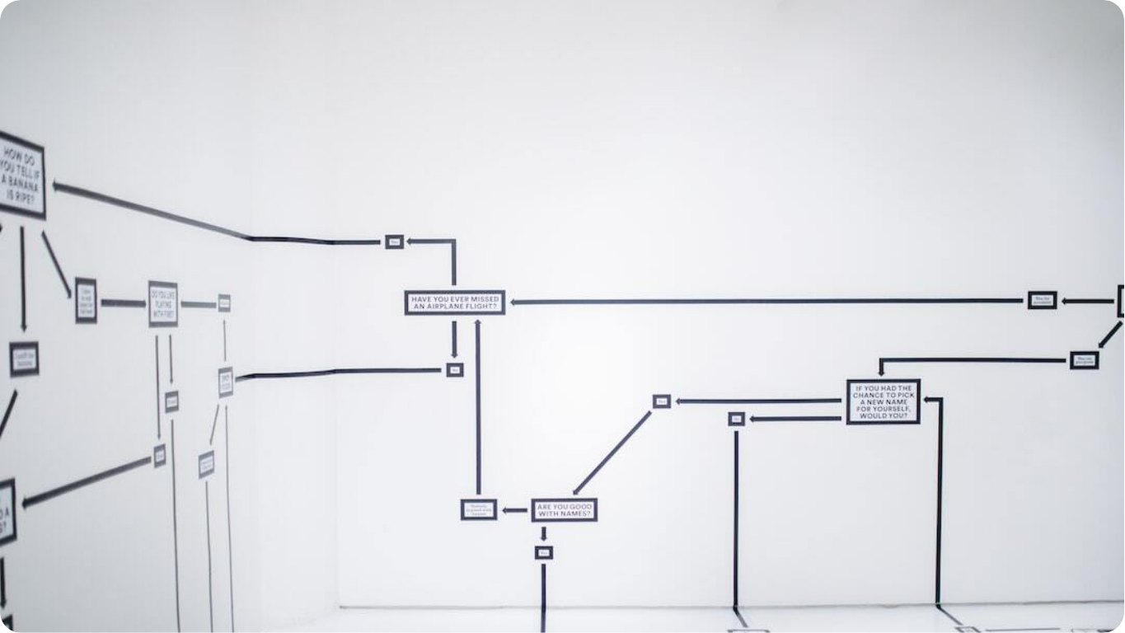
Architecture Overview
Batch Data Processing
Event-Driven Design: Uses Azure Event Grid and Service Bus for asynchronous ingestion of high-volume banking transactions.
Unified Analytics Layer: Azure Databricks and Power BI serve as the unified analytical layer combining historical and real-time insights.
Notes:
The platform’s foundation lies in the Lambda architecture — a hybrid design that combines batch and real-time data flows. This model ensures that high-volume banking transactions can be processed with minimal latency while maintaining data consistency.
Azure Event Grid and Service Bus enable efficient event-driven communication, while Azure Functions handle ingestion and transformation in real-time. The architecture ensures a secure and scalable framework capable of supporting critical workloads such as fraud detection and customer analytics.

Slide 5

Data Ingestion Layer
Batch Data Flow Integration
Real-Time Streams: Ingests ATM and UPI events through Azure Event Grid and Service Bus for immediate availability.
Batch Data Loads: Processes daily core banking extracts and KYC data using ADLS Gen2 and Azure Data Factory.
Validation and Transformation: Python Azure Functions perform schema validation, de-duplication, and enrichment before data persistence.
Notes:
The data ingestion layer is where raw information from various banking channels first enters the platform. Real-time ingestion uses Azure Event Grid and Service Bus to handle thousands of transactions per second, while batch ingestion brings in larger historical and master datasets.
Azure Functions written in Python perform early validation and enrichment, ensuring only clean and structured data moves downstream. This foundation supports not just analytics, but also operational resilience and security through integrated network firewalls.

Slide 6
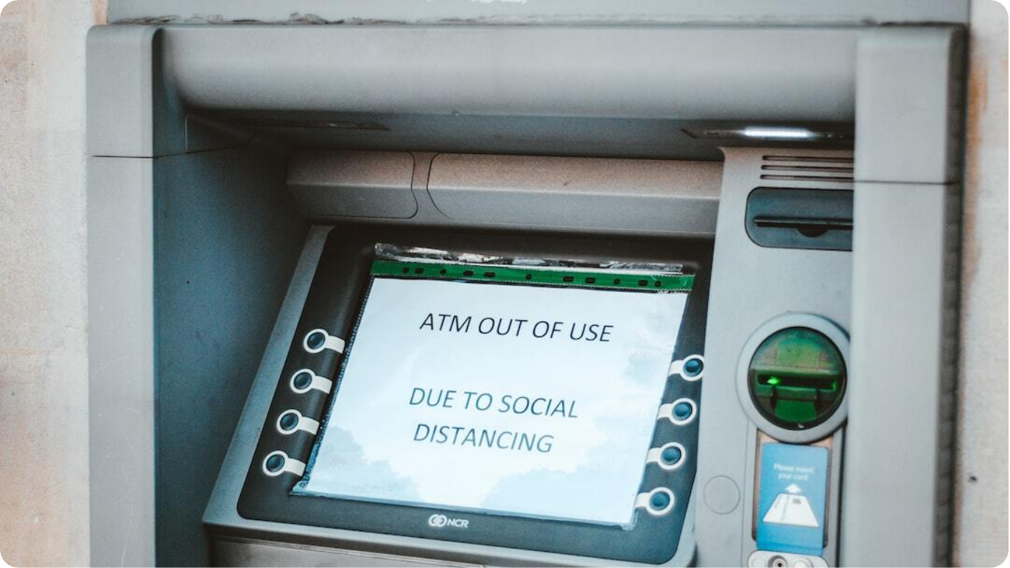
Source Systems Integration
ATM, UPI and Core Banking Data Feeds
Real-Time Channels: ATM withdrawal logs and UPI debit/credit events streamed for instant visibility.
Batch Data Sources: Core banking system daily extracts, account master updates, and KYC document storage pipelines.
Hybrid Integration Model: Combines asynchronous event-driven ingestion with scheduled batch pipelines for complete data coverage.
Business Continuity: Redundant source connectivity and message retries ensure zero data loss across ingestion workflows.
Notes:
The platform ingests information from diverse banking sources — real-time transactional streams and batch-based enterprise systems. Real-time data includes ATM and UPI transactions, while batch processes handle daily core banking extracts and KYC documentation.
This hybrid design provides both immediacy for operational analytics and completeness for regulatory reporting. Through redundancy and retry mechanisms, the ingestion system ensures reliability even under peak banking loads.

Slide 7

Event-Driven Ingestion Framework
Azure Event Grid and Service Bus for High-Volume Processing
Asynchronous Data Capture: Azure Event Grid triggers ingestion workflows immediately when new files or events are created in storage.
High-Throughput Queues: Azure Service Bus manages transaction-heavy queues ensuring ordered and reliable message delivery.
Automated Routing: Ingestion events are intelligently routed to processing functions or storage queues for scaling efficiency.
Scalability: Event-driven design allows the system to automatically scale to millions of transactions with minimal latency.
Notes:
Azure’s event-driven architecture ensures that every new piece of data — whether a file upload or transaction — is captured instantly. Event Grid orchestrates the process, triggering downstream actions automatically.
Service Bus acts as a high-performance backbone, maintaining reliability and ordering across thousands of parallel ingestion flows. This asynchronous architecture provides near real-time responsiveness and elasticity during transaction spikes.

Slide 8



Azure Functions for Data Transformation
Python-Based ETL and Validation Workflows
Event-Triggered Processing
Functions execute automatically upon new event messages, enabling continuous ingestion without manual intervention.
Data Validation
Schema integrity, missing value checks, and duplicate detection ensure data quality before storage.
Transformation Logic
Implements rule-based classification and suspicious transaction flagging for fraud detection.
Integration with Storage
Validated and transformed data is pushed to Cosmos DB for downstream analytics.
Notes:
Azure Functions form the intelligent backbone of this data platform. Written in Python, these lightweight serverless components handle ingestion, validation, and transformation automatically whenever new data arrives.
The functions are designed to classify and enrich transactional data, detect anomalies, and maintain high data integrity. Once validated, the refined data flows seamlessly into Cosmos DB or ADLS for analytics — forming the foundation for downstream data science and fraud monitoring pipelines.

Slide 9

Cosmos DB Operational Store
Low-Latency Database for Banking Transactions
NoSQL Architecture: Stores transactional and account data in partitioned collections for high scalability and fast lookups.
Collections Design: ATMTransactions, UPIEvents, and FraudAlerts collections optimized by TransactionID.
High Availability: Offers global replication, ensuring consistent read/write access with minimal latency.
Integration Layer: Feeds real-time applications, fraud detection functions, and the analytical warehouse.
Notes:
Cosmos DB serves as the operational backbone of the platform, providing ultra-low-latency reads and writes across globally distributed data centers. Each collection—whether for transactions, alerts, or customer profiles—is designed for optimal performance using partitioning strategies that align with access patterns.
This store not only powers real-time dashboards and API calls but also feeds the analytical layers for deeper insights and predictive modeling.

Slide 10

PySpark Data Cleaning Pipeline
Data Refinement
Ingestion from Raw Sources: Reads raw data from Cosmos DB and ADLS containers containing ATM, UPI, and customer datasets.
Data Normalization: Standardizes currency, timestamps, and schema fields across different transaction types.
Merging and Consolidation: Unifies data streams into a Fact_Transactions dataset stored in Bronze, Silver, and Gold layers.
ETL Scalability: PySpark enables distributed processing and efficient handling of millions of transactions daily.
Notes:
The PySpark pipeline forms the heart of the data transformation layer. It ingests raw, semi-structured data from Cosmos DB and Azure Data Lake Storage and then cleans, normalizes, and merges it.
By structuring data into Bronze, Silver, and Gold Delta Lake layers, the system supports iterative data refinement and reliable analytics. This design ensures enterprise scalability and quality control for downstream BI and ML workloads.

Slide 11

Data Warehouse Design – Star Schema
Optimized Model for Banking Analytics
Dimensional Modeling: Implements a classic Star Schema with dimensions for Customer, Account, Branch, Product, and Date.
Fact Tables: Central facts include transactions, fraud events, and customer activity for BI and compliance analytics.
ETL Automation: PySpark ETL pipelines load data from Delta layers into Azure SQL using MERGE/UPSERT operations.
Business Intelligence Foundation: Serves as the single source of truth for Power BI dashboards and regulatory reports.
Notes:
The analytical data warehouse leverages a Star Schema for simplicity and high performance in reporting. With dimension tables like Customer and Product, and fact tables such as Transactions and Fraud Detection, analysts can slice and dice data across multiple perspectives.
This layer provides the foundation for Power BI reporting and compliance analytics, ensuring data consistency, auditability, and fast query performance.

Slide 12


ETL Pipeline Logic
PySpark Integration for Reliable Data Flows
Load and Merge Operations
PySpark jobs load data from Silver layer and perform MERGE/UPSERT into fact and dimension tables.
Orchestration
ETL pipelines are orchestrated through Azure Data Factory and scheduled via Azure Functions.
Data Quality Enforcement
Automated validation ensures referential integrity and schema consistency before loading.
Notes:
The ETL pipeline automates the movement and transformation of data from raw to refined states. PySpark leverages the Delta Lake format for reliability and consistency, ensuring every operation adheres to ACID principles.
Incremental updates are applied using efficient MERGE/UPSERT operations into dimension and fact tables within the Azure Synapse warehouse. With orchestration managed by Azure Data Factory and Functions, the system ensures end-to-end automation and traceability.

Slide 13

Real-Time Fraud Detection
Event-Driven Anomaly Detection with Azure Functions
Event Triggers: High-value transactions (e.g., ₹50,000+) trigger immediate fraud analysis via Event Grid.
Anomaly Detection: Azure Functions apply rule-based logic to identify suspicious behaviors such as location anomalies or rapid withdrawals.
Alert and Action: Fraud alerts are stored in Cosmos DB and trigger customer notifications via Service Bus.
Response Time: Alerts are generated in near real-time, ensuring rapid risk mitigation and customer protection.
Notes:
Fraud detection is one of the most critical use cases in this banking data platform. Using Azure Event Grid and Functions, every high-value or unusual transaction triggers an automated anomaly check.
The system correlates transaction data with location, device, and behavioral patterns to identify potential risks. Once an anomaly is confirmed, an alert is written to Cosmos DB and customer notifications are dispatched via Service Bus — all in seconds.

Slide 14




Project Challenges
Key Obstacles in Building the Azure Banking Data Platform
Integration Complexity
Coordinating event-driven services (Event Grid, Service Bus, Functions) and data layers (Cosmos DB, Azure SQL) required careful dependency orchestration.
Data Quality Issues
Inconsistent schemas and data types across ATM, UPI, and core banking systems demanded dynamic validation and cleansing logic.
Security Configuration
Implementing VNet isolation, firewall rules, and role-based access controls without disrupting pipelines posed major challenges.
Performance Optimization
Tuning PySpark clusters and scaling event ingestion pipelines to handle millions of transactions daily required advanced optimization.
Notes:
Security is paramount in the banking domain, and this architecture embeds protection at every layer. All traffic passes through controlled firewalls — either Juniper vSRX or Azure Firewall — ensuring strict perimeter defense.
By applying Banking Zone segmentation, the platform limits access to essential subnets only. Private Endpoints further isolate data services like Synapse and Cosmos DB, ensuring that no data ever leaves the secured virtual network. Continuous monitoring and egress inspection safeguard against data breaches or unauthorized transfers.

Slide 15

CI/CD Pipeline Automation
GitHub Actions for Continuous Delivery
Automated Deployments: Implements GitOps-driven CI/CD for Functions, PySpark notebooks, and SQL schema migrations.
Version Control Integration: Source code managed in GitHub with automated build.
Notes:
Automation is key to modern data platform operations. The project employs GitHub Actions and Azure DevOps to build, test, and deploy all components — from Azure Functions to Synapse SQL schemas — in a fully automated fashion.
Using Infrastructure as Code ensures consistency across environments, while Blue/Green deployments minimize service disruption. This DevOps integration accelerates release cycles and reduces human error in deployment processes.

Slide 16
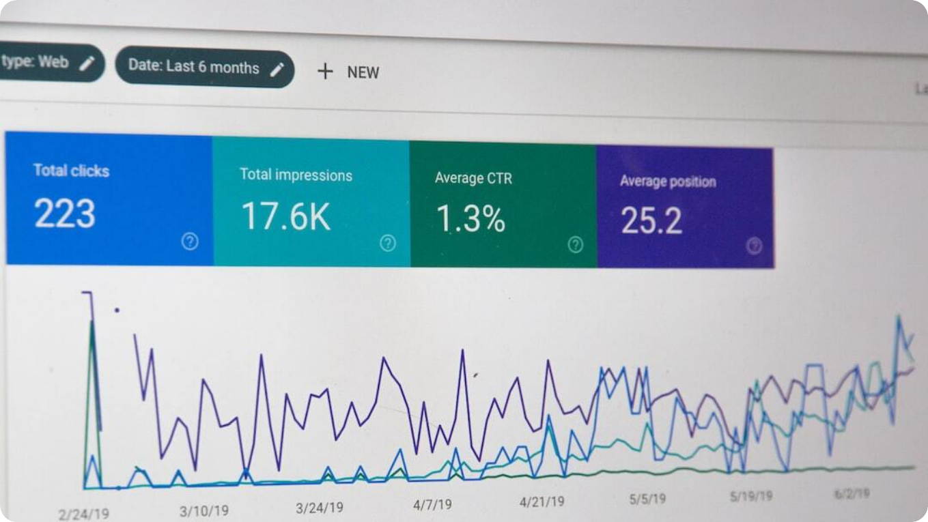
Customer 360 Analytics
Unified View of Customer Behavior and Risk
Data Consolidation: Combines transactions, demographics, and device data into a unified customer profile.
Comprehensive Insights: Analyzes spending patterns, credit exposure, and engagement trends to enable personalized offers.
Risk Scoring: Calculates fraud and risk scores using behavioral and transactional analytics.
Data Sources: Integrates FactTransactions and DimCustomer from SQL and Cosmos DB.
Notes:
The Customer 360 module provides a complete, data-driven view of each customer. It merges data from multiple sources — including transactions, demographics, and device logs — to deliver a real-time analytical portrait.
This enables the bank to predict churn, detect fraud, and personalize product recommendations. By integrating data from both operational (Cosmos DB) and analytical (Synapse SQL) systems, the organization gains actionable insights that directly improve customer experience and risk management.

Slide 17

Power BI Dashboards
Real-Time Banking Insights and Compliance Reports
Branch Performance: Visualizes key performance metrics such as transaction volume, revenue, and customer growth.
Fraud Analytics: Monitors alert types, response time, and fraud losses in real-time dashboards.
Channel Analysis: Analyzes ATM and UPI usage trends across geographic and time dimensions.
Regulatory Reporting: Automates RBI compliance dashboards with data sourced from SQL and Cosmos DB layers.
Notes:
Power BI dashboards transform the underlying data into actionable visual insights for all stakeholders. Executives can track branch and channel performance, compliance officers can monitor RBI reporting, and risk teams can evaluate fraud metrics in real-time.
This suite of dashboards forms the analytical front-end of the platform, making it possible to translate complex data pipelines into accessible, decision-ready intelligence.

Slide 18


End-to-End Demo Scenario
Validating the Complete Banking Data Flow
Ingestion Simulation
Uploading ATM transaction CSV triggers Event Grid, which invokes an Azure Function for processing.
Transformation & Storage
PySpark pipeline cleanses and loads the data into Cosmos DB and Azure SQL.
Visualization
Power BI dashboards automatically refresh with updated transaction metrics and fraud alerts.
Real-Time Alerting
High-value suspicious transactions trigger instant notifications through Service Bus.
Notes:
The end-to-end demo brings all platform components together. When a new ATM transaction file is uploaded, Event Grid immediately triggers Azure Functions to validate and process it. The cleaned data flows through PySpark pipelines into Cosmos DB and Synapse SQL.
Within seconds, Power BI dashboards refresh with new metrics while any suspicious transactions automatically generate fraud alerts and notifications. This seamless automation demonstrates the platform’s real-world readiness and reliability.

Slide 19

Final Platform Capabilities
Comprehensive, Secure, and Scalable Banking Data Solution
Real-Time and Batch Processing: Handles high-throughput event streams and historical batch data with equal efficiency.
Advanced Analytics: Supports fraud detection, Customer 360 insights, and predictive modeling using PySpark and Power BI.
Automation & CI/CD: Fully automated deployments with GitHub Actions ensure rapid, consistent releases.
Enterprise Security: Implements end-to-end encryption, firewall protection, and network isolation for compliance.
Notes:
The completed banking data platform exemplifies enterprise-grade engineering. It seamlessly combines real-time and batch data handling, enabling continuous analytics and operational intelligence.
Automation through CI/CD ensures every deployment is fast and reliable, while built-in network and data security align with strict banking regulations. The result is a resilient and scalable system ready for production environments.

Slide 20

Business Impact & Insights
Transformational Outcomes for the Bank
Operational Efficiency: End-to-end automation reduced manual reporting effort by over 60% and improved data refresh times.
Risk Mitigation: Real-time fraud detection minimized transaction-related losses and improved response speed.
Customer Intelligence: Customer 360 analytics enabled better segmentation, retention, and product cross-selling.
Regulatory Compliance: Automated RBI reporting ensured full adherence to financial and data protection standards.
Notes:
The implementation delivered tangible business value beyond technology enablement. Operational workflows became significantly more efficient, risk exposure was reduced through proactive fraud detection, and customer intelligence reached new levels of personalization.
Moreover, automated compliance reporting reduced regulatory overhead, allowing the bank to focus on innovation and customer satisfaction while maintaining stringent data governance standards.

Slide 21

Conclusion & Next Steps
Building the Future of Data-Driven Banking
End-to-End Modernization: Delivered a robust Azure-based data platform integrating ingestion, processing, analytics, and reporting.
Scalable and Secure: Designed with enterprise security, CI/CD automation, and real-time analytics for future scalability.
Future Roadmap: Integrate machine learning models for predictive credit scoring and customer churn prevention.
Continuous Innovation: The platform establishes a foundation for ongoing digital transformation across all banking domains.
Notes:
This project marks a major milestone in the bank’s digital journey, laying the groundwork for data-driven operations and AI-powered innovation. The Azure Banking Data Platform delivers unmatched agility, visibility, and resilience across all functions.
As the next step, integrating advanced machine learning and predictive analytics will further enhance decision-making and customer experience. With this foundation in place, the bank is now positioned to lead the future of intelligent, secure, and customer-centric financial services.

