Slide 1


Pathly.
By
YOUR individual pathfinder for YOUR Coding Journey

Slide 2


Use Case: Florian
No Prior Experience
Disconnect
Intensive Program
Time Pressure
Stress
Broad Selection
Uncertain about Direction
Fear
Self Doubt

Slide 3
Checklist
Disconnected between old & new skills
Pressure to learn a lot in a short time
Uncertainty about Career Path
Daily Reflection to evaluate personal learning
Flexible & individualized Study Experience, catering to user‘s strengths and preferences
Concrete Job Recommendations based on CV, Daily Progress & Preferences

Slide 4
YOUR Milestone System
Finish YOUR Day
Daily Reflection
Proceed with the next Day
AI collects and saves User Input
Finish YOUR Course
AI evaluates prior inputs & current CV
AI determines YOUR ideal Career & recommendJobs
AI tailors course recommen-dations
Enroll- ment
Employ-ment
Aligned Career Path & Next Step
Strength
Weak-ness
Likes
Dislikes

Slide 5
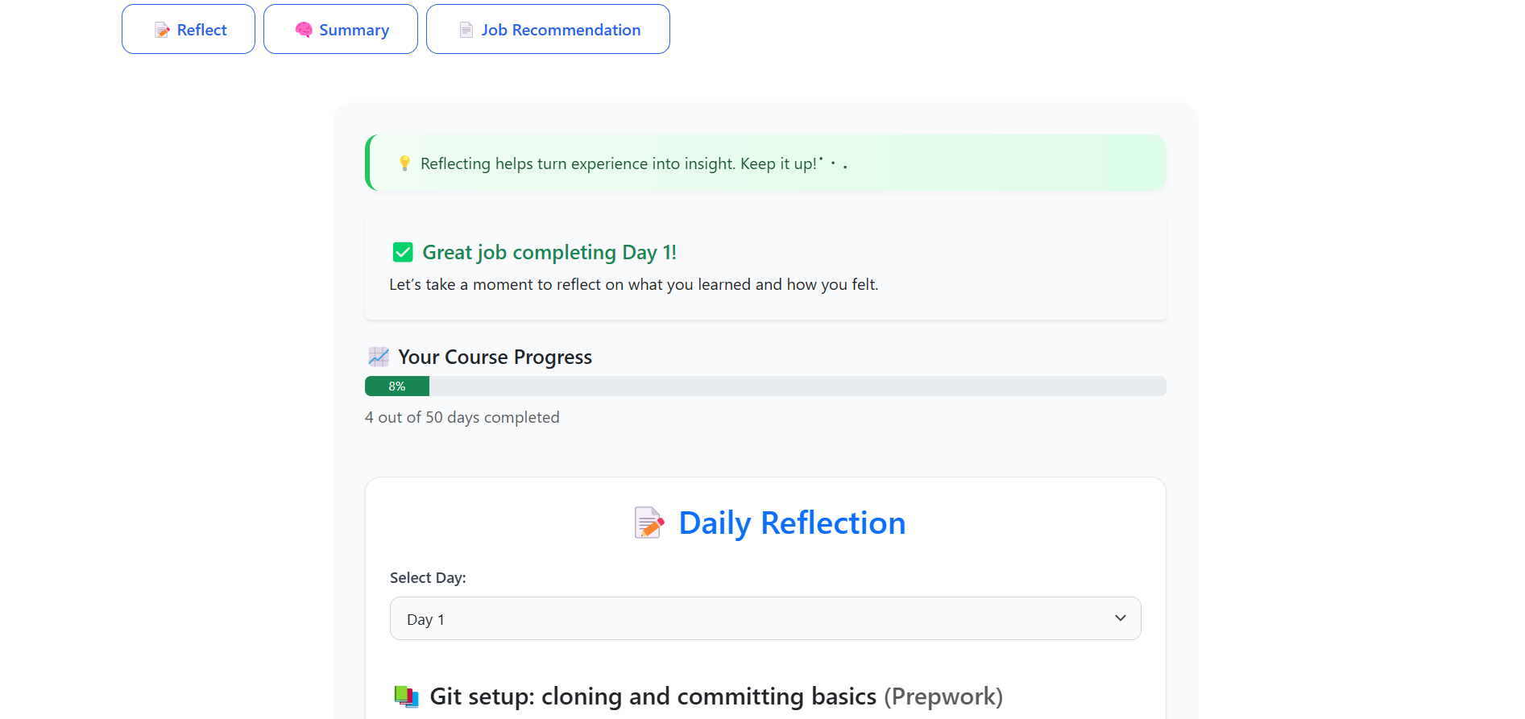

Slide 6
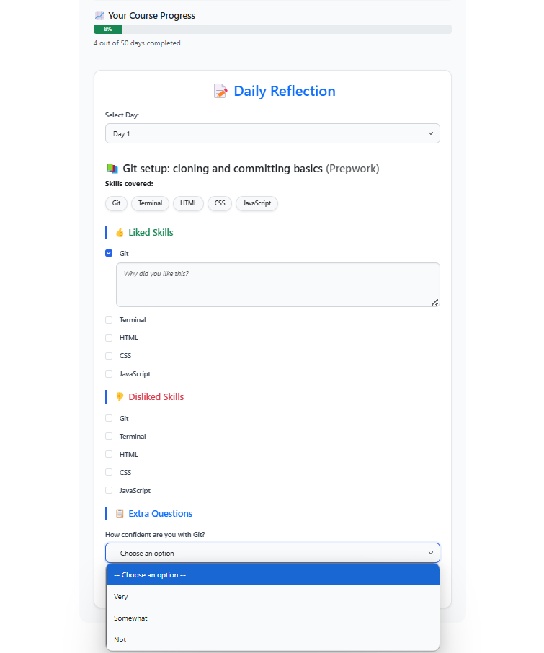

Slide 7
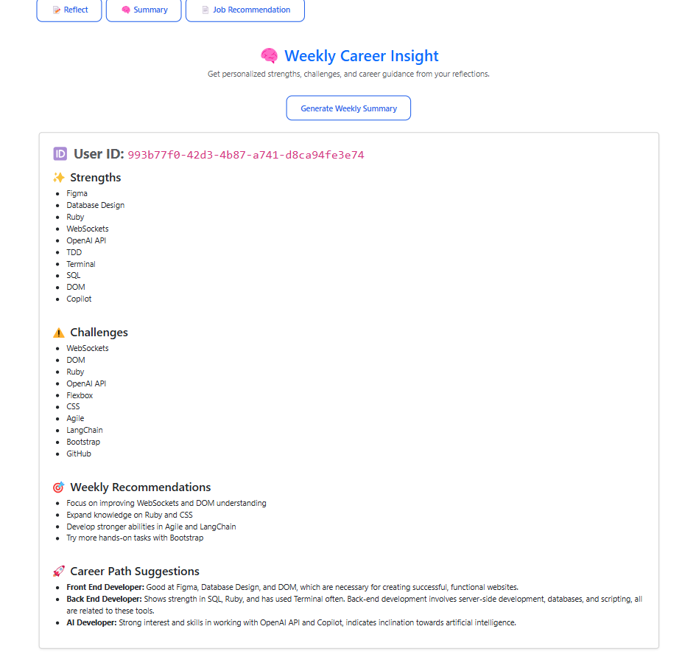

Slide 8
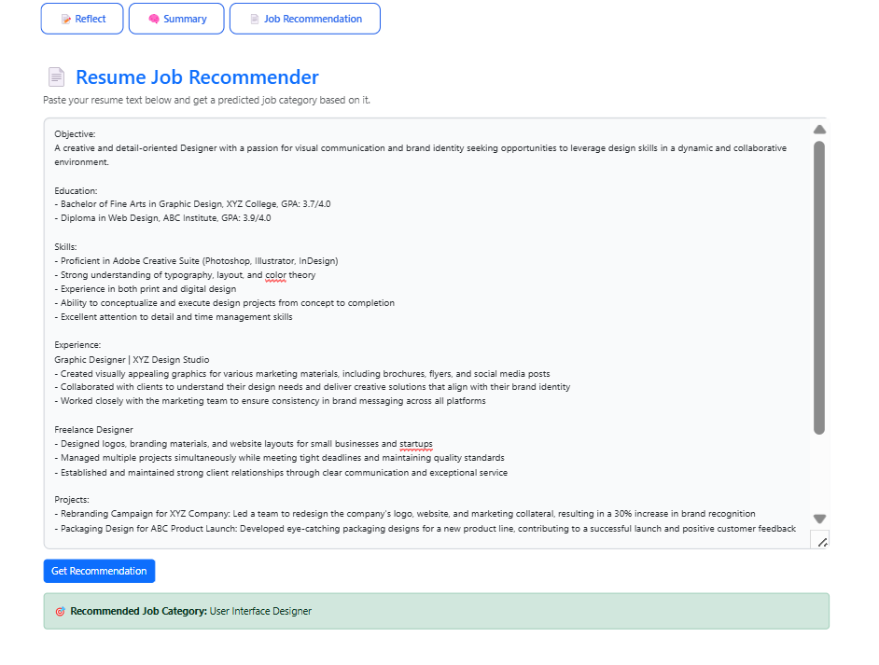

Slide 9
Value Proposition of Pathly.
Feedback & Evaluation Culture
Learning Skills with Clarity
Individual Study Expe-rience
Higher Product Satisfaction
Improved Job Placement Outcomes
Boosted Completion Rate
User Perspective
Business Perspective
Easier Usability for ALL Customers
Market Differen-tiation

Slide 10
Pathly.
By
Team Debug Thugs
Thank YOU for YOUR Time!

