Slide 1


KALLAM HARANADHA REDDY INSTITUTE OF TECHNOLOGY (Autonomous) Approved by AICTE,New Delhi, Permanently Affiliated to JNTUK,Kakinada Department of DCME
Image to Sketch Application using AI
PRESENTED BY:BATCH NO 6 Under the guidance of
M.Prasad Rao
Y.Bhanu Sai (23608-CM-064) (TL)
G.Nanda Kishor (23608-CM-013)
G.Bhaskar (23608-CM-010)
K. Akash (23608-CM-071)

Slide 2
Overview
Abstract
Hardware reqirements
Software reqirements
Benefits & Advantages
RealTime uses
Implementation

Slide 3
ABSTRACT
Image to Sketch Application is a user-friendly tool that transforms regular photos into pencil sketch-style images using basic image processing techniques. Built with Python and OpenCV, it works by converting the image to grayscale, inverting it, applying Gaussian blur, and blending it to create a hand-drawn sketch effect.
This lightweight application is perfect for photo editing, digital art, social media content, and educational use. Users can easily upload an image, view the sketch preview, and download the final result. The project highlights how simple computer vision techniques can be used to create fun and creative tools.

Slide 4
Hardware Reqirements
Personal Computer or Laptop with latest processors,8GB internal storage with 256GB SSD Storage

Slide 5
Software Requirements
Operating System: Windows
Programming Language: Python (latest version preferred)
AI Libraries: TensorFlow ,Streamlit
Image Processing Library: OpenCV
Numerical Computation: NumPy
AI Model :sketch.onnx
IDE/Code Editor: VS Code,Andriod Studio(for App Development)
Package Manager: pip or Anaconda (to install Python libraries)

Slide 6
Benefits &Advantages
Why should I use and in which situations should I use this app..?
Converts Photos to Art Instantly
Works Fast & Offline
Educational Value: Learn AI + Image Processing
Offline Access without internet
Realtime use for instant convertion of images
Free and no ads
In which situation should I use..?
Mainly helpful for news channels for visualizing the crime or other activities.
Live or video calls for unknown person when we don’t want to show our actual identity.
Used for social media content creation(Trending).
Law Enforcement / Forensics -Creating suspect sketches from images or converting CCTV shots into sketch-like visuals.

Slide 7
What if this system does not exist..?
Lack of Free, Offline Sketch Tools
Privacy Concerns about image security
No Real-Time Live Sketching
Missed AI Educational Opportunities
Increased Cost for Creatives and ads
Lost Digital Creativity for Non-Artists
No Affordable Alternative to Paid Tools

Slide 8
Implementation

Slide 9
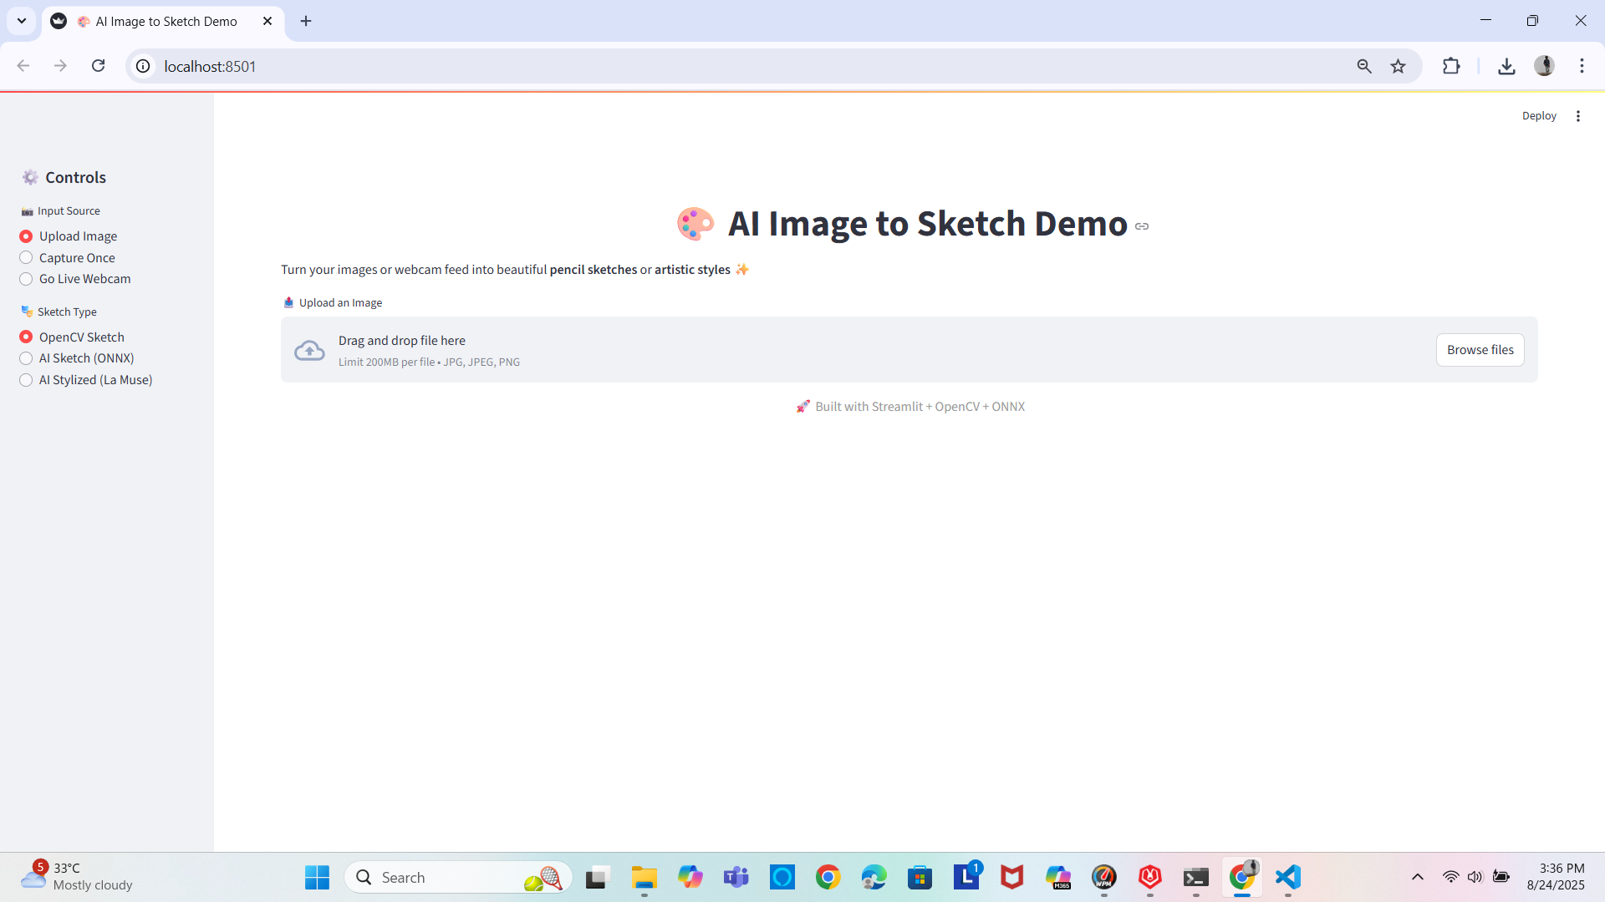
Click on Browse files to upload an image

Slide 10
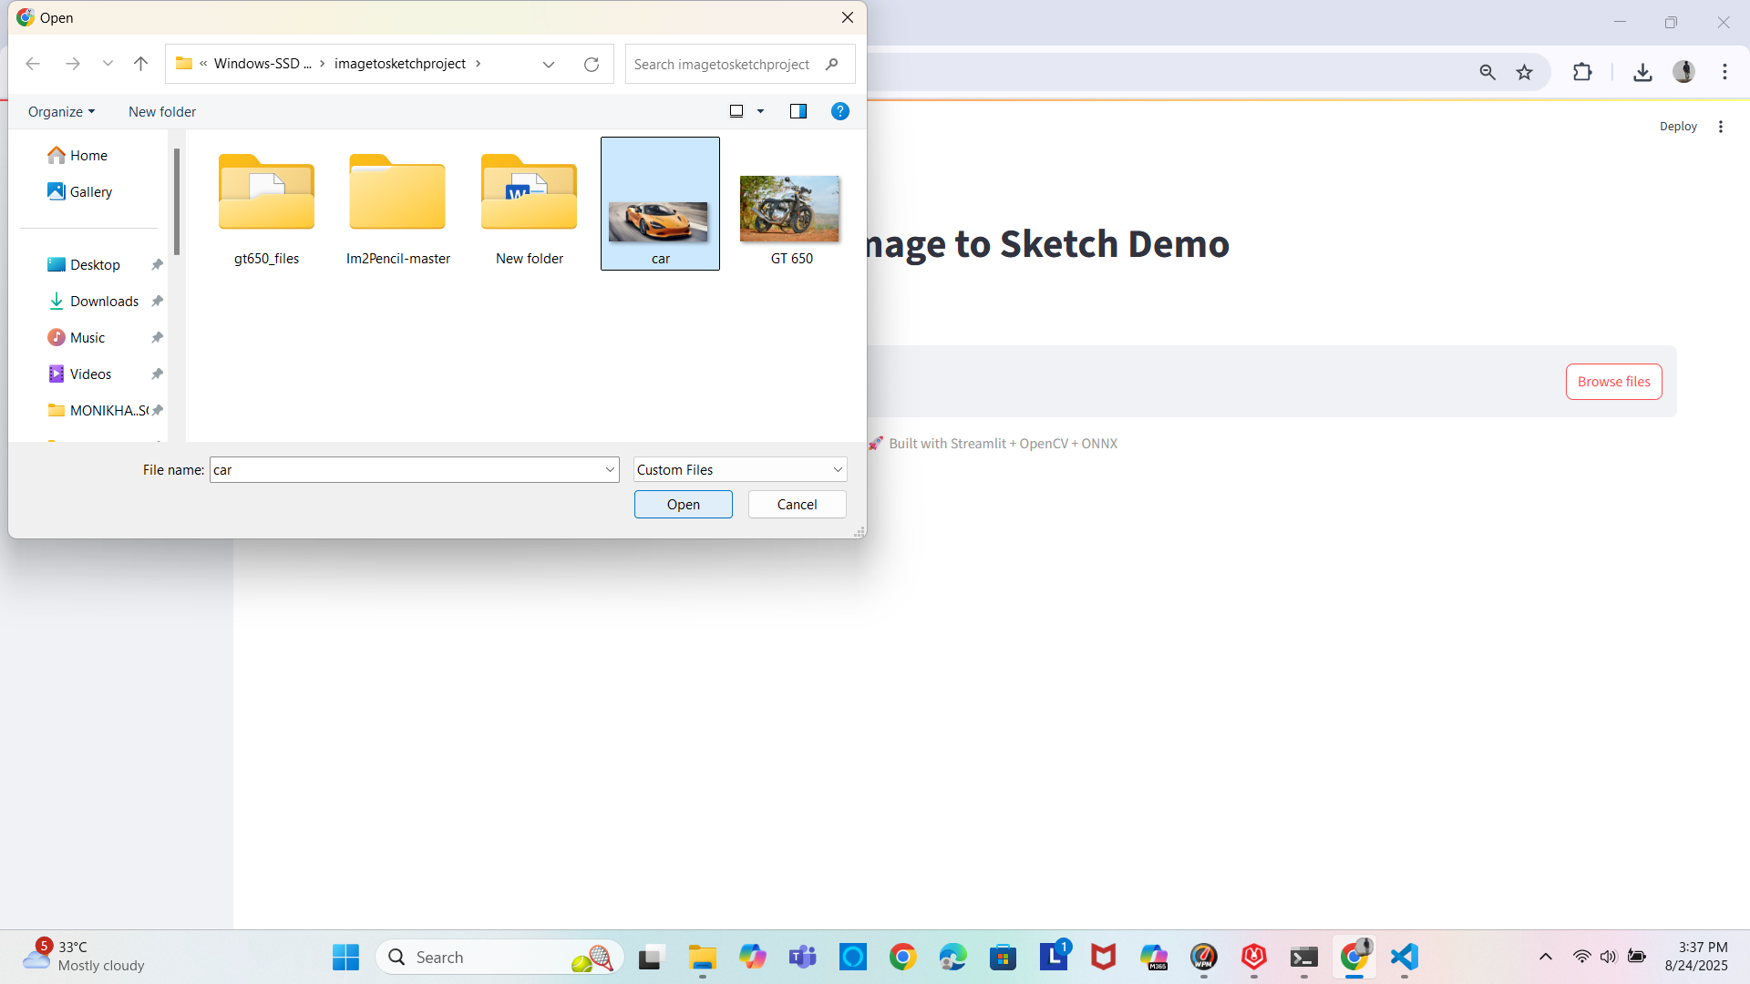
Select and click on open button

Slide 11
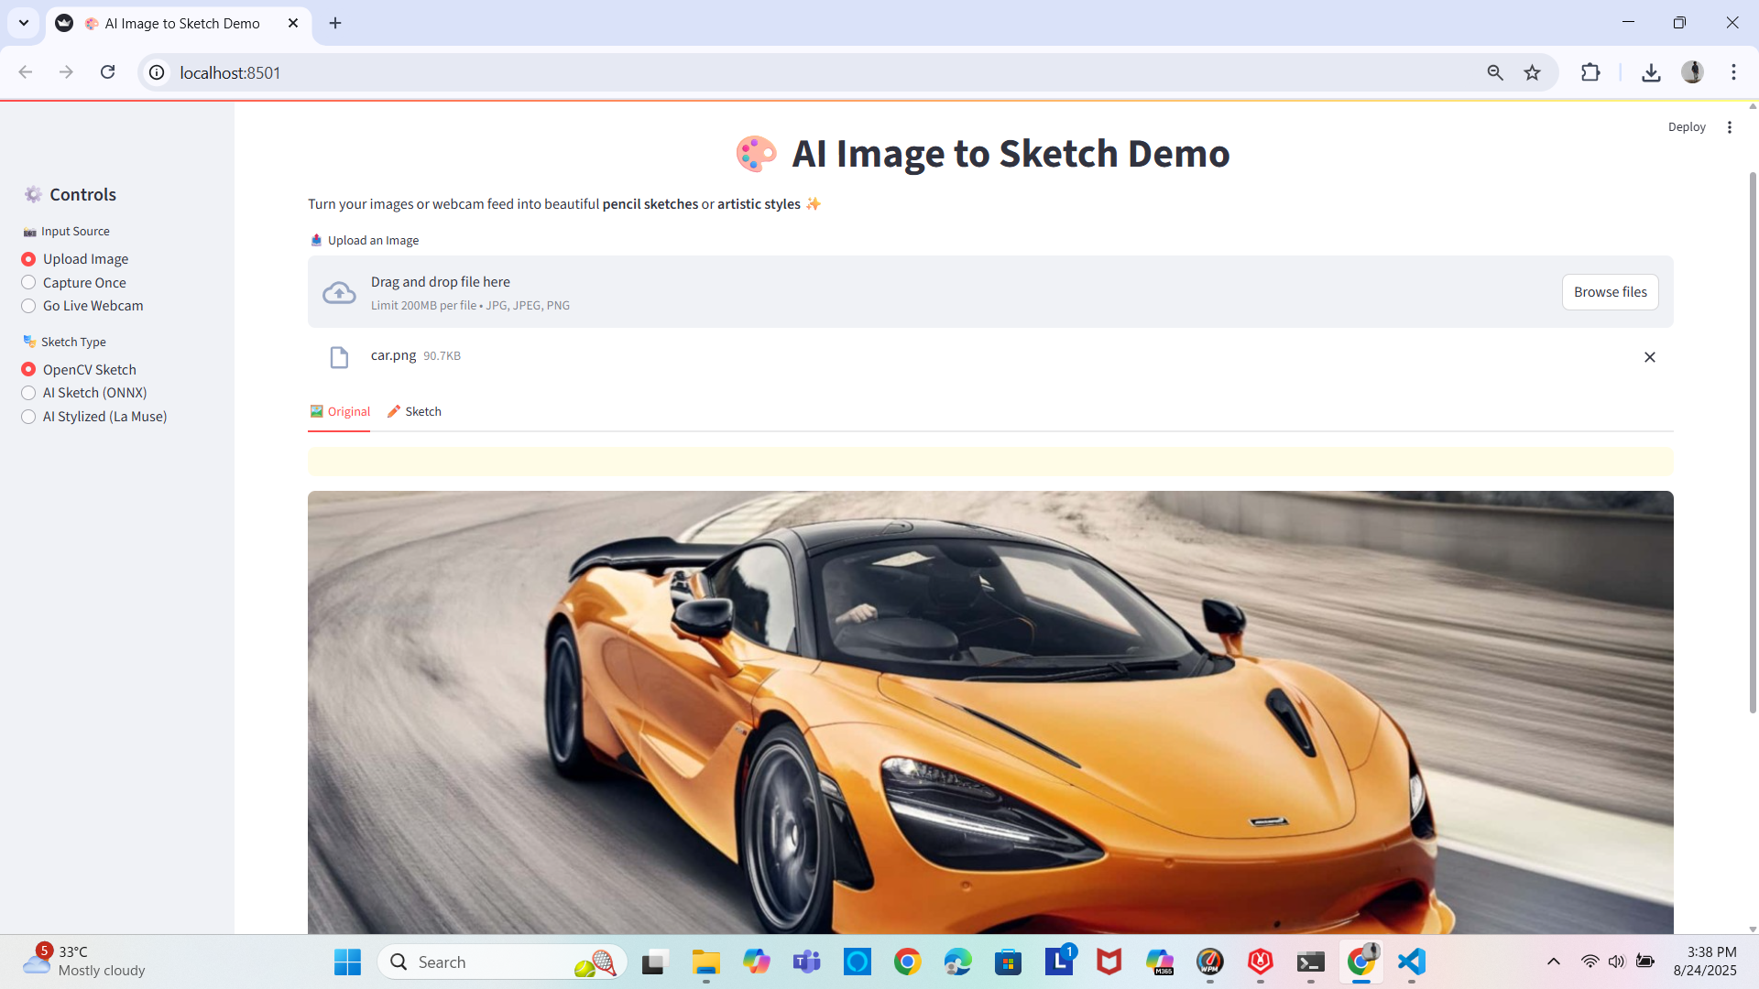
Click and select the OpenCV sketch

Slide 12
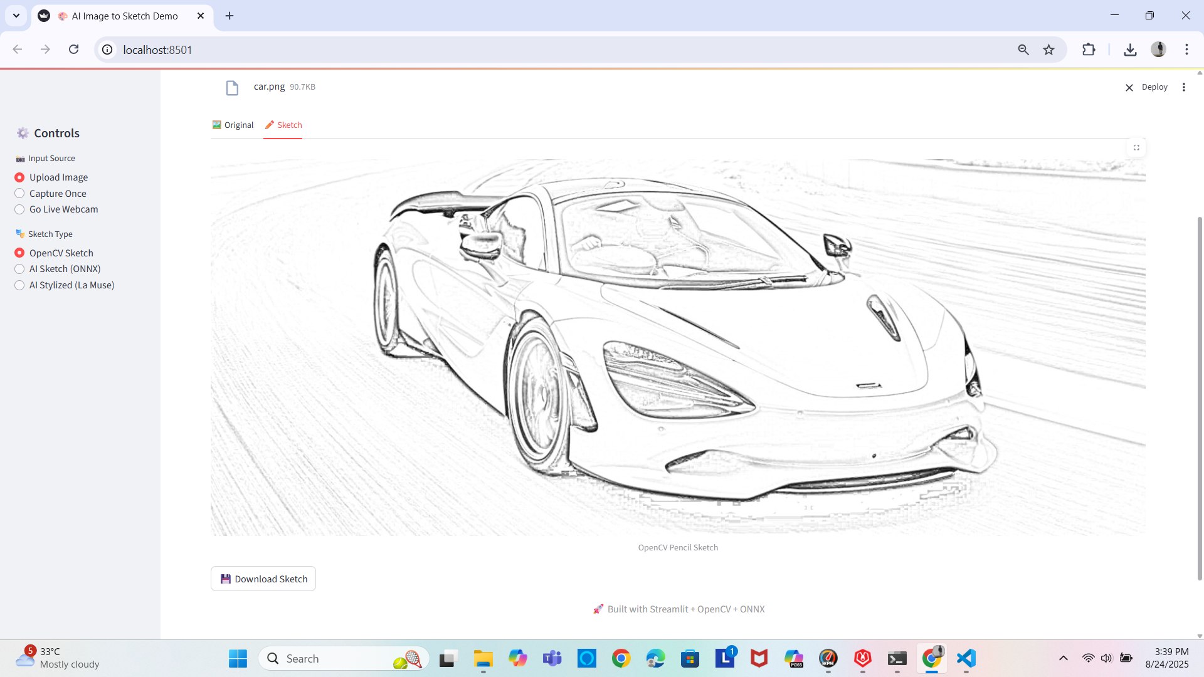
Pencil Sketch type image is generated in the sketch tab

Slide 13
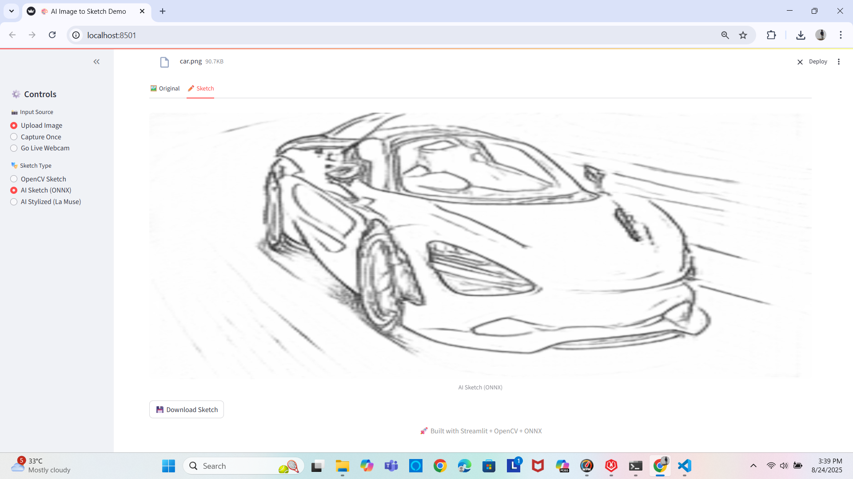
Click on Ai sketch if you want Ai generated sketch effect

Slide 14
Thank You

