Slide 1
Travelling Salesman Problem
Shrikant Mudholkar
Varsha Bhanushali
Team Number: 536

Slide 2

PROBLEM Statement
Given a list of cities and the distances between each pair of cities, what is the shortest possible route that visits each city.
Genetic algorithms are an evolutionary technique that use crossover and mutation operators to solve optimization problems using a survival of the fittest idea.
The genetic algorithms are useful for NP-hard problems, especially the traveling salesman problem.

Slide 3
Sequence of Steps
Generate genome using random sequences of genes
Initiate Population by mapping genome to phenome(different routes of the cities)
Evaluate fitness and distance of each child in the population and sort the population
Optimal solution met?
New Generation
YES
NO
Best Route Found
Best Route Found
Select Parents for the next generation by picking top phenome(routes ) from the current generation
Generate next generation’s genome by crossover between top selected parents of current generation
END
END
Generate new generation based on the new genome

Slide 4
Details of the Algorithm
Genotype Gene Expression and Phenotype
Gene Expression Gene String is a string array of 8 numbers where every number represents the index of the city stored in the phenotype
Phenotype Every phenotype is mapped to Genotype A phenotype consists of list of cities representing the route.
Fitness Function Fitness of every phenotype is based on the total distance of that route
Sort Function Sorting of the phenome is based on the fitness of every phenotype
Evolution Mechanism Find the optimal solution until the minimum distance is constant for 10 generations. Creation of new generations would go until maximum of 100 generations

Slide 5
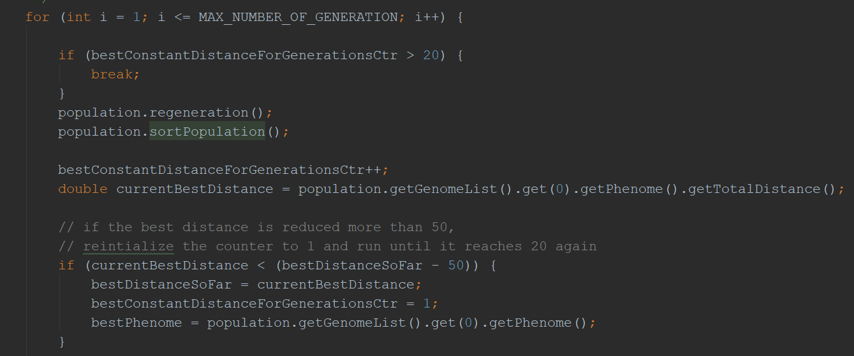
Evolution Mechanism
Find optimal solution until the minimum distance of the route is constant with in a range(min distance is updated if it is dropped below 50unit of current best) for 20 generations. Max generation goes up till 100.

Slide 6
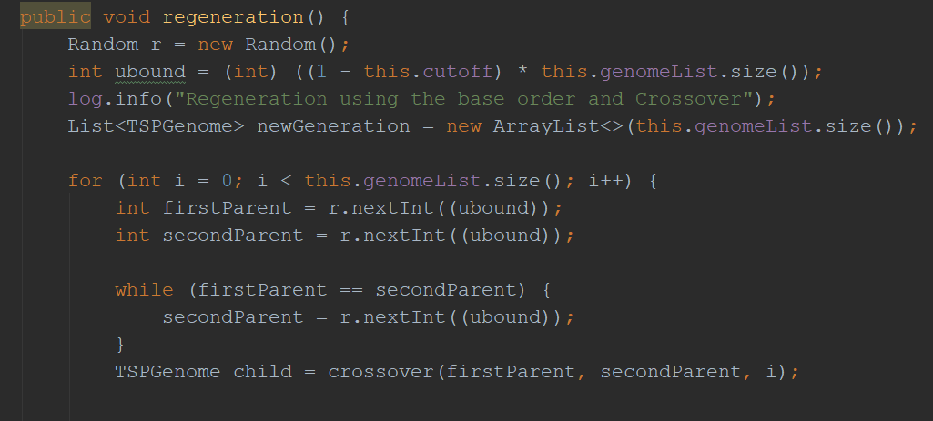
Regeneration using Crossover
This function takes 80% of the sorted genome population form the current generation to create a new generation of genomes. The Children are created using a crossover between two randomly selected parents

Slide 7
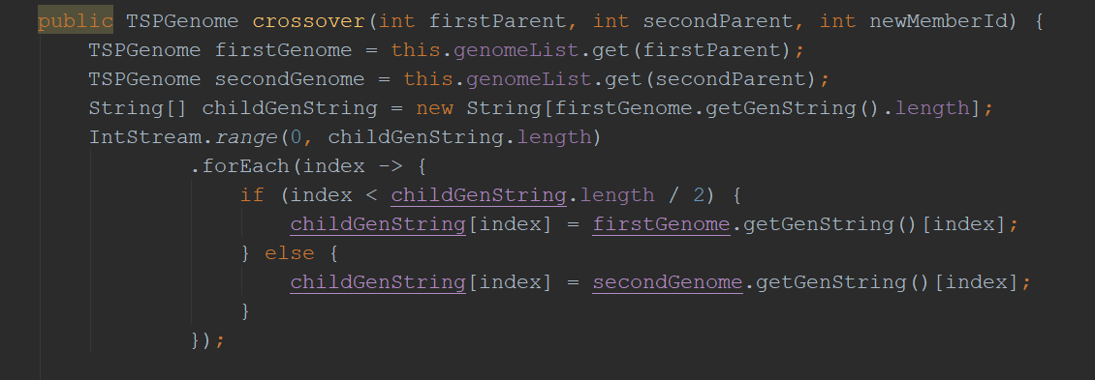
Crossover
For Crossover, select gene from top selected parent 1 and parent 2. Create new gene for next generation using first half gene of parent 1 and second half of other parent.

Slide 8
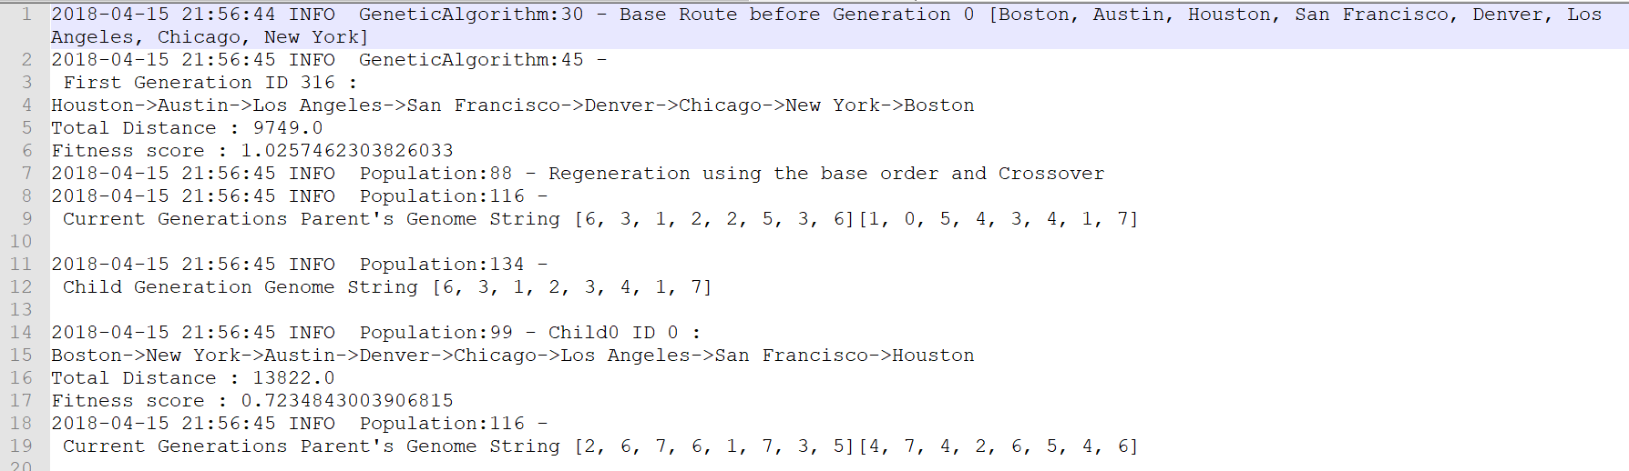
Application Logs
Recreation of new Generation Using Crossover of parent genes

Slide 9
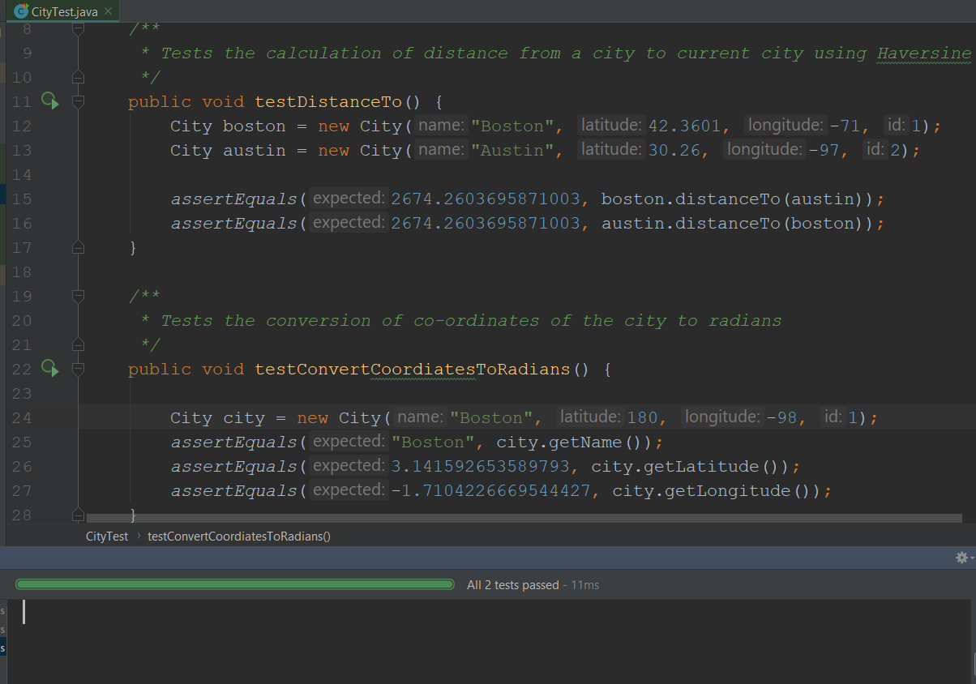
Unit Test (City)

Slide 10
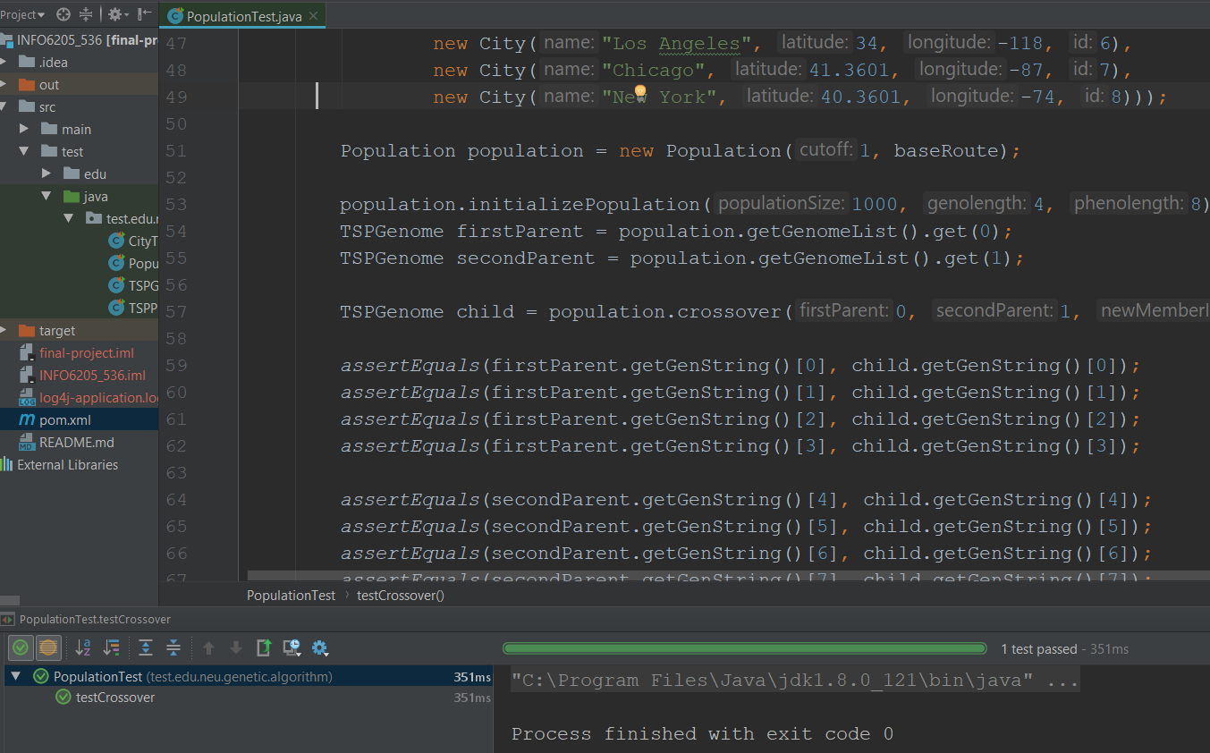
UNIT TEST (Population)

Slide 11
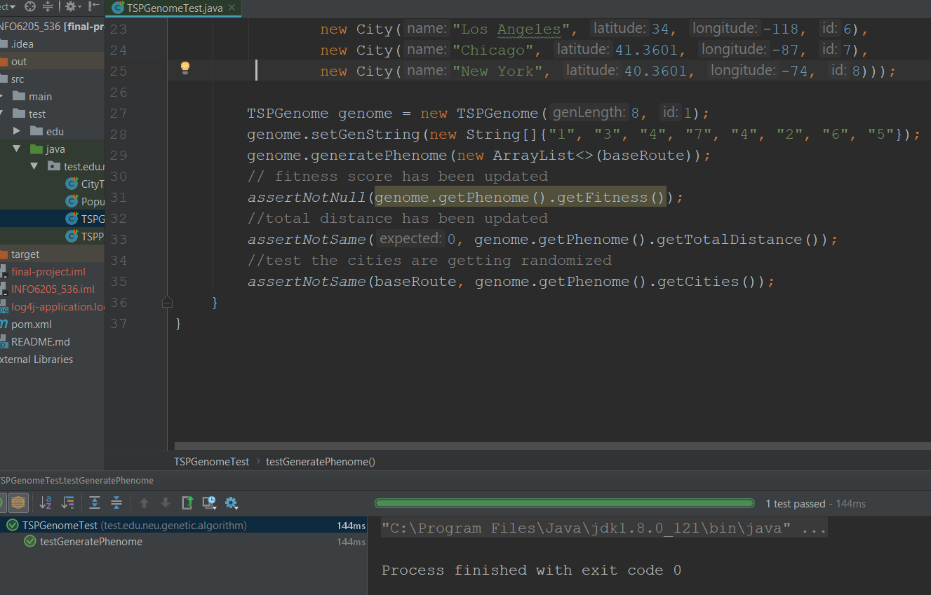
UNIT TEST (Genotype)

Slide 12
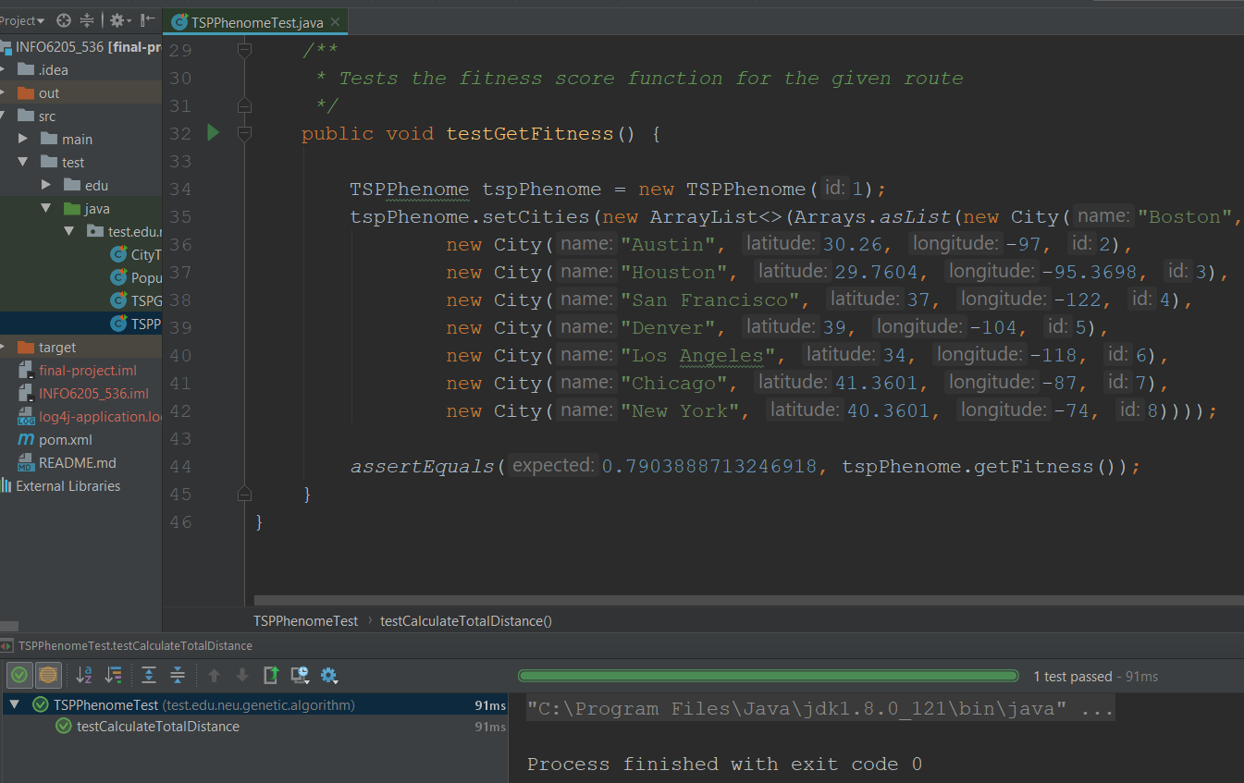
UNIT TEST (Phenotype)

Slide 13
RESULT (Optimal Solution)
We are able to reach an optimal solution with one-fourth of total possible solution space using GA approach for solving Travelling Salesman problem.
We have chosen 1000 population as it gives optimal solution earlier when ran against population size of 100, 500, 800
Statistics :
Total Cities = 8
Genotype Length = 8
Total Solution by brute force = 8! (40320)
Population = 1000
Optimal solutions is found by keeping 40320/1000 ~ 40% of the Solution space
Optimal Solution found in 4th generation (on average)
Since the best solution is not changed for 10 generation our program concludes the optimal solution has reached

Slide 14
Running the Application
Download the source code from :
https://github.com/bhanushaliv/INFO6205_536
mvn clean install (Have Maven and Java preinstalled)
After successfully running unit test cases and maven build
java –jar ./target/final-project-1.0-SNAPSHOT.jar

