Slide 1
Road Accident Analysis using Python Programming
Haneesha Sanikommu
Priyanka Ganguri
BhanuShruthi Nayudu
Nikith Kumar

Slide 2
Agenda
The business problem
Data Description
Data Preparation
Data exploration
Model and Analysis
Conclusion

Slide 3
Motivation
We have data for road accidents.
We are processing, cleaning, preparing, exploring our dataset and predicting number of accidents.
Which state has highest number of accidents?
What are the factors affecting accident severity?
The Question is: what is the major reasons for accident and how can we prevent it ?

Slide 4
Data Description
There are around 60,000 records in US accident list -2019.
We have data based on source, severity, time , latitude, longitude, distance, location, weather condition etc...
Data Source - Road Accident Dataset (Dataset taken from Kaggle-we have considered only few records as per our convenience.)

Slide 5
Data preparation - cleaning
Get the basic information about the dataset: shape and info() and column
What are the data types
Cast Start_Time to datetime
drop the following features:End_Lat and End_Lng and Wind Chill
count the columns with null values and assigned nan or mean as required
Remove “A-” from ID and convert latitude and longitude from float to Int.
Sources: reduce the number of sources by summarizing them and turn it into dummies.
Time zone: split and turn them into dummy variables.

Slide 6
Data preparation – missing values
The following variables have missing values:
“End_Lat”, “End_Lng”, “Number” : Replace with mean.
“Precipitation”, “Wind_speed”, “visibility”, “pressure”, “humidity”, ”Wind_direction:, “wind_chill”, “Temperature”, “weather_timestamp”: Replace the missing data with NaN value.

Slide 7
Data preparation
Dropping all the unwanted columns:
‘TMC’,'End_Lat', 'End_Lng', 'Number', 'Description','Street','Side', 'City', 'County', 'State','Zipcode','Country', 'Airport_Code','Start_Time','End_Time','dt','Weather_Timestamp','ID','Year','Month','Day','Hour','Minute','Source_MapQuest-Bing','Timezone_US/Eastern','Timezone_US/Mountain','Timezone_US/Pacific'
replace weather conditions in simple terms
Creating Dummies for Columns 'Amenity','Bump','Crossing','Give_Way','Junction','No_Exit','Railway','Roundabout','Station','Stop','Traffic_Calming','Traffic_Signal','Turning_Loop','Civil_Twilight','Nautical_Twilight','Astronomical_Twilight','Weather_Condition','Wind_Direction','Weekday'

Slide 8
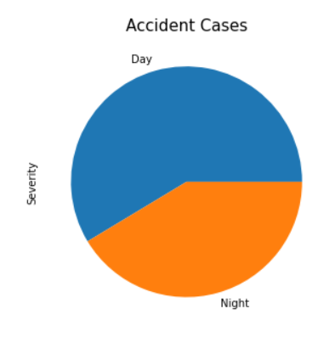
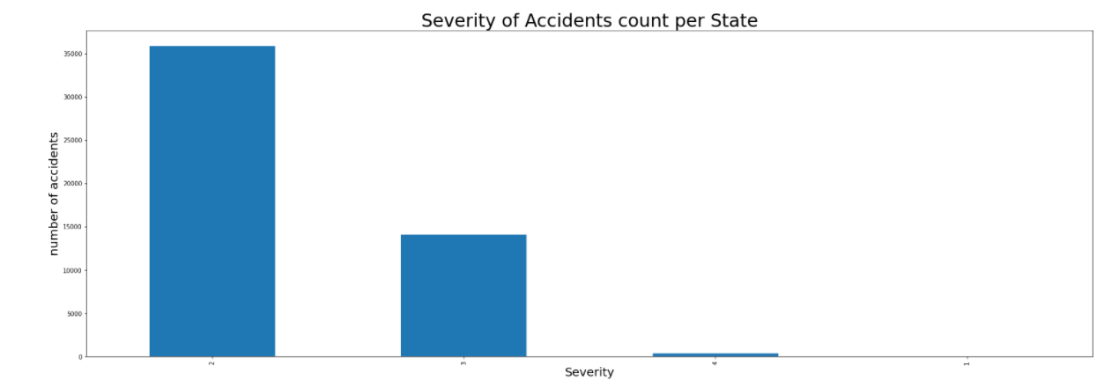
Data exploration
Severity over Number of accidents - We can observe severity level-2 has highest number of accidents.
Also, the most occurrence of accidents during day and night times.

Slide 9
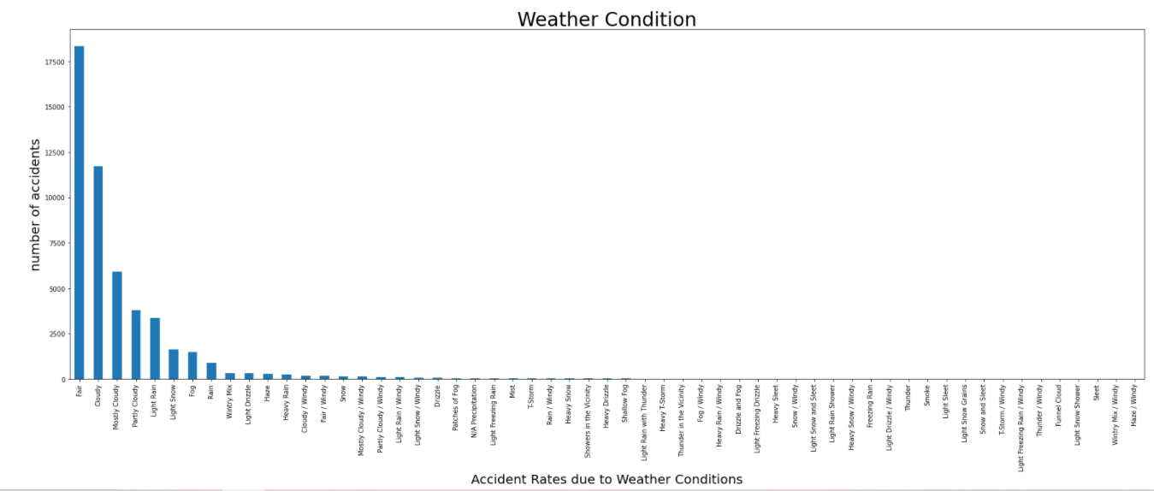
Data exploration
Weather Condition impact on Number of Accidents - Weather condition with Fair records highest number of accidents, the second highest is during Cloudy.

Slide 10
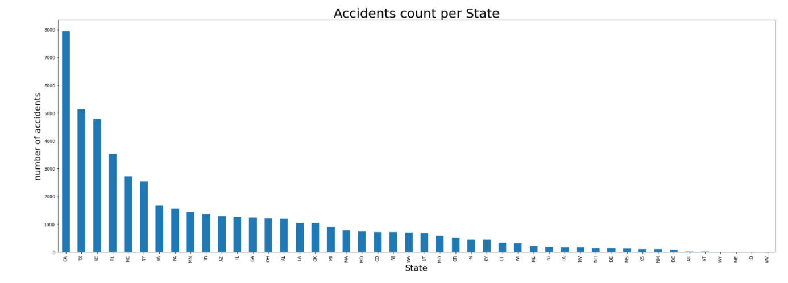
Data exploration
Analysis Accidents count for state-wise with a bar graph

Slide 11
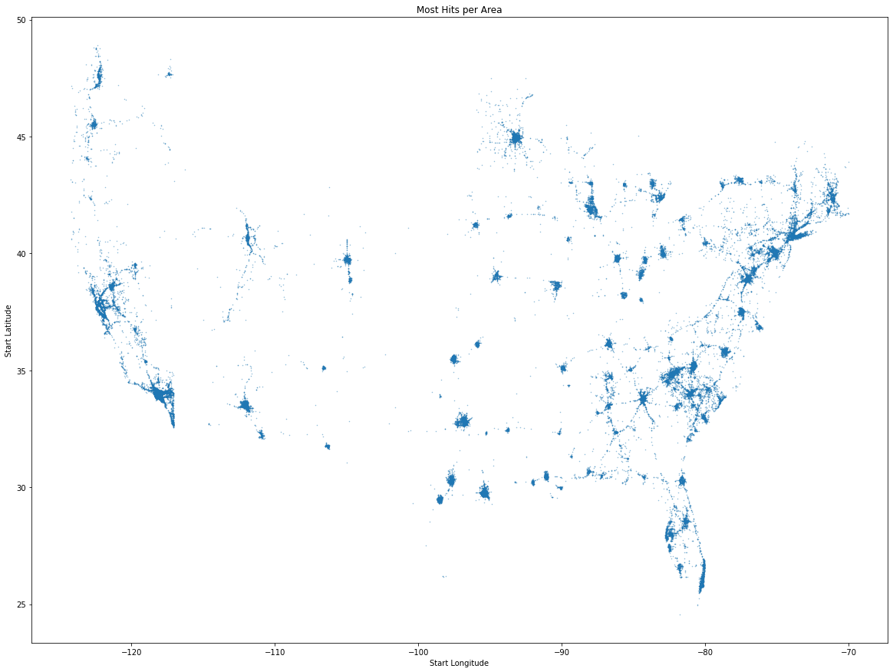
Data Exploration
Most Hits per Area.

Slide 12
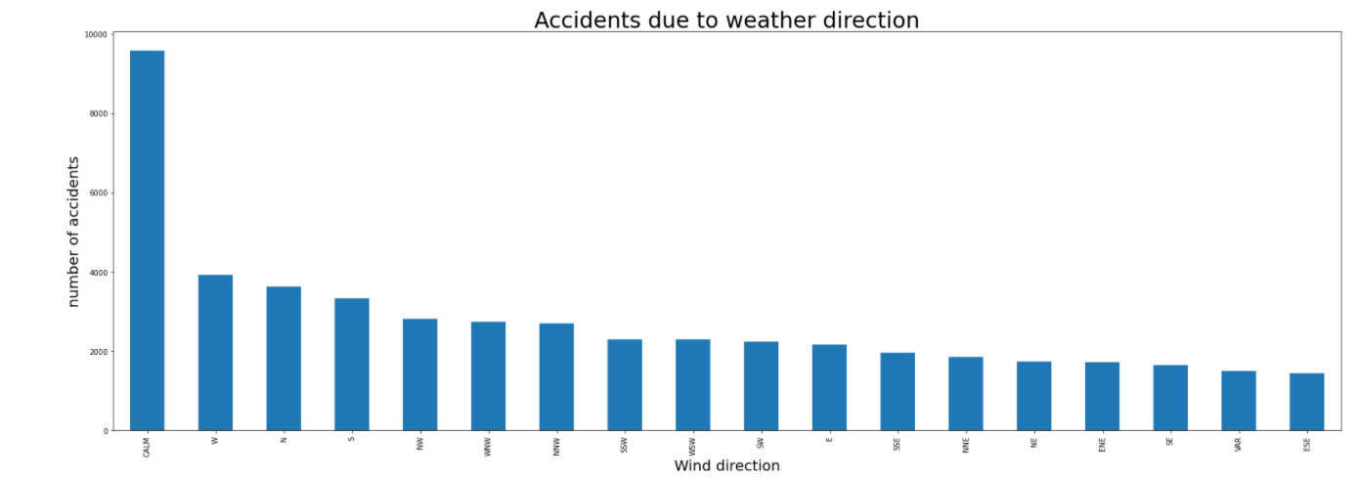
Data Exploration
Number of Accidents due to Wind Directions - When the wind is CALM , we see highest number of accidents.

Slide 13
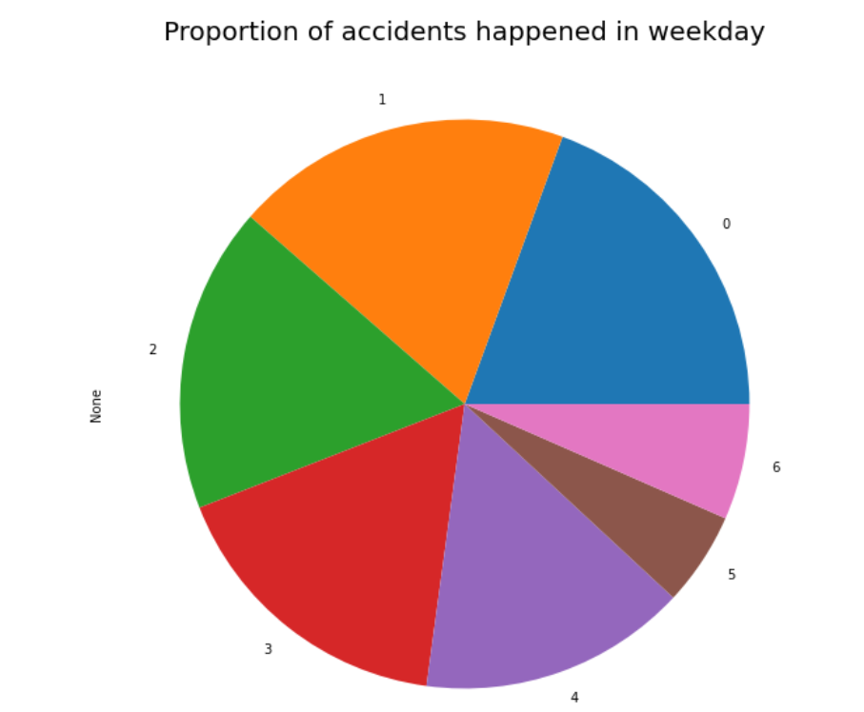
Data Exploration
Almost all the weekdays have the equal number of accidents.

Slide 14
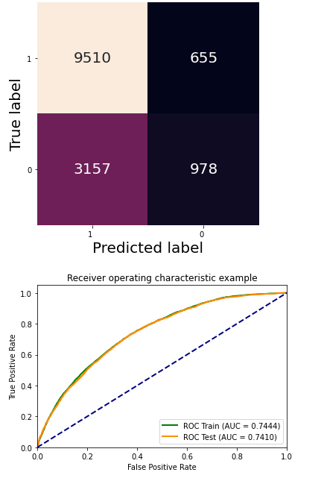
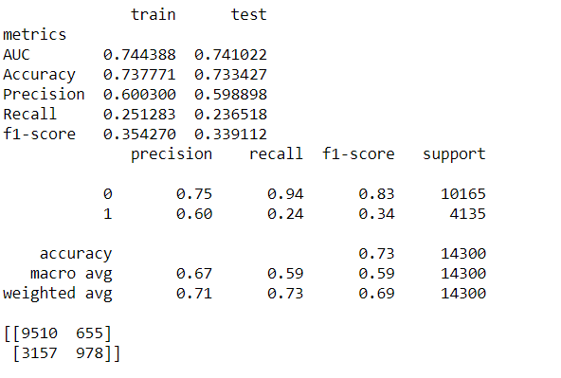
Model and Analysis
Logistic Regression - the logistic model is used to model the probability of a certain class or event existing.

Slide 15
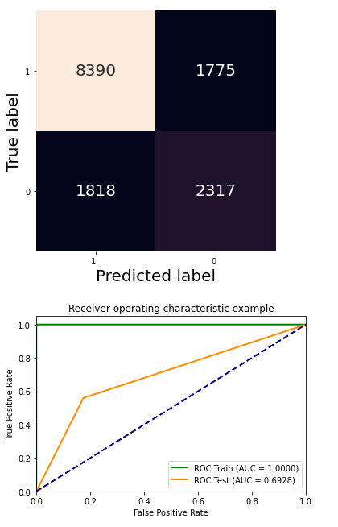
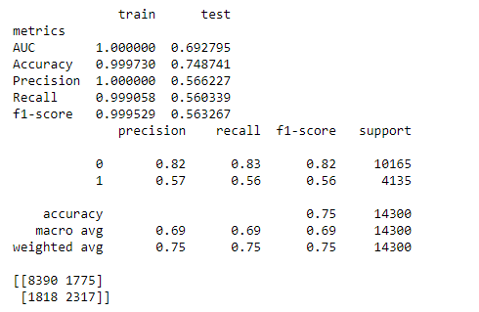
Model and Analysis
Decision Tree - a decision support tool that uses a tree-like model of decisions and their possible consequences, including chance event outcomes, resource costs, and utility.

Slide 16
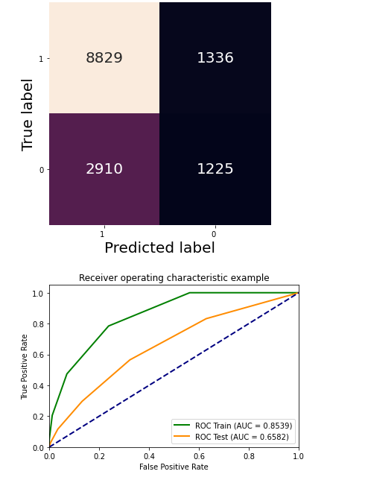
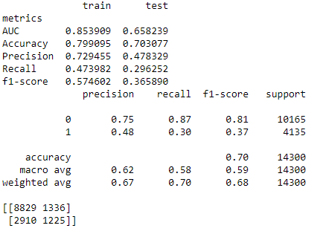
Model and Analysis
KNN - a simple, supervised machine learning algorithm that can be used to solve both classification and regression problems.

Slide 17
Model Comparison
Logistic Regression model - 0.7534965034965035
Decision Tree accuracy : 0.756993006993007
KNeighborsClassifier accuracy - 0.7086713286713286
Decision Tree has better accuracy.

Slide 18
Conclusion
We explored the data on road accidents
We build models to predict severity of road accidents
Decision Tree model turns out to be the best based on evaluation metrics

Slide 19
Thank you

