Slide 1
Micro Credit Project
By
Bhanusree.Ponnapalli

Slide 2
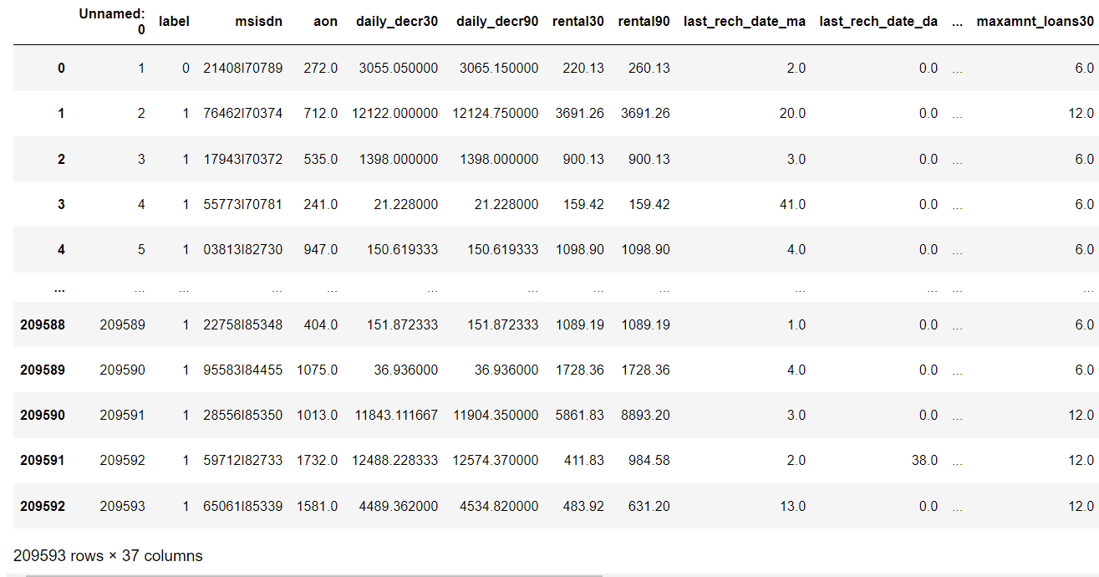
Data Set

Slide 3
EDA:
Shape : 209593 rows × 37 columns
Information: Float64(21),int64(13),object(3) memory usage:59.2 +MB
Handling missing values: In our dataset there is no null values to handle
Duplicate checking: there is no duplicate values all so.
Data Description: Statistical measure of the variables.’’

Slide 4
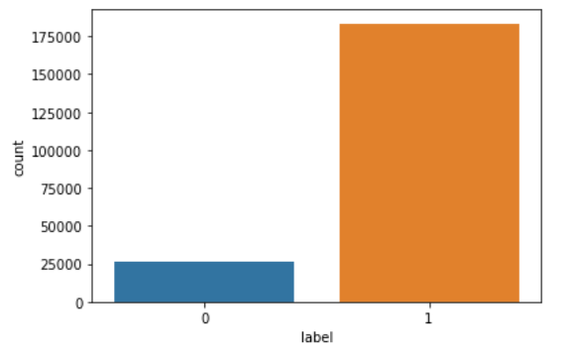
Data Visualization

Slide 5
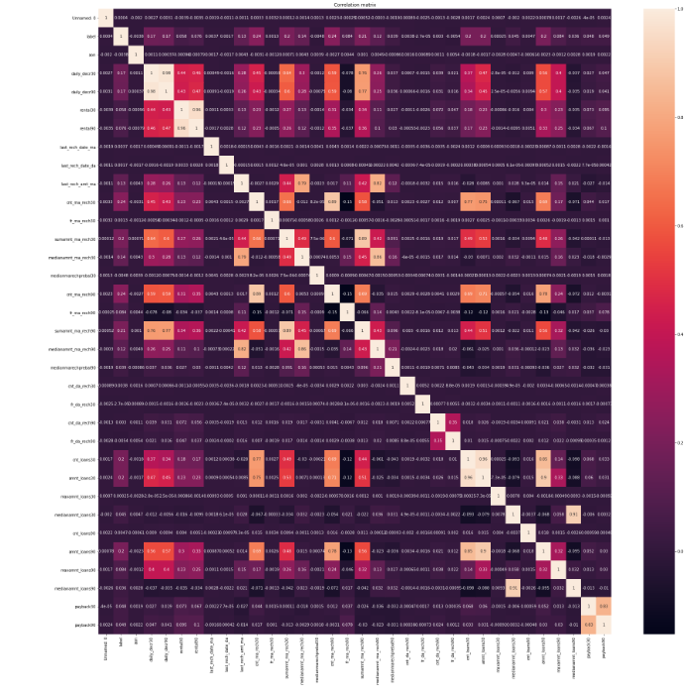
Checking Relational matrix

Slide 6
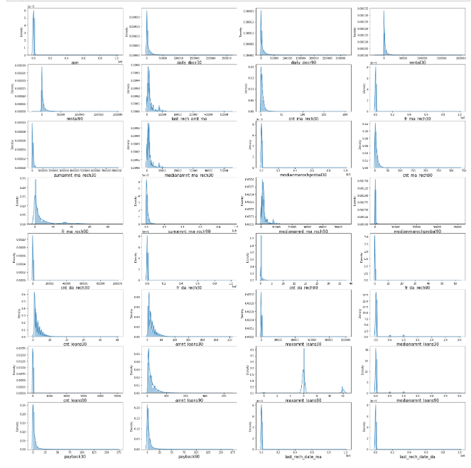
Checking data Distribution

Slide 7
Data Scaling:
From the data distribution we found that our data is right skewed.
To impute skewness in the dataset we have few methods. those are log transformation, cube root, square root and power transformation method.
Based on the data and skewness we select the imputation methods.my data is positive data and right skewed that why I went for power transformation yeo-johnson method
After that my data set look like

Slide 8
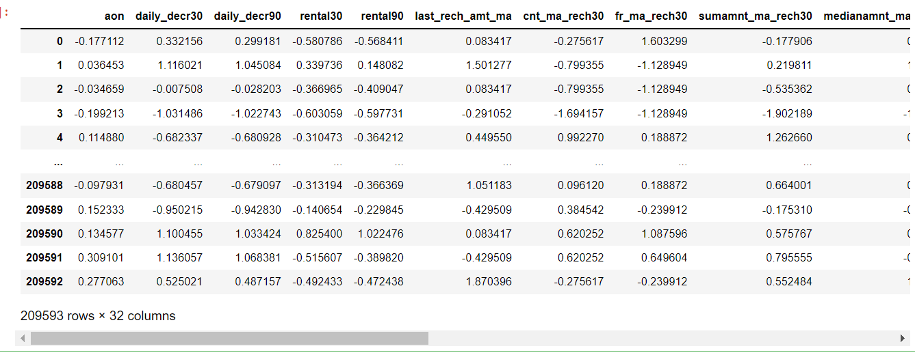

Slide 9
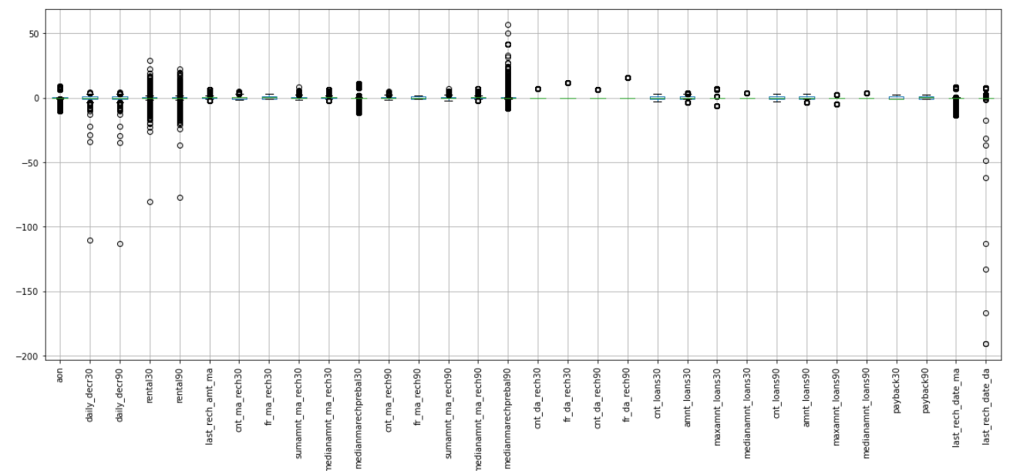
Checking for outliers

Slide 10
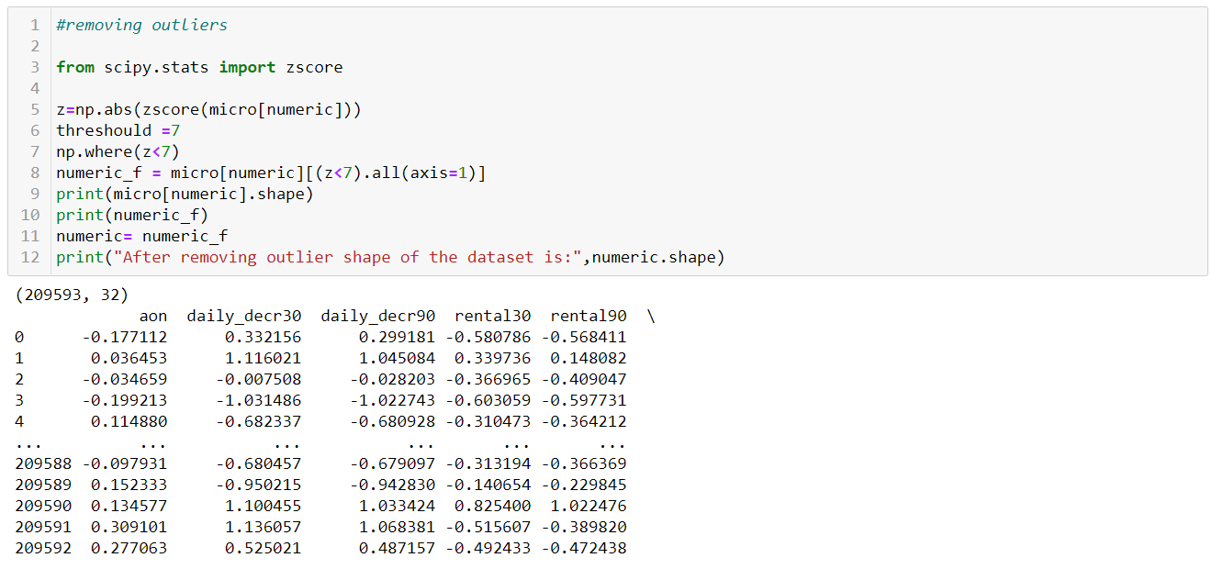
Removing outliers. After removing outliers percentage of loss data is 6%

Slide 11
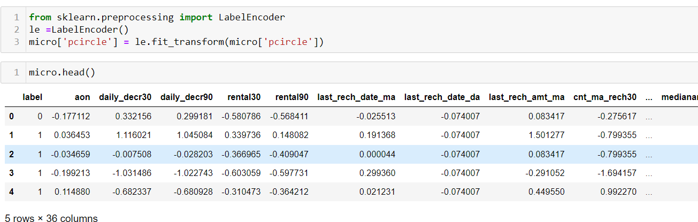
Label Encoding:

Slide 12
Modelling Data

Slide 13
Diving Feature and target variables (x,y)
After dividing feature and target variables we need to standardize the feature data for modelling.
For modelling all data need to be in 0 and 1 format for that we need to scale the data using standard scaler methods.

Slide 14
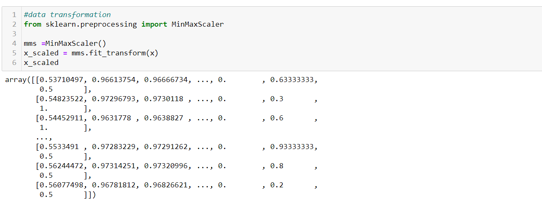

Slide 15
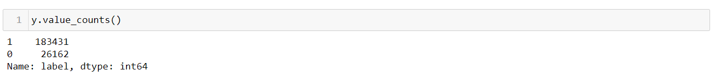
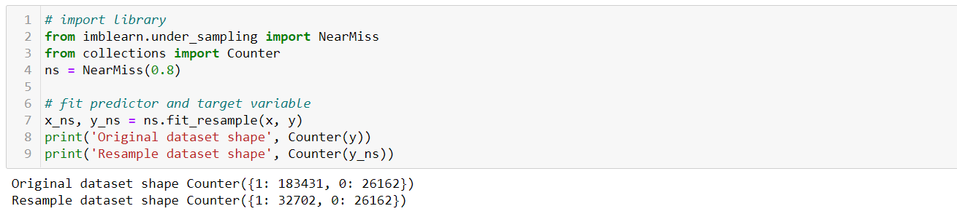
Checking value count for target variable to know whether there is class imbalance problem

Slide 16
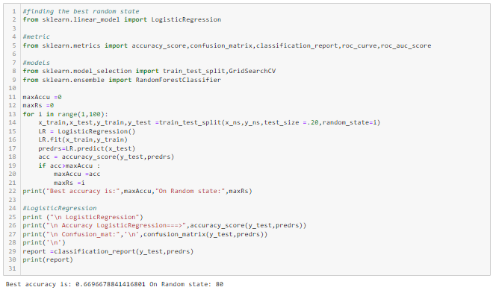
Modelling Data(Selecting Random State)

Slide 17
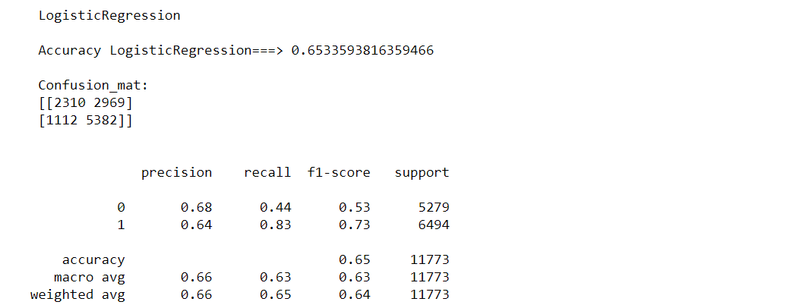
Logistic Regression:
Cross validation:

Slide 18
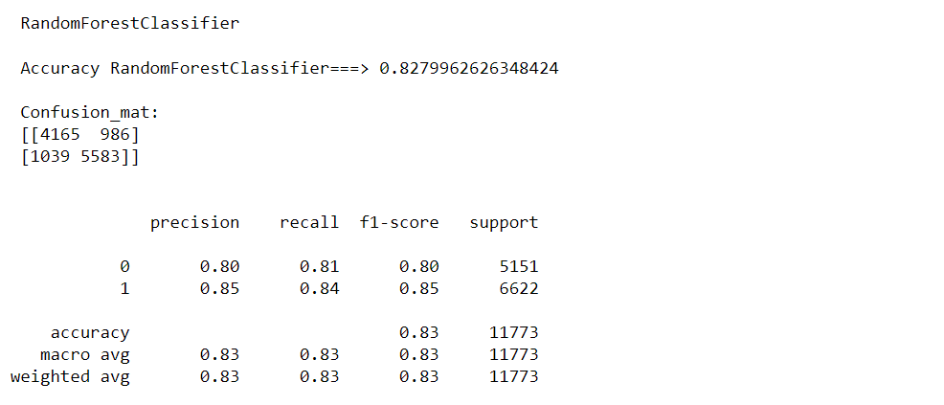
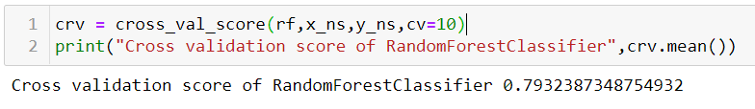
Random Forest Classification
Cross validation Score

Slide 19
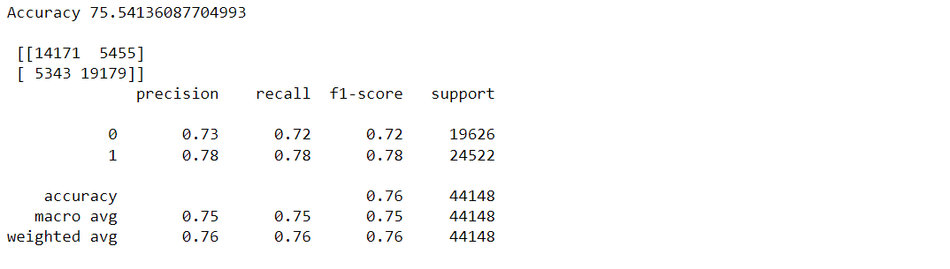
Decision Tree Classification
Cross Validation Score

Slide 20
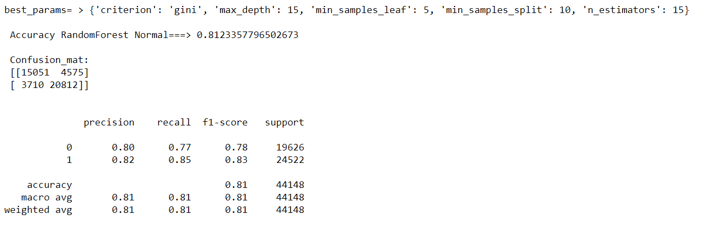
Parameter tunning using Grid Search CV

Slide 21
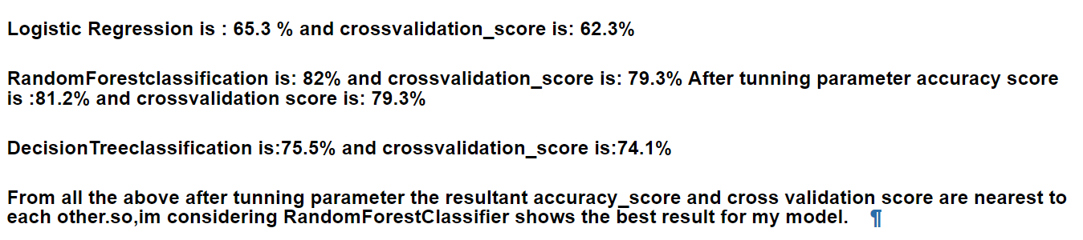
Conclusion

Slide 22
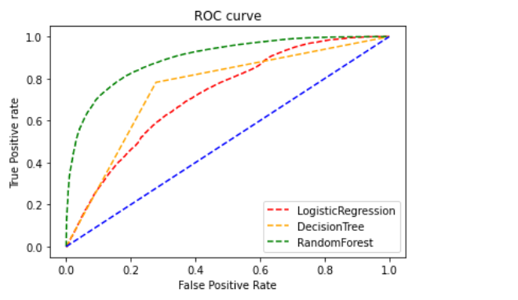
AUC-ROC curve

