Slide 1
Flight Price Prediction

Slide 2
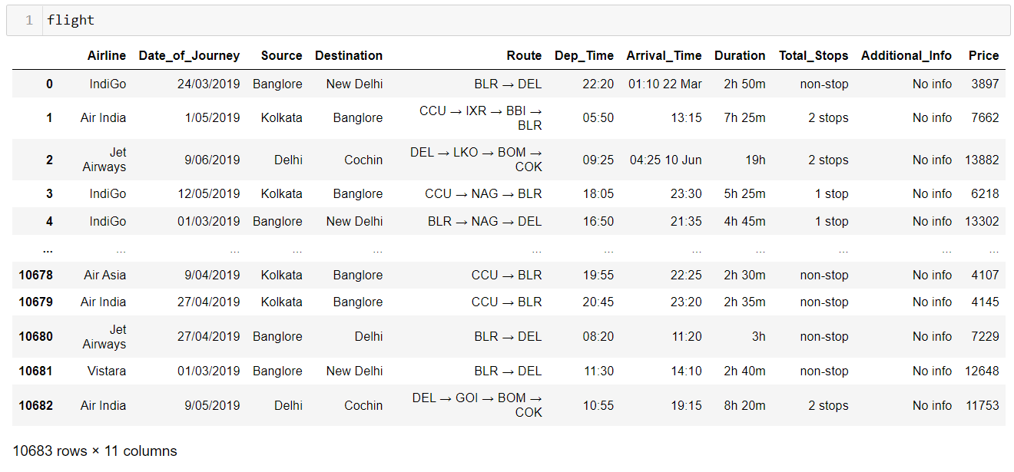
Data Set

Slide 3
EDA
Shape : 10683 rows × 11 columns
Information: Int64(1),object(10) memory usage:918.2 +KB
Handling missing values: In our dataset two columns found missing values. to impute drop them from the data set.
Duplicate checking: After deleting duplicate values shape of the data set is 10462 rows and 11 columns.
Data Description: Statistical measure of the variables.

Slide 4
Visualization

Slide 5
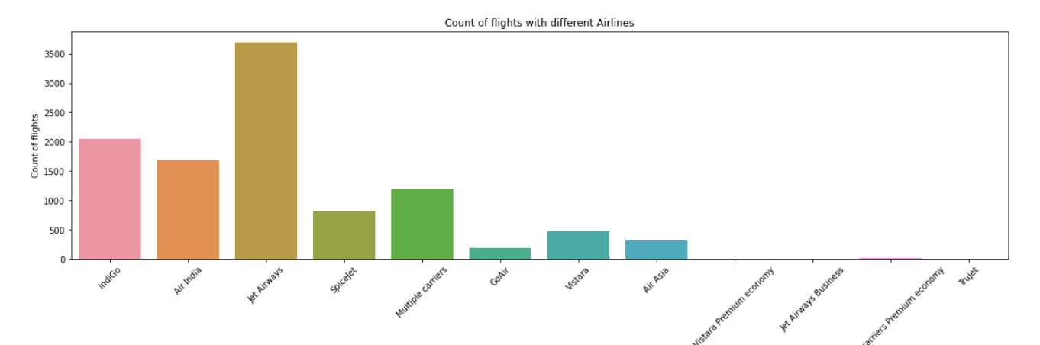
Airline Vs Count of flights

Slide 6
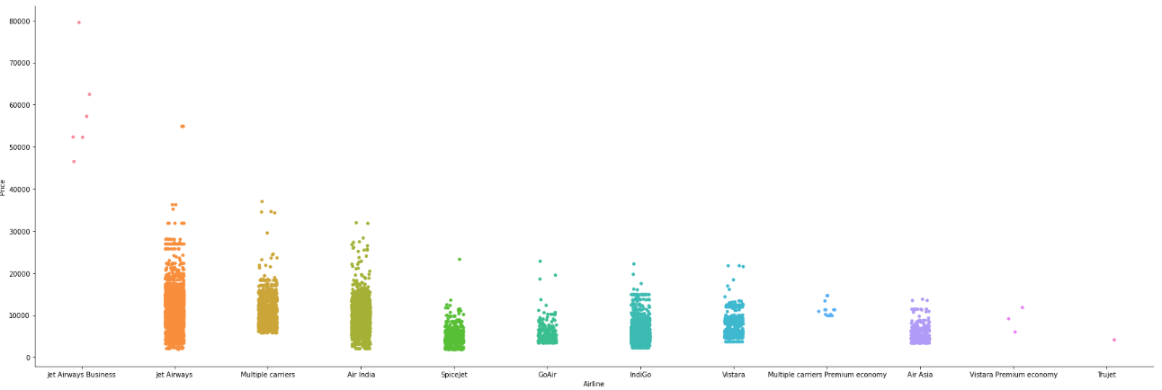
Price VS Airline

Slide 7
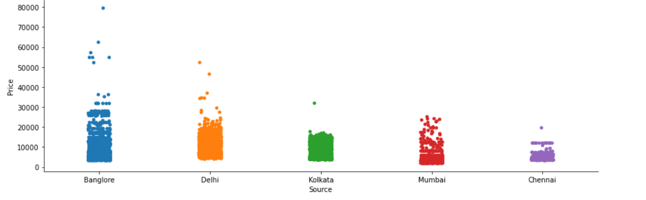
Price Vs Source

Slide 8
Price Vs Destination

Slide 9
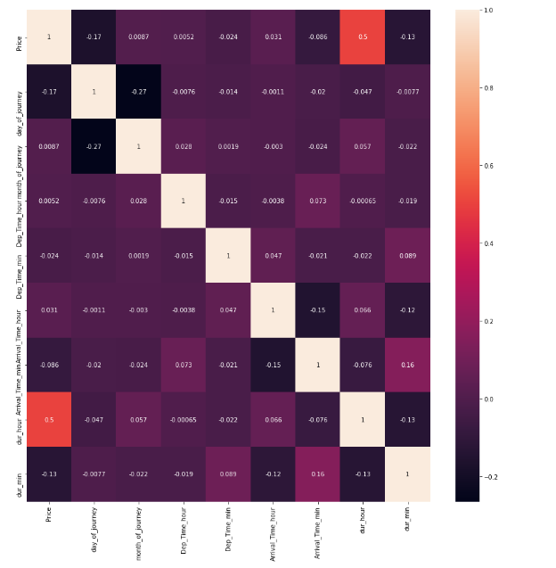
Correlation Metrix

Slide 10
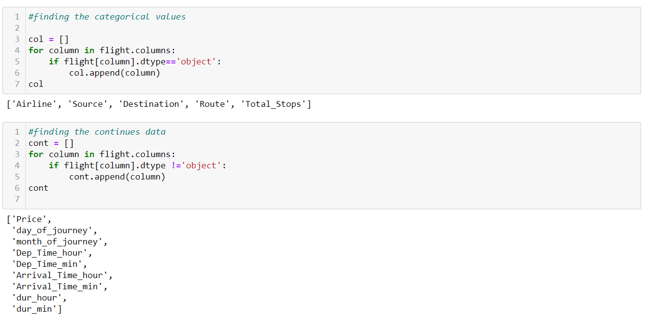
Dividing Categorical and Continues data for feature

Slide 11
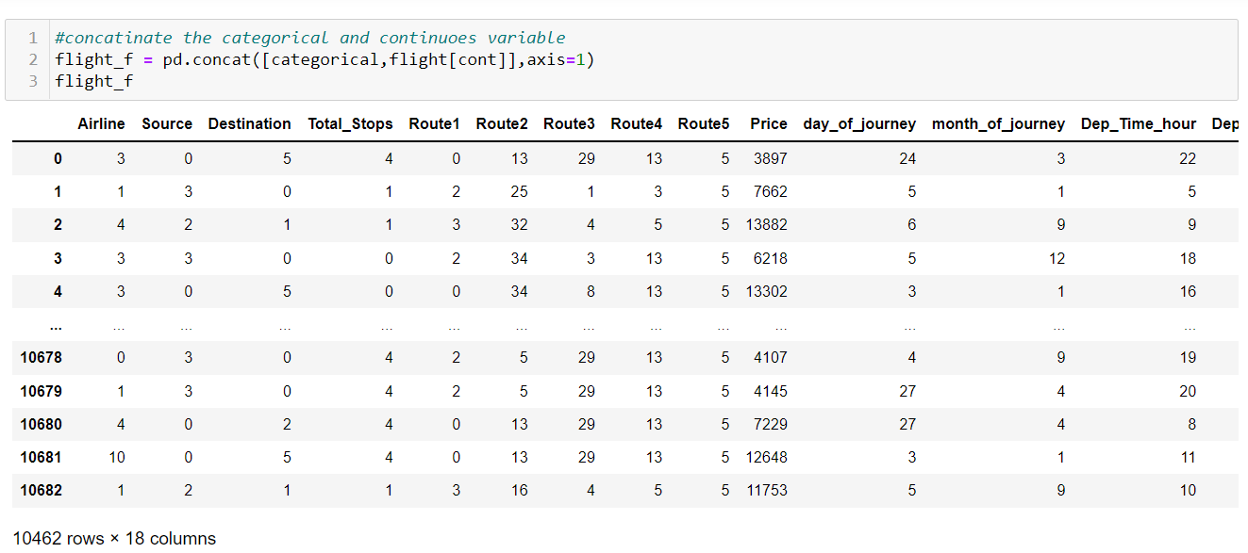
After Label Encoding final data set

Slide 12
Data Scaling

Slide 13
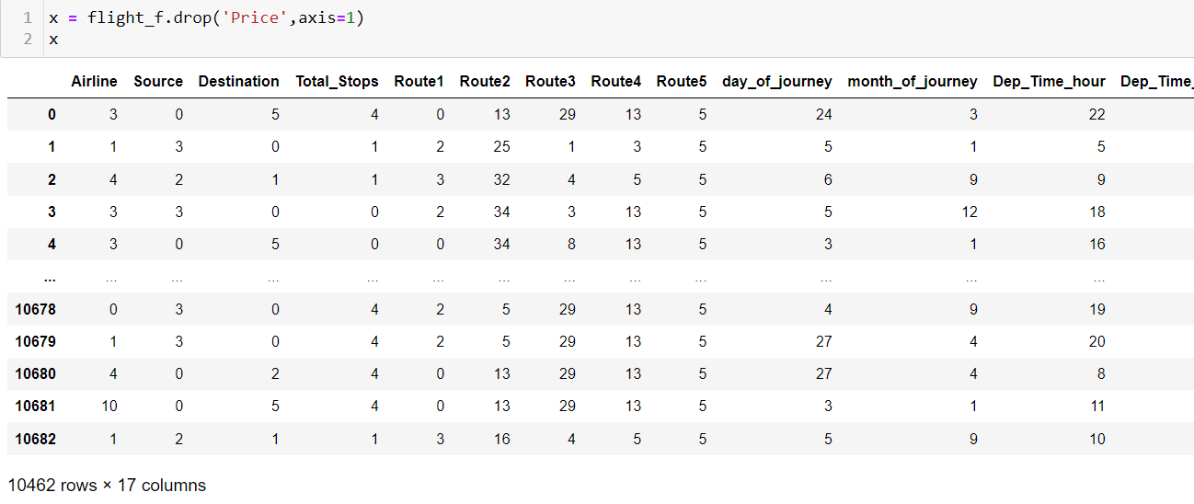
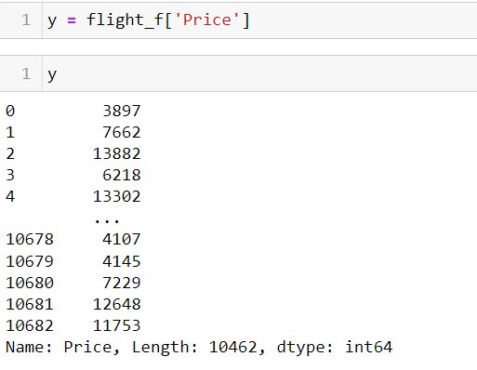
Dividing Feature and Target variables

Slide 14
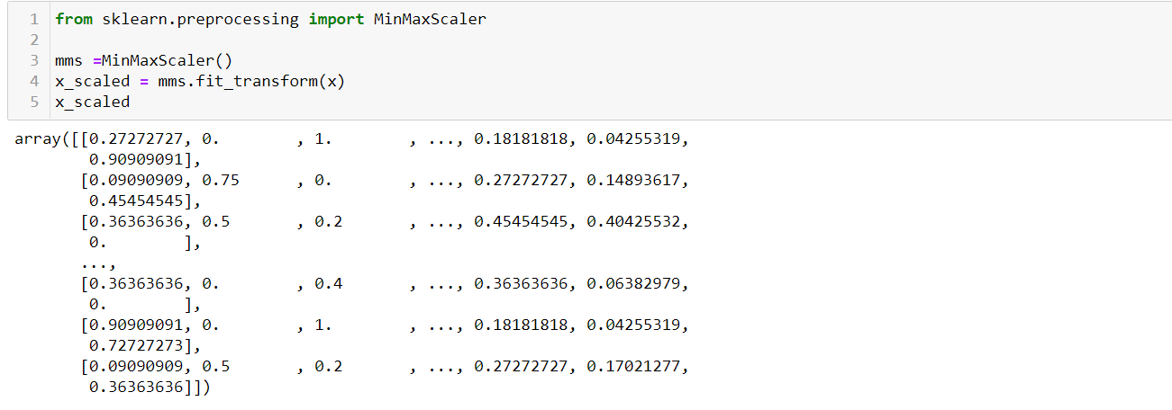
Scaling Feature variables

Slide 15
Modelling Data

Slide 16
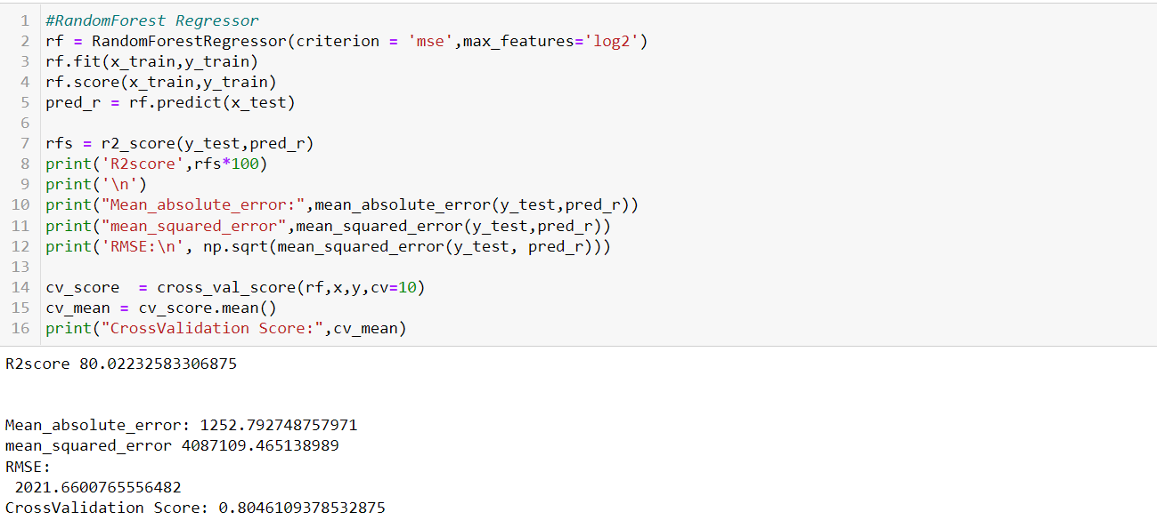
Random Forest Regressor & Cross validation score

Slide 17
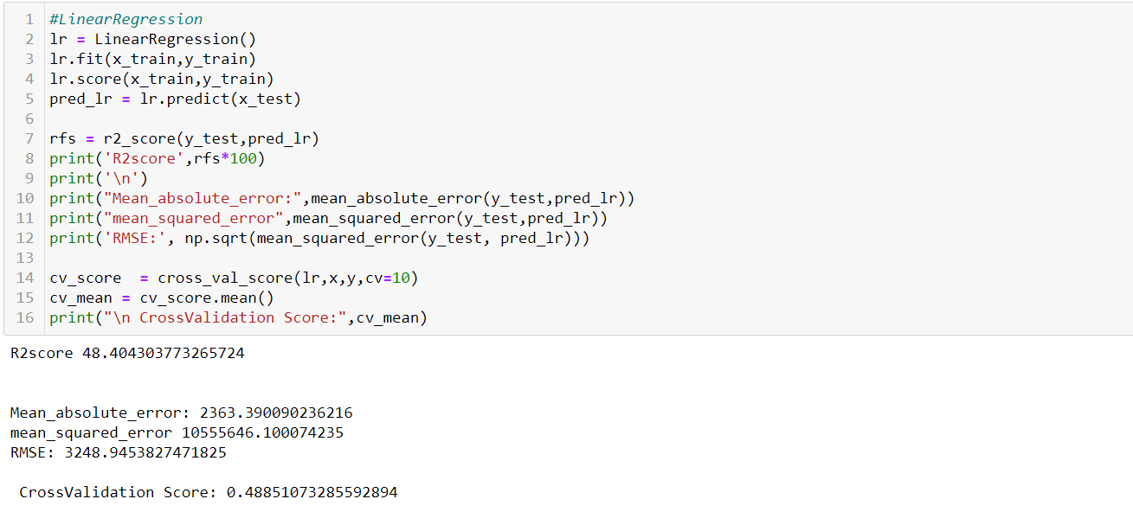
Linear Regression & Cross validation score

Slide 18
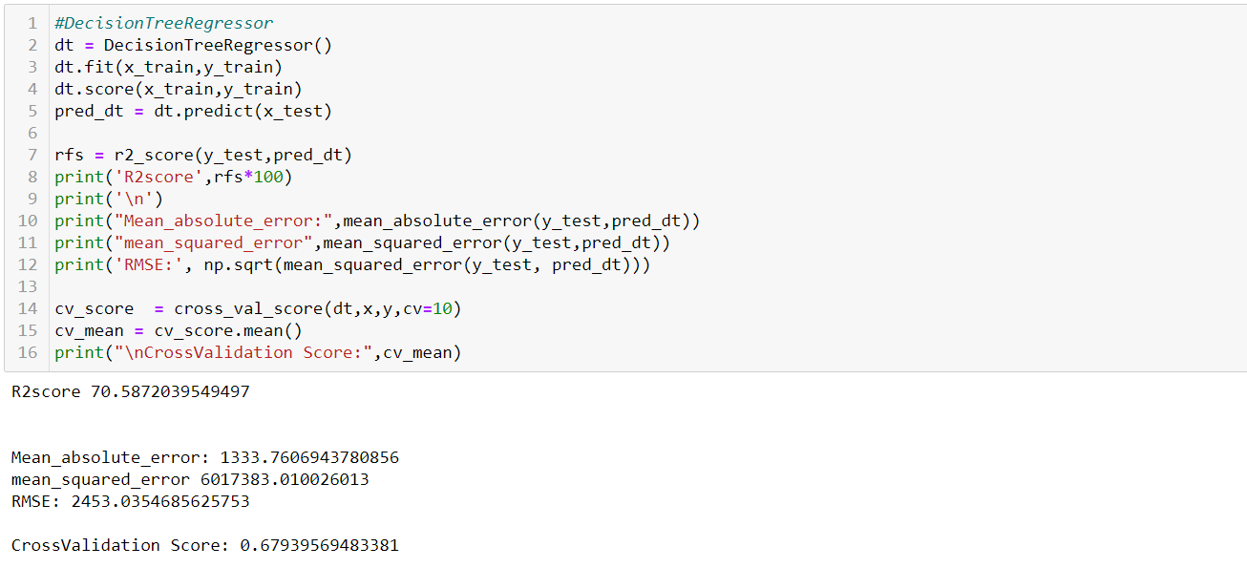
Decision Tree regressor & Cross validation score

Slide 19
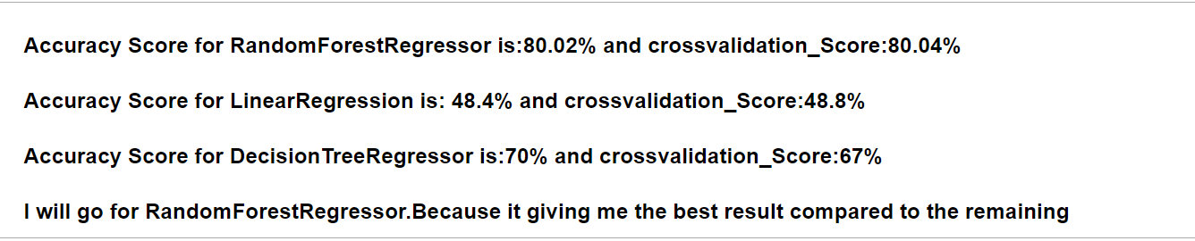
Conclusion

Slide 20
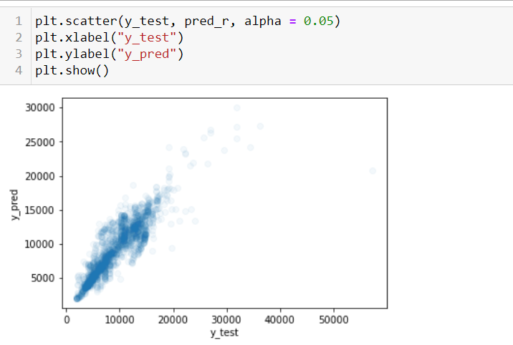
Resultant plotting

