Slide 1
HOUSING PRICE PREDICTION

Slide 2
OVERVIEW:
Houses are one of the necessary need of each and every person around the globe and therefore housing and real estate market is one of the markets which is one of the major contributors in the world’s economy. It is a very large market and there are various companies working in the domain.
A US-based housing company named Surprise Housing has decided to enter the Australian market. The company uses data analytics to purchase houses at a price below their actual values and flip them at a higher price. For the same purpose, the company has collected a data set from the sale of houses in Australia.
AIM:
You are required to model the price of houses with the available independent variables. This model will then be used by the management to understand how exactly the prices vary with the variables. They can accordingly manipulate the strategy of the firm and concentrate on areas that will yield high returns. Further, the model will be a good way for the management to understand the pricing dynamics of a new market.

Slide 3
Exploratory Data Analysis
Train dataset consists of 1168 rows and 81 columns, it consists of 3 float type, 35 integer type and 43 object type of data.
Test data set consists of 292 rows and 80 columns , it consists of 4 float type, 34 integer type and 42 object type of data.
Both train and test data set has null values we need deal with them .Based on the type of the data we need to fill null values. If the variable is null then we need to fill null value with mean else if variable is categorical then we need to fill with mode means most repeated value.
In our dataset most of the null value are categorical that’s why I'm filling the null values with mode. Or for deleting the null values loss of data is high. At the same time for the dropping the entire row it effects the resultant.
At the same time filling null values with mean or mode it may also effect the result. It may give the approximate result not accurate result.

Slide 4
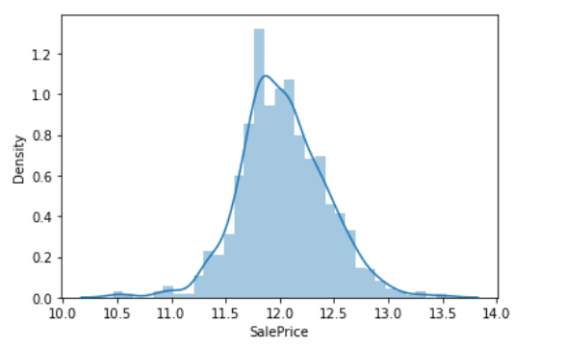
Check For the Data Distribution of numerical variable: In our data set numerical feature is ‘Sale Price’ .
Here the curve is right skew so we apply the log transformation to reduce the skewness of the data.

Slide 5
Check the correlation Matrix:
From the correlation matric we can observe that Lot frontage, LotArea,BsmtfinSF1,2ndFlrSF,BsmtFullBath,HalfBath,BedroomAbvGr,GarageYrBit,WoodDeckSf,OpenPorchSf are low positively related to 'Sale Price’.
OverallQual,YearBuilt,YearRemodAdd,MaxVnrArea,TotalBsmtSF,1stFlrstGrLiveArea,FullBathTotRmAbvGrd,Freeplaces,GarageCars,GarageArea are highly positively related to 'Sale Price’.
OverallCond,LowFinSF,BsmtHalfBath,KitchenAbvGr,EnclosedPorchMisvVal,YrSold are negatively related to 'Sale Price'

Slide 6
Visualization Part

Slide 7
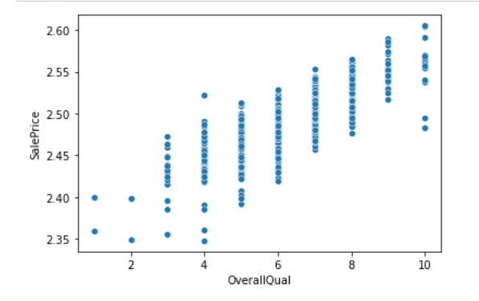
'Overall Qual’ Vs 'Sale Price'

Slide 8
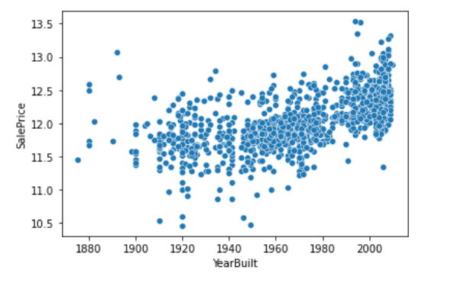
Year Built VS Sale Price

Slide 9
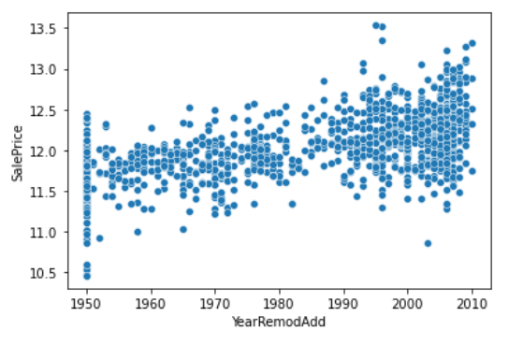
'Year Remod Add' VS 'Sale Price'

Slide 10
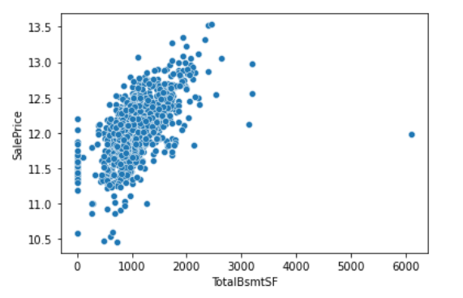
‘Total BsmtSF' Vs 'Sale Price’

Slide 11
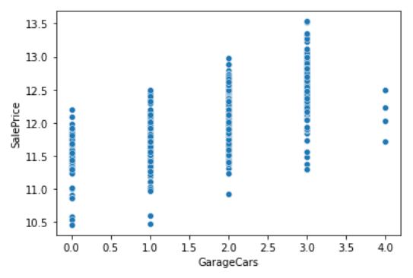
'GarageCars' Vs 'SalePrice’

Slide 12
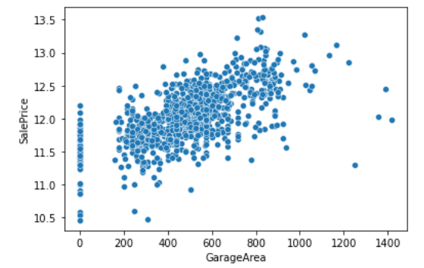
'GarageArea' Vs 'SalePrice'

Slide 13
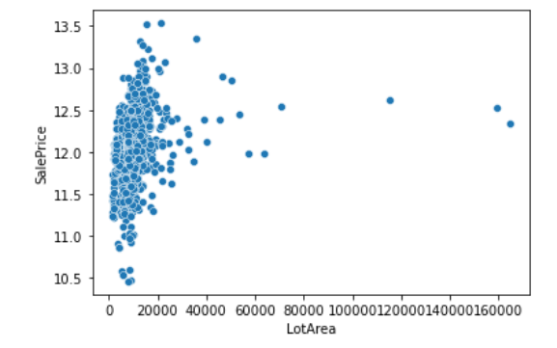
'LotArea' Vs'Saleprice'

Slide 14
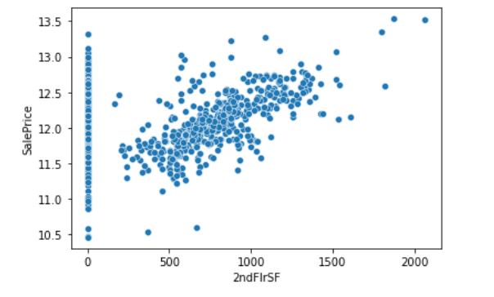
'2ndFlrSF’ Vs 'Sale Price’

Slide 15
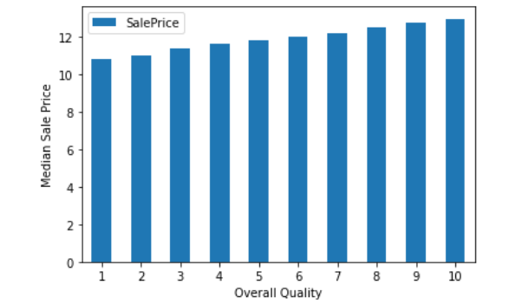
'Overall Quality’ VS ‘Sales Price’

Slide 16
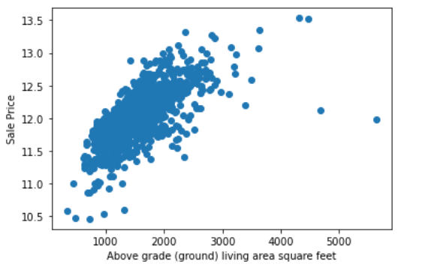
‘GrLivArea’ VS ‘Sale Price’

Slide 17
Data Transformation
For feature process we need to convert the categorical data into numeric format. For that we need to divide the categorical and numerical columns first and then we need to identify the unnecessary columns and drop them from the data set.
After dividing the shape of the numeric set is 1168 columns and 37 rows. For categorical set 1168 columns and 43 rows
Same process for the test data set also. After dividing the shape of the numeric set is 292 columns and 36 rows. For categorical set 292 columns and 43rows.
Now we need to convert categorical data into numerical format for that we used label Encoders for both train and test categorical datasets.
After completing the conversion of data. We concatenate the both numerical and categorical data sets together.

Slide 18
Data Scaling:
Before going to model the data we need to scale our data.
For that we need to divide target and feature variables. then apply the standard scaler for ‘x’.
The process is repeat for the test data set also. After this we go for the modelling our data.
Before building our model we need to train our data by importing train_test_split.

Slide 19
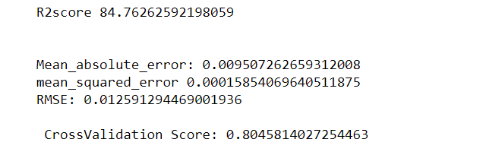
Linear Regression:

Slide 20
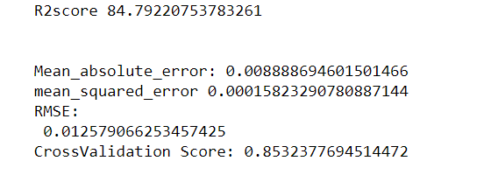
Random Forest Regressor

Slide 21
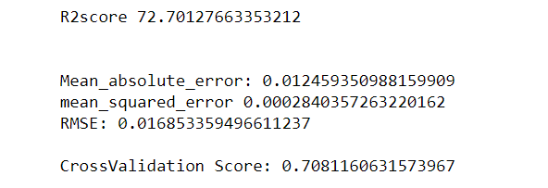
Decision Tree Regressor

Slide 22
Accuracy Score and Cross validation score are
Linear Regression 85% and crossvalidation_Score:80%
Random Forest Regressor is:84% and crossvalidation_Score:85%
Decision Tree Regressor is:72.7% and crossvalidation_Score:70%
I will go for Random Forest Regressor. Because it giving me the best result compared to the remaining

Slide 23
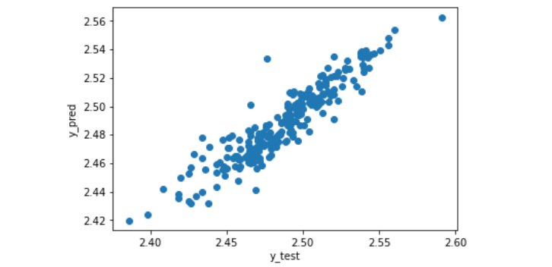
‘Prediction’ Vs ‘Actual’

Slide 24
Conclusion
Our model predicts that based on overallQual,YearBuilt, YearRemod Add,MaxVnrArea,TotalBsmtSF,1stFlrstGrLiveArea,FullBathTotRmAbvGrd,Freeplaces,GarageCars,GarageArea on these variables ‘Sales Price’ is increased

