Slide 1
CUSTOMER RETENTION

Slide 2
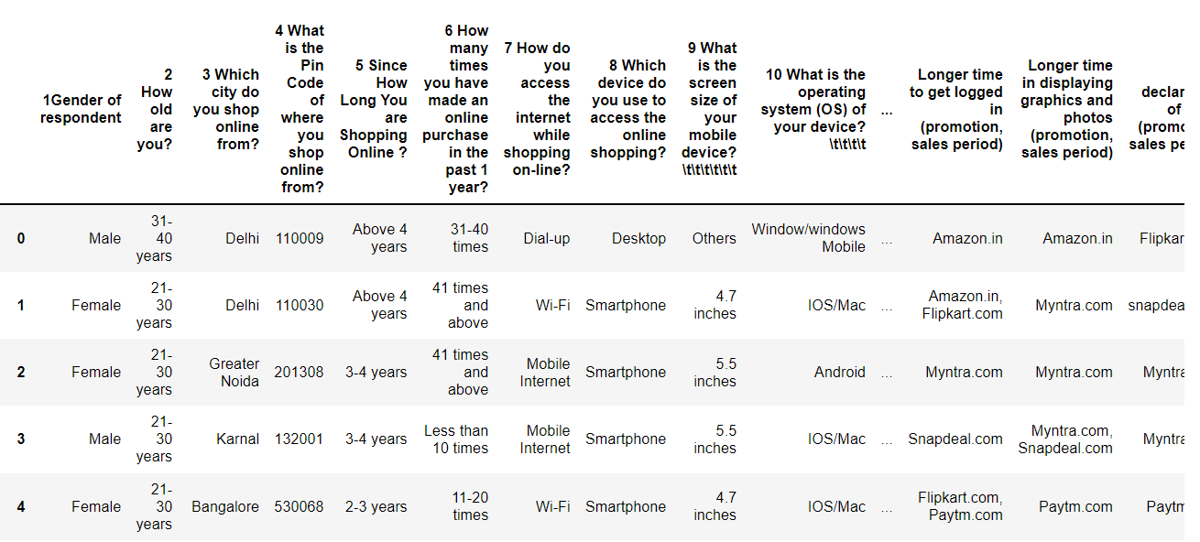
Our dataset

Slide 3
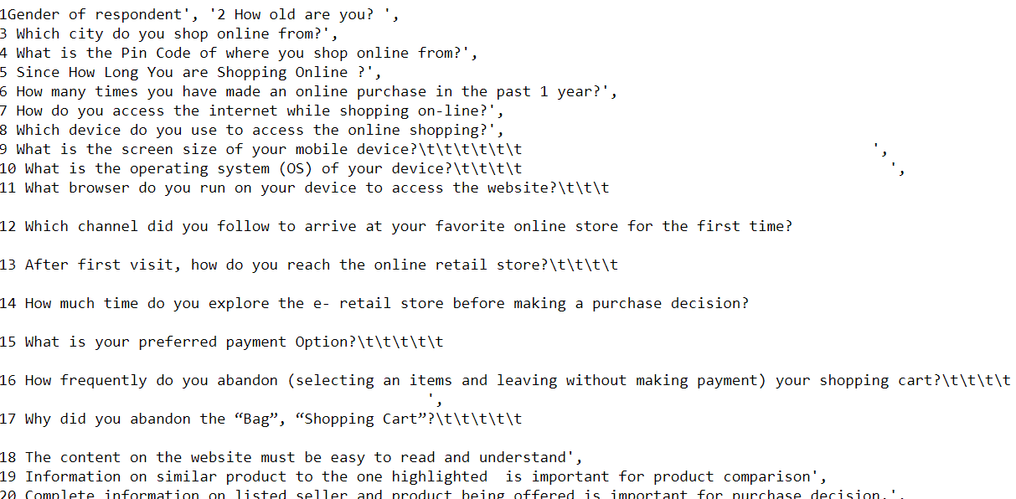
Columns:

Slide 4
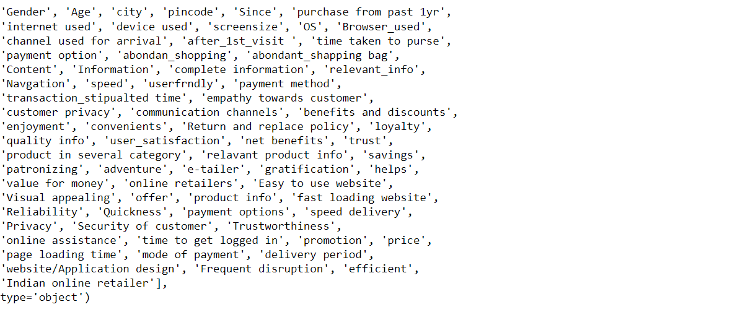
Column name are not in understandable way. so, we need to rename them. after renaming resultant.

Slide 5
Check list for Data set:
Shape : 269 rows and 71 columns
Information : Our data set has 1-integer and 70-object values.
Null values : There is no null values in our dataset

Slide 6
Visualization Customer Retention Vs Data factors

Slide 7
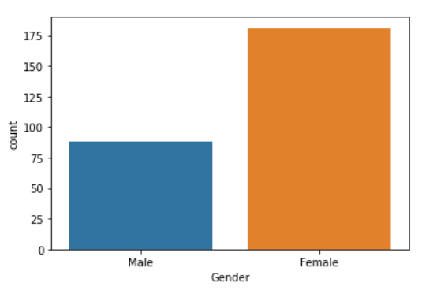
Gender:
From the above we can observe that most of online shopping customers are female

Slide 8
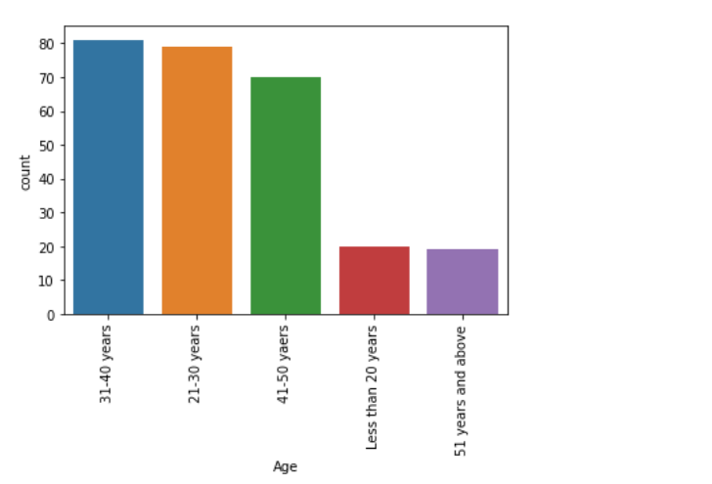
Age:
Most of online shopping age group are in between 31-50

Slide 9
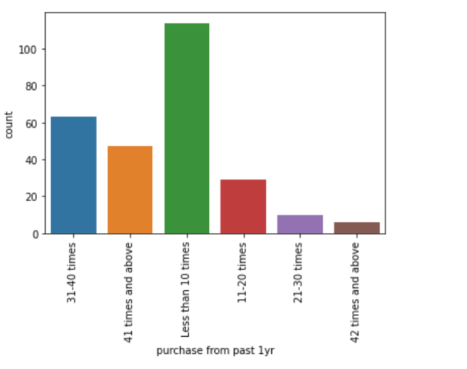
Purchase from past 1yr:

Slide 10
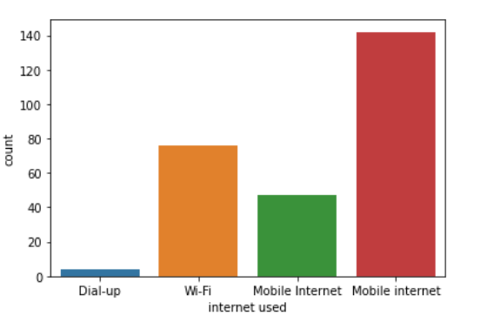
Internet Used:
Most of them are using their mobile internet

Slide 11
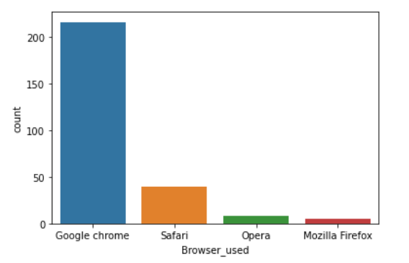
Browser used:
Most of them are using Google chrome

Slide 12
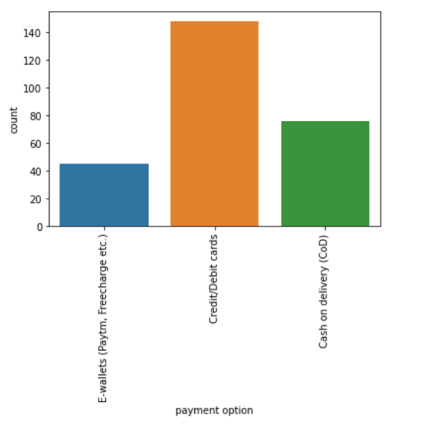
Payment option:
Most of them are preferred Credit/Debit cards

Slide 13
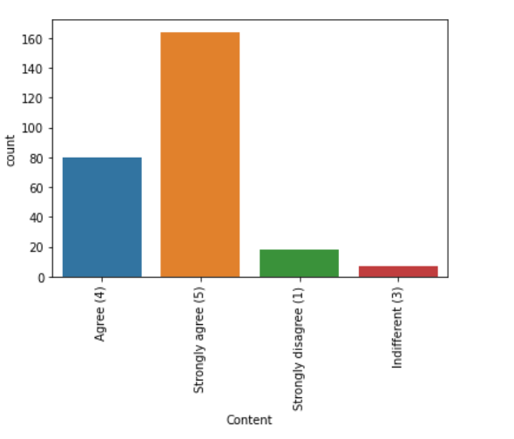
Content:

Slide 14
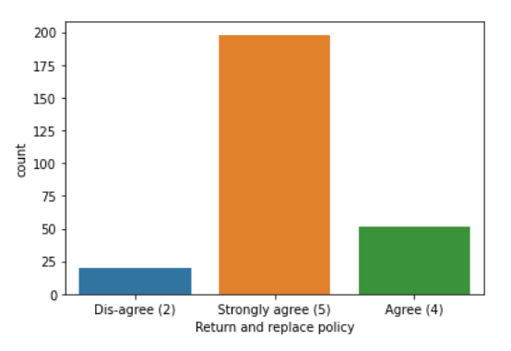
Return and replace policy:

Slide 15
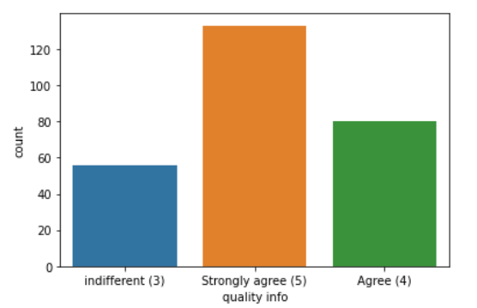
Quality info:

Slide 16
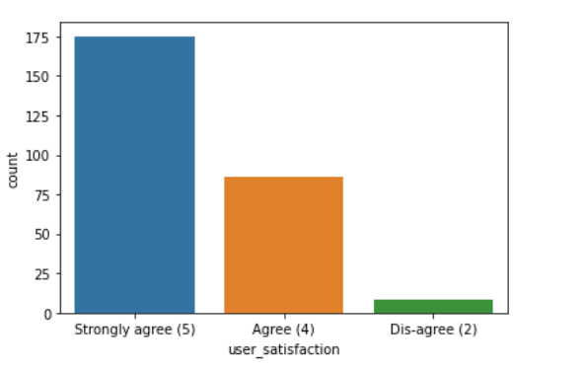
User satisfaction:

Slide 17
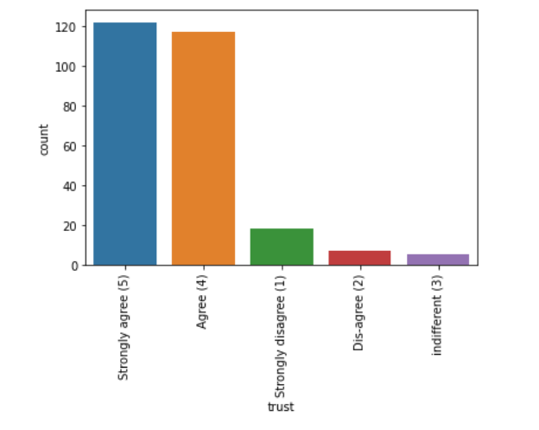
Trust:

Slide 18
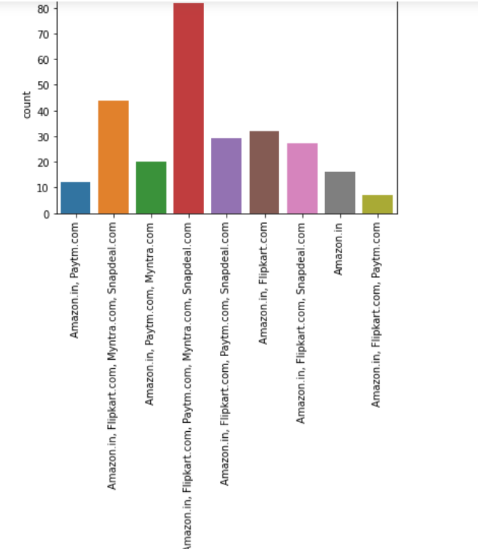
Online retailers:

Slide 19
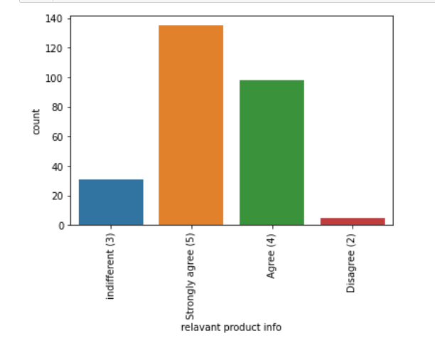
Relevant product information:

Slide 20
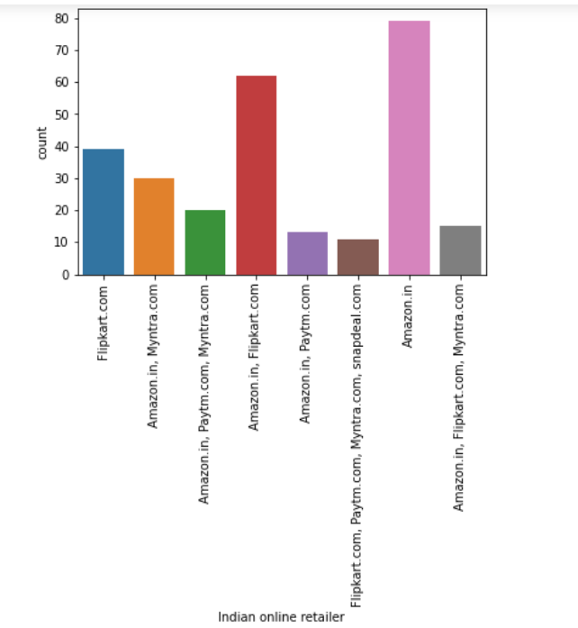
Indian online retailer:

Slide 21
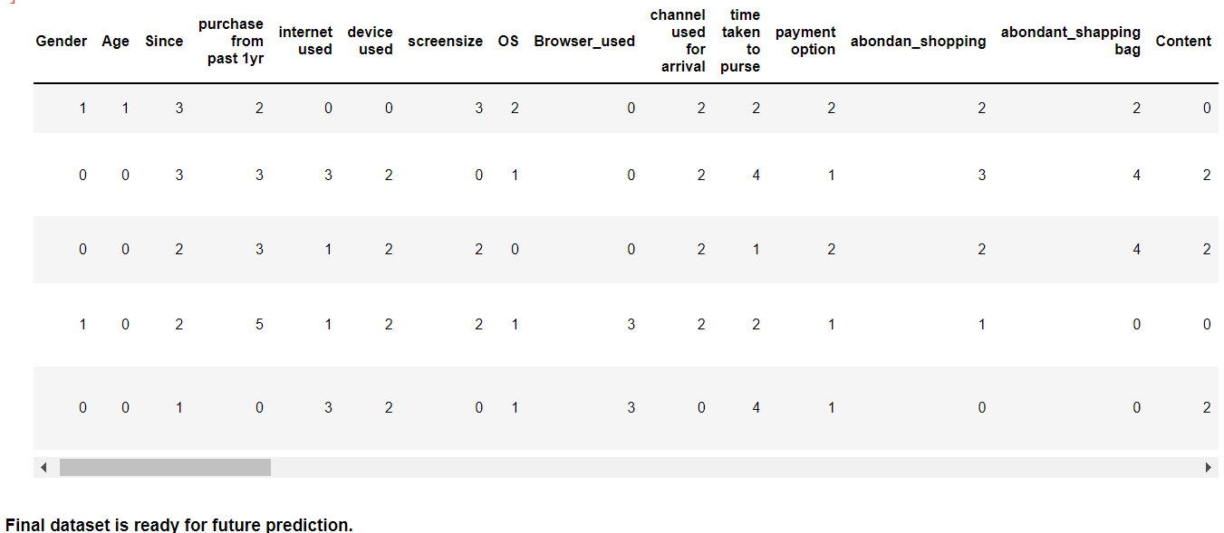
For future purpose we need to encode our data. After encoding data it looks like.

Slide 22
Conclusion:
Our data set is completely in categorical data format. For future purpose we need to encode the data.
For encoding purpose I divided the data set into categorical and nominal data sets.
Categorical :Represents only categorical data like age, gender, type etc
Nominal :Represent the particular name of the data set.
For encoding purpose me used Label Encoder. Before use this we need to import the supporting library files.
To check for the outliers and data distribution. our data is categorical data. so, I didn’t went for it.

