Slide 1

Analysis of Covid Spread in the Subcontinent

Slide 2
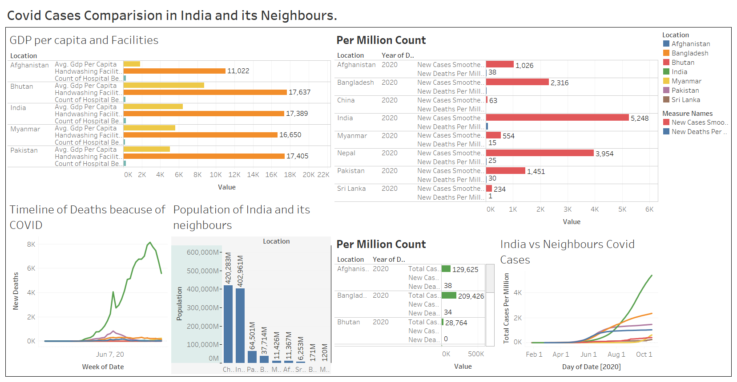
Dashboard
https://public.tableau.com/profile/bhanu.teja2171#!/vizhome/Covid_16031720885220/Dashboard1

Slide 3
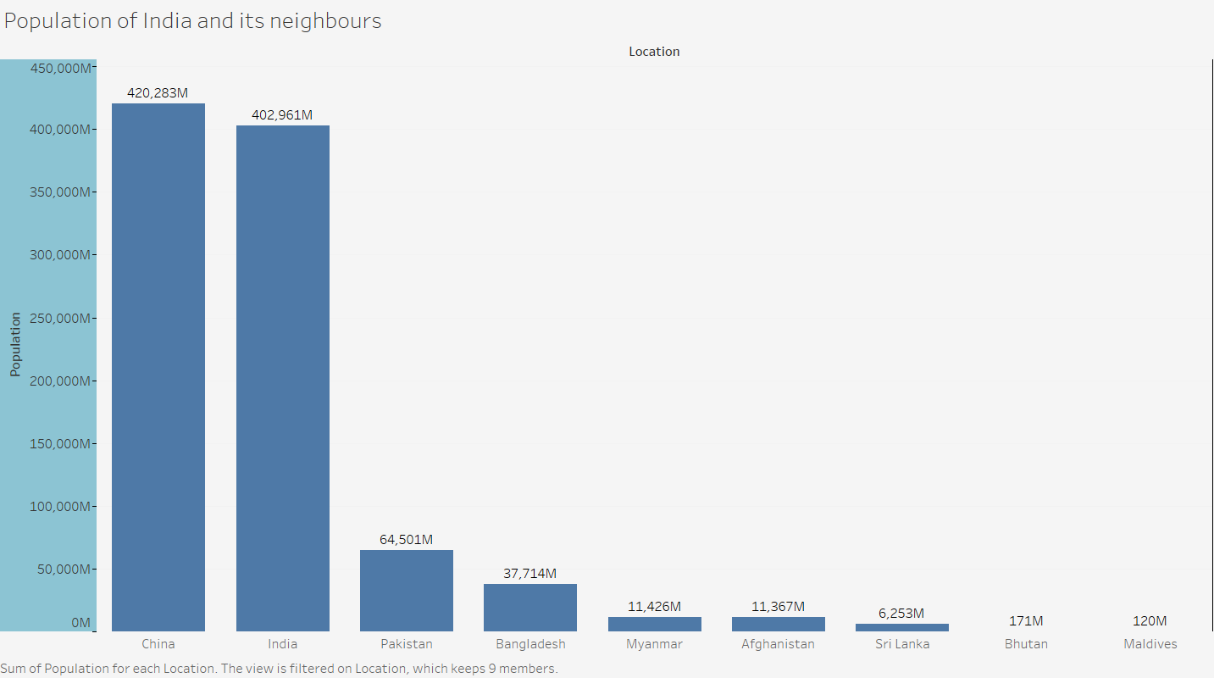
Notes:
Population Wise China’s Population is more than that of India and other countries.

Slide 4
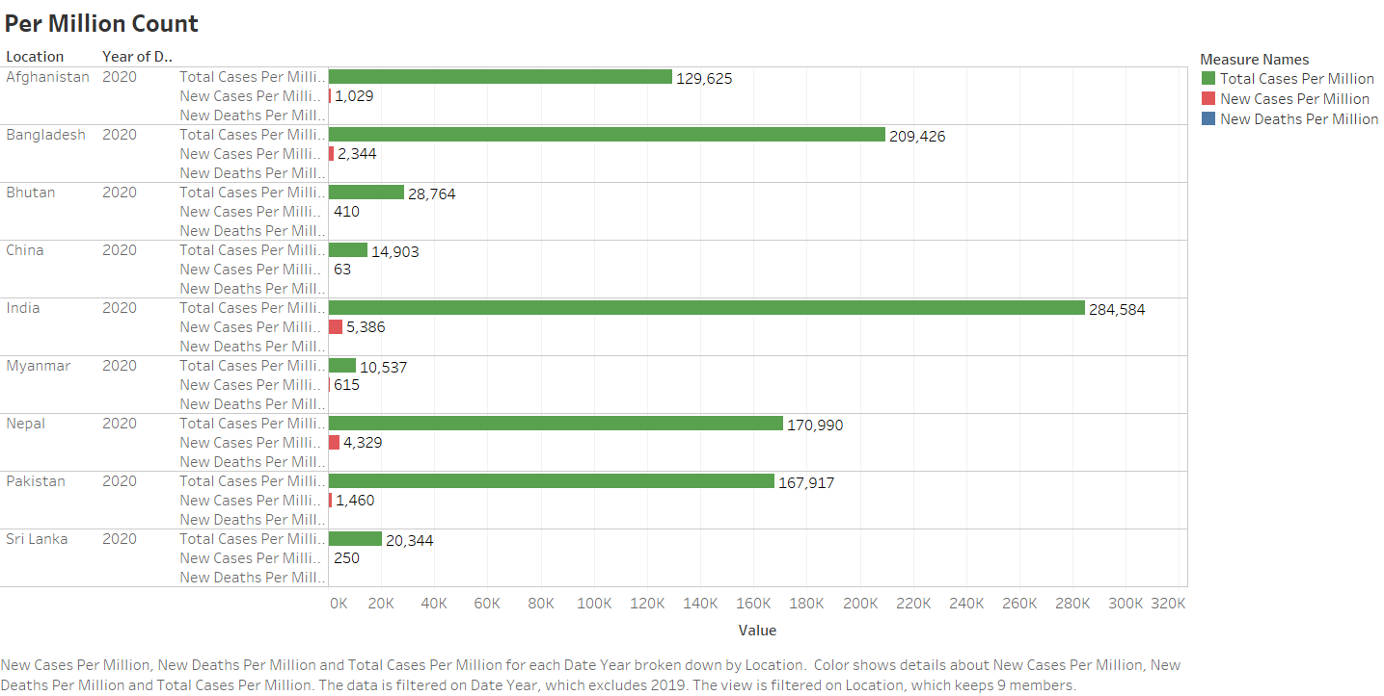
Notes:
China’s Data is Incorrect because the PRC(People’s Republic of China) has stopped making its COVID tally public.
Comparing the countries in Subcontinent India has more cases followed by Bangladesh.(Not the Latest Data Source)

Slide 5
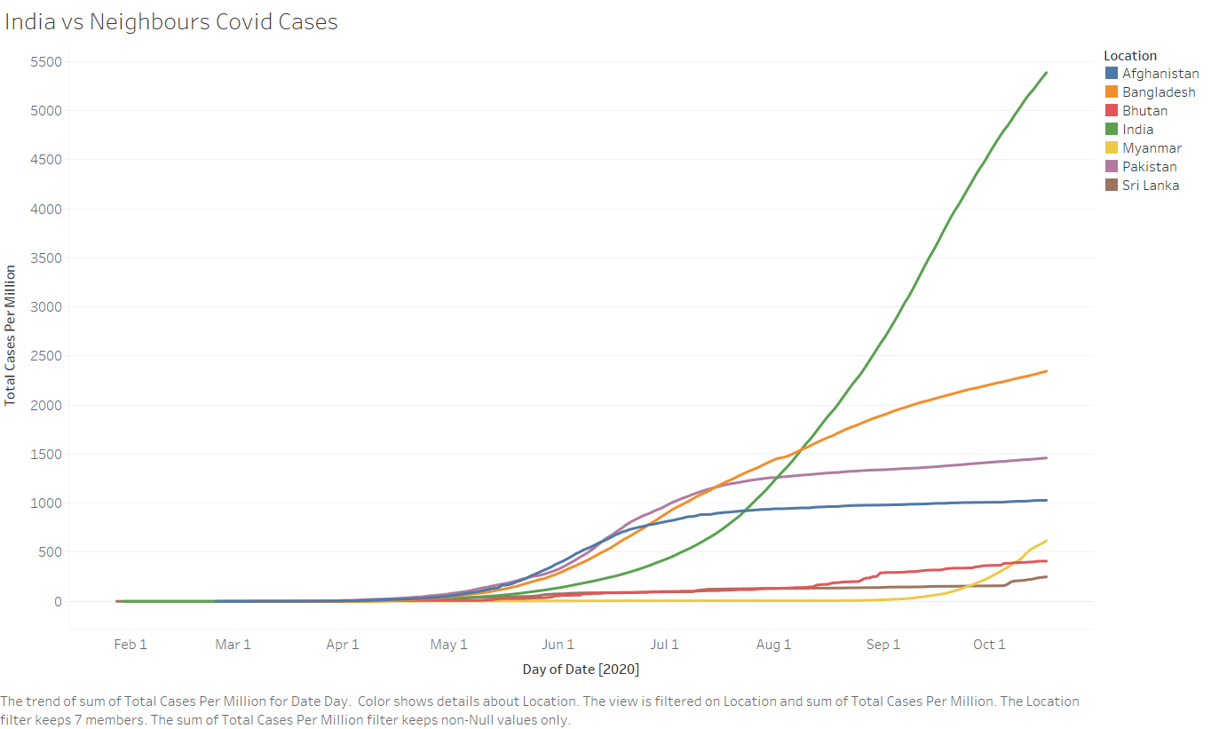
Notes:
Seeing the Timeline as well the Cases per million is drastically increasing in India and Bangladesh

Slide 6
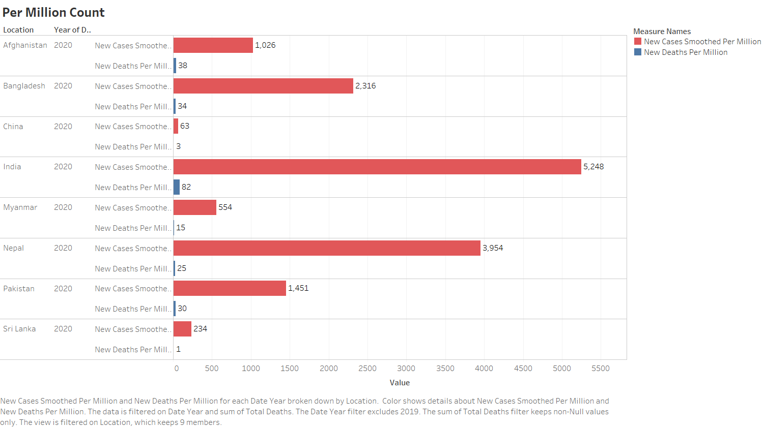
Notes:
India and Nepal Dominates here.

Slide 7
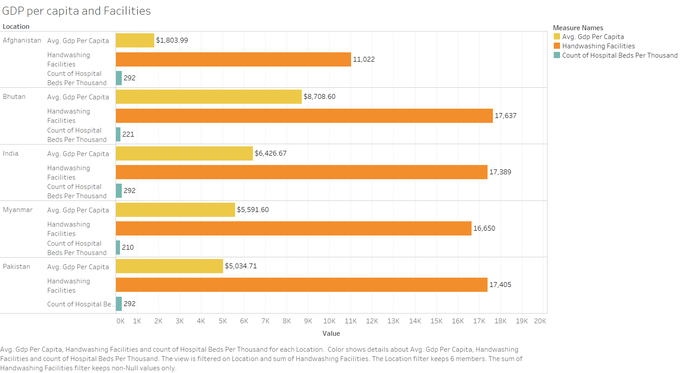
Notes:
The Handwashing Facilities of almost all the countries in the subcontinent is same. India being the most populated country and with the highest per capita income among all the countries must increase the number of hospitals and Handwashing Facilities.

Slide 8
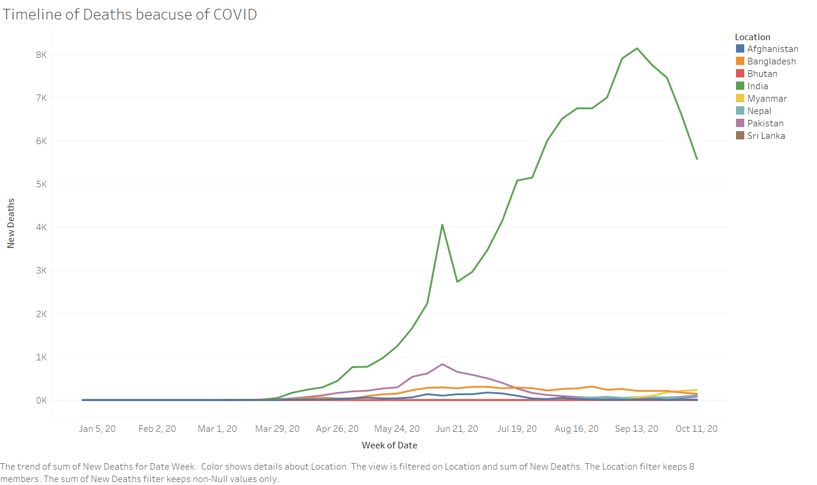
Notes:
Though the Number of Deaths are decreasing in many of the countries but still the governments must focus on increasing the number of health care facilities.

