Slide 1


Introduction to HDFS Directory Structure
HDFS (Hadoop Distributed File System) organizes data into a file system with a unique structure. It's essential to understand the directory layout for effective data management in HDFS.

Slide 2
Command to Create a Directory in HDFS
Command
Example
Use the command hadoop fs -mkdir to create a directory in HDFS.
For example, hadoop fs -mkdir /user/your_username/hdfs_directory.

Slide 3
Using the -p Option to Create Parent Directories
1
Functionality
2
Use Case
The -p option allows the creation of parent directories if they don't exist.
It's useful when creating nested directory structures in HDFS.

Slide 4

Specifying the Path for the New Directory
Path
Ensure to specify the complete path for the new directory in HDFS.

Slide 5
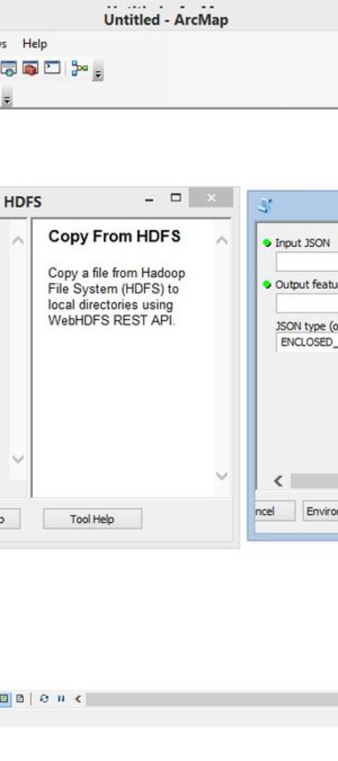
Command to Move a File in HDFS
Command
Execute hadoop fs -mv to move a file in HDFS to another location.

Slide 6
Moving a File to a Different Directory in HDFS
1
Step 1
Specify the source path of the file to be moved.
2
Step 2
Provide the destination path for relocating the file in HDFS.

Slide 7



Specifying Source and Destination Paths for the File
Source
Destination
Define the path of the file to be moved within HDFS.
Specify the target directory for moving the file in HDFS.

Slide 8
Conclusion and Key Points
1
2
Maintain Order
Command Accuracy
Keep directory structures tidy for efficient data organization.
Ensure precise use of commands to avoid data loss.

