Slide 1
Project 1
Bike Rental
(Presentation by Bhanwar Singh Rathore)

Slide 2
STEP 1: Data Loading & Merging in Excel
We imported datasets and merged all three datasheets on common keys like instant & date(dteday) via Power Query.
STEP 2: Data Handling & Cleaning in Excel datasheets
We used shortcuts and formating data by applying sort, filter data.
Detected and handled missing or inconsistent data by applying formulas
Removed duplicate data and filled with correct data types.
We Used basic formulas like SUM, AVERAGE, COUNT, TEXT etc to fill missing values and format data.
Screenshots attacted of the work done below:

Slide 3
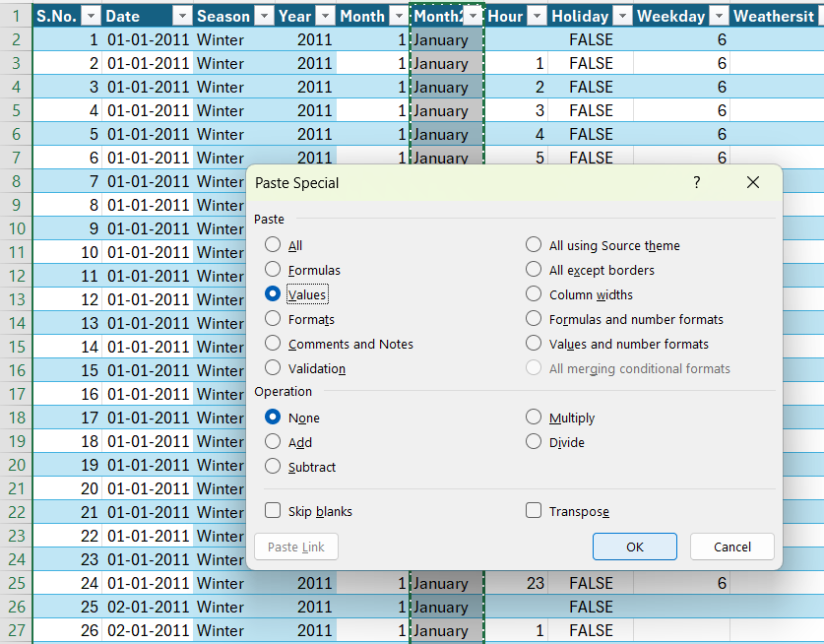

Slide 4
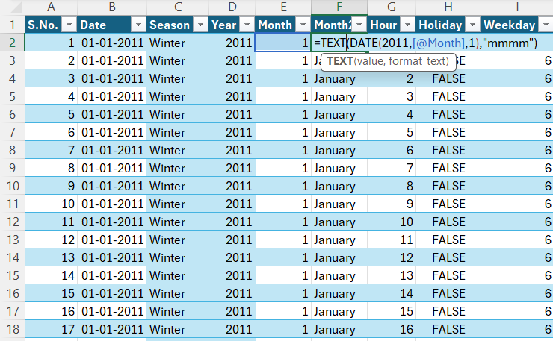

Slide 5
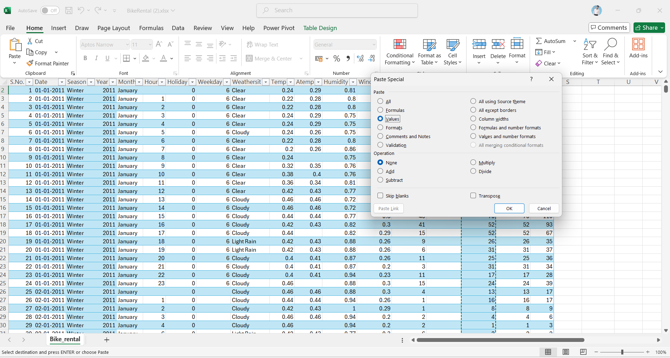

Slide 6
STEP 3: Advanced Data Analysis
Created pivot tables and pivot charts to summarize user demand by time, weather.
STEP 4: Data Visualization
Build interactive dashboards combining multiple charts (line, bar, pie, etc.).
Add slicers and timelines for filtering dashboards dynamically.
STEP 5: Final Project: Automated Data Reporting
Generate comprehensive, automatically updating dashboards and reports.
Provides insights.
Screenshots attacted of the work done below:

Slide 7
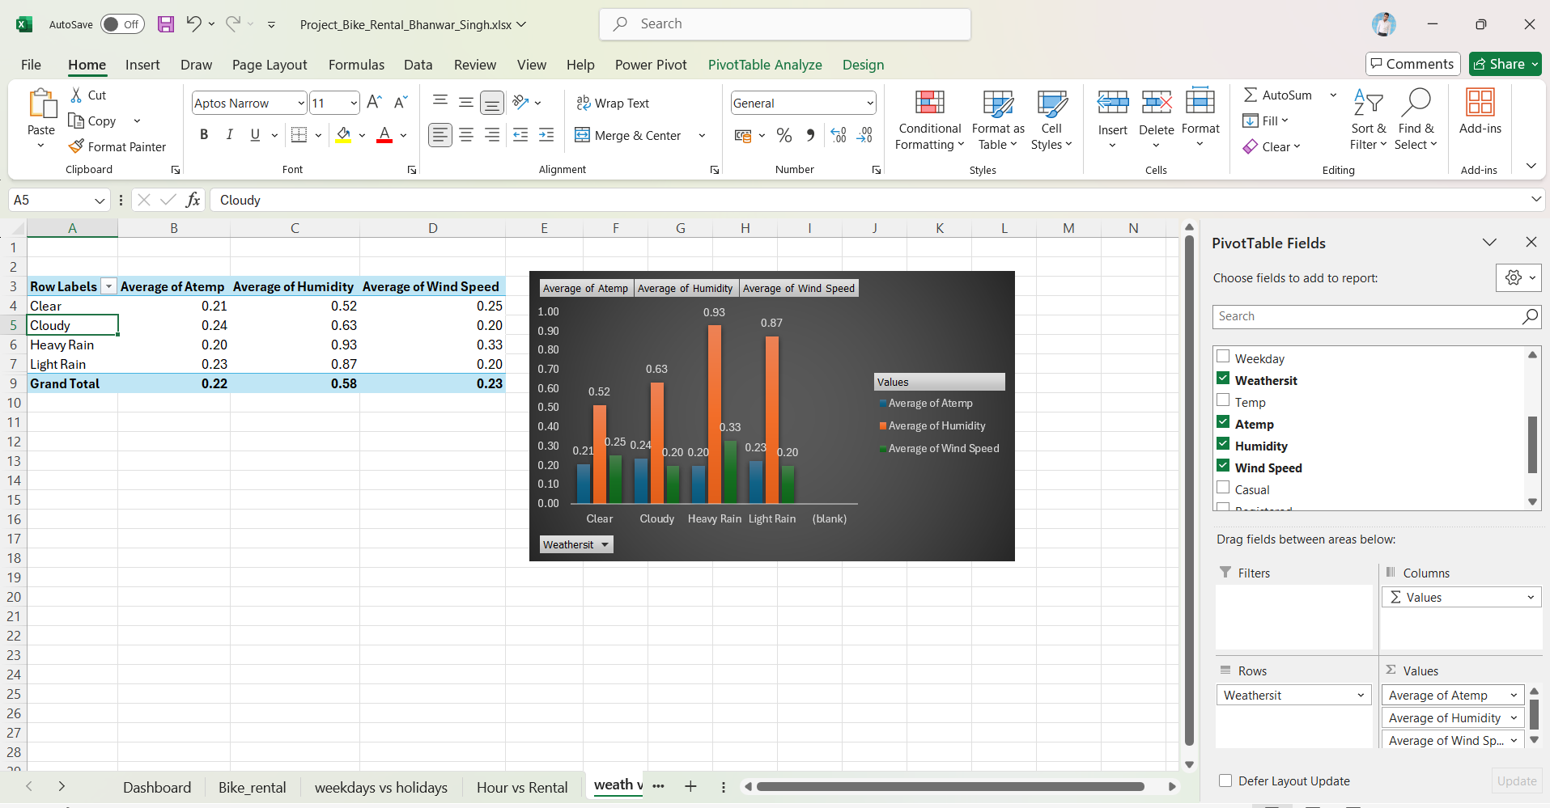

Slide 8
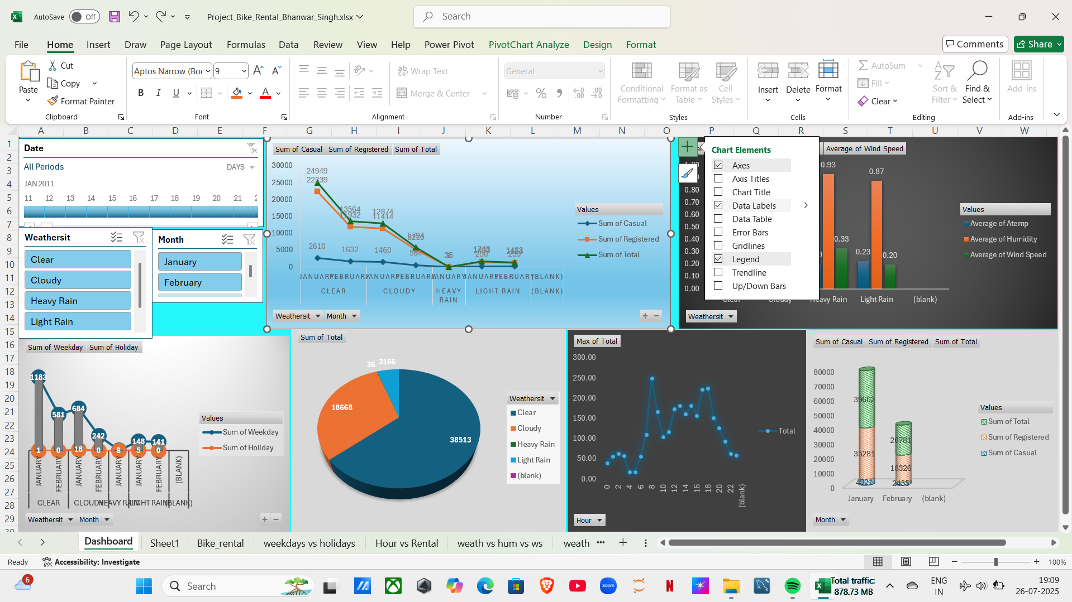

Slide 9
Insights
In January month, person taken maximum bikes on rent.
Maximum person took rike in clear weathersit & thereafter cloudy and light rain.
In heavy rain,lowest number of rides taken.
Advance registration is higher than casual registration in all weathersit.
Ride time is higher around 9 AM & 7PM whereas lower around 4AM.
ATTACHEMENTS
Excel workbook : To provide overview in details
Data analysis,
Dashboards &
Automations

Slide 10
THANK YOU

