Slide 1
AI Medical Report Information Extraction Using Gemini Vision (Project 10)
Prepared by Bhanwar Singh

Slide 2
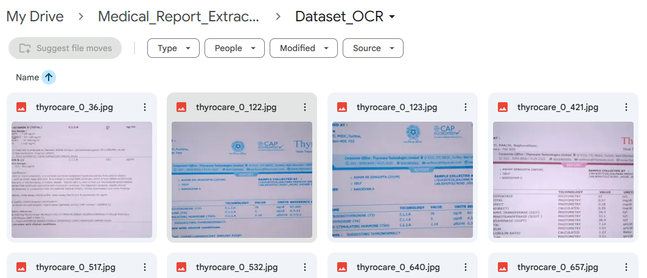
Problem Statement
Healthcare organizations generate large numbers of scanned medical reports.
Challenges:
Medical reports are often scanned documents.
Manual extraction is time-consuming.
Data is unstructured.
Difficult to manage large datasets.
Human errors may occur.

Slide 3
Project Overview
This project automatically extracts structured medical information from scanned medical reports using Google's Gemini Vision model.
The extracted information is converted into structured CSV and Excel formats.

Slide 4
Objectives
The objectives of this project are:
Extract information from scanned medical reports
Automate document understanding
Convert unstructured reports into structured data
Export results to CSV and Excel
Reduce manual effort

Slide 5
Technology Stack
Technology | Purpose
Google Colab | Development
Google Drive | Storage
Gemini API | Information Extraction
Pandas | Data Processing
OpenPyXL | Excel Export
Python | Programming

Slide 6
System Architecture
Medical Report Images
Google Drive Storage
Google Colab
Random Image Selection
Gemini Vision API
JSON Extraction
Pandas DataFrame
CSV / Excel Output

Slide 7
Key Features
Automated medical report analysis
Gemini Vision-based extraction
Random image selection
Structured JSON generation
CSV export
Excel export
Google Drive integration

Slide 8
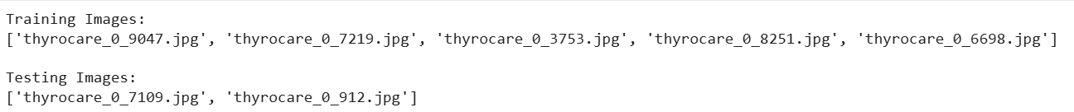
Dataset Description
Dataset Details:
Total Images = 100
Format = JPG
Random Selection Used
Training Images = 5
Testing Images = 2

Slide 9
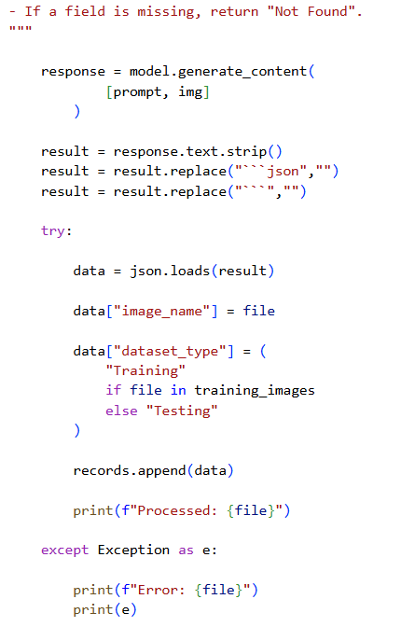
Implementation
Workflow:
Mount Google Drive
Load Dataset
Random Selection
Gemini Analysis
Extract Information
Store Results
Export CSV/Excel

Slide 10
Gemini Extraction Output
Fields Extracted:
Name
Test Asked
Test Name
Technology
Value
Unit
Clinical Significance

Slide 11
Results & Outcomes
Successfully processed medical reports
Extracted structured information
Generated JSON output
Created DataFrame
Automated information extraction
Reduced manual processing effort
Exported CSV reports
Exported Excel reports
Future Scope
PDF report support
Multi-language documents processing
Streamlit web application
Hospital database integration
Medical analytics dashboard

Slide 12
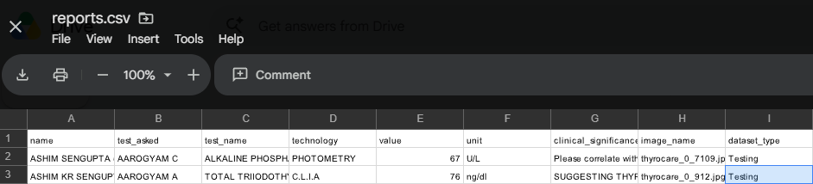
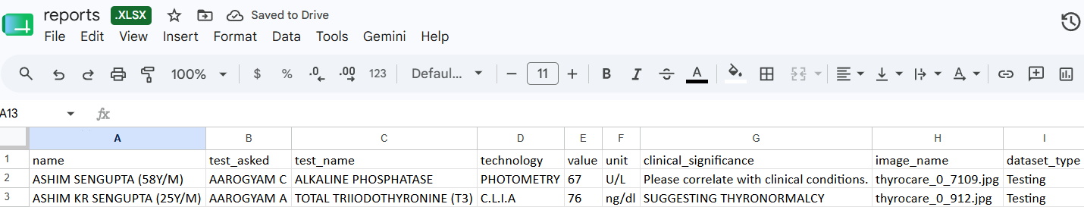
Output Files
Generated Files:
reports.csv
reports.xlsx

Slide 13
Conclusion & Future Enhancements
Conclusion
Successfully extracted medical information from scanned reports.
Converted unstructured documents into structured datasets.
Generated CSV and Excel outputs automatically.
Demonstrated AI-powered document understanding using Gemini Vision.
Future Enhancements
PDF report support
Multi-language document processing
Streamlit web application
Hospital database integration
Real-time analytics dashboard

Slide 14
THANK YOU

