Slide 1
PROJECT 2
Calculator
(Presented by Bhanwar Singh Rathore)

Slide 2
Introduction
GUI Calculator Application (Built with Python and Tkinter)
Overview:
A simple yet functional calculator
Performs basic arithmetic operations
Interactive graphical interface

Slide 3
Objectives: To create a user-friendly calculator with essential features using Python's Tkinter library.
Key Features:
Equation display screen
Clickable buttons for input
Core arithmetic operations (+ - x ÷ )
Result evaluation and display (=)
Clear input (AC) and backspace (←) functionality
Square root (√ )and percentage support (%)
Code Structure:
Modules used:
tkinter for GUI
math for square root

Slide 4
Functions Used:
buttonClick(number) – Handles input
buttonEqual() – Evaluates expression
buttonClear() – Clears display
buttonBackspace() – Deletes last character
buttonSqrt() – Computes square root
eval() and math.sqrt() – for calculations
GUI Layout:
Grid System Used:
5 rows × 4 columns
Each button placed using .grid(row, column)
Entry widget spans all columns for display
STYLING:
Font: Arial, bold, size 20
Background: Powder blue for display
Buttons: Consistent padding and border

Slide 5
Error Handling:
Try–except blocks used in:
buttonEqual()
buttonSqrt()
Displays "Error" for invalid input
Prevents app from crashing
Conclusion
Demonstrates GUI development using Tkinter
Covers core calculator logic and user interaction
A great foundation for more advanced Python GUI projects
Attachements:
Python GUI Calculator (.py) file using Visual Studio Code

Slide 6
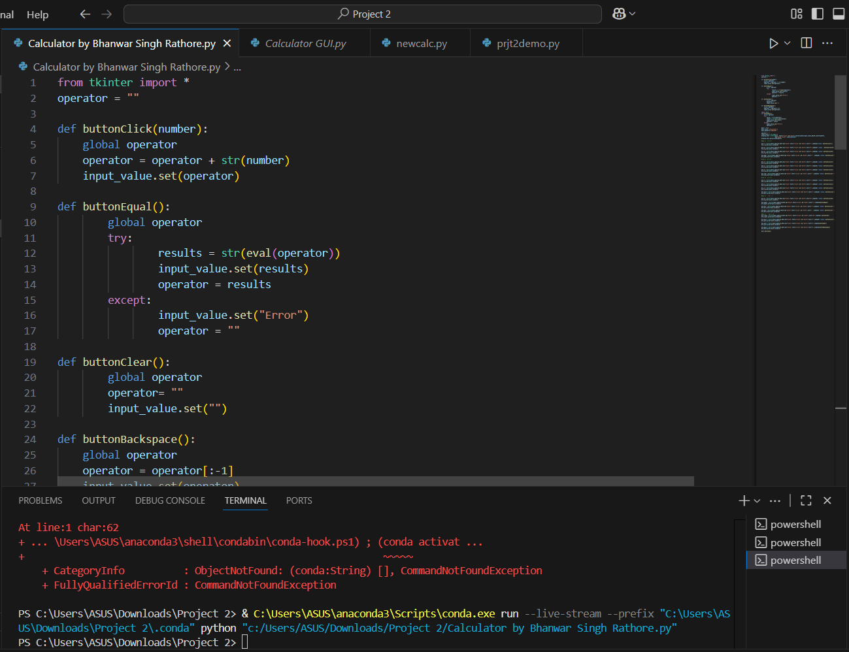
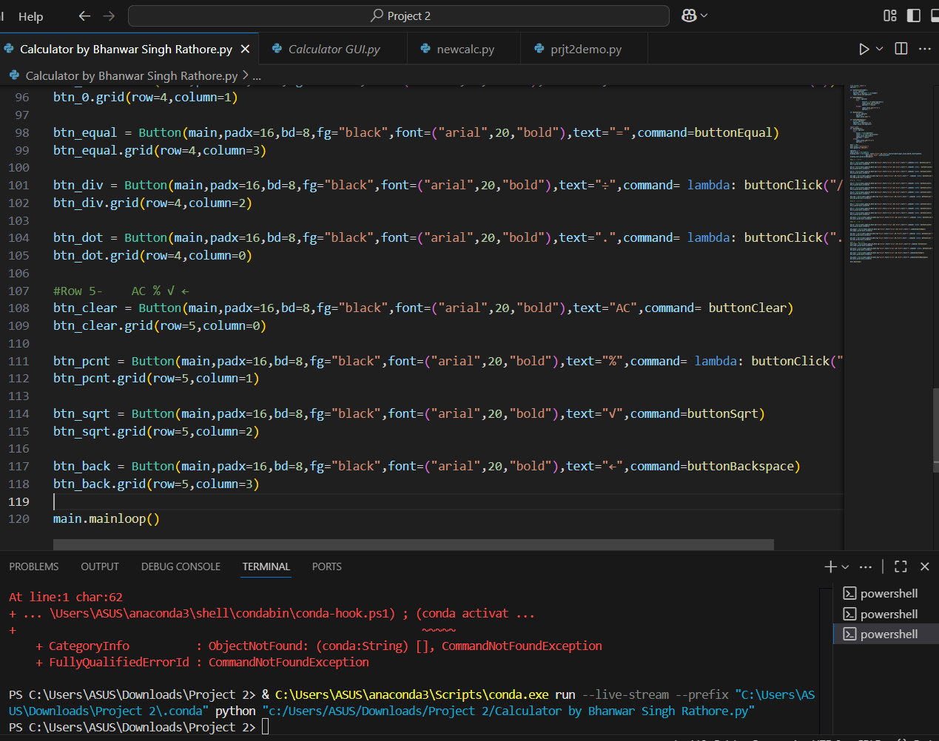
Visual Studio Code

Slide 7
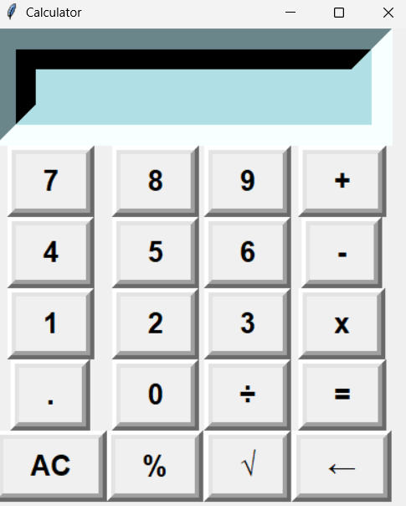
Calculator

Slide 8
THANK YOU

