Slide 1

Established 2005

Slide 2
Introductions
Logan Woods- Chief Executive Officer, Drive Team
Scott Varvel- Chief Operating Officer, Drive Team
Alex Cambiano- Chief Safety Officer, Electrical
Joseph Tatum- Awards Coordinator, Mechanical

Slide 3
What is FIRST?
For Inspiration and Recognition of Science and Technology
Founded 1989, by inventor Dean Kamen
“…to create a world where science and technology are celebrated….where young people dream of becoming science and technology heroes….”
85,000 volunteers worldwide
Notes:
$32 million operating budget
3,000+ corporate sponsors
Board Chairman John Abele, Founder Chairman of Boston Scientific

Slide 4
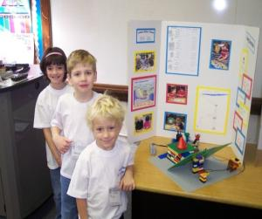
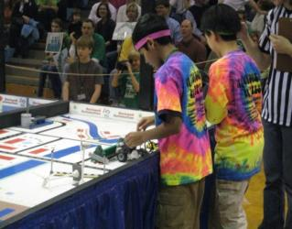
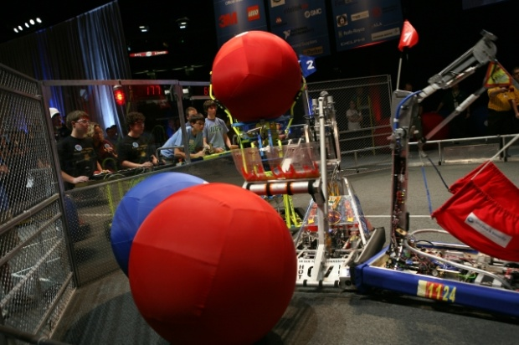
What is FIRST?
FIRST Programs
Problem solving and creativity with new challenges every year
Teams of young people with mentors working under a tight timeline to learn efficiency and effectiveness
A value system based on “Gracious Professionalism,” “Teamwork,” and “Co-opetition”
Jr. FIRST LEGO League
FIRST LEGO League
FIRST Robotics Competition
K 1 2 3 4 5 6 7 8 9 10 11 12
Grade Level
Notes:
“Sport for the mind,” combining the excitement of sport with science and technology
Junior Lego League:
FIRST Lego League:
FIRST Robotics Competition:

Slide 5
Liberty High School Robotics
Comprises a year long program with an “Off-Season”, a “Build Season” and a “Competition Season”
Off-Season – May to December
Website Design
Marketing and Public Relations
Community Outreaches
Mentor and Team Member Recruitment
Training/Development
Notes:
Off-Season
May-December
Website Design
Marketing and Public Relations
FIRST Lego League Competition Host
Community Outreaches
Robotics Camp
Massive Mini
Highway Clean-Up
Presentations to local elementary schools and corporations
Fundraising
Mentor and Team Member Recruitment
Training/Development

Slide 6
Build Season
First Weekend of January – Third Week of February
Begins with Kick Off
Building a robot from the ground up
40+ hours a week including weekends
Creating competition award entries
Notes:
First Weekend of January – Third Week of February
Begins with Kick Off
Building a robot from the ground up
Mandated 6 week timeframe
40+ hours a week including weekends
Most nights end between 9 P.M.-10 P.M.
Study period if needed
One night off per week scheduled…
We work on snow days
Creating competition award entries
Chairman’s Award
Woody Flowers Award
Autodesk Inventor Design and Visualization Design

Slide 7
Post Build/ Pre-Competition Season
Late February to April
Pit design (10’x10’x10’)
Scouting
Pre-Competition Event
Notes:
Late February to April
Pit design (10’x10’x10’)
Sponsor and Mentor Banners
Organization
Educational Displays
Safety Preparation
Mandatory team safety test
Safety personnel selection
Safety equipment
Scouting
Pre-Competition Event

Slide 8
Competition
Alliance format
Team analysis
Seeding
Double elimination final matches
Two Regional Competitions
Kansas City
Out of State
World Championships in Atlanta, GA

Slide 9


Slide 10
Learned and Demonstrated Expertise
Engineering Skills
Mechanical
Electrical
Computer Aided Design (CAD)
Programming
Metal Working
Woodworking
Equipment Operation
Safety
Business Skills
Accounting
Marketing and Public Relations
Teamwork
Project Management
Graphic Design
Design Process
Web Design
3D Animation

Slide 11
Robotics has Changed Every One of Us
Notes:
J.D. Irwin 2006-2007
“Robotics was an invaluable experience for me, which helped me to further my skills working with a team, showed me responsibility, and to have faith and rely on others. While you can learn to work with a team in many school activities, you don't learn to function like a family. With the intensity of the robotics program you develop a relationship with your teammates that far surpasses any involvement in any other school activities. Simply put robotics isn't a team experience, its a life experience.”

Slide 12
Team Accomplishments
Awards
2008 Engineering Innovation Award
2008 Motorola Quality Award
2009 Controller System Award
2009 Team Safety Award
2009 Gracious Professionalism Award
Competition
2008 Quarter Finalist Denver Regional
2008 and 2009 Quarter Finalist Kansas City Regional
2009 Quarter Finalist St. Louis Regional
CAD
Top 5 CAD Finalists at World Competition in both 2008 and 2009 Autodesk Inventor Award

Slide 13
Current Budget
Competition Entry Fees
Competition Travel
2 Regional Events : Kansas City and St. Louis (25 Students + mentors and parents)
Atlanta: CAD Award Finalist Only (7 Students and 1 Coach)
Robot (R&D, Parts, Build, etc)
Community Outreach
Massive Mini, KC LEGO League Championship, Fall Festival Parade, 5th Grade Science Nights, Science Olympiad
Total
$10,000
$10,000
$7,000
$1,500
$28,500

Slide 14
Upcoming Newly Budgeted Items
Elementary/Middle School Robotic Summer Camps
“Week 0” Competition
Sponsoring Elementary Jr. FIRST Lego League Teams
Additional Travel Expenses
Web address hosting, 501c3 filing charges, Patent fees and other legal fees
Student Scholarship Program ($1000 for 2 students)
Engineering Day at the K (may be for 2010 season)
Additional Total
$7,000
Est. $2,000
$500
$8,000
Est. $3,500
$2000
$10,000
$33,000

Slide 15
Team Mission Statement
Our mission is to inspire young people to be science and technology leaders, by engaging them in exciting mentor-based programs that build science, engineering and technology skills, that inspire innovation, and that foster well-rounded life capabilities including self-confidence, communication, and leadership.

Slide 16
Team Values
Students drive the project. Mentors assist.
Each team member, mentor and parent is equally important to the success of the team.
Sharing knowledge among team members and developing youth is key to the longevity of the program.
We work in co-opetition with other teams in the FIRST community.
“Gracious Professionalism” is a capstone of our program.
Through a high level of mutual support, trust, and coordination, a high standard in innovation can be achieved.

Slide 17
Team Goals
Compete at World Championship in Atlanta
Win a Regional Chairman’s Award
Double the active members on the team while also increasing ethnic and gender diversity
Achieve an effective mentor base for all aspects of the competition by 2010
Increase Sponsorship
Assist ALL Team Members in securing scholarships, internships and other professional level support
Be a mentor team for those teams who need support
Win Industrial Safety Award

Slide 18
How You Can Help
Liberty Robotics needs Sponsors
Sustainability of the Team for years to come
Robotics Students need Mentors
Internships for Team Members
Scholarships for Team Members
Team members should not be kept from college by their financial situation

Slide 19
Sponsorship Benefits
Benefits may include:
Company Name recognition
Pit
Robot
Parades
Community Outreaches
Before matches at competition
Alliance selection/acceptance speeches
See handout for detail

Slide 20
Keep it Going
The excitement grows every year
This program develops a multi-disciplined skill set for every team member
90% + of all team members attend college
50% of all collegiate team members choose STEM (Science, Technology, Engineering, Mathematics) as their fields of study.
Other fields include math & elementary education, web design, art, US. Army, and self-employed.
This is FIRST Robotics- Join Us and Help Us Change the World

Slide 21
Questions?

