Slide 1
Redux :
State Management

Slide 2

REDUX
Redux is a state management tool. ... With Redux, the state of your application is kept in a store, and each component can access any state that it needs from this store.

Slide 3
Redux Architecture

Slide 4
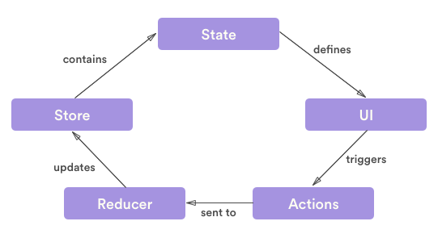
Redux Data Flow

Slide 5
ACTIONS
The status of our application will only change if we execute an action. An action is a simple plain Java Script object that describes a change. Just as the state is the minimum representation of the data in our app, the action is the minimum representation of the change in the data. Any action should always have a type property; whose value is different from undefined. Each app will have its own actions defined to describe the changes in the state.
Action: This is an object that contains the type of action and the state that was changed because of the action.
Action Creator: This is the code that is called to create an action and send it along to the reducer.

Slide 6
REDUCERS
The reducer is the function that every Redux application has, it will return always a new state and receives as parameters a state and action to be executed.

Slide 7
STORE
It is the center of our application, it stores the current state of the application and allow us to execute actions to modify the state.

Slide 8
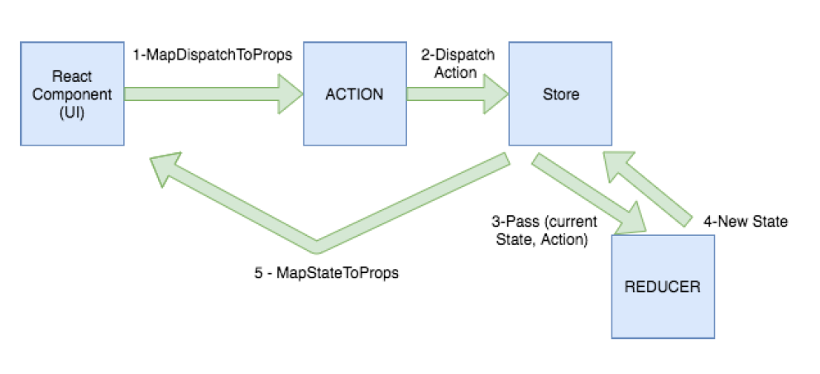

Slide 9
Internals
Once we have the presentation component made by React, we have to connect it to Redux. We do this through a container, which is nothing more than a React component that uses the store subscribe method to read a part of the Redux state tree, providing the properties to the renderer presentational component. The easiest way to do this is through the connect () function of the React Redux library which already provides lots of useful optimizations to avoid unnecessary re-renders.
The connect() allows us to connect basically 2 functions:
mapStateToProps: Indicates how to transform the current state of the Redux store into the presentation component’s props.
mapDispatchToProps: It allows us to define what actions we are going to execute on the reducer. This method receives the dispatch () method and returns the callback props that you want to inject into the presentation component.

Slide 10
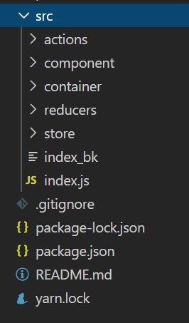
Folder Structure

Slide 11
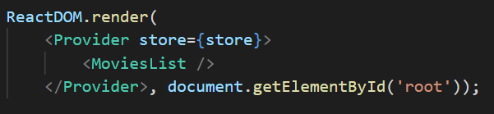
Index.js

Slide 12
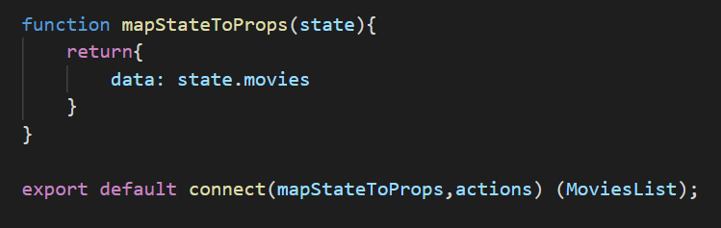
Component

Slide 13
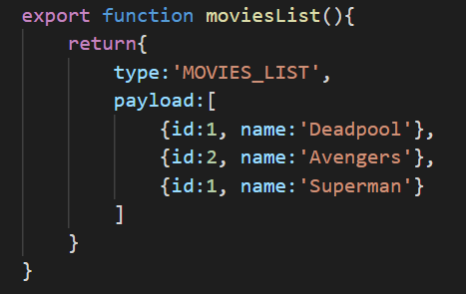
ACTION

Slide 14
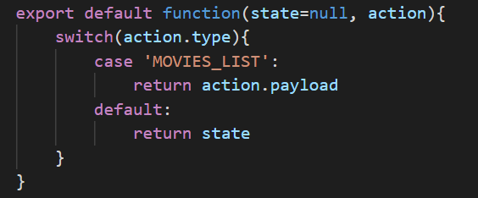
Reducer

Slide 15
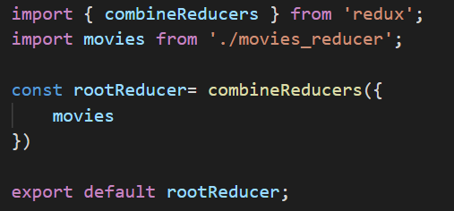
Combine reducers

Slide 16
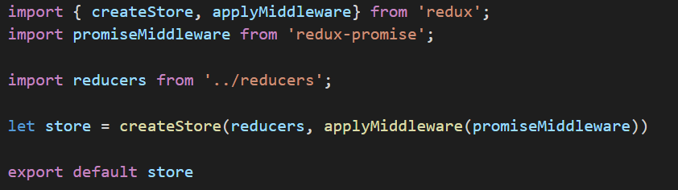
store

Slide 17
Thank You ☺

