Slide 1

React Forms

Slide 2
Forms
HTML form elements work a little bit differently from other DOM elements in React, because form elements naturally keep some internal state.
In HTML form typically maintain their own state and update it based on user input. In React, mutable state is typically kept in the state property of components, and only updated wit setState.

Slide 3
Continue….
The form data, for instance, is usually handled by the component rather than the DOM, and is usually implemented using controlled components.
Controlled Input is when the react component that renders a form also controls what happens in that form on subsequent user input. Meaning, as form value changes, the component that renders the form saves the value in its state.

Slide 4
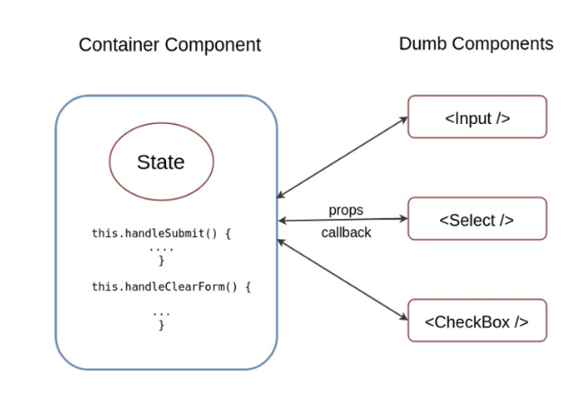

Slide 5
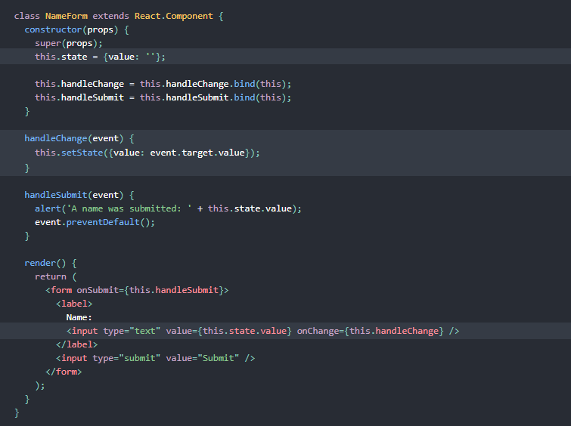

Slide 6
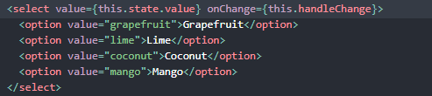

Slide 7
Prevent default

Slide 8
e.preventDefault is called on the event when submitting the form to prevent a browser reload/refresh.
All native HTML elements come with their internal native behavior. For instance, input elements store their internal state. That's why often React is used to take over for having controlled components by managing the state via React. The same applies for a form element which has a submit event that is invoked via a submit button element. In the past, it was desired to refresh the browser to flush all state and to submit the data to a backend. Nowadays, a library such as React, gives us more flexibility to deal with the submit event ourselves.

Slide 9
Thank You ☺

