Slide 1
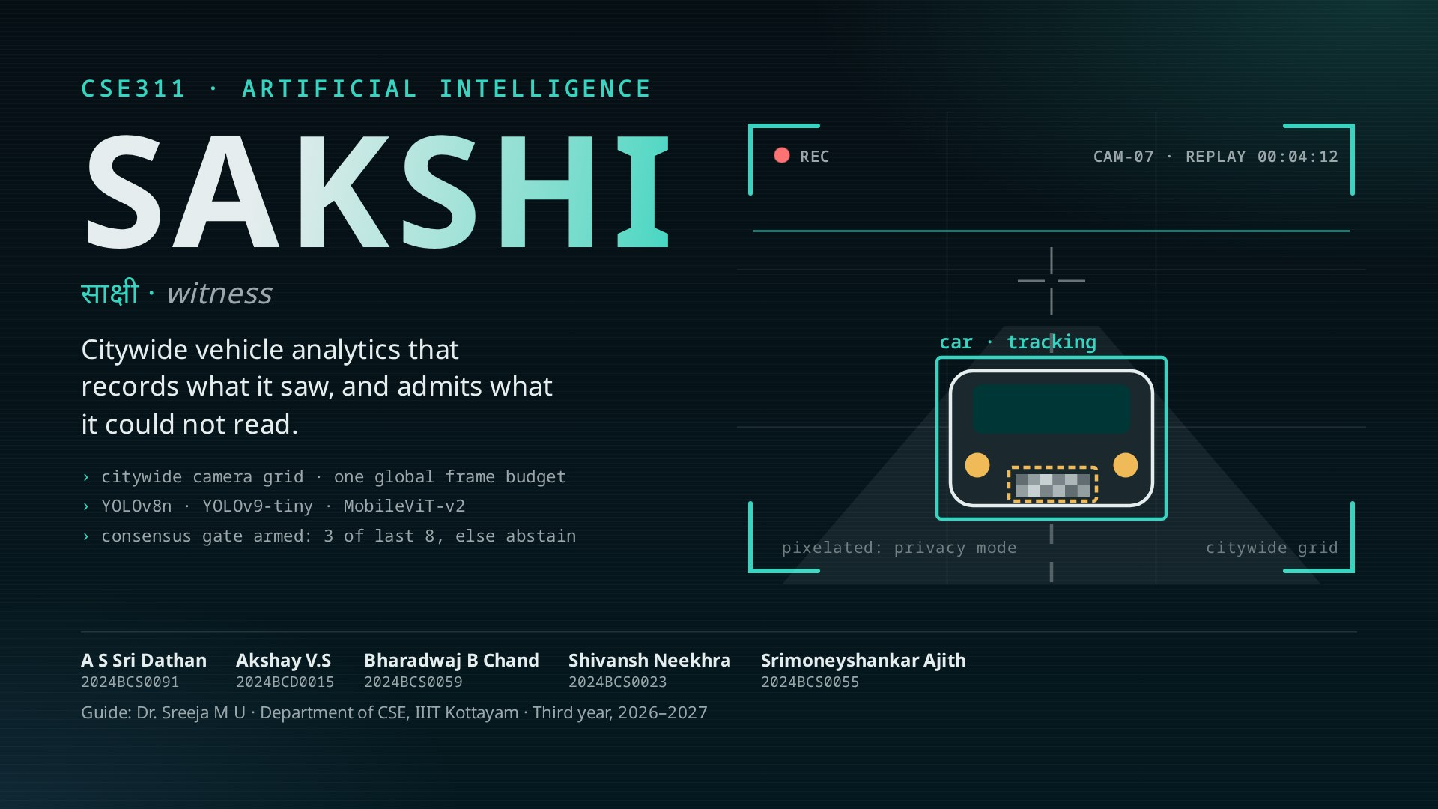
Notes:
Introduce the team in one breath. Sakshi is Sanskrit for witness: a witness says what it saw, and says when it is not sure.
That sentence is the design. Everything after this shows how the system earns, or refuses, an identity.

Slide 2
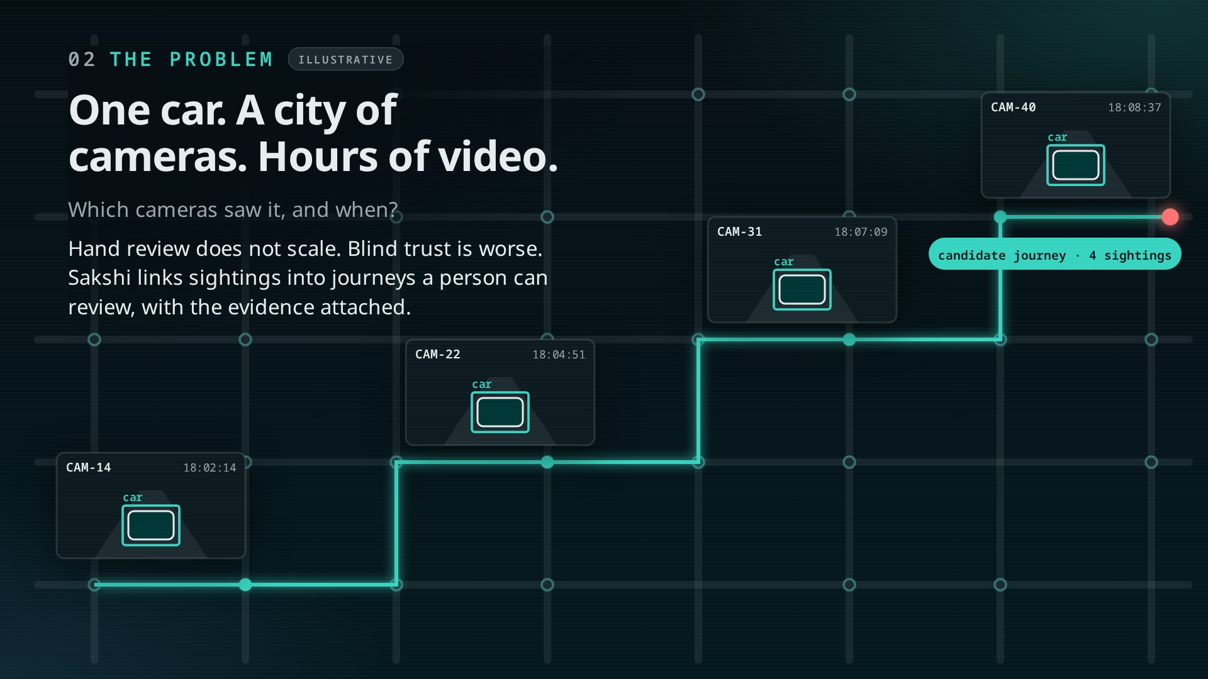
Notes:
Click once: a car crosses the city. Each camera on its path snaps a detection and a replay timestamp.
Click twice: the sightings link into a candidate journey. That is the product: citywide sightings, joined for a human to review, never a confident guess.

Slide 3
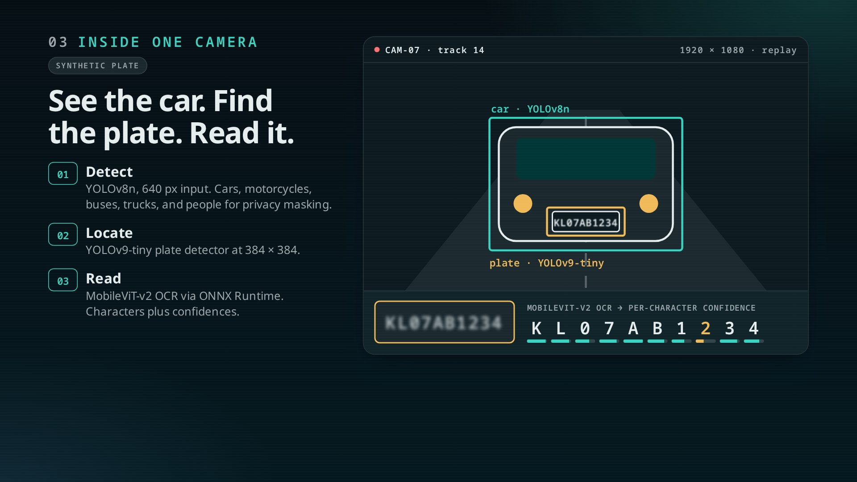
Notes:
Three pretrained models. Click 1: vehicle box. Click 2: plate box. Click 3: the OCR decodes the crop character by character.
Watch the 8th character: low confidence. One read is never enough, which is the next slide. Plate and scores here are synthetic.

Slide 4
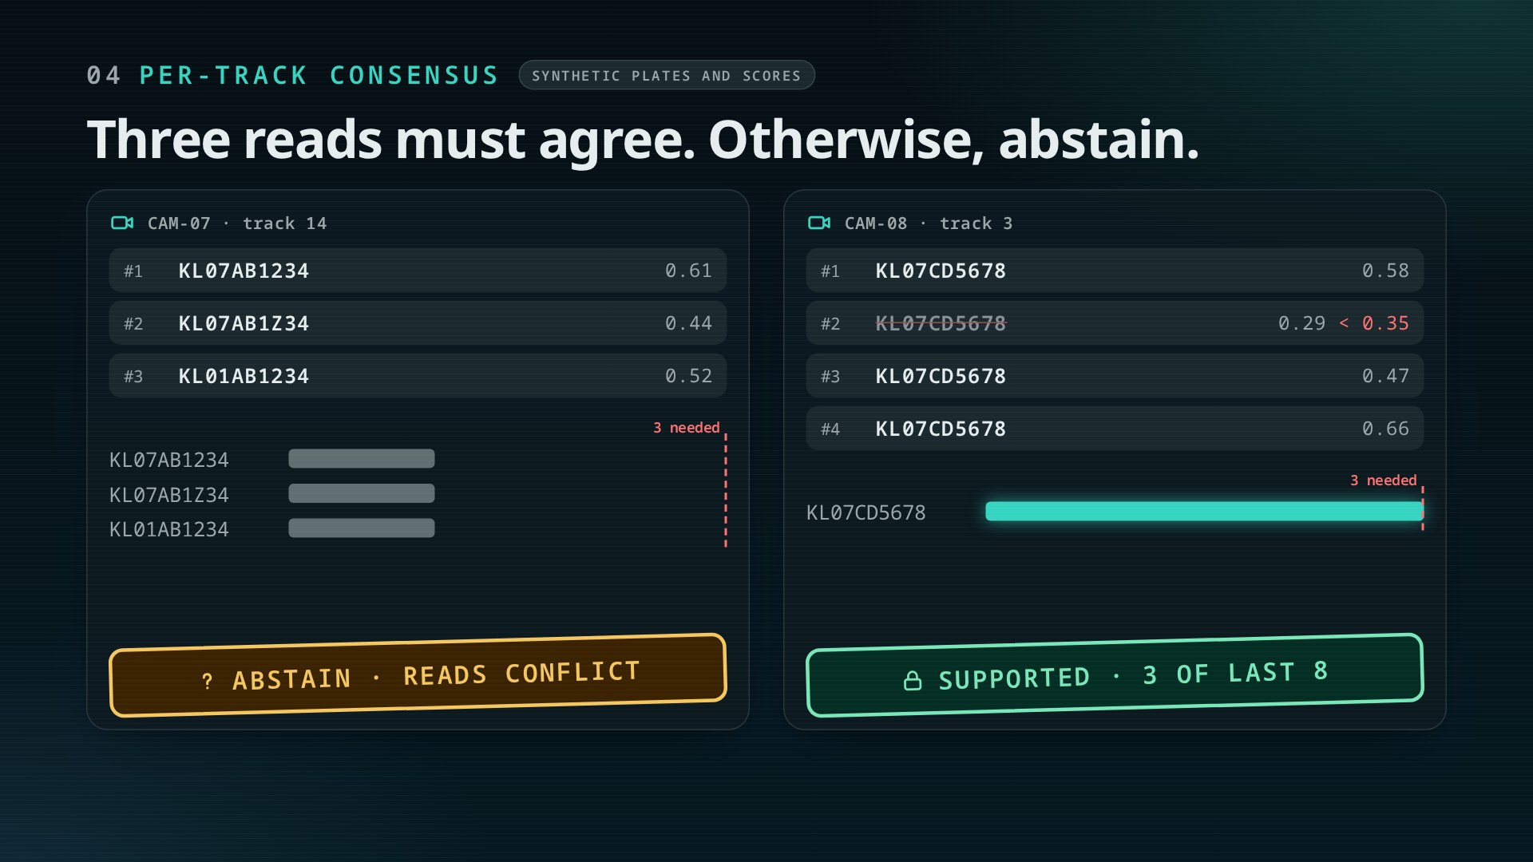
Notes:
Click 1–2: track 14 gets three different strings. No string reaches three votes, so Sakshi abstains. The raw reads stay for a human.
Click 3–4: track 3. One read is below 0.35 and never votes. The other three agree, so the plate is supported, scoped to that camera and track only.

Slide 5
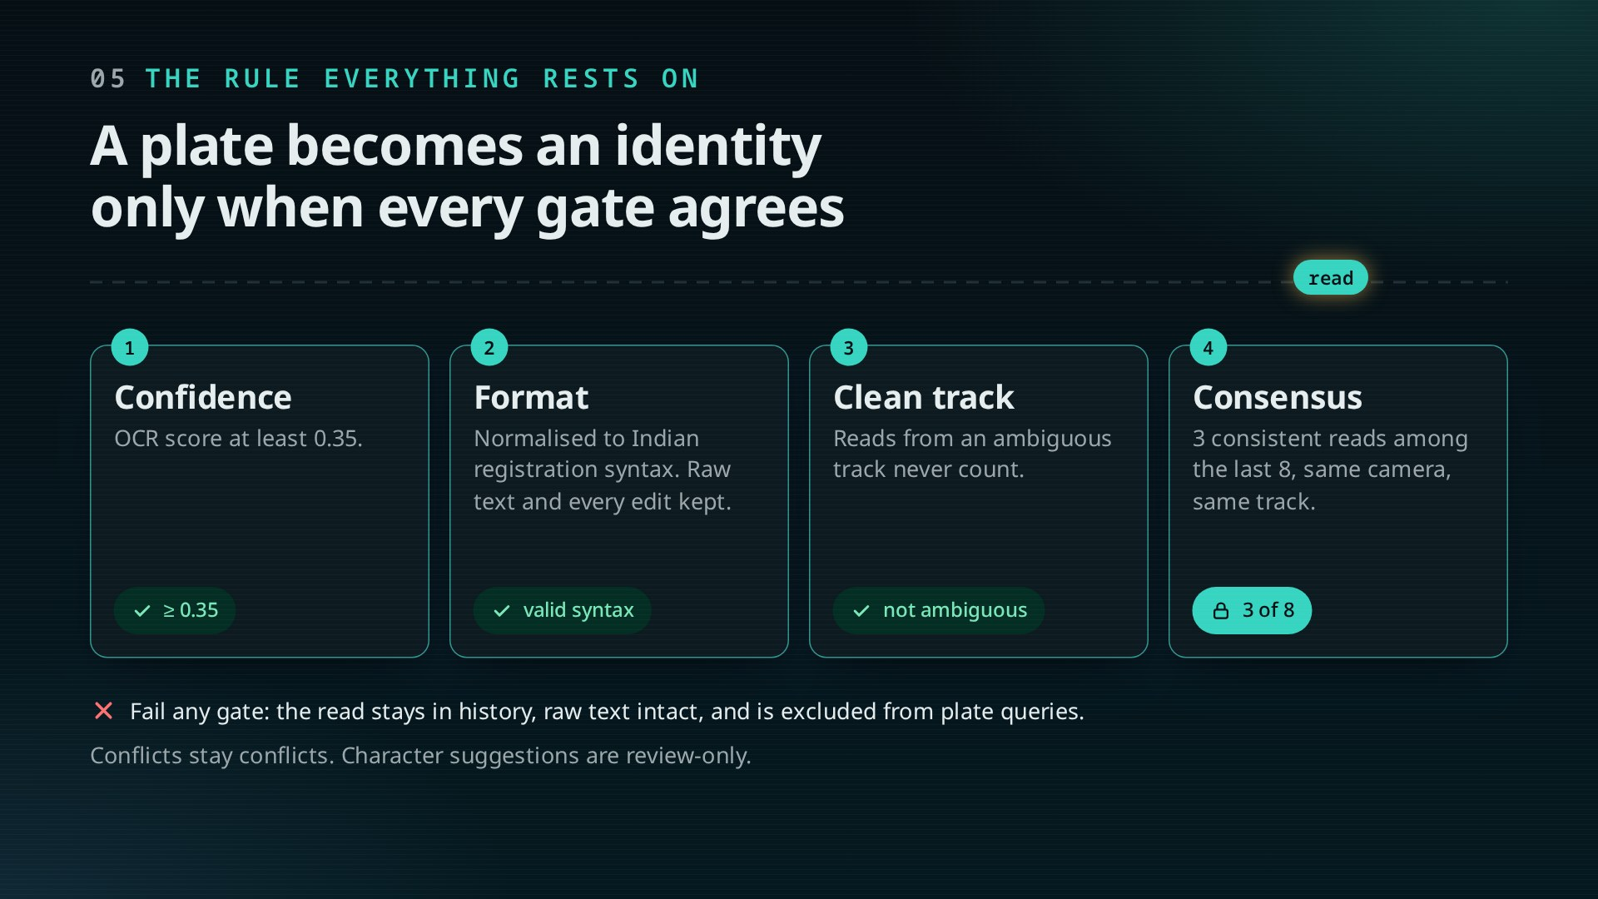
Notes:
Each click passes the read through one gate: confidence ≥ 0.35, valid Indian syntax, a non-ambiguous track, then 3-of-8 consensus.
Key line: a wrong plate is worse than no plate. Failing reads are not deleted; they are kept and labelled.

Slide 6
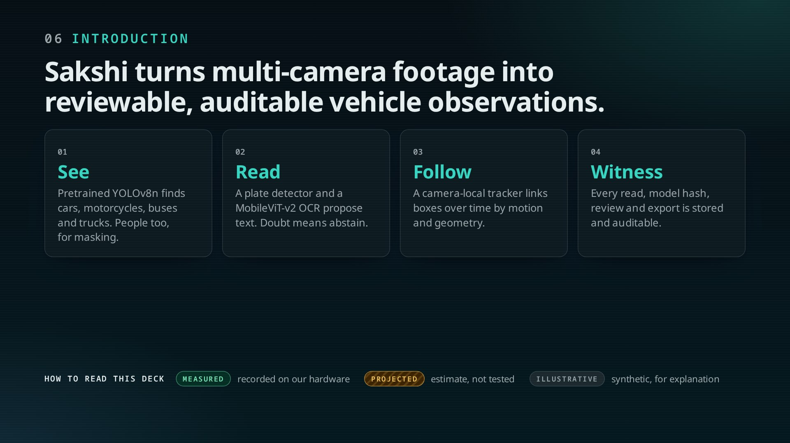
Notes:
Four verbs: see, read, follow, witness. Pretrained models do the seeing; our contribution is the pipeline that keeps their uncertainty visible.
Point at the legend: every number from here on carries one of three labels.

Slide 7
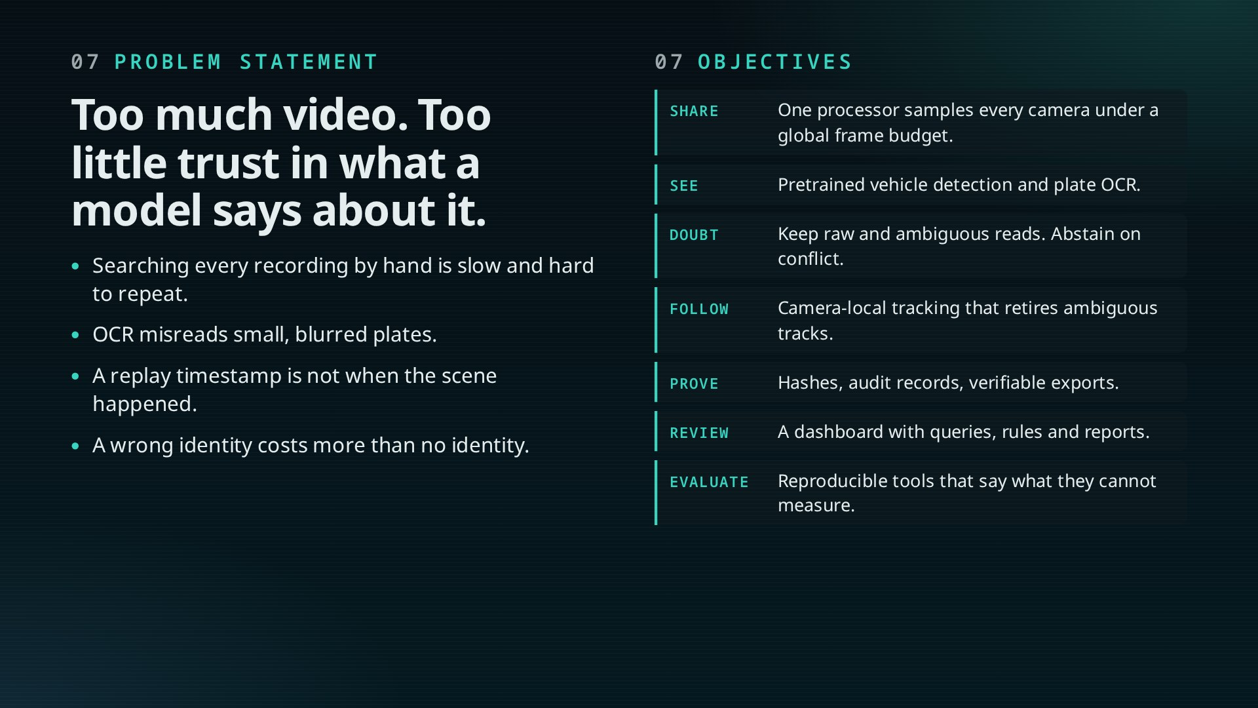
Notes:
Problem statement from the report: detect vehicles, propose plates, keep provenance, help review, without turning a low-quality prediction into an identity.
Seven objectives map onto the pipeline stages. The last one matters: tools that say what they cannot measure.

Slide 8
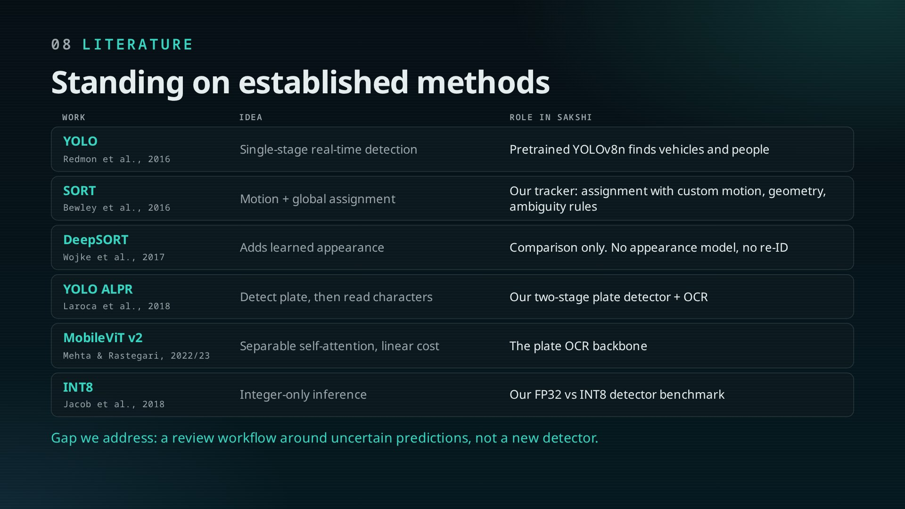
Notes:
We combine known methods rather than invent a detector. YOLO for detection, SORT-style assignment for tracking, YOLO-based ALPR structure, MobileViT-v2 for OCR, INT8 quantisation for speed.
The gap is the workflow: provenance, audit, abstention. Full references are in the report.

Slide 9
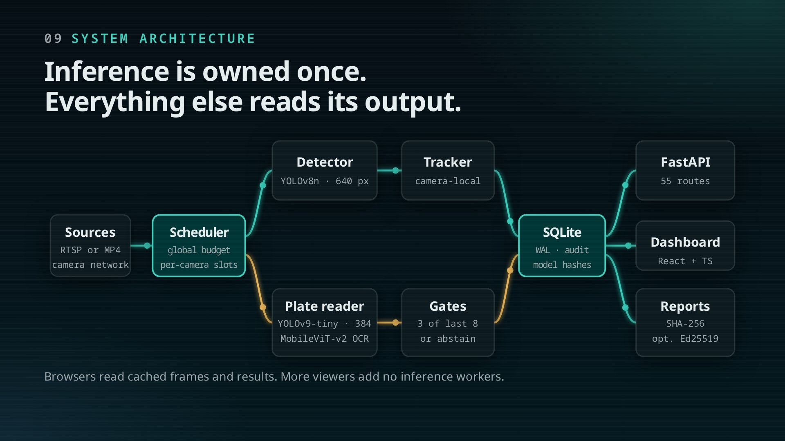
Notes:
Build left to right. Sources, one scheduler, two AI branches (vehicles; plates), the tracker and gates, SQLite with WAL and model hashes, then FastAPI, the React dashboard and signed reports.
The amber packets are the plate branch. The design choice: inference is owned by one process, so viewers never add load.

Slide 10
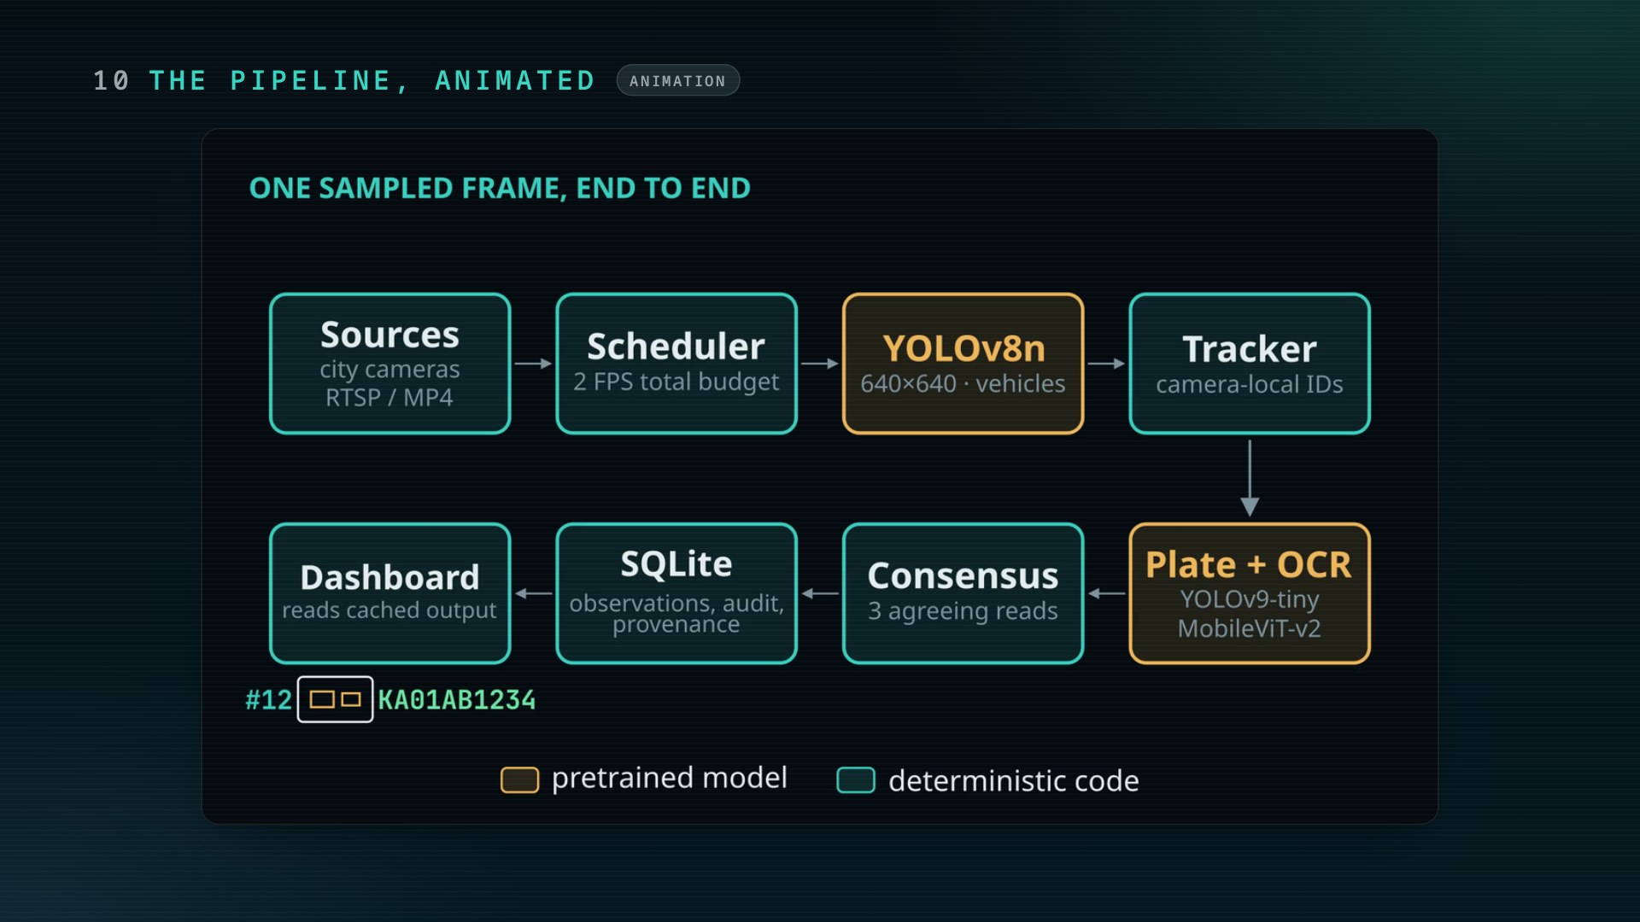
Notes:
Let the animation run. Narrate: frame sampled, detected, plate read, gated, stored, served.

Slide 11
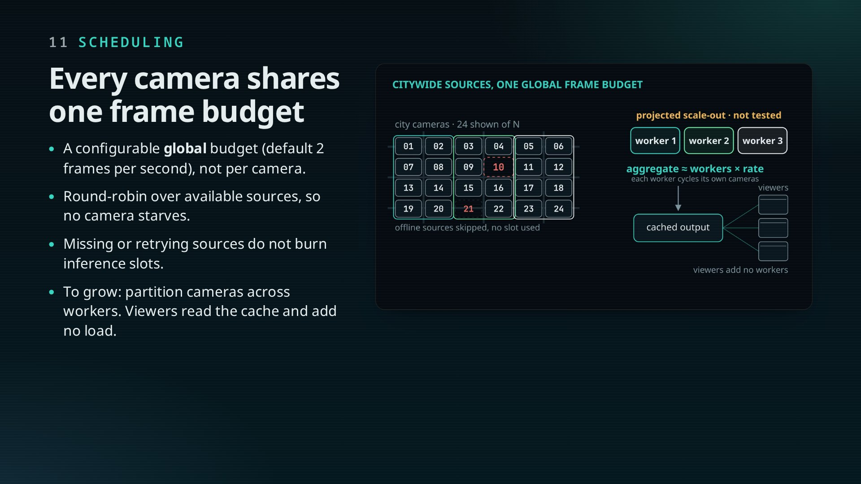
Notes:
The hand sweeps the cameras in turn: one budget, shared fairly. Missing sources are skipped, not waited on.
This is the unit of scale: a city network is split into camera partitions, each with its own worker and the same scheduler. Viewers read cached output, so a control room of browsers costs no inference.

Slide 12
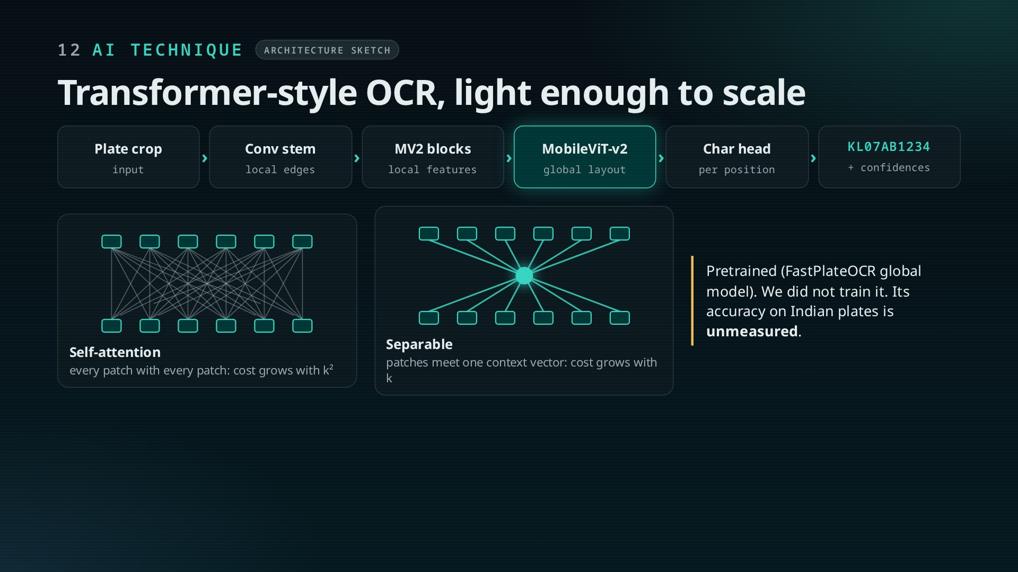
Notes:
This is the AI core of the plate path. Convolutions capture local strokes; MobileViT-v2 blocks unfold the feature map into patches and use separable self-attention for global layout.
Why it matters: separable attention is linear in patches, not quadratic, so it stays cheap per camera as the network grows. Be clear that it is pretrained and unvalidated on Indian plates.

Slide 13
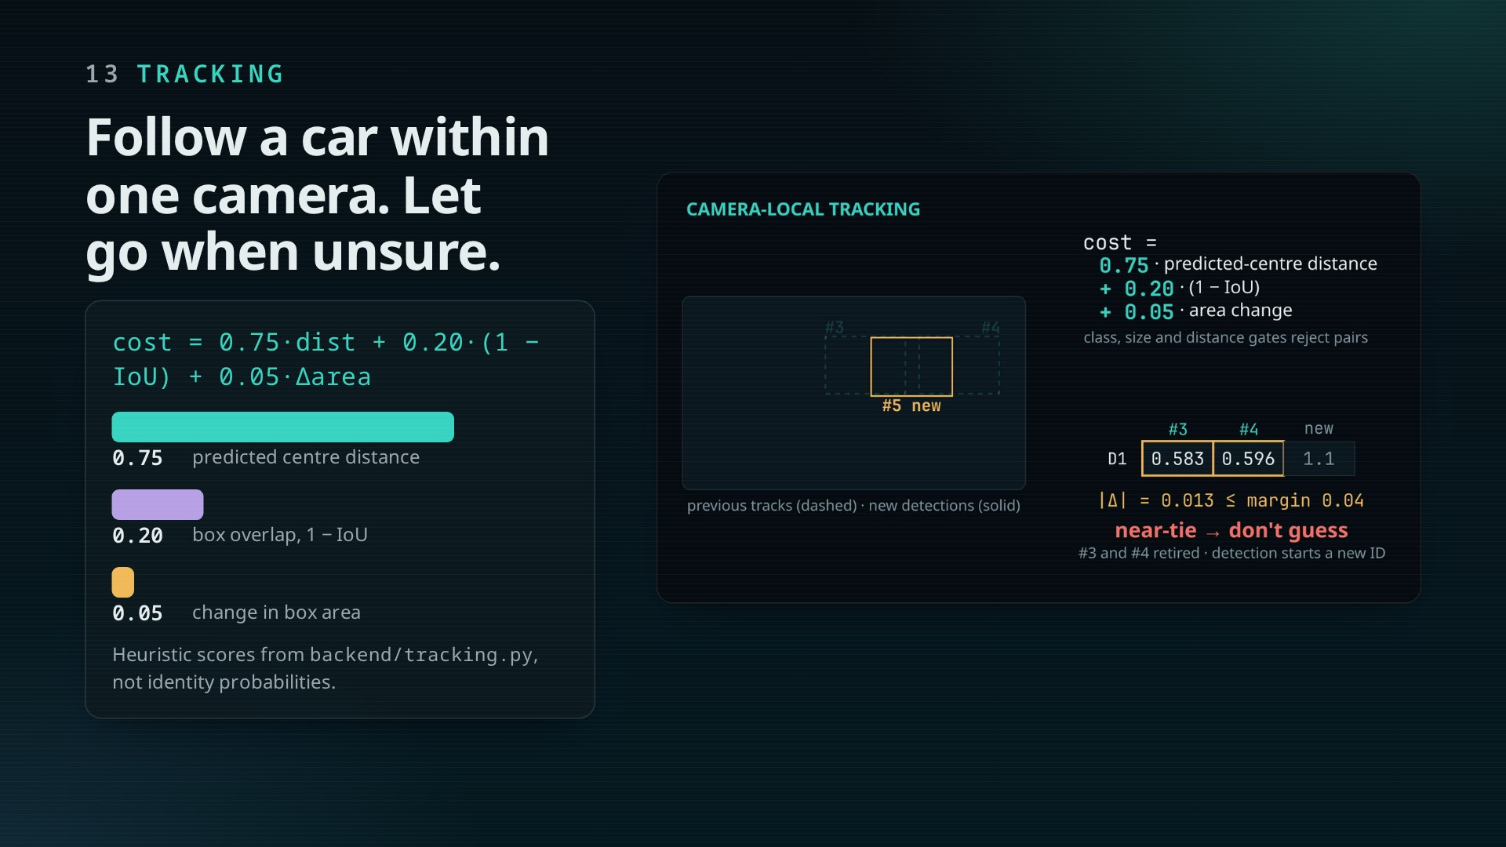
Notes:
The cost is mostly distance from the predicted centre, then overlap, then area change. Class mismatch or a far jump rejects a pair outright.
Click 3: when two tracks compete almost equally, Sakshi does not guess; those tracks retire. No appearance model, so no cross-camera identity.

Slide 14
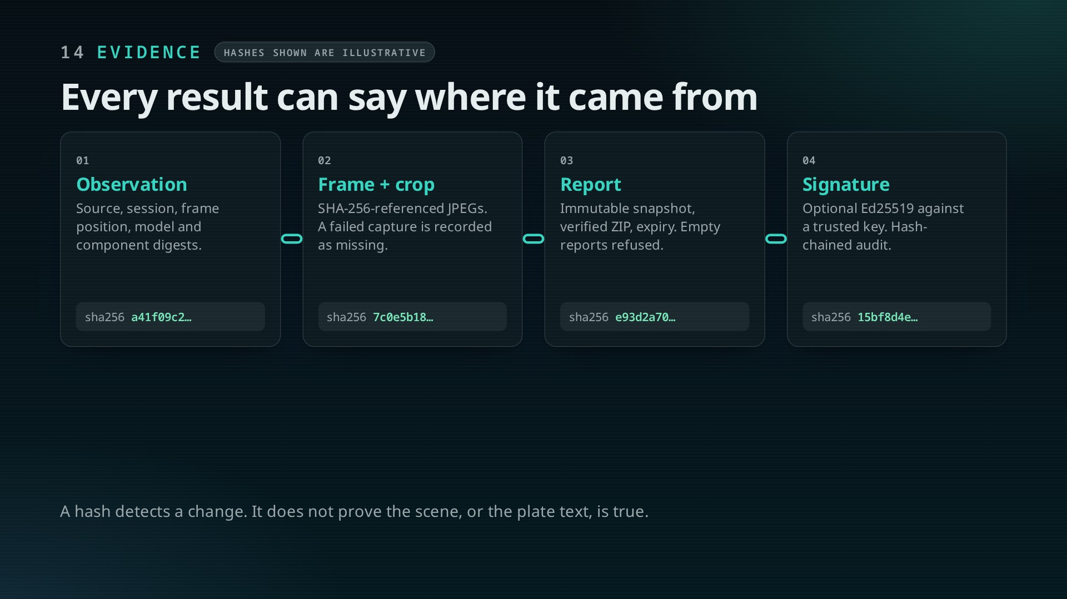
Notes:
Each block links to the last: observation, image derivatives, report snapshot, optional signature. Missing captures are recorded, never hidden.
Say the footer out loud. Integrity is not truth.

Slide 15
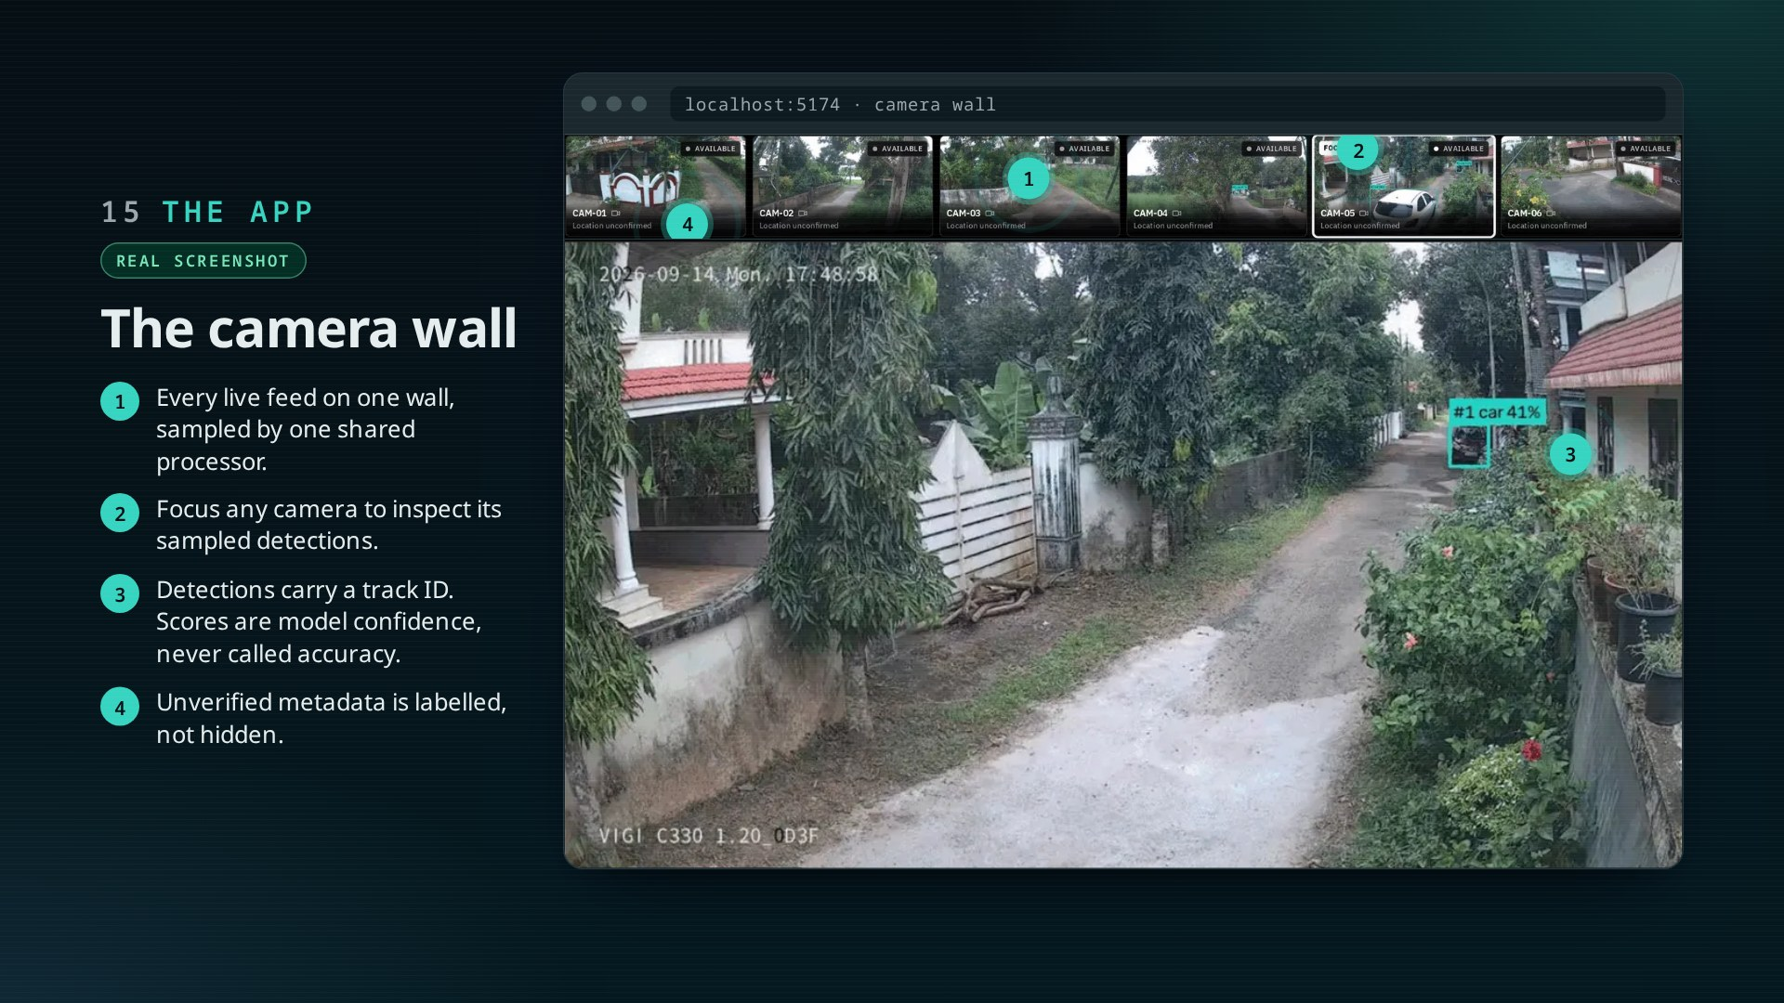
Notes:
The real dashboard, running on the sample feeds. One processor samples every camera; the wall and the focus view read its cached output.
Walk the pins: shared sampling, focus view, track IDs with confidence labelled as confidence, and metadata that says “unconfirmed” until it is verified.

Slide 16
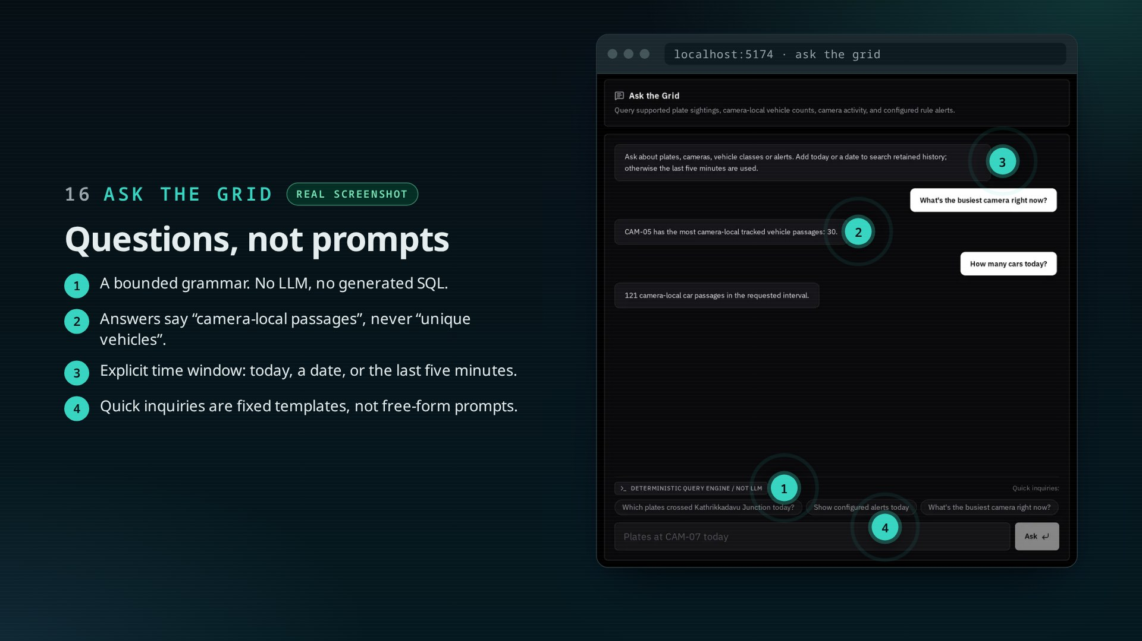
Notes:
Plate, camera, class and date queries through a fixed grammar. Unsupported questions are rejected, not guessed.
Note the wording in the answers: camera-local passages. The app speaks as carefully as the report.

Slide 17
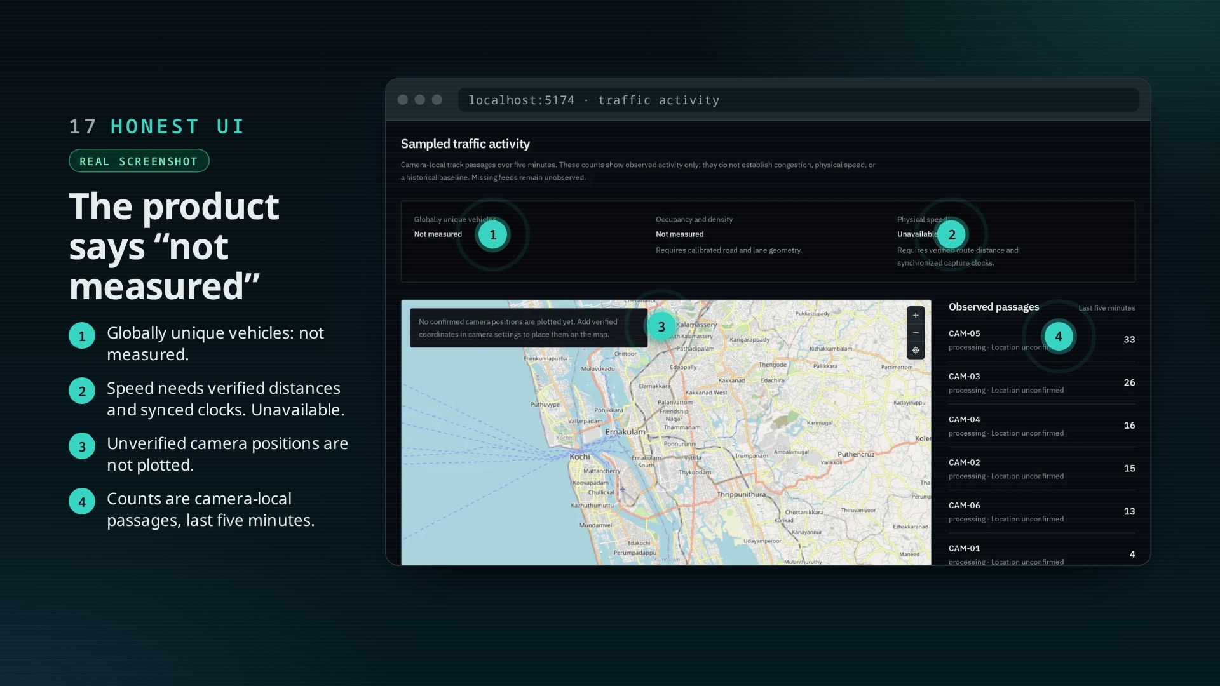
Notes:
Our favourite screen. Where a typical dashboard would invent a congestion score, ours states what is not measured and why.

Slide 18
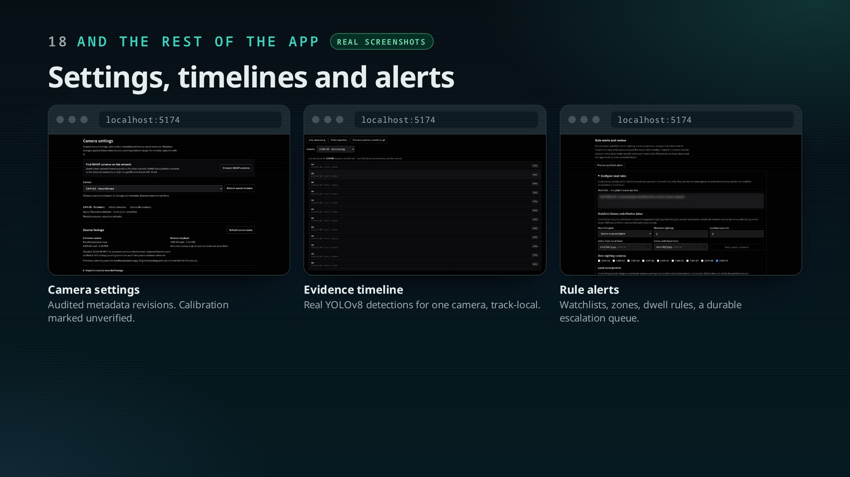
Notes:
Quick tour: audited camera settings with calibration marked unverified, the per-camera evidence timeline, and local rule alerts with a durable escalation queue.

Slide 19
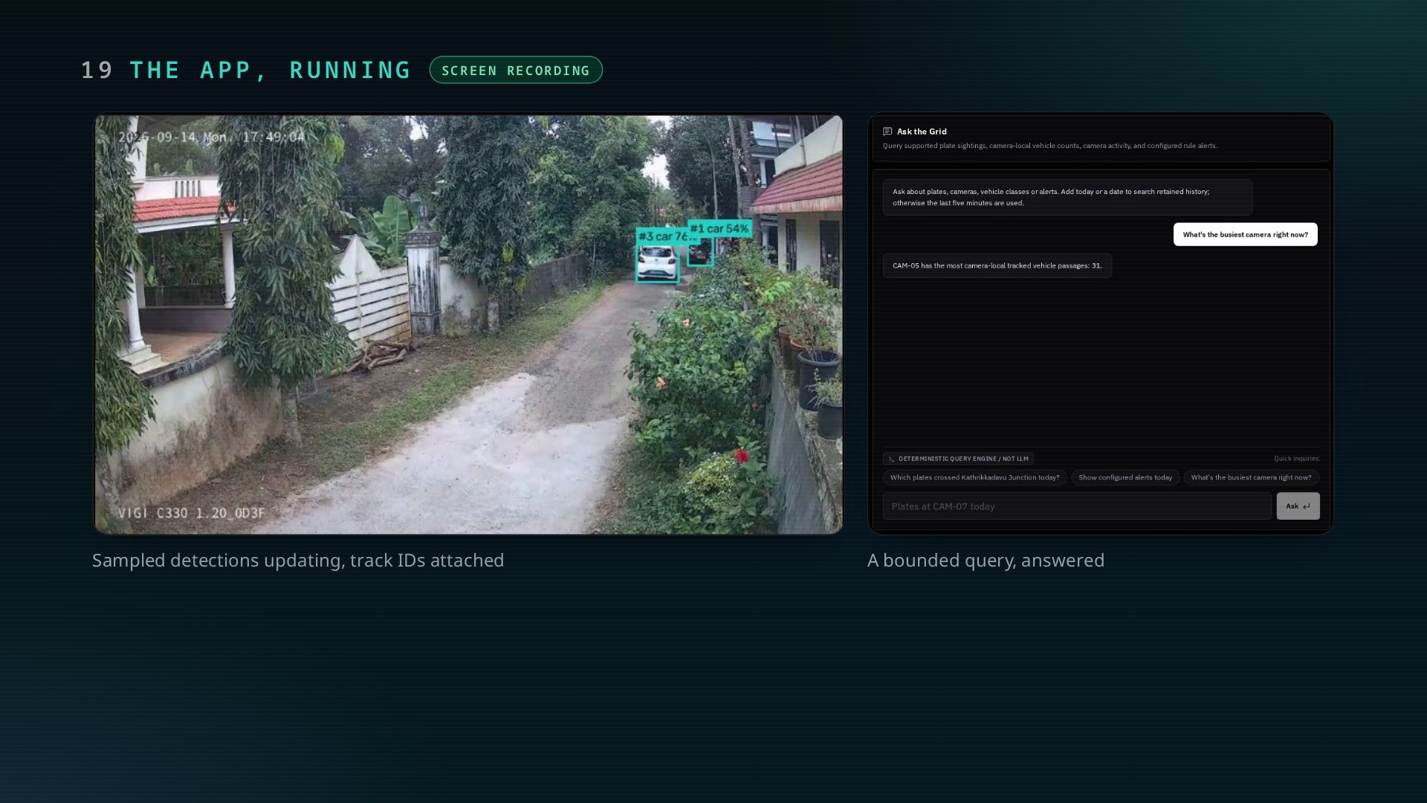
Notes:
Let the recording play. Point out the sampled detection view updating and a query being answered.

Slide 20
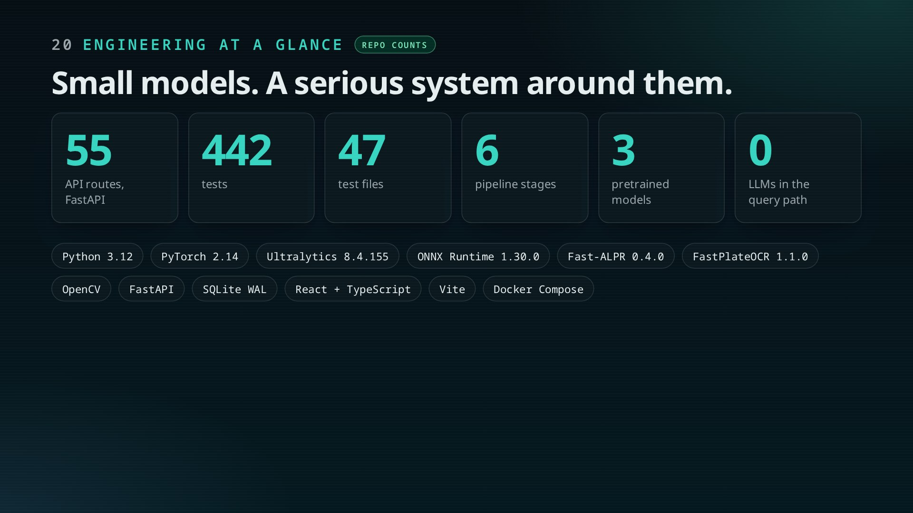
Notes:
Counts are from the repository: 55 API routes, 47 test files with 442 tests. Versions are from the model card.
The AI is three small pretrained models; most of the engineering is what surrounds them.

Slide 21
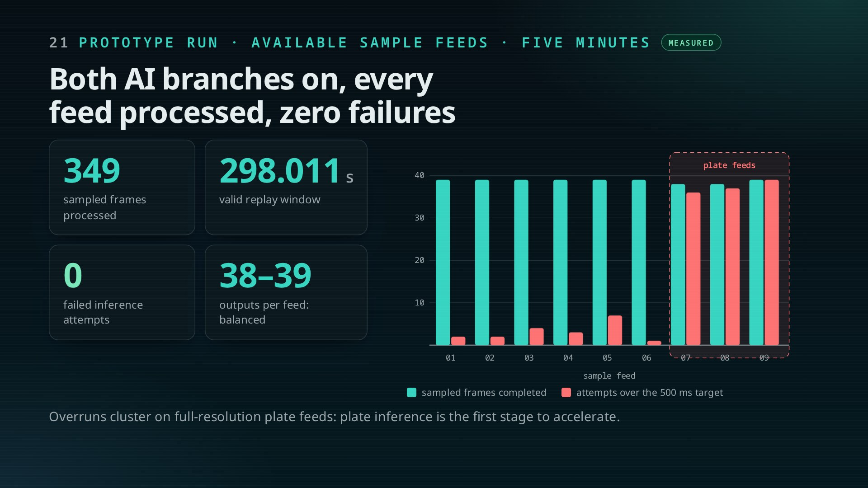
Notes:
Validation profile of 18 October 2026, run on the sample footage we had. 349 sampled frames over a valid 298.011 s window with both branches on, zero failed attempts, balanced at 38 to 39 outputs per feed.
Click 3: overruns come from the full-resolution plate feeds. Overruns are late attempts, not dropped frames. These are execution measurements, not accuracy.

Slide 22
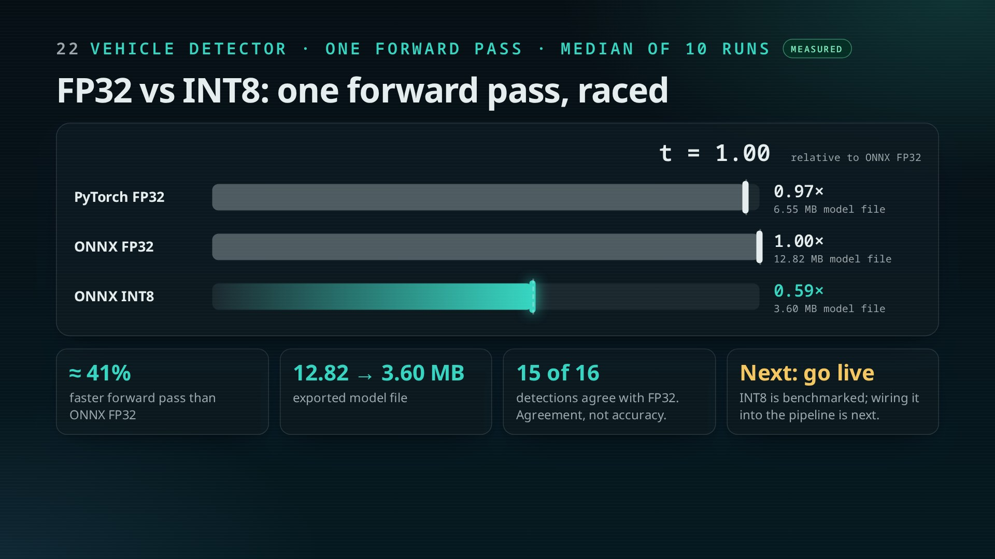
Notes:
Benchmark of 14 October 2026 on 60 calibration frames from the sample feeds: 2 warm-ups, 10 measured runs, model forward pass only.
The INT8 export is about 41% faster than ONNX FP32 and the file shrinks from 12.82 to 3.60 MB. With no labels, 15-of-16 agreement is model-to-model, not accuracy.

Slide 23
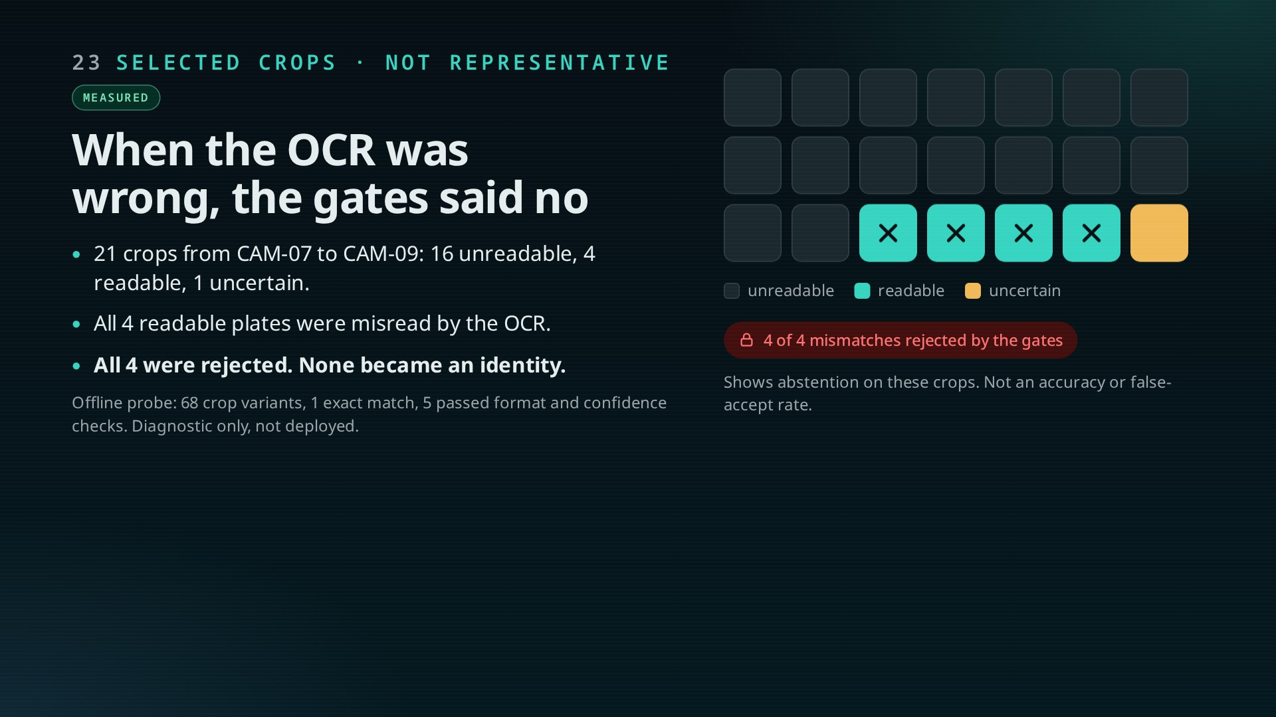
Notes:
A person reviewed 21 selected crops; only 4 were readable. On all 4 the OCR was wrong, and all 4 were stopped by the gates.
The honest takeaway: on these examples the system declined to name a plate rather than name a wrong one. No accuracy claim.

Slide 24
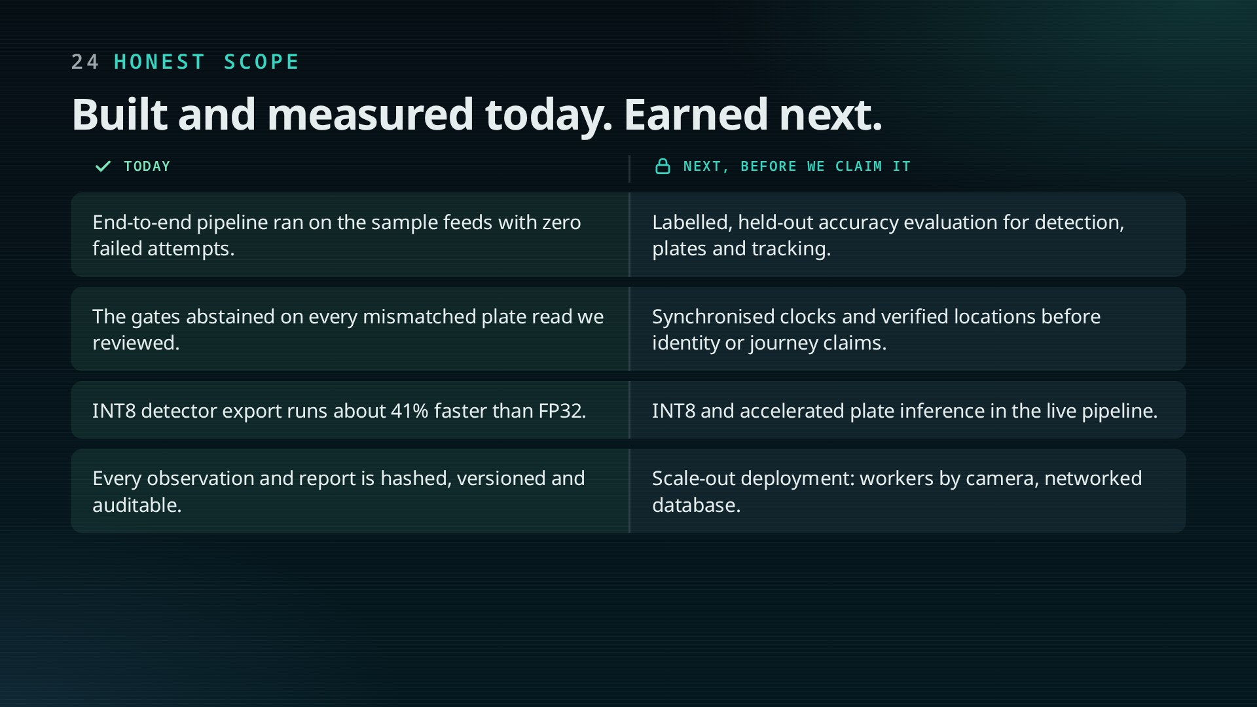
Notes:
Left: what the prototype has shown. Right: what has to be earned before we say more. The two that matter most: a labelled accuracy evaluation, and synchronised clocks with verified locations before any identity or journey claim.

Slide 25
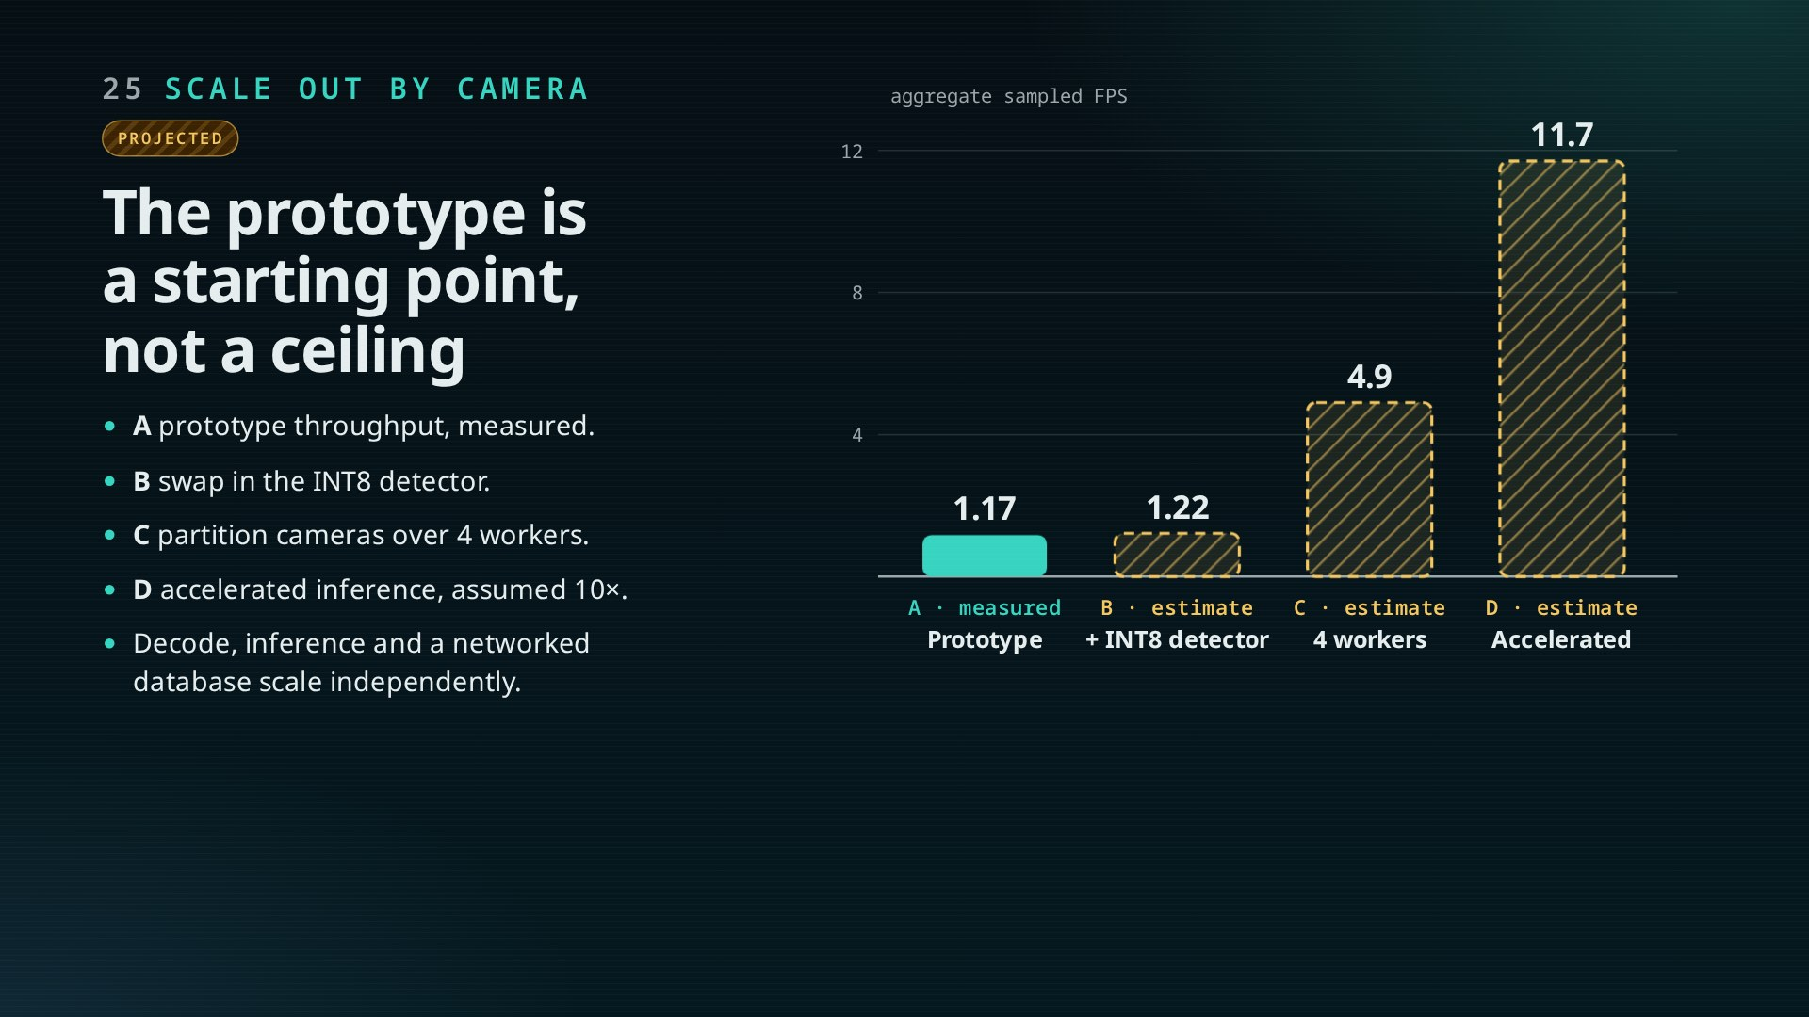
Notes:
Only bar A was measured. B applies the measured INT8 saving; C assumes cameras partition linearly over four workers; D assumes a 10× accelerated worker, illustrative only.
The point: throughput is a property of the deployment, not the design. Each worker owns its cameras, so capacity grows by adding workers.

Slide 26
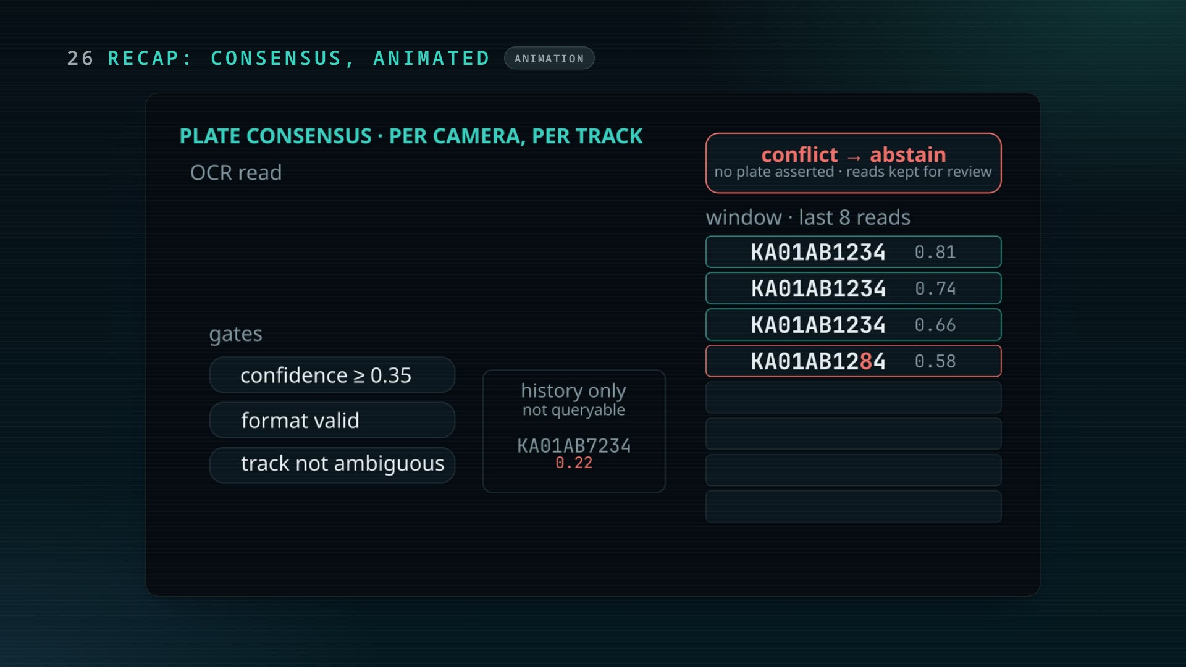
Notes:
Optional recap of the gate logic before the roadmap.

Slide 27
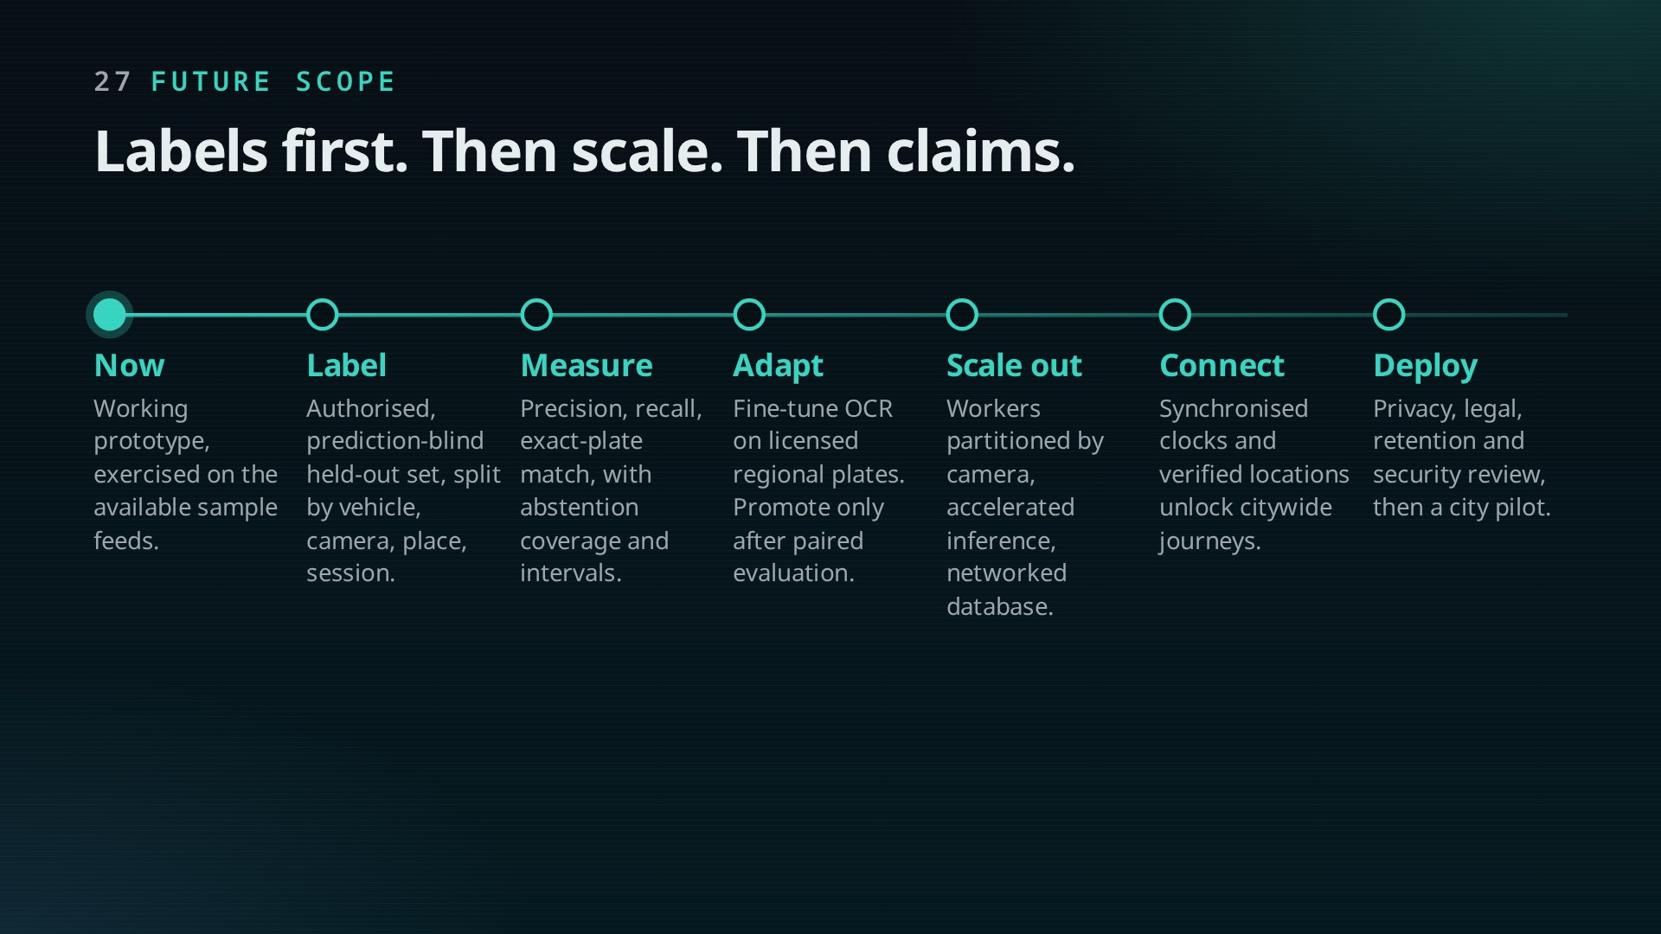
Notes:
Order matters. Without an authorised, independent labelled set, no accuracy number means anything. Then measure, adapt OCR to regional plates, scale on real hardware, and only then attempt cross-camera journeys.

Slide 28
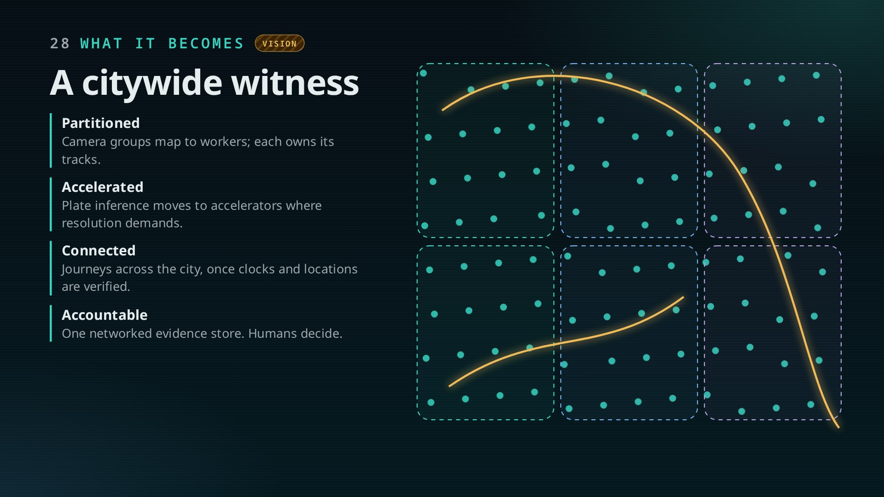
Notes:
The end state: a city camera network split into partitions, each with workers running the same pipeline; one networked evidence store; investigators asking bounded questions and getting journeys with evidence.
The prototype already has the pieces; the citywide version is about scale, labels and verified time, not a redesign.

Slide 29
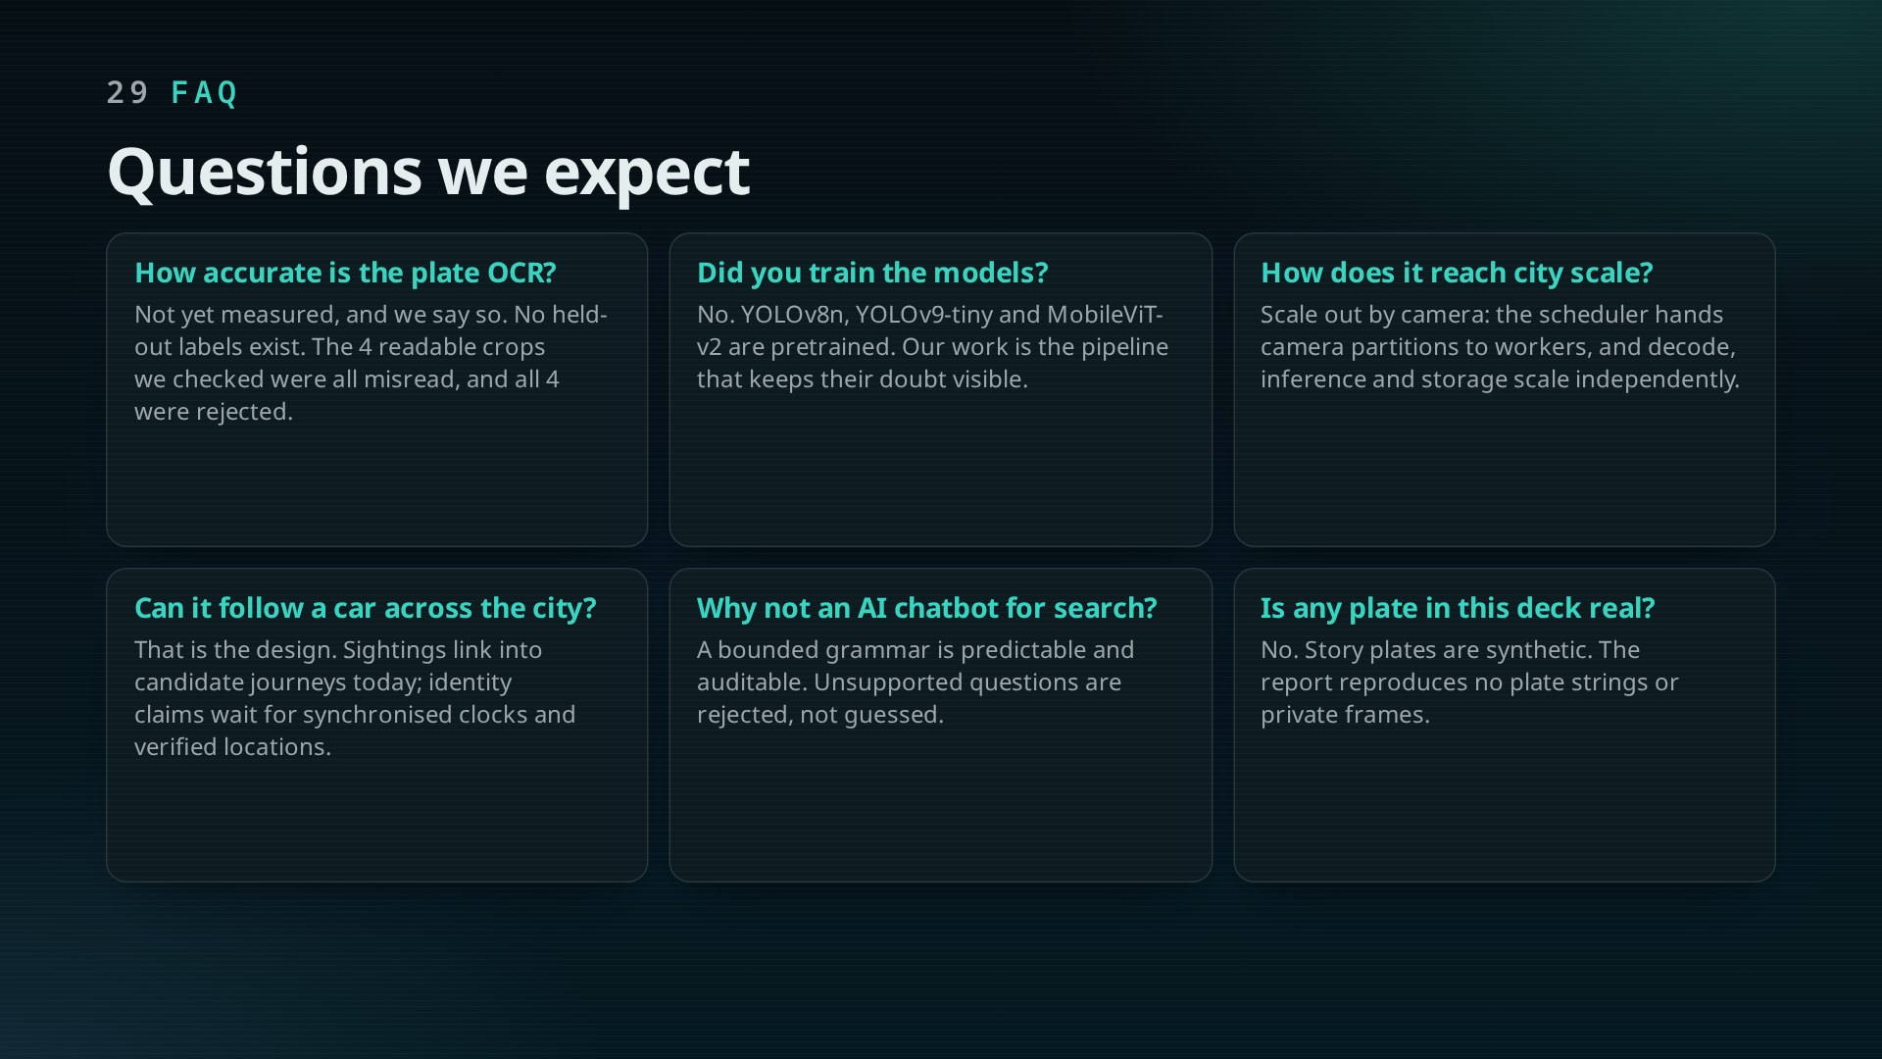
Notes:
Questions show first; each click reveals two answers. Use this slide to pre-empt the viva: accuracy, training, FPS, cross-camera, chatbot, real plates.

Slide 30
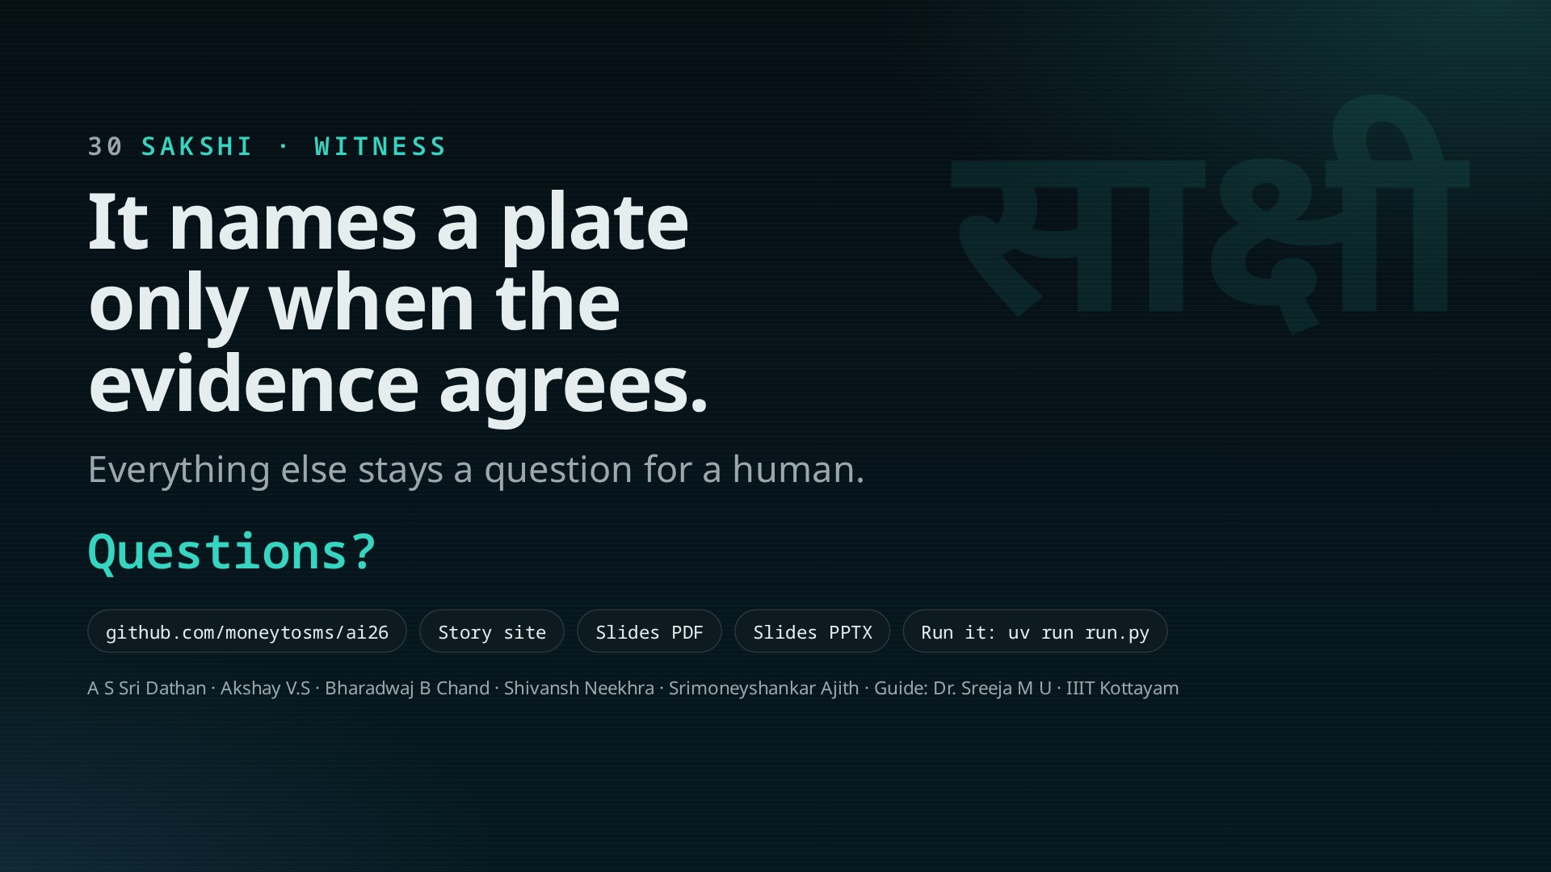
Notes:
Close on the one sentence. Then: thank the guide, invite questions, offer the live demo (uv run run.py, dashboard on port 5174).

