Slide 1

ENPM808A: Introduction to Machine Learning Final Project
Data-Driven Motion Planning
BHARADWAJ CHUKKALA
118341705

Slide 2
Need for a Data-Driven Motion Planner
Robot navigation means the robot's ability to determine its own position in its frame of reference and then to plan a path towards some goal location.
Path planning involves the creation of a map of the environment by analyzing various types of sensor data, which involves a lot of computation processing.
The whole process of autonomous navigation and planning is highly computational. So, to reduce these computations, this project presents a data-driven motion planner.

Slide 3
Problem Statement
The goal is to develop a model, which provides action commands in the form of a translational velocity command (v) and a rotational velocity command (w)
The data that is given consists of laser scan data captured amongst moving obstacles in two environments (A corridor scenario with moving obstacles & an open box/hall environment with moving obstacles). The data is generated from a Motion Planning Algorithm called A*.
The Model will be trained on this data extensively therefore the Data-Driven approach does not require a global map to navigate. Given the sensor data and the relative final and local goal positions, the robot will be able to navigate to the local goal keeping in mind the final goal while also avoiding obstacles.

Slide 4
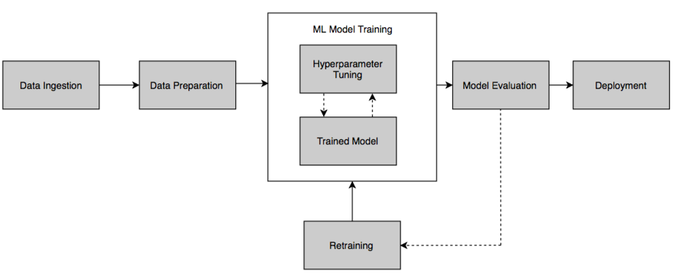
The Steps Involved in Solving the Problem
Data Preprocessing
Feature Engineering
Training different models
Linear Regression model
Neural Network model
Finalizing the model
Prediction Testing
Hyperparameter Tuning
Regularization
Generalization
The Flowchart, albeit missing some steps that I discussed gives a holistic workflow of an ML pipeline

Slide 5
Data Preprocessing
Reduced the number of dimensions to 20 by taking relative distances and orientations
The data is already Preprocessed.
Data need not be separated into Training and Testing.
Only a fraction of the given data has been used due to memory constraints.

Slide 6
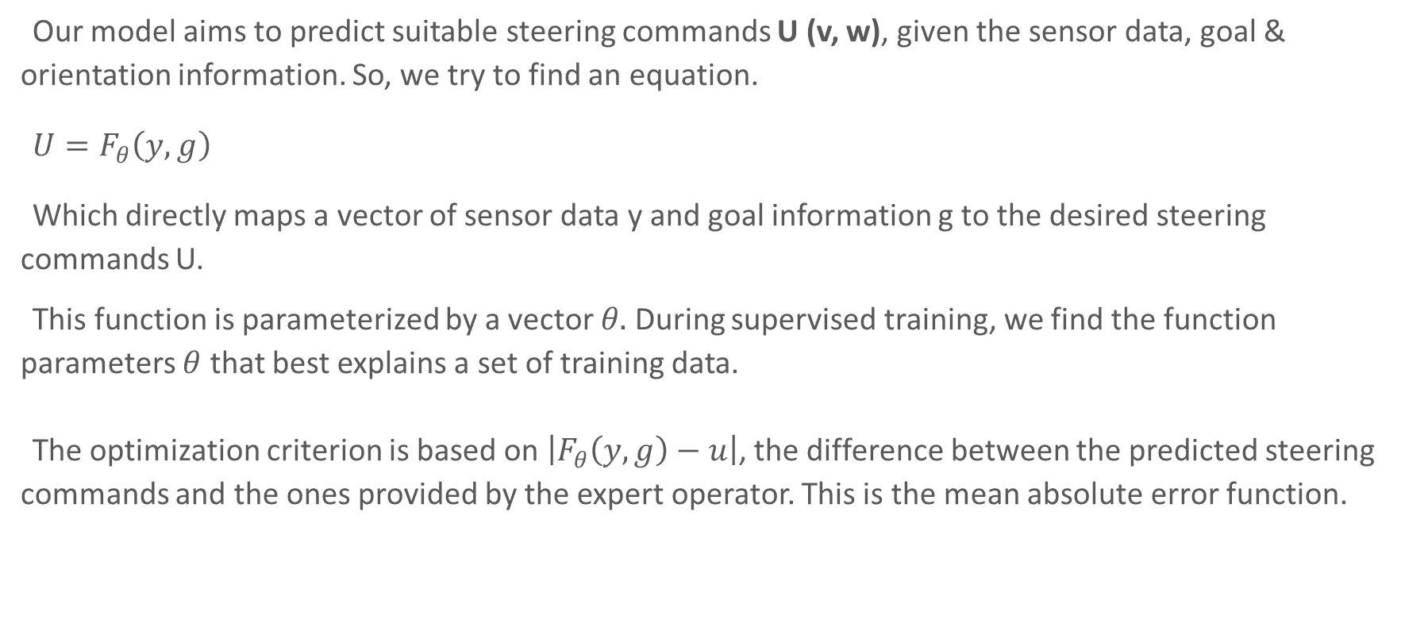
Loss function
Our model aims to predict suitable steering commands U (v, w), given the sensor data, goal & orientation information. So, we try to find an equation.
$U=F_{θ}\left(y,g\right)$
Which directly maps a vector of sensor data y and goal information g to the desired steering commands U.
This function is parameterized by a vector $θ.$ During supervised training, we find the function parameters $θ$ that best explains a set of training data.
The optimization criterion is based on $\left|F_{θ}\left(y,g\right)−u\right|$, the difference between the predicted steering commands and the ones provided by the expert operator. This is the mean absolute error function.

Slide 7
Model Selection
The given problem statement is of regression data type.
Hyperparameter Tuning is done by looking at the learning curve for train data.
Neural Network has the following Hyperparameters & have been tuned to optimize the classifier:
Training Length (number of epochs)
Batch size
Number of Layers
Learning rate
Regularization
Activation Layer Types
Optimizer
Weights Initialization

Slide 8
Hyperparameter Tuning
The apt Hyperparameters can be tuned by looking at the learning rate and validation curve.
Learning Curve: The validation curve was used to tune the Hyperparameters of the model. After each change in the hyperparameter, the validation curve & the learning curve was plotted and see how the model is fitting. The curve helped in understanding how the model is fitting the data and what effect the change in the hyperparameter had on the model which helped in making decisions to improve the model.
Regularization: We are using a mean absolute error loss function to optimize so the constraint on the weights based on the ‘absolute value of magnitude seemed more logical. But the data doesn’t have any inherent noise as seen in the model selection process. Hence, decided not to put any constraints on the weights.
Depth: I have played around with the depth by increasing the number of nodes and layers to improve fitting.
But to be sure, tried L2 regularization too, and checked the learning curve which showed similar results. Hence, did not use any regularization on the final model.
Check resultant plots here

Slide 9
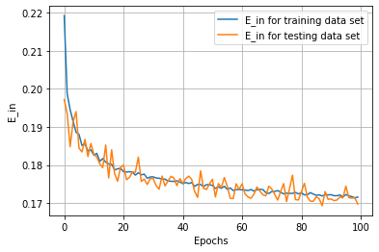
Final Model Evaluation
The final model chosen is DNN with five layers which had the least in-sample error.
With this model, the in-sample decreases along with the validation loss
Starts to diverge at iteration 250, which is where we need to stop training.

Slide 10
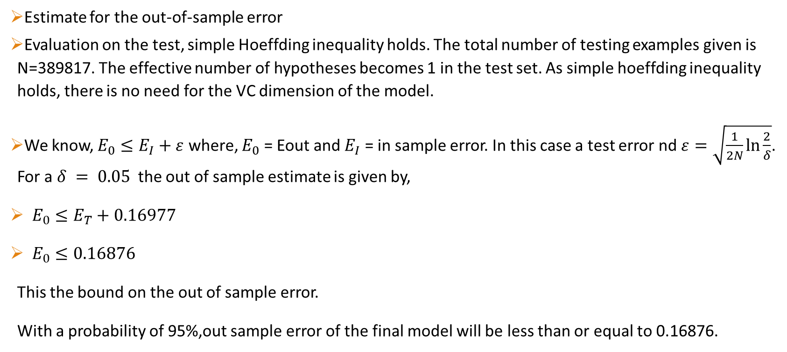
Generalization
Estimate for the out-of-sample error
Evaluation on the test, simple Hoeffding inequality holds. The total number of testing examples given is N=389817. The effective number of hypotheses becomes 1 in the test set. As simple hoeffding inequality holds, there is no need for the VC dimension of the model.
We know, $E_{0}≤E_{I}+ε$ where, $E_{0}$ = Eout and $E_{I}$ = in sample error. In this case a test error nd $ε=\sqrt{\frac{1}{2N}\ln{\frac{2}{δ}}}$. For a $δ = 0.05$ the out of sample estimate is given by,
$E_{0}≤E_{T}+0.16977$
$E_{0}≤0.16876$
This the bound on the out of sample error.
With a probability of 95%,out sample error of the final model will be less than or equal to 0.16876.

Slide 11
Conclusion
Improvements
The Hypothesis set considered was very limited. Needs to be expanded to more complex models to fit the model better.
Development of the architecture of the DNN model can be approached as a classification problem first, and then as a regression problem.
All Relevant codes and plots → GitHub Repository

