Slide 1
RAZOR VIEWS AND UX

Slide 2





TEAM MEMBERS
BHARADWAJ DASARI
HYNDAVI MUSIPATLA
HARI PRIYA JUPALLY
SUSHMITHA KOTYADA
VYSHNAVI YALAMAREDDY

Slide 3
CONTENTS
WHAT IS RAZOR ?
Features
ASPX VS RAZOR
Advantages
Disadvantages
UX
Elements of UX
Demo

Slide 4

WHAT IS RAZOR ?
Markup language syntax that lets user to embed server based code into web pages using C# and VB.Net.
It is not a programming language.
Server side markup language.
Razor does not have any ties with ASP.NET MVC.
Sushmitha Kotyada

Slide 5
Features
Razor has a capability to protect critical sections with lock statements.
Unit Testable
Syntax :
@lock (Some lock)
{
//Do critical section work
}
Sushmitha Kotyada

Slide 6
Features
Compact
Enables to minimize number of characters and keystrokes required to write a code
Expressive
Expresses your intent
Fluid
Fast and fluid coding work flow
Sushmitha Kotyada

Slide 7
ASPX VS RAZOR
RAZOR VIEW ENGINE | ASPX/WEB VIEW ENGINE
Namespace : System.Web.Razor | Namespace : System.Web.Mvc.WebFormViewEngine
File extension : .cshtml, .vbhtml | File extension : .aspx
View engine : Introduced with MVC 3.0. | View engine : Introduced with beginning of MVC.
Syntax : Compact & reduce typing | Syntax : same as ASP.Net forms applications
Uses “@” to render server-side content. | Uses "<%= %>" or "<%: %>" to render server-side content.
Doesn’t require code block to be closed. | Require code block to be closed.
Bharadwaj Dasari

Slide 8
ASPX VS RAZOR
RAZOR VIEW ENGINE | ASPX/WEB VIEW ENGINE
Prevents Cross site scripting attacks. | Doesn’t prevent Cross site scripting.
Supports Test Driven Development(TDD) | Doesn’t support Test Driven Development.
Comments : “@*….*@” | Comments : “<!-- …→” for markup “/*…*/” for C# code
Bit slower | Bit faster
Bharadwaj Dasari

Slide 9
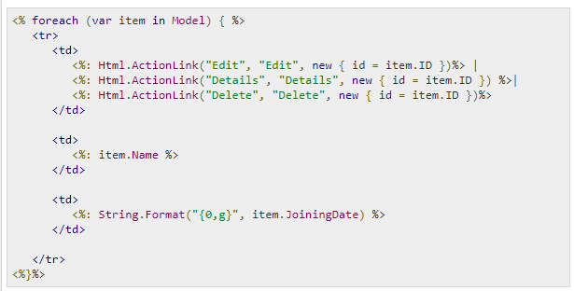
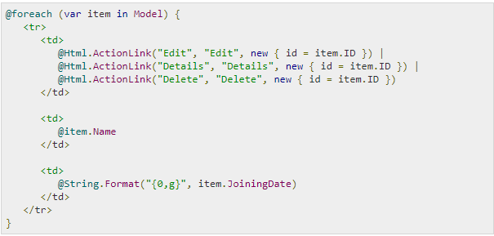
ASPX VS RAZOR
Sample code from ASPX file
Same code using RAZOR syntax
Bharadwaj Dasari

Slide 10
Razor Syntax Rules
Must be enclosed in @{….}
Statements must end with Semicolon “;”
Files will have .cshtml extension
Inline expressions like variables and functions start with @
Hyndavi Musipatla

Slide 11
Advantages
Easy to learn, can also use existing HTML skills.
The parser is smart enough.
It is lightweight syntax, readability, maintainability, TDD, and more.
Can easily go with Razor view engine if you are comfortable with c#.
Works with any text editor.
Has great Intellisense.
Hyndavi Musipatla

Slide 12
Disadvantages
Not supported by modern visual editors like Dreamweaver.
It does not support design mode in visual studio.
Some limitations in HTML generated
Harder to sync with jQuery selectors
Hyndavi Musipatla

Slide 13

UX
User Experience is how users feel when using a product
It is the quality of experience a person has when interacting with
a specific design
UI : Visual part of computer application or operating system through which a user interacts with a computer or a software.
Vyshnavi Yalamareddy

Slide 14
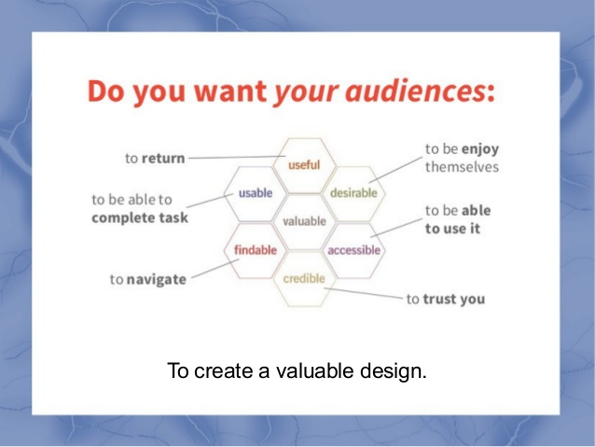
UX
To create an ideal design, one must consider the following factors.
Vyshnavi Yalamareddy

Slide 15
Elements of UX
Surface
Visual Design
UI
Skeleton
Wire-frame
Interaction patterns
Global navigation
Structure
Information architecture
Defining content
Vyshnavi Yalamareddy

Slide 16
Elements of UX
Scope
Functionality
Usefulness
Requirements
Strategy
Business requirements
Defining user needs
Goals and Aspirations
Vyshnavi Yalamareddy

Slide 17

Hari Priya Jupally

Slide 18
References
https://www.c-sharpcorner.com/UploadFile/ff2f08/aspx-view-engine-vs-razor-view-engine/
https://www.tutorialspoint.com/asp.net_mvc/asp.net_mvc_razor.htm
https://www.c-sharpcorner.com/blogs/razor-view-engine-in-mvc2
https://www.itprotoday.com/web-application-management/working-aspnet-mvc-3-razor-view-engine

Slide 19


Slide 20


