Slide 1
GENPACT TEAM
Group - 12

Slide 2
INTRODUCTION
The main Focus of this Project is to detect Duplicate Instances in Multi Head and Multi scale scenario.
The object views / instances should be identified as same if the angle of capture differs by ~20-25 degree. The object views / instances should be identified as different if the angle of capture differs more than 25 degrees.
The data provided to was collected by the Center for Research on Intelligent Systems at the Department of Computer Science, Columbia University. The database contains color images of 100 objects. The objects were placed on a motorized turntable against a black background and images were taken at pose internals of 5 degrees.

Slide 3
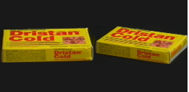
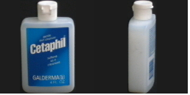
https://www.cs.columbia.edu/CAVE/software/softlib/coil-100.php is the link to the dataset.
Example1 : Duplicate instance Example2 : Different instance

Slide 4
APPROACHES
After going through a number of research papers to find a solution, we’ve decided to pursue 2 approaches.
Traditional Computer Vision Approach
Deep Learning Approach
Both have their own advantages and disadvantages such as Deep Learning approach might give a great result but at a cost of heavy computation and time
Where as the Traditional approaches might have a higher chance of failing

Slide 5
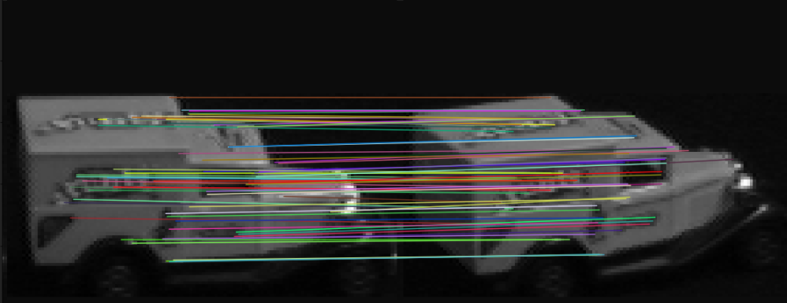
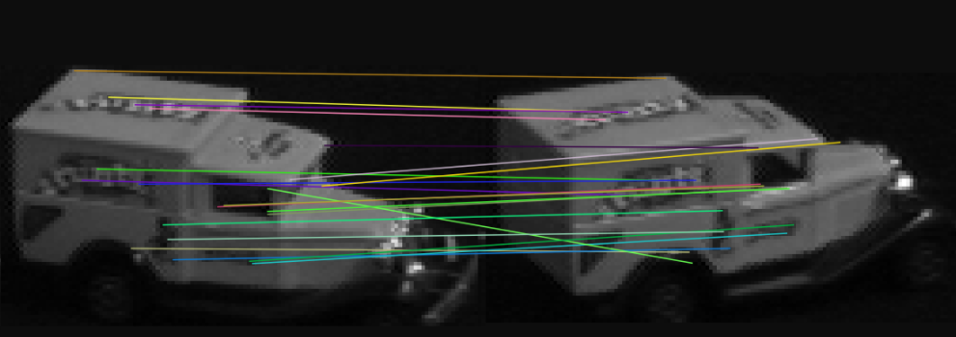
Traditional Approach
The algorithms we looked into are SIFT, ORB and Fundamental Matrix Estimation.
Applying this algorithm on a pair of images and matching the Key-points, worked really well for duplicate instance images (absolute angle difference is less than 25), but in the case of different instance Images it failed quite badly.
Key-point matching for duplicate instance image Key-point matching for different instance image

Slide 6
Estimating Fundamental Matrix of 2 images has given a better result in matching keypoint than any other Traditional Computer Vision Algorithm.
But, couldn’t make any progress in this approach after we this.
We’ve met a dead end here.
But a lot has been learned during the time we spent on these algorithms.

Slide 7
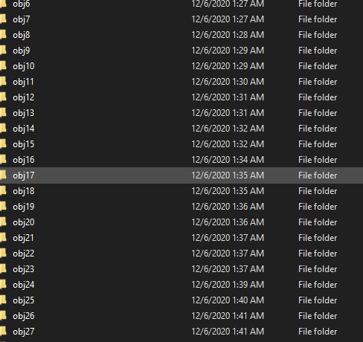
Deep Learning Approach
Half of the struggle with deep learning approach is to get the data ready. And the other half is to find the right parameters.
As, all the images were in single folder nothing could be done, unless all the objects are separated. And had to be done manually, this was a horrible task.
So, we got it done.

Slide 8
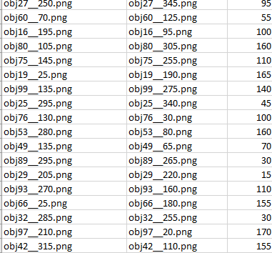
Then a CSV of filenames of all the image pairs with the absolute difference of angles is made.
The formula used to get the difference of angle between image pairs is
Min[ 360 - (angle_1 - angle_2), (angle_1 - angle_2) ]

Slide 9
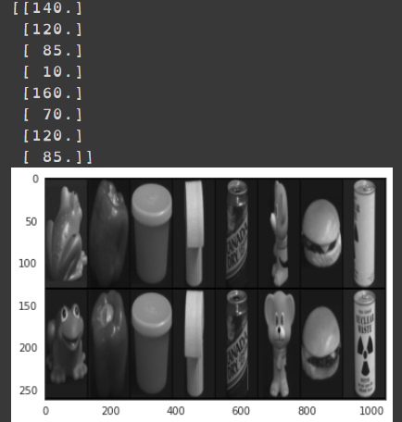
We, Used pytorch for the deep learning tasks.
Total number of image pairs formed is 518,400.
We divided the Csv in to train.csv (80%) and test.csv (20%).
The image is a snippet of one batch of data, with a batch size of 8

Slide 10
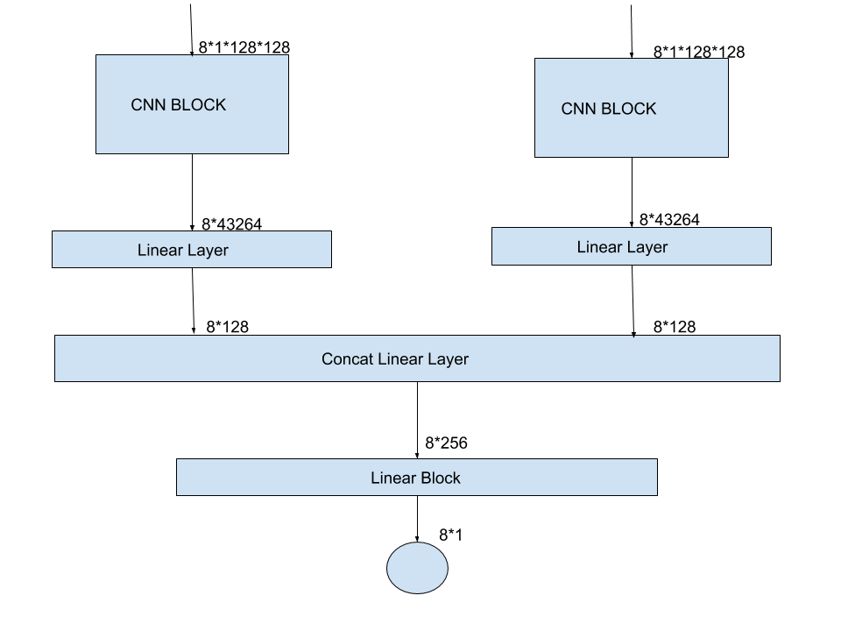
The architecture of the network we used is roughly represented in the image below.

Slide 11
As, google colab has a time limit of 12 hrs, we had to buy colab pro which has a limit of 24 hrs and also prioritising our job on better GPU’s.
We trained the network for 10 epochs, which took nearly 14 hrs.
We believe that better results can be achieved with more number of epochs.
Right now we have a RMSE of 63 degree.
It’s not a good result, but we can get good results

Slide 12
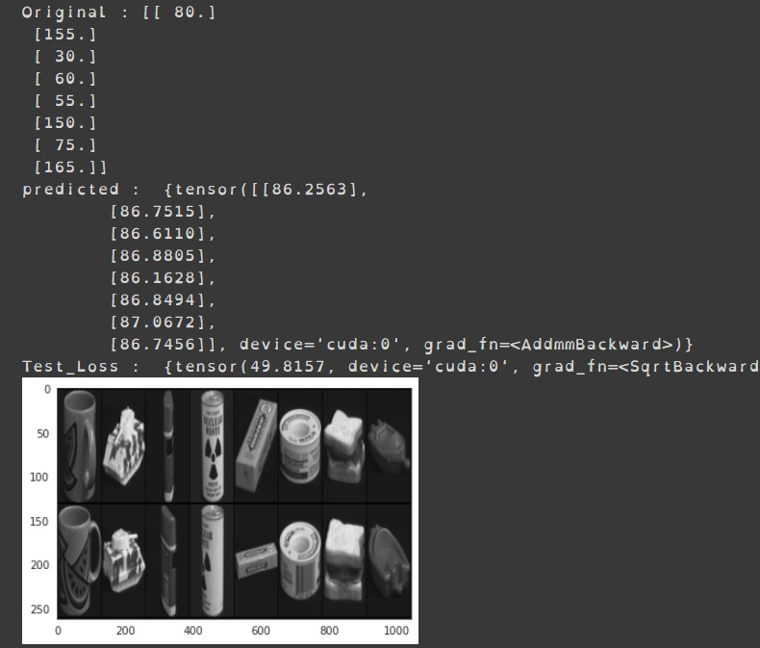
This is example result.

