Slide 1
Mining Frequent Patterns without Candidate Generation
Jiawei Han, Jian Pei and Yiwen Yin
School of Computer Science
Simon Fraser University
Presented by Song Wang. March 18th, 2009 Data Mining Class
Slides Modified From Mohammed and Zhenyu’s Version

Slide 2
Outline
Outline of the Presentation
Frequent Pattern Mining: Problem statement and an example
Review of Apriori-like Approaches
FP-Growth:
Overview
FP-tree:
structure, construction and advantages
FP-growth:
FP-tree →conditional pattern bases → conditional FP-tree
→frequent patterns
Experiments
Discussion:
Improvement of FP-growth
Conclusion Remarks
Mining Frequent Patterns without Candidate Generation (SIGMOD2000)

Slide 3
Frequent Pattern Mining: An Example
Frequent Pattern Mining Problem: Review
Given a transaction database DB and a minimum support threshold ξ, find all frequent patterns (item sets) with support no less than ξ.
Input:
DB:
TID Items bought
100 {f, a, c, d, g, i, m, p}
200 {a, b, c, f, l, m, o}
300 {b, f, h, j, o}
400 {b, c, k, s, p}
500 {a, f, c, e, l, p, m, n}
Minimum support: ξ =3
Output:
all frequent patterns, i.e., f, a, …, fa, fac, fam, fm,am…
Problem Statement: How to efficiently find all frequent patterns?
Mining Frequent Patterns without Candidate Generation (SIGMOD2000)

Slide 4
Apriori
Review of Apriori-like Approaches for finding complete frequent item-sets
Candidate
Generation
Main Steps of Apriori Algorithm:
Use frequent (k – 1)-itemsets (L_{k-1}) to generate candidates of frequent k-itemsets C_{k}
Scan database and count each pattern in C_{k} , get frequent k-itemsets ( L_{k} ) .
E.g. ,
Candidate Test
TID Items bought
100 {f, a, c, d, g, i, m, p}
200 {a, b, c, f, l, m, o}
300 {b, f, h, j, o}
400 {b, c, k, s, p}
500 {a, f, c, e, l, p, m, n}
Apriori iteration
C1 f,a,c,d,g,i,m,p,l,o,h,j,k,s,b,e,n
L1 f, a, c, m, b, p
C2 fa, fc, fm, fp, ac, am, …bp
L2 fa, fc, fm, …
…
Mining Frequent Patterns without Candidate Generation. SIGMOD2000

Slide 5
Performance Bottlenecks of Apriori
Disadvantages of Apriori-like Approach
Bottlenecks of Apriori: candidate generation
Generate huge candidate sets:
10⁴ frequent 1-itemset will generate 10⁷ candidate 2-itemsets
To discover a frequent pattern of size 100, e.g., {a₁, a₂, …, a₁₀₀}, one needs to generate 2¹⁰⁰ ≈ 10³⁰ candidates.
Candidate Test incur multiple scans of database: each candidate
Mining Frequent Patterns without Candidate Generation (SIGMOD2000)

Slide 6
Overview of FP-Growth: Ideas
Overview: FP-tree based method
Compress a large database into a compact, Frequent-Pattern tree (FP-tree) structure
highly compacted, but complete for frequent pattern mining
avoid costly repeated database scans
Develop an efficient, FP-tree-based frequent pattern mining method (FP-growth)
A divide-and-conquer methodology: decompose mining tasks into smaller ones
Avoid candidate generation: sub-database test only.
Mining Frequent Patterns without Candidate Generation (SIGMOD2000))

Slide 7
FP-Tree
FP-tree:
Construction and Design
Mining Frequent Patterns without Candidate Generation (SIGMOD2000)

Slide 8
Construct FP-tree
FP-tree
Two Steps:
Scan the transaction DB for the first time, find frequent items (single item patterns) and order them into a list L in frequency descending order.
e.g., L={f:4, c:4, a:3, b:3, m:3, p:3}
In the format of (item-name, support)
2. For each transaction, order its frequent items according to the order in L; Scan DB the second time, construct FP-tree by putting each frequency ordered transaction onto it.
Mining Frequent Patterns without Candidate Generation (SIGMOD2000)

Slide 9
FP-tree
FP-tree Example: step 1
Step 1: Scan DB for the first time to generate L
L
TID Items bought
100 {f, a, c, d, g, i, m, p}
200 {a, b, c, f, l, m, o}
300 {b, f, h, j, o}
400 {b, c, k, s, p}
500 {a, f, c, e, l, p, m, n}
Item frequency
f 4
c 4
a 3
b 3
m 3
p 3
By-Product of First Scan of Database
Mining Frequent Patterns without Candidate Generation (SIGMOD2000)

Slide 10
FP-tree
FP-tree Example: step 2
Step 2: scan the DB for the second time, order frequent items in each transaction
TID Items bought (ordered) frequent items
100 {f, a, c, d, g, i, m, p} {f, c, a, m, p}
200 {a, b, c, f, l, m, o} {f, c, a, b, m}
300 {b, f, h, j, o} {f, b}
400 {b, c, k, s, p} {c, b, p}
500 {a, f, c, e, l, p, m, n} {f, c, a, m, p}
Mining Frequent Patterns without Candidate Generation (SIGMOD2000)

Slide 11
FP-tree
FP-tree Example: step 2
Step 2: construct FP-tree
{}
{}
f:1
f:2
{f, c, a, m, p}
{f, c, a, b, m}
{}
c:1
c:2
a:1
a:2
m:1
m:1
b:1
NOTE: Each transaction corresponds to one path in the FP-tree
p:1
p:1
m:1
Mining Frequent Patterns without Candidate Generation (SIGMOD2000)

Slide 12
FP-tree
FP-tree Example: step 2
Step 2: construct FP-tree
{}
{}
{}
f:3
f:3
c:1
f:4
c:1
{f, b}
{c, b, p}
{f, c, a, m, p}
c:2
b:1
c:2
b:1
b:1
c:3
b:1
b:1
a:2
a:2
p:1
a:3
p:1
m:1
b:1
m:1
b:1
m:2
b:1
p:1
m:1
p:1
m:1
p:2
m:1
Node-Link
Mining Frequent Patterns without Candidate Generation (SIGMOD2000)

Slide 13
FP-tree
Construction Example
Final FP-tree
{}
Header Table
Item head
f
c
a
b
m
p
f:4
c:1
c:3
b:1
b:1
a:3
p:1
m:2
b:1
p:2
m:1
Mining Frequent Patterns without Candidate Generation (SIGMOD2000)

Slide 14
FP-Tree Definition
FP-tree
FP-tree is a frequent pattern tree . Formally, FP-tree is a tree structure defined below:
1. One root labeled as “null", a set of item prefix sub-trees as the children of the root, and a frequent-item header table.
2. Each node in the item prefix sub-trees has three fields:
item-name : register which item this node represents,
count, the number of transactions represented by the portion of the path reaching this node,
node-link that links to the next node in the FP-tree carrying the same item-name, or null if there is none.
3. Each entry in the frequent-item header table has two fields,
item-name, and
head of node-link that points to the first node in the FP-tree carrying the item-name.
Mining Frequent Patterns without Candidate Generation (SIGMOD2000)

Slide 15
Advantages of the FP-tree Structure
FP-tree
The most significant advantage of the FP-tree
Scan the DB only twice and twice only.
Completeness:
the FP-tree contains all the information related to mining frequent patterns (given the min-support threshold). Why?
Compactness:
The size of the tree is bounded by the occurrences of frequent items
The height of the tree is bounded by the maximum number of items in a transaction
Mining Frequent Patterns without Candidate Generation (SIGMOD2000)

Slide 16
Questions?
FP-tree
Why descending order?
Example 1:
{}
f:1
a:1
TID (unordered) frequent items
100 {f, a, c, m, p}
500 {a, f, c, p, m}
a:1
f:1
c:1
c:1
m:1
p:1
p:1
m:1
Mining Frequent Patterns without Candidate Generation (SIGMOD2000)

Slide 17
Questions?
FP-tree
Example 2:
{}
TID (ascended) frequent items
100 {p, m, a, c, f}
200 {m, b, a, c, f}
300 {b, f}
400 {p, b, c}
500 {p, m, a, c, f}
p:3
m:2
c:1
m:2
b:1
b:1
b:1
a:2
c:1
a:2
p:1
This tree is larger than FP-tree, because in FP-tree, more frequent items have a higher position, which makes branches less
c:2
c:1
f:2
f:2
Mining Frequent Patterns without Candidate Generation (SIGMOD2000)

Slide 18
FP-Growth
FP-growth:
Mining Frequent Patterns
Using FP-tree
Mining Frequent Patterns without Candidate Generation (SIGMOD2000)

Slide 19
Mining Frequent Patterns Using FP-tree
FP-Growth
General idea (divide-and-conquer)
Recursively grow frequent patterns using the FP-tree: looking for shorter ones recursively and then concatenating the suffix:
For each frequent item, construct its conditional pattern base, and then its conditional FP-tree;
Repeat the process on each newly created conditional FP-tree until the resulting FP-tree is empty, or it contains only one path (single path will generate all the combinations of its sub-paths, each of which is a frequent pattern)
Mining Frequent Patterns without Candidate Generation (SIGMOD2000)

Slide 20
3 Major Steps
FP-Growth
Starting the processing from the end of list L:
Step 1:
Construct conditional pattern base for each item in the header table
Step 2
Construct conditional FP-tree from each conditional pattern base
Step 3
Recursively mine conditional FP-trees and grow frequent patterns obtained so far. If the conditional FP-tree contains a single path, simply enumerate all the patterns
Mining Frequent Patterns without Candidate Generation (SIGMOD2000)

Slide 21
Step 1: Construct Conditional Pattern Base
FP-Growth: An Example
Starting at the bottom of frequent-item header table in the FP-tree
Traverse the FP-tree by following the link of each frequent item
Accumulate all of transformed prefix paths of that item to form a conditional pattern base
{}
Conditional pattern bases
item cond. pattern base
p fcam:2, cb:1
m fca:2, fcab:1
b fca:1, f:1, c:1
a fc:3
c f:3
f { }
Header Table
Item head
f
c
a
b
m
p
f:4
c:1
c:3
b:1
b:1
a:3
p:1
m:2
b:1
p:2
m:1
Mining Frequent Patterns without Candidate Generation (SIGMOD2000)

Slide 22
Properties of FP-Tree
FP-Growth
Node-link property
For any frequent item a_{i}, all the possible frequent patterns that contain a_{i} can be obtained by following a_{i}'s node-links, starting from a_{i}'s head in the FP-tree header.
Prefix path property
To calculate the frequent patterns for a node a_{i} in a path P, only the prefix sub-path of a_{i} in P need to be accumulated, and its frequency count should carry the same count as node a_{i}.
Mining Frequent Patterns without Candidate Generation (SIGMOD2000)

Slide 23
Step 2: Construct Conditional FP-tree
FP-Growth: An Example
For each pattern base
Accumulate the count for each item in the base
Construct the conditional FP-tree for the frequent items of the pattern base
{}
Header Table
Item head
f 4
c 4
a 3
b 3
m 3
p 3
f:4
{}
c:3
f:3
m- cond. pattern base:
fca:2, fcab:1
a:3


c:3
m:2
b:1
a:3
m:1
m-conditional FP-tree
Mining Frequent Patterns without Candidate Generation (SIGMOD2000)

Slide 24
Step 3: Recursively mine the conditional FP-tree
FP-Growth
conditional FP-tree of
“m”: (fca:3)
conditional FP-tree of
“am”: (fc:3)
conditional FP-tree of
“cam”: (f:3)
add
“c”
{}
{}
{}
add
“a”
Frequent Pattern
Frequent Pattern
Frequent Pattern
f:3
f:3
f:3
c:3
add
“f”
add
“c”
add
“f”
c:3
conditional FP-tree of
“cm”: (f:3)
conditional FP-tree of
of “fam”: 3
a:3
{}
add
“f”
Frequent Pattern
Frequent Pattern
add
“f”
f:3
conditional FP-tree of
“fcm”: 3
Frequent Pattern
Frequent Pattern
fcam
conditional FP-tree of “fm”: 3
Mining Frequent Patterns without Candidate Generation (SIGMOD2000)
Frequent Pattern

Slide 25
Principles of FP-Growth
FP-Growth
Pattern growth property
Let α be a frequent itemset in DB, B be α's conditional pattern base, and β be an itemset in B. Then α ∪ β is a frequent itemset in DB iff β is frequent in B.
Is “fcabm ” a frequent pattern?
“fcab” is a branch of m's conditional pattern base
“b” is NOT frequent in transactions containing “fcab ”
“bm” is NOT a frequent itemset.
Mining Frequent Patterns without Candidate Generation (SIGMOD2000)

Slide 26
Conditional Pattern Bases and Conditional FP-Tree
FP-Growth
Item
Conditional pattern base
Conditional FP-tree
p
{(fcam:2), (cb:1)}
{(c:3)}|p
m
{(fca:2), (fcab:1)}
{(f:3, c:3, a:3)}|m
b
{(fca:1), (f:1), (c:1)}
Empty
a
{(fc:3)}
{(f:3, c:3)}|a
c
{(f:3)}
{(f:3)}|c
f
Empty
Empty
order of L
Mining Frequent Patterns without Candidate Generation (SIGMOD2000)

Slide 27
Single FP-tree Path Generation
FP-Growth
Suppose an FP-tree T has a single path P. The complete set of frequent pattern of T can be generated by enumeration of all the combinations of the sub-paths of P
{}
All frequent patterns concerning m: combination of {f, c, a} and m
m,
fm, cm, am,
fcm, fam, cam,
fcam
f:3

c:3
a:3
m-conditional FP-tree
Mining Frequent Patterns without Candidate Generation (SIGMOD2000)

Slide 28
Summary of FP-Growth Algorithm
Mining frequent patterns can be viewed as first mining 1-itemset and progressively growing each 1-itemset by mining on its conditional pattern base recursively
Transform a frequent k-itemset mining problem into a sequence of k frequent 1-itemset mining problems via a set of conditional pattern bases
Mining Frequent Patterns without Candidate Generation (SIGMOD2000)

Slide 29
Efficiency Analysis
FP-Growth
Facts: usually
FP-tree is much smaller than the size of the DB
Pattern base is smaller than original FP-tree
Conditional FP-tree is smaller than pattern base
➔ mining process works on a set of usually much smaller pattern bases and conditional FP-trees
Divide-and-conquer and dramatic scale of shrinking
Mining Frequent Patterns without Candidate Generation (SIGMOD2000)

Slide 30
Experiments:
Performance Evaluation
Mining Frequent Patterns without Candidate Generation (SIGMOD2000)

Slide 31
Experiment Setup
Experiments
Compare the runtime of FP-growth with classical Apriori and recent TreeProjection
Runtime vs. min_sup
Runtime per itemset vs. min_sup
Runtime vs. size of the DB (# of transactions)
Synthetic data sets : frequent itemsets grows exponentially as minisup goes down
D1: T25.I10.D10K
1K items
avg(transaction size)=25
avg(max/potential frequent item size)=10
10K transactions
D2: T25.I20.D100K
10k items
Mining Frequent Patterns without Candidate Generation (SIGMOD2000)

Slide 32
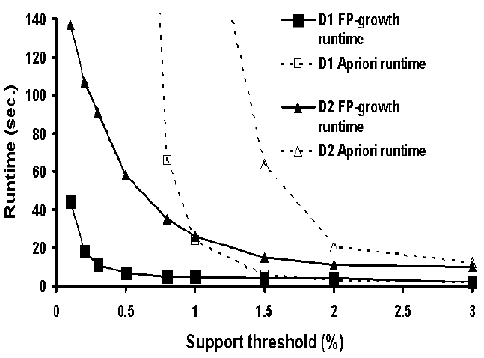
Scalability: runtime vs. min_sup (w/ Apriori)
Experiments
Mining Frequent Patterns without Candidate Generation (SIGMOD2000)

Slide 33
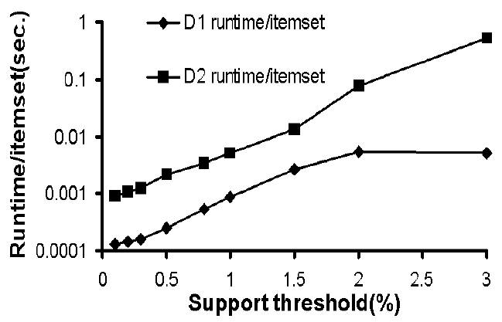
Runtime/itemset vs. min_sup
Experiments
Mining Frequent Patterns without Candidate Generation (SIGMOD2000)
Notes:
Experimental Evaluation and Performance Study (Continue)
FP-growth is about an order of magnitude faster than Apriori in large databases.
This Gap grows wider when the minimum support threshold reduces.

Slide 34
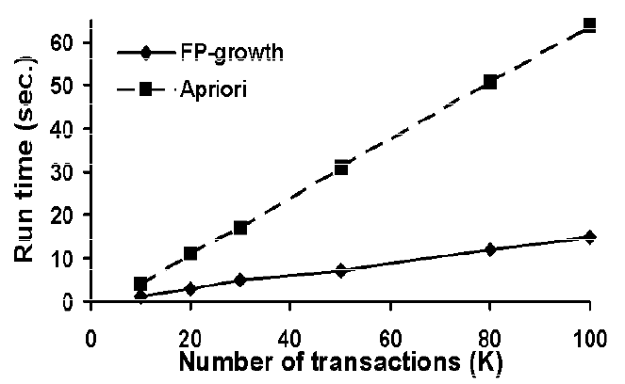
Scalability: runtime vs. # of Trans. (w/ Apriori)
Experiments
* Using D2 and min_support=1.5%
Mining Frequent Patterns without Candidate Generation (SIGMOD2000)

Slide 35
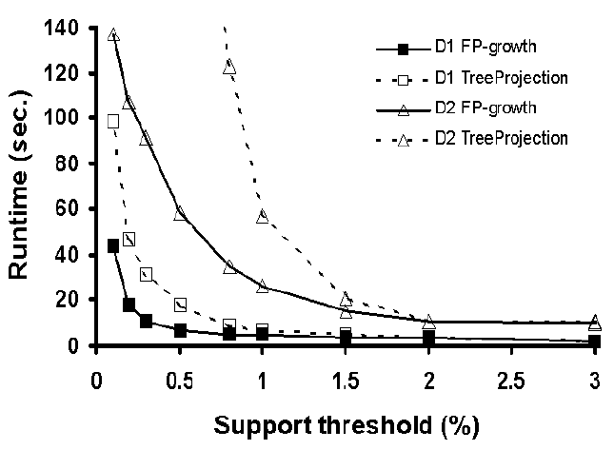
Scalability: runtime vs. min_support (w/ TreeProjection)
Experiments
Mining Frequent Patterns without Candidate Generation (SIGMOD2000)

Slide 36
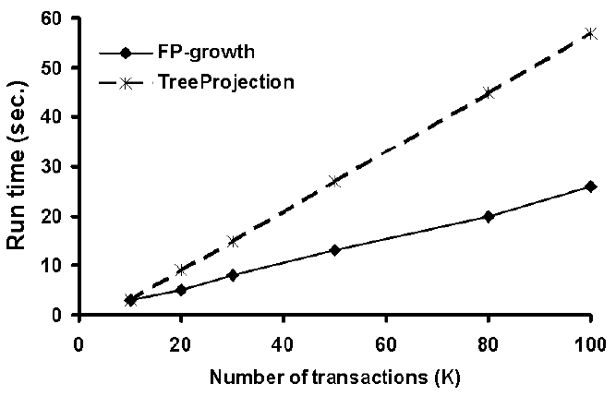
Scalability: runtime vs. # of Trans. (w/ TreeProjection)
Experiments
Support = 1%
Mining Frequent Patterns without Candidate Generation (SIGMOD2000)

Slide 37
Discussions:
Improve the performance
and scalability of FP-growth
Mining Frequent Patterns without Candidate Generation (SIGMOD2000)

Slide 38
Performance Improvement
Discussion
Projected DBs
Disk-resident
FP-tree
FP-tree
Materialization
FP-tree
Incremental update
partition the DB into a set of projected DBs and then construct an FP-tree and mine it in each projected DB.
Store the FP-tree in the hark disks by using B+ tree structure to reduce I/O cost.
a low ξ may usually satisfy most of the mining queries in the FP-tree construction.
How to update an FP-tree when there are new data?
Reconstruct the FP-tree
Or do not update the FP-tree
Mining Frequent Patterns without Candidate Generation (SIGMOD2000)

Slide 39
Conclusion Remarks
FP-tree: a novel data structure storing compressed, crucial information about frequent patterns, compact yet complete for frequent pattern mining.
FP-growth: an efficient mining method of frequent patterns in large Database: using a highly compact FP-tree, divide-and-conquer method in nature.
Mining Frequent Patterns without Candidate Generation (SIGMOD2000)

Slide 40
Some Notes
In association analysis, there are two main steps, find complete frequent patterns is the first step, though more important step;
Both Apriori and FP-Growth are aiming to find out complete set of patterns;
FP-Growth is more efficient and scalable than Apriori in respect to prolific and long patterns.
Mining Frequent Patterns without Candidate Generation (SIGMOD2000)

Slide 41
Related info.
FP_growth method is (year 2000) available in DBMiner.
Original paper appeared in SIGMOD 2000. The extended version was just published: “Mining Frequent Patterns without Candidate Generation: A Frequent-Pattern Tree Approach” Data Mining and Knowledge Discovery, 8, 53–87, 2004. Kluwer Academic Publishers.
Textbook: “Data Ming: Concepts and Techniques” Chapter 6.2.4 (Page 239~243)
Mining Frequent Patterns without Candidate Generation (SIGMOD2000)

Slide 42
Exams Questions
Q1: What are the main drawback s of Apriori –like approaches and explain why ?
A:
The main disadvantages of Apriori-like approaches are:
1. It is costly to generate those candidate sets;
2. It incurs multiple scan of the database.
The reason is that: Apriori is based on the following heuristic/down-closure property:
if any length k patterns is not frequent in the database, any length (k+1) super-pattern can never be frequent.
The two steps in Apriori are candidate generation and test. If the 1-itemsets is huge in the database, then the generation for successive item-sets would be quite costly and thus the test.
Mining Frequent Patterns without Candidate Generation (SIGMOD2000)

Slide 43
Exams Questions
Q2: What is FP-Tree?
Previous answer: A FP-Tree is a tree data structure that represents the
database in a compact way. It is constructed by mapping each frequency
ordered transaction onto a path in the FP-Tree.
My Answer: A FP-Tree is an extended prefix tree structure that represents the transaction database in a compact and complete way. Only frequent length-1 items will have nodes in the tree, and the tree nodes are arranged in such a way that more frequently occurring nodes will have better chances of sharing nodes than less frequently occurring ones. Each transaction in the database is mapped to one path in the FP-Tree.
Mining Frequent Patterns without Candidate Generation (SIGMOD2000)

Slide 44
Exams Questions
Q3: What is the most significant advantage of FP-Tree? Why FP-Tree is complete in relevance to frequent pattern mining?
A: Efficiency, the most significant advantage of the FP-tree is that it requires two scans to the underlying database (and only two scans) to construct the FP-tree. This efficiency is further apparent in database with prolific and long patterns or for mining frequent patterns with low support threshold.
As each transaction in the database is mapped to one path in the FP-Tree, therefore, the frequent item-set information in each transaction is completely stored in the FP-Tree. Besides, one path in the FP-Tree may represent frequent item-sets in multiple transactions without ambiguity since the path representing every transaction must start from the root of each item prefix sub-tree.
Mining Frequent Patterns without Candidate Generation (SIGMOD2000)

