Slide 1
Data Cleaning and Combining Data in Excel
Transforming Raw Data into Actionable Insights
Bharadwaj Dubbaka| GitHub | LinkedIn

Slide 2
What This Project Covers
Cleaning messy data in three datasets: `orders`, `products`, and `customer`.
01
Combining data for insights using Excel functions.
02
Developing clean and structured tables for analysis.
03

Slide 3
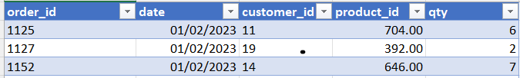
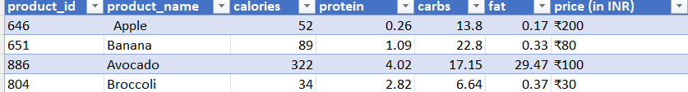

About the Dataset
- Orders Table: Order details such as Order ID, Customer ID, Product ID, Date, and Quantity.
- Products Table: Product details such as ID, Name, Nutritional Info, and Price.
- Customer Table: Customer names and IDs.

Slide 4
Steps for Cleaning the Data
Orders Table:
Eliminate duplicate `order_id`.
Convert `product_id` to text format.
Correct `qty` entries ending with 'Q' and handle missing values.
Products Table:
Use `TRIM()` to clean product names.
Extract numerical values from 'price (in Rs)' and rename columns.
Customer Table:
Convert names to lowercase and use 'Paste Special' to finalize.

Slide 5
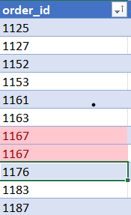
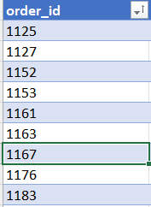
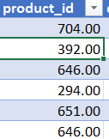
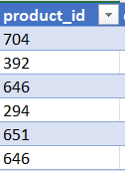
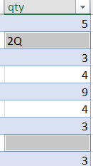
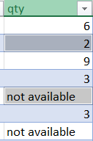
Data Cleaning in Order Table
Eliminated duplicate `order_id`.
Convert `product_id` to text format.
Correct `qty` entries ending with 'Q' and handle missing values.

Slide 6
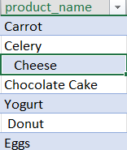
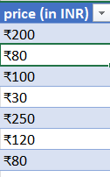
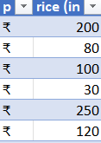
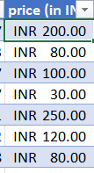
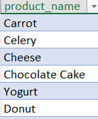
Data Cleaning in Product Table
Use `TRIM()` to clean product names.
Extract numerical values from 'price (in Rs)’ by splitting columns and rename columns.

Slide 7
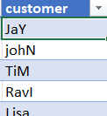
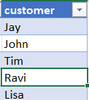
Data Cleaning in Customer Table
Convert all customer names to lowercase using proper().

Slide 8




Steps for Merging the Data
VLOOKUP: Fetch customer names using `customer_id`.
INDEX-MATCH: Retrieve product names for `product_id`.
XLOOKUP: Find product prices from the `products` table.
- New Column (total_price): Calculate `qty * price`.

Slide 9
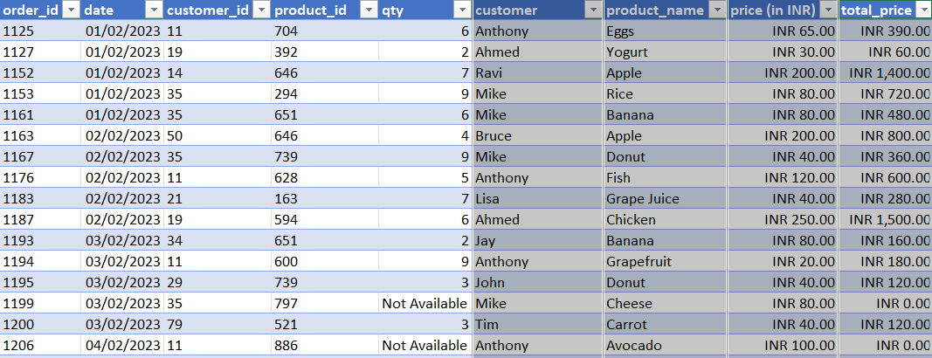
Cleaned and Combined Dataset

Slide 10
What I Learned
- Importance of data cleaning in data analysis.
- Techniques to handle duplicates, missing values, and inconsistent formatting.
- Using Excel formulas (VLOOKUP, INDEX-MATCH, XLOOKUP) for data merging.
- Creating analysis-ready datasets.

Slide 11
Explore My Work
- GitHub link to the project repository.
- Invite viewers to connect on LinkedIn.

