Slide 1
Tata Data Visualization Project
Business Insights & Recommendations
Bharadwaj Dubbaka | 2025

Slide 2
Objective: Analyze business performance to provide strategic insights.
Tools Used: Power BI for interactive data visualization.
Areas of Focus: Data Cleaning, Revenue trends, country-wise sales, top customers, and product demand.

Slide 3
Why Data Cleaning?
Ensure accuracy and reliability of insights.
Remove incorrect values to prevent misleading analysis.
Steps Taken in Data Cleaning:
Removed Negative Quantities: Excluded rows where Quantity < 1 as these indicate product returns.
Fixed Incorrect Unit Prices: Excluded records with Unit Price < $0 as they were likely data entry errors.
Handled Missing Customer ID's: Replaced blank CustomerIDs with 'Anonymous' to retain all sales transactions.
Excluded UK for Specific Analyses: In visuals where expansion was the focus, the UK was filtered out.
Outcome:
Improved data consistency.
Ensured accurate revenue and sales calculations.
Maintained completeness by retaining Anonymous purchases.

Slide 4
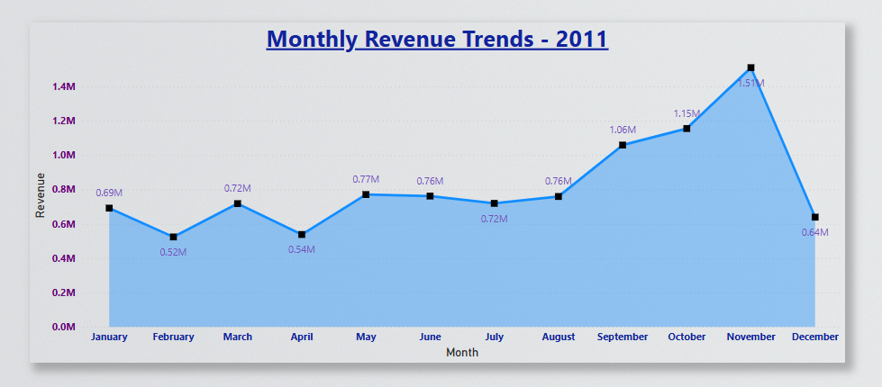
📊 Visual: Line Chart (Revenue Trends 2011)
Key Insights:
Revenue peaks in October & November indicate seasonality.
Likely influenced by holiday shopping & promotions.
Business strategy: Plan marketing campaigns around peak months.

Slide 5
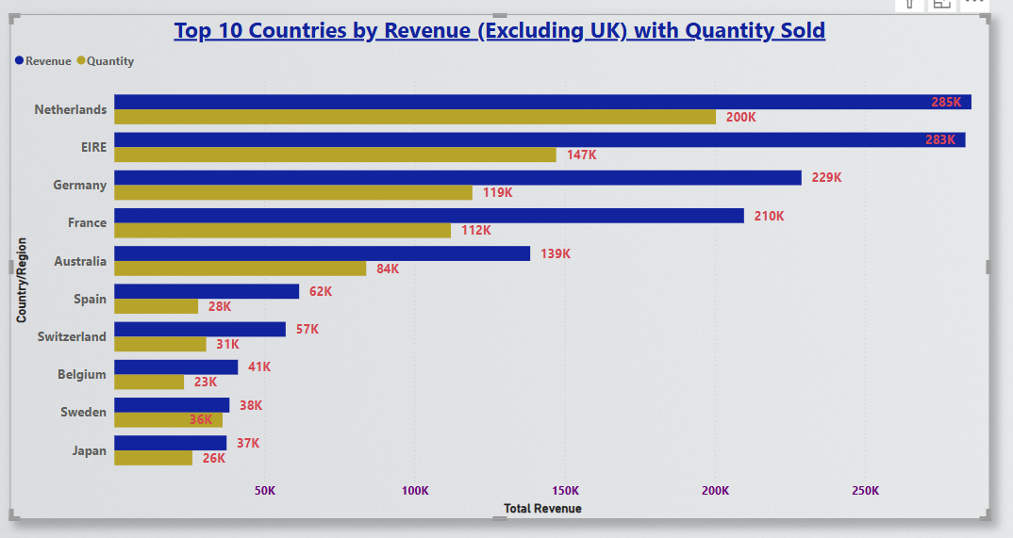
📊 Visual: Clustered Bar Chart (Top 10 countries by Revenue)
Key Insights:
Netherlands & EIRE lead in revenue, but Germany & France have high sales volume.
Different pricing and sales behaviors observed.
Business strategy: Adjust pricing models for optimal revenue.

Slide 6

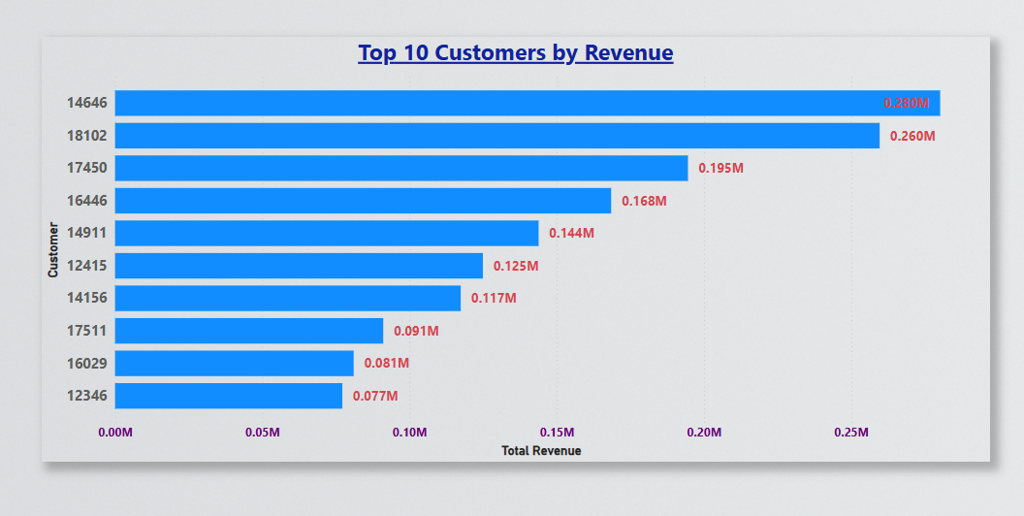
📊 Visual: Clustered Bar Chart (Top 10 Customers by Revenue)
Key Insights:
High-value customers contribute significantly to total revenue.
Need to assess repeat vs. one-time buyers.
Business strategy: Implement loyalty programs & personalized marketing.

Slide 7
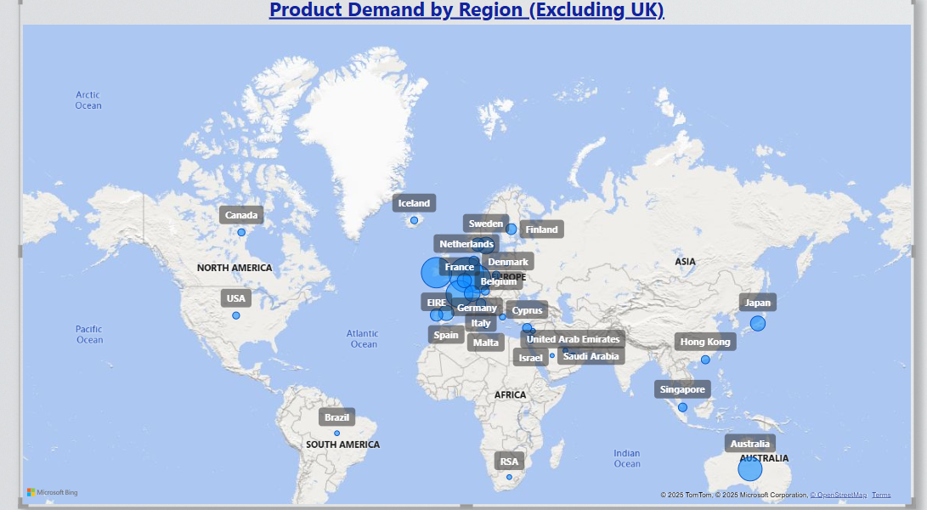
📊 Visual: Map Chart (Product Demand by Region)
Key Insights:
High product demand in Netherlands, Germany, Japan, and Australia.
UK excluded to focus on international growth opportunities.
Business strategy: Expand marketing & distribution in high-demand regions.

Slide 8
Additional Insights & Recommendations Extra Business Insights:
Identify high-performing product categories in top revenue countries.
Compare past years’ trends to confirm seasonality patterns.
Explore emerging markets with moderate demand but high growth potential.
Strategic Actions:
Develop data-driven pricing strategies per country.
Improve customer segmentation for better marketing.
Optimize supply chain for high-demand regions.

Slide 9
Implement strategic recommendations based on insights.
Continue monitoring revenue trends & customer behavior.
Optimize marketing & expansion strategies for sustained growth.
Thank you for your time and attention!

