Slide 1
Recommend a location in Manhattan,New York to open a new Ramen Restaurant

Slide 2
Business Problem
My client wants to open his business in Manhattan area, so I focus on that borough during my analysis. We define potential neighborhood based on the number of ramen restaurants which are operating right in each neighborhood. Manhattan has full potential but also is a very challenging district to open a business because of high competition. New ramen restaurant should be open in an area that inadequate neighborhood in this way the bar can attract more customers. Therefore, this analysis necessary to ensure that we have enough customers and that we are not so close to other ramen restaurants.

Slide 3
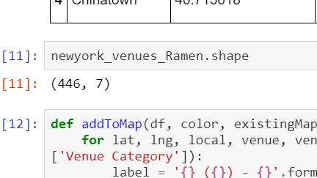
Data selection
To identify the characteristics of our competitors' venues in Manhattan, we would first need to find out the number of ramen restaurants in Manhattan currently and their location.
We then used Google Map API to find their geographic coordinates based on their postal code addresses.
In Manhattan, there is 446 ramen restaurants are currently operating.

Slide 4
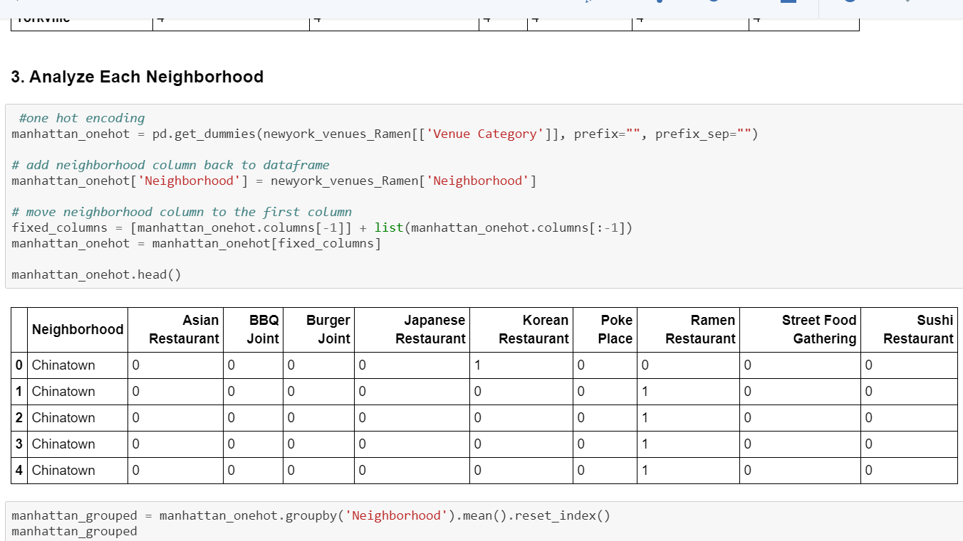
Methodology
addresses are converted into their equivalent latitude and longitude values.
Foursquare API is used to explore neighborhoods in Manhattan, New York.
After that, explore function to get ramen restaurant categories in each neighborhood.

Slide 5
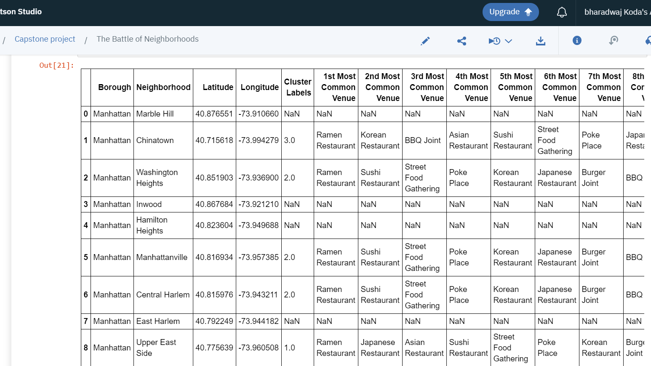
Methodology
Then using this feature to group the neighborhoods into clusters K-means clustering algorithm will be use to complete this task. And also, the Folium library to visualize the neighborhoods in Manhattan and its emerging clusters.

Slide 6
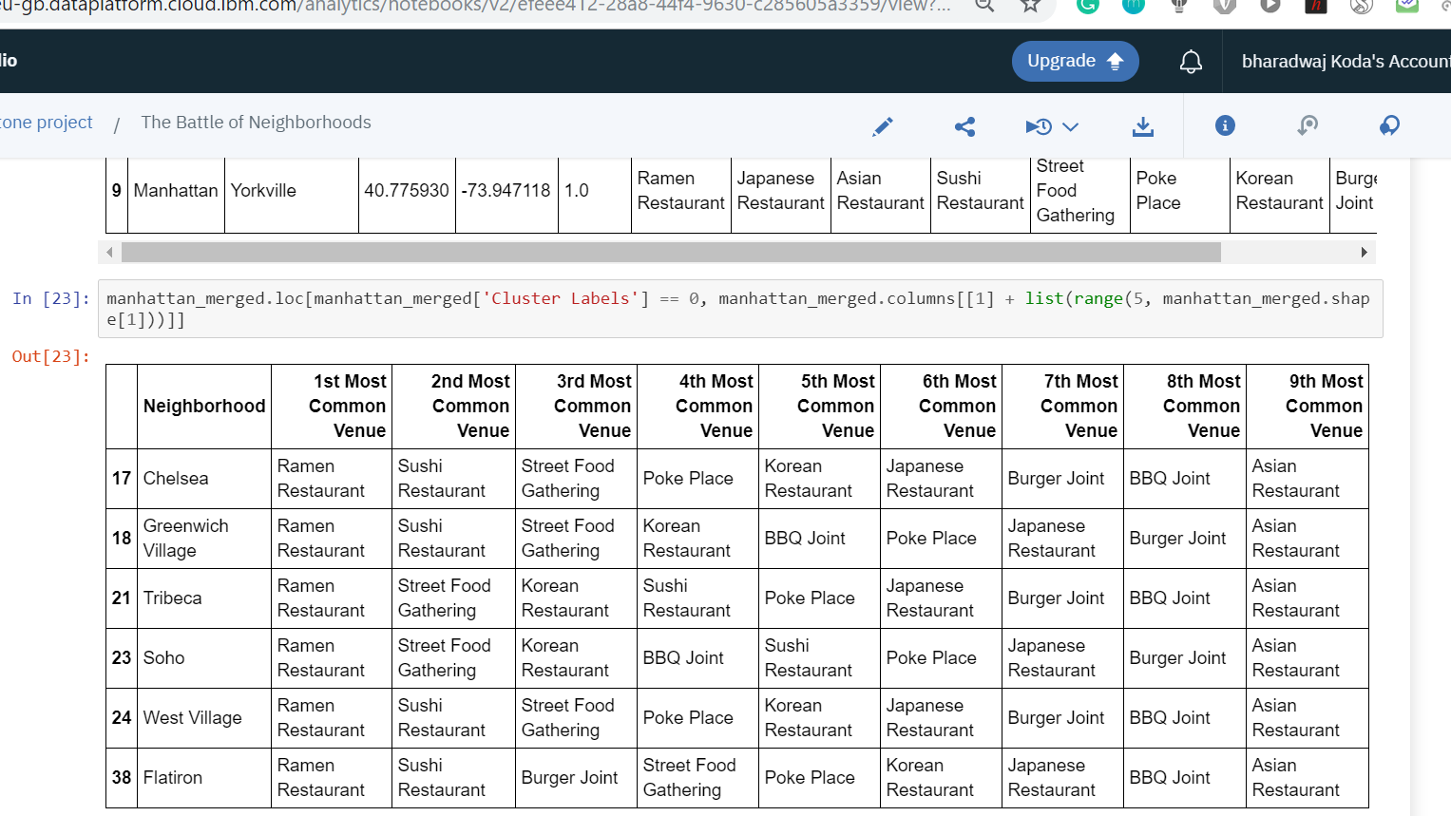
Results
Using K-mean to clustering data area with less number of ramen restaurants
For Cluster 0

Slide 7
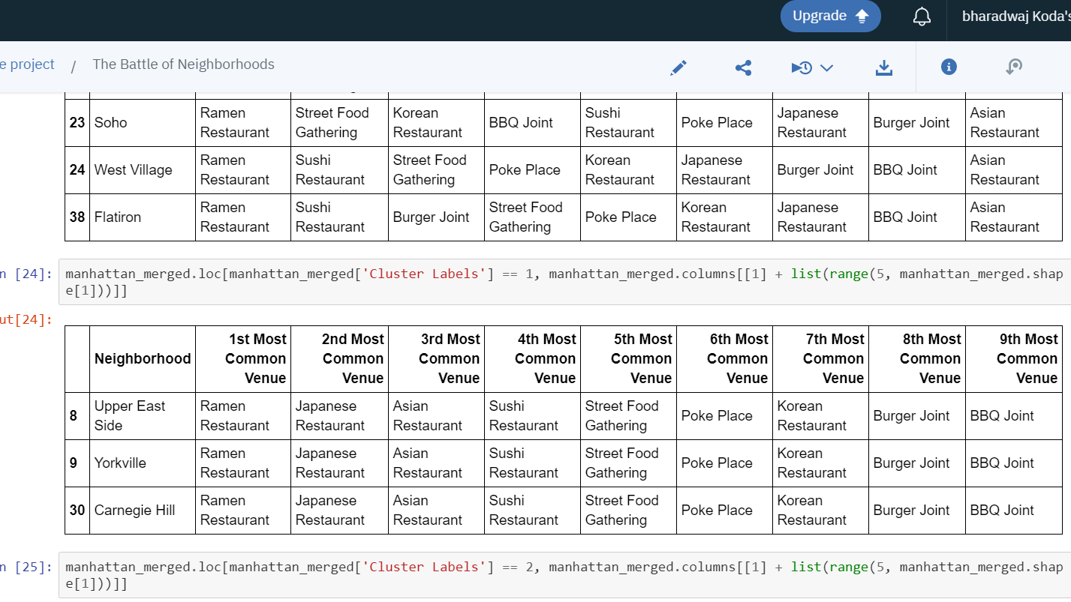
Results
Cluster 1

Slide 8
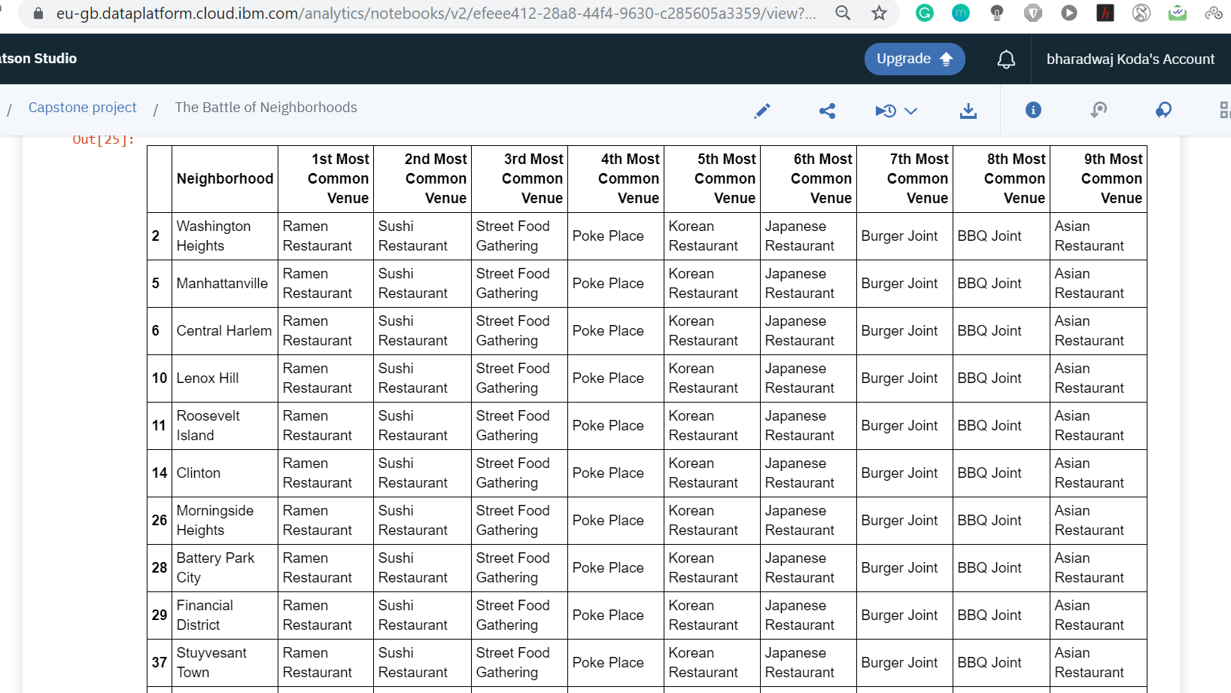
Results
Cluster 2

Slide 9
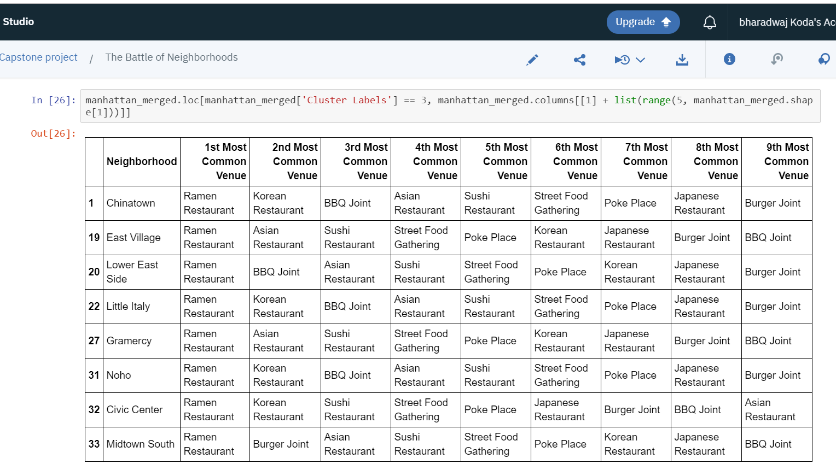
Results
Cluster 3

Slide 10
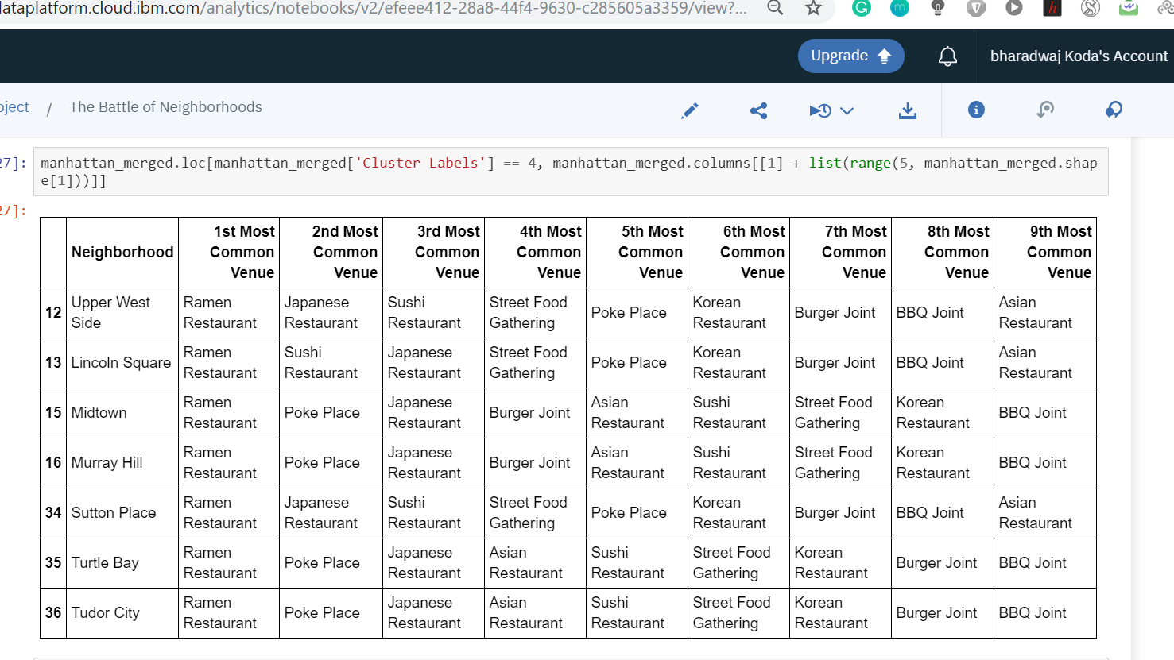
Results
Cluster 4

Slide 11
Discussion
Based on dataframe analysis above Cluster 1 (Upper East Side ,Yorkville ) areas are the best places to open a new ramen restaurant business.
This analysis is performed on limited data. This may be right or may be wrong. But if good amount of data is available there is scope to come up with better results.
It can be done more detailed analysis by adding other factors such as transportation, demographics of inhabitants.

Slide 12
Conclusion
Although all of the goals of this project were met there is definitely room for further improvement and development as noted below. However, the goals of the project were met and, with some more work, could easily be developed into a fully functional application that could support the opening a business idea in an unknown location.

