Slide 1
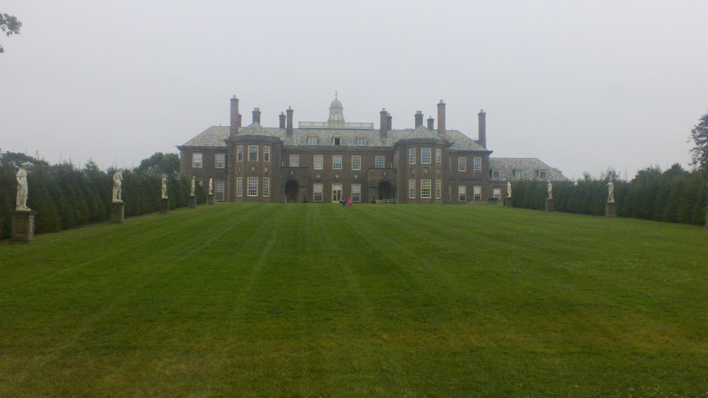
TEAM STRONGE ENCRYPTION
TERENCE GRIFFIN (CAPTAIN) BILL STRONGE RICCARDO GULIA SRIVIDYA VENKATAKUPPA BHARADWAJ NALLAVELLI
SECURE FTP PICTURE STORAGE
WITH SIGNATURES

Slide 2



BOB BUYS A PICTURE FROM ALICE
Alice (user1)
PUT
PEM keys
File Storage
www.tmz.com
user1
user2
LS
Bob (user2)
PEM keys
GET
Verify

Slide 3
ENCRYPTION / DECRYPTION ROUTINES
client_main.c
connect_to_server()
get_rand_iv() // rand.c
PKE_client() // PKE.c
Authentication/HMAC // authentication.c
process_input (PUT, GET, LS, VERIFY, …)
file_transfer.c
put_cmd_client()
creates signature file
send_file()
utils.c
encrypted_send()
encrypt() // EVP.c
raw_send()
send // hton routines
server_main.c
accept()
fork to connected_sock
process_client()
PKE_server() // session key
user_authentication_server() // authentication.c
while(true)
put_cmd_server()
file_transfer.c
put_cmd_server()
receive_file()
utils.c
encrypted_recv()
decrypt() // EVP.c
raw_recv()
recv() // ntoh routines

Slide 4
AUTHORIZATION AND AUTHENTICATION 4 WAY HANDSHAKE
Client Sends Authorization Request to Server
Challenge string, Client certificate
Server receives request
Verifies client’s certificate, extracts the clients name. Verifies the client name is authorized
Responds with Server challenge, Server Certificate, hashed Client challenge using Server Private key
Client receives server response
Verifies Server certificate and hashed client challenge using Server public key
Responds with hashed server challenge using Client private key
Server receives client response
Verifies hashed server challenge using Client public key
Responds to Client whether they are authenticated and authorized

Slide 5
SHA-256 HASHING
create_file_hash()
Image, user name, and timestamp
Produces
SHA 256
Hash
CLIENT
Saves in server

Slide 6
SHA-256 HASHING
Working of SHA 256:
When the client puts the image into server using the put command then the respective hash is produced and saved on server side as .sig file.
When another client requests the same image file using get command then the client is provided with the image and the hash file. Then the client can verify using the verify command.
SHA hashing will ensure that the data remains unchanged and the original owner is identified.

Slide 7
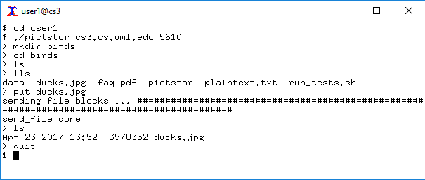
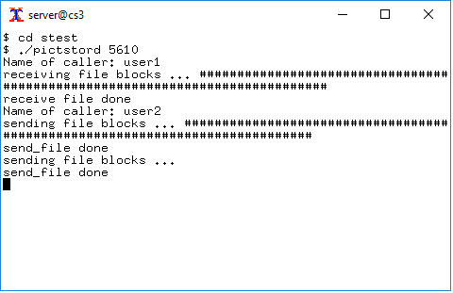
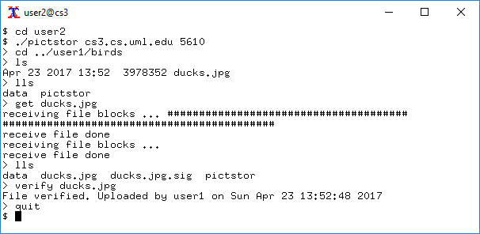
Running the program

