Slide 1
MACHINE LEARNING MINI - PROJECT for human activity detection using smart phone dataset Neural approach for credit card Fraud Detection MEGAVATH BHARADWAJ RATHOD ROLL N0: 1901108 Dept. of Computer Science & Engineering Indian Institute of Information Technology, Guwahati. Course: CS360 - Machine Learning Lab

Slide 2

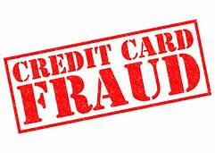


OUT LINE :
ABSTRACTION
INTRODUCTION(LITERATURE SURVEY).
1. Overview of credit card fraud detection.
2. Classifications of credit card frauds.
3. Problem Statement.
4. LITERATURE REVIEW
SCOPE OF OUR PROJECT
MATERIALS
Dataset Used.
Result analysis
RESULTS OF OVER FITTING CURVES FOR SIX DIFFERENT MODELS
Confusion Matrix of six different models
RESULTS OF MODELS

Slide 3
ABSTRACTION:
This Project is focused on credit card fraud detection in real world scenarios. Criminals are using fake identity and various technologies to trap the users and get the money out of them. Therefore, it is very essential to find a solution to these types of frauds.
In this proposed project we designed a model to detect the fraud activity in credit card transactions. As technology changes constantly, it is becoming difficult to track the behavior and pattern of criminal transactions.
We come up the solution one can make use of technologies with the increase of machine learning, artificial intelligence and other relevant fields of information technology.
Initially, we will collect the credit card usage data-set by users and classify it as trained and testing dataset using an Artificial Neural Network ,random forest algorithm and decision trees. Using this feasible algorithm, we can analyze the larger data-set and user provided current data-set. Then augment the accuracy of the result data.

Slide 4
INTRODUCTION:
Credit card fraud is happening in all organization such as appliances industry, automobile industry, banks and so on.
Many of the process like machine learning algorithmic approaches are applied to identify the fraud in the credit card transactions but did not get considerable result.
Hence, there is a need of effective and efficient algorithms to be developed that works significantly. we try to avoid the fraudster using our credit card before the transaction gets approved by using artificial neural network algorithm and compared with few other machine learning algorithms.

Slide 5
1) Overview of credit card fraud detection:
The user or the customer enters the necessary credentials in order to make any transaction using credit card and the transaction should get approved only upon being checked for fraud activity.
For this to happen, we first pass the transaction details to the verification module where, it is classified under fraud and non-fraud categories. Any transaction that is put under fraud category is rejected. Otherwise, the transaction gets approved

Slide 6
2) Classifications of credit card frauds:
1 . Application fraud: When a fraudster acquires the control over the application, steals the credentials of customer, and makes a fake account and then the transactions takes place.
2 . Electronic or manual card imprints: In this form of fraud, the fraudster skims the information from the magnetic strip which is present on the card then uses the credentials
and fraud transactions are carried out .
3 . Card id theft : The type of fraud in which the id of the cardholder were theft and fraud takes place.
4 . Account Takeover : Here the fraudster will take the complete control of the account holder and
make a fraud.
5 . Fake fraud in website : Fraudster will introduce a malicious code which does their work on the website

Slide 7
3) Problem statement:
Now -a-days, most of them are using credit cards for buying the goods which are so much in need. Credit card fraud stands as major problem for word wide financial institutions.
Find out weather the upcoming transaction is Fraud or Non-Fraud.
In order to meet the needs credit cards are used and the fraud associated with it is also increasing so there is a need of developing a model that’s fit well and predicts at higher accuracy.

Slide 8
4) LITERATURE REVIEW:
Bhattacharya S, Jha S, Tharakunnel K have summarized a comparative study on data mining approaches that tend to ascertain the productivity of the few available techniques that help to combat the fraudsters.
This research wrapped-up the contrast of various machine learning techniques that are accessible to prognosticate the credit card fraud. . The analysis specifying the comparison between various different techniques like SVM, logistic regression, neural networks constituted that neural networks performed the best in combating the fraud.
E. Duman, in aimed to denote the advantages/superiority of applying the data mining techniques including Decision Trees & Support Vector Machine (SVM) to the credit card fraud detection problem to lessen the banks risk. The results obtained manifested that the classifiers & other Decision Tree approaches outmatched SVM approaches in solving the problem under investigation.

Slide 9
→ Geoffrey F.Miller, Peter M.Todd [9] have stated the problem associated with intuitive network design by humans and have put forward the idea of an automated evolutionary deign method that is revolving on genetic algorithms and as a solution to it they have modeled a system which would have applications in biological, neurological and psychological modelling as well as the engineering and design applications using automated network design. Their research aims to free the network design process from the constraints of human biases. →Debachudamani Prusti and Santhnu Kumar Rath designed an application with applied machine learning approaches such as Decision tree (DT), k-nearest algorithm (kNN), Extreme learning machine (ELM), Multilayer perceptron (MLP) and support vector machine (SVM) to detect the accuracy in fraud identification. They proposed a model by hybridizing the DT, SVM and kNN techniques. They used two web-based protocols such as simple object access protocol (SOAP) and Representational state transfer (REST) for efficient exchange of data across multiple heterogeneous platforms. They compared five machine learning algorithm results based on accuracy metric. SVM performed better than other algorithms by 81.63% but the hybrid system proposed by them had higher accuracy of 82.58%. →M. S. Kumar, V. Soundarya, S. Kavitha, E. S. Keerthika and E. Aswini worked on project that made a model for detection of fraud in credit card transactions using Random forest techniques. The random forest algorithm (RFA) is a supervised machine learning techniques which uses the decision tree for classification of the credit card transactions and further performance is calculated using confusion matrix. The proposed system gives an accuracy of 90%

Slide 10
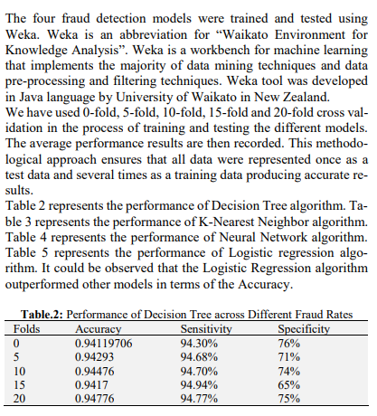
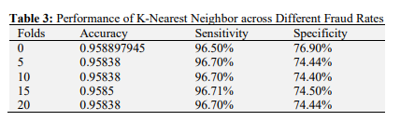
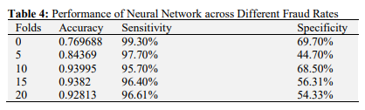
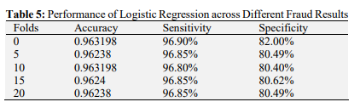
→ Fraudulent Detection in Credit Card System Using SVM & Decision Tree (Vijayshree B. Nipane, Poonam S. Kalinge, Dipali Vidhate, Kunal War, Bhagyashree P. Deshpande): With growing advancement in the electronic commerce field, fraud is spreading all over the world, causing major financial losses. In the current scenario, Major cause of financial losses is credit card fraud; it not only affects tradesperson but also individual clients. Decision tree, Genetic algorithm, Metalearning strategy, neural network, HMM are the presented methods used to detect credit card frauds. In contemplating system for fraudulent detection, artificial intelligence concept of Support Vector Machine (SVM) & decision tree is being used to solve the problem. Thus by the implementation of this hybrid approach, financial losses can be reduced to greater extent. → →

Slide 11
Scope of our Project:
Detect the fraudulent transactions
Minimization of credit card fraud.
Analysis Multiple Machine Learning Algorithm.
Better Performance and Accuracy.

Slide 12
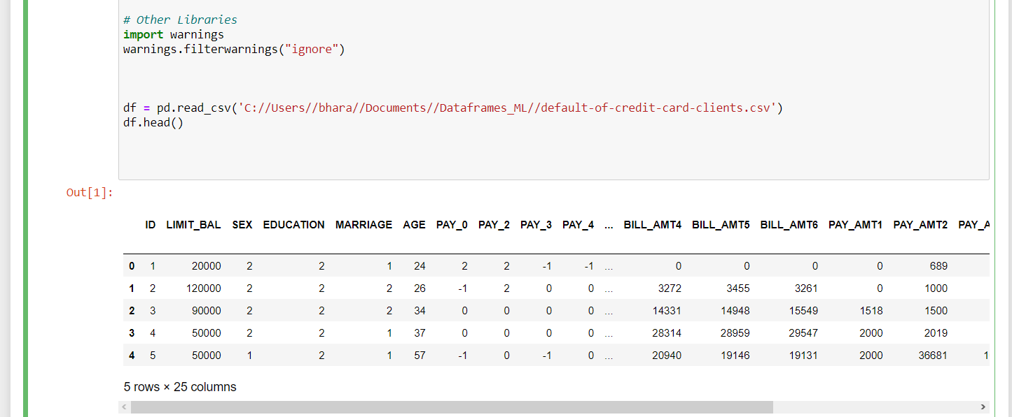
MATERIAL:
1) Data Used:
This dataset’s present transaction have occurred , where we 6636(22.1%) frauds and 23364(77.9%) non –frauds.
The dataset is highly imbalanced.
The dataset used in the project consist of 24 attributes(features x1,x2, ……..,x24) and attribute gives the outcome in either fraud transaction or non fraud transaction(1/0).

Slide 13
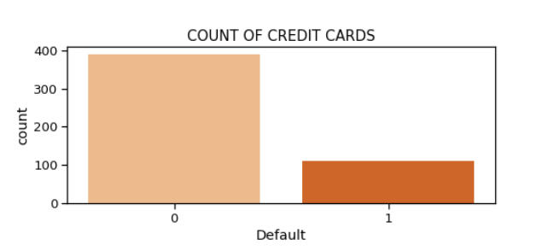
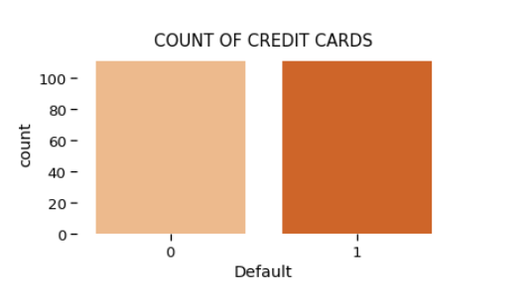
In these project our datasets is derived into classification algorithm which is to predict the discrete values (like fraud /non-fraud).
And our target value (Y ) is Binary Classification model .
To solve the class imbalance problem I have used the oversampling technique and undersampling technique.
After applying these techniques oversampling has given the better results as compared to undersampling because of insufficient data.
Fraudulent(1) : 22.2%.
Non-fraudulent(0) : 77.8%
Fraudulent(1) : 50.0%
Non-fraudulent(0) : 50.0%
In a given data frame data is highly Imbalance.
After balancing data by Undersampling Method
Fig. Above figure shows number of fraudulent and non-fraudulent.

Slide 14
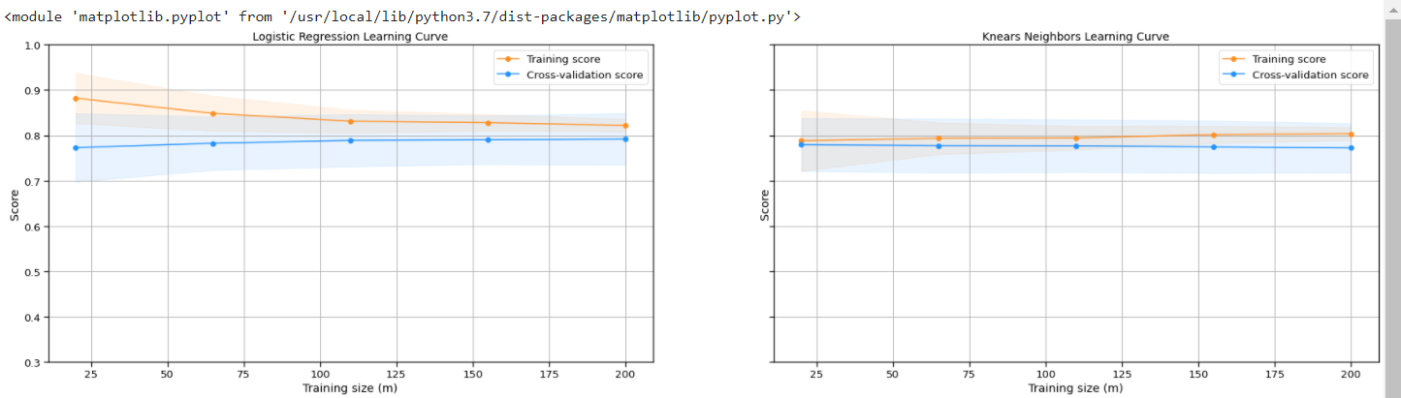
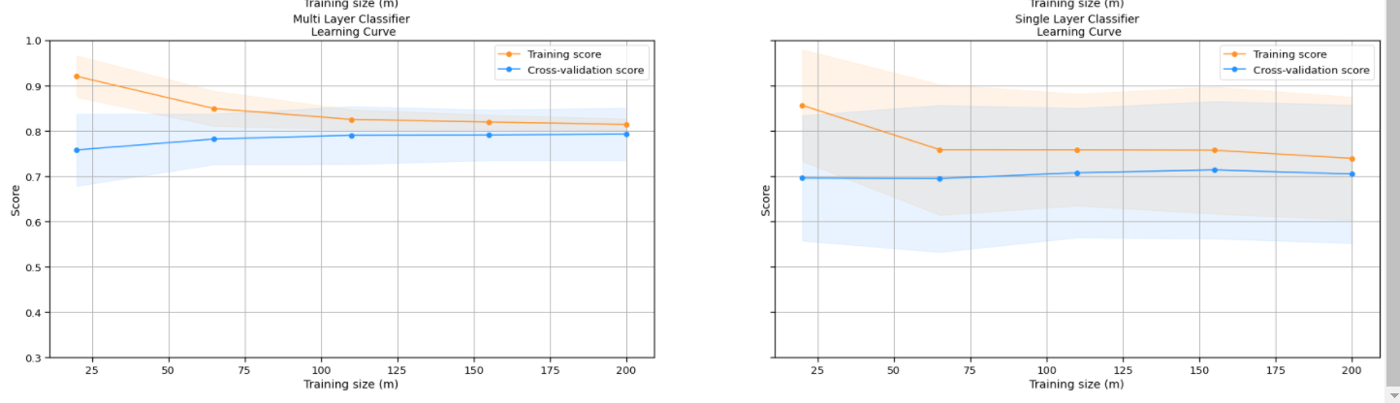
A)RESULTS OF OVER FITTING CURVES FOR SIX DIFFERENT MODELS :
a)Logistic Regression : b) K-Nearest Neighbors : .
c) MLP Classifier :
d) SLP Classifier :

Slide 15
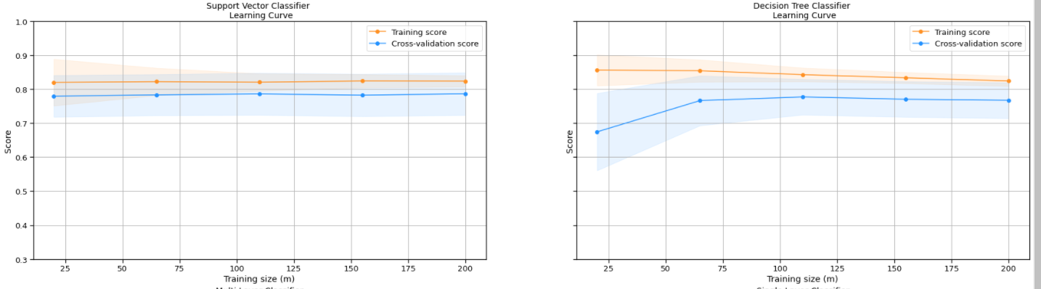
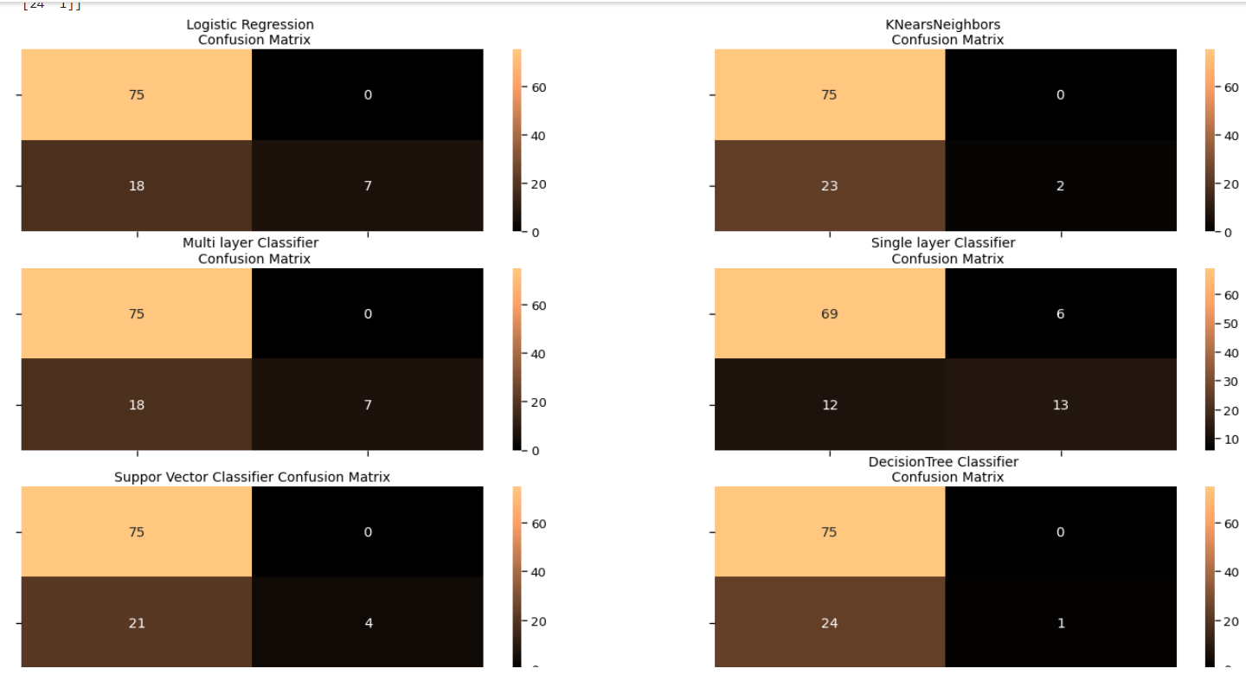
e) Support Vector classifier:
f) Decision Tree:
B) Confusion Matrix of six different models:

Slide 16
C) RESULTS OF MODELS:
By using the logistic regression , I have got the accuracy for the test data set as 80%.
By using the K – Nearest Neighbors(KNN), I have got the accuracy for the test data set as 80% which is same as logistic regression.
By using the Multi Layer Classifier (MLP), I have got the accuracy for the test data set as 84.168% which is comparatively more than other models.
By using the Single layer Perceptron (SLP), I have got the accuracy for the test data set as 72.5% which is comparatively lesser than other models.
By using the Support Vector Classifier (SVC) , I have got the accuracy for the test data set as 80% which is same as log reg and KNN .
By using the Decision Tree Classifier , I have got the accuracy for the test data set as 83% which is comparatively less than MLP.
By Comparing above model’s accuracy the Best Model is “MLP Classifier”.

Slide 17
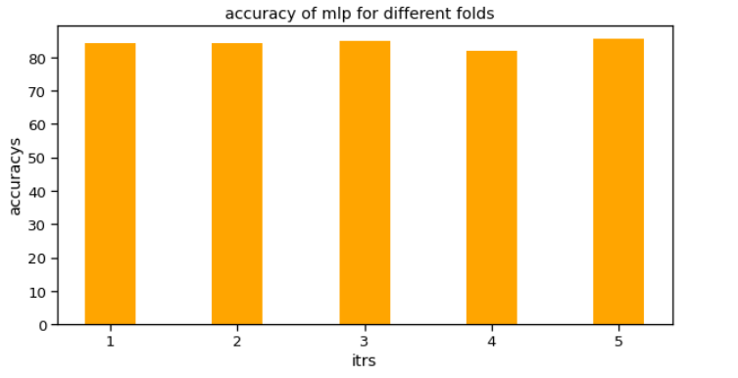
For Logistic Regression , KNN , Multi-layer Perceptron , SLP , SVC , Decision Tree . I have applied k-fold cross validation technique to check whether the random initialization of weights and random assignments of samples to train and test set will effect or not .
After applying 5-fold cross validation I have got all the five accuracies above 80% other than SLP .
In case of SLP I have got 72.5% which is comparatively lesser than all other Models But which is better than the training set of SLP.
By Comparing above model’s Accuracy the Best Model in K-Fold Cross validation (test set) is “Multi Layer Perceptron Classifier”- AVG Accuracy : 84.168.

Slide 18
References:
A.A. Taha, S. J . , An intelligent approach to credit card fraud detection using an optimized light gradient boosting machine, IEEE Access 8 (2020) 25579–25587, doi:10.1109/ACCESS.2020.2971354.
I. , R. Pratap, U. Nambiar, Ensemble learning for credit card fraud detection, in: Proceedings of the ACM India Joint International Conference on Data Science and Management of Data Association for Computing Machinery, New York, NY, USA, 2018, pp. 289–294, doi:10.1145/3152494.3156815.
RB, A., & KR, S. K. (2021). Credit card fraud detection using artificial neural network. Global Transitions Proceedings, 2(1), 35–41. doi:10.1016/j.gltp.2021.01.006

Slide 19

!!!!!!

