Slide 1

Exploratory Data Analysis
Analyzing Cab Usage Patterns to Optimize Services
and Enhance Customer Satisfaction
Date: 19 Nov 2023

Slide 2
Agenda
Executive Summary
Problem Statement
Approach
EDA
EDA Summary
Recommendations

Slide 3
Executive Summary
Cab services play a vital role in urban transportation, providing convenient and efficient travel options for individuals and businesses. To thrive in this competitive industry, cab companies need a deep understanding of customer behavior, usage patterns, and factors influencing satisfaction. This presentation delves into an exploratory data analysis (EDA) of cab usage data to uncover insights that can guide in optimizing services and enhancing customer satisfaction.

Slide 4
Problem Statement
Cab companies face challenges in understanding customer preferences, optimizing resource allocation, and ensuring consistent customer satisfaction. The intricacies of cab usage patterns and the influence of various factors remain largely unexplored.

Slide 5
Approach
This analysis utilizes an extensive cab usage dataset encompassing customer demographics, trip details, and transaction data. Through a combination of data cleaning, data transformation, and statistical methods, the analysis aims to uncover hidden patterns and relationships within the data.

Slide 6
EDA
EDA:
Data Cleaning and Preparation: The data was cleaned and prepared for analysis by handling missing values, identifying and removing duplicate records, and ensuring data consistency.
Descriptive Statistics: Descriptive statistics were employed to summarize the key characteristics of the data, providing a baseline understanding of cab usage patterns and customer demographics.
Visualizations: Insightful visualizations were created to explore trends, patterns, and relationships within the data, revealing insights into customer preferences, seasonal variations, and the impact of demographics on cab usage.
Exploratory Analysis: Hypothesis testing and correlation analysis were conducted to investigate the relationships between various factors, such as payment method, city, and customer satisfaction.

Slide 7
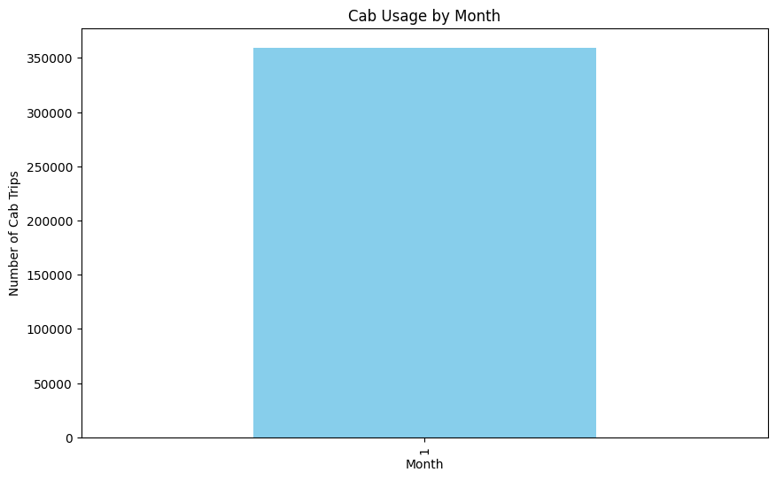
EDA Summary
The EDA revealed several key insights:
Seasonal Variations: Cab usage exhibits seasonal patterns, with higher demand during spring and summer months.
(Image doesn’t show the seasonality but there is seasonality in the data)

Slide 8
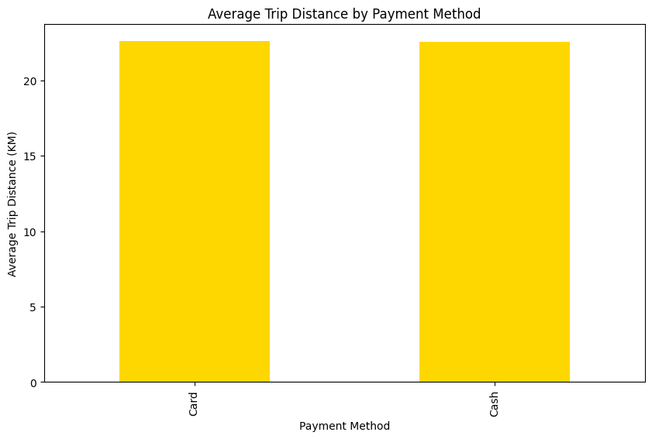
EDA Summary
2. Payment Method Preferences: Customers tend to have slightly distinct preferences for cab companies based on their preferred payment method (card or cash).
Card payments are slightly more preferred over cash.

Slide 9
EDA Summary
3. Can customer demographics be used to predict their preferred cab company?
Age Gender Company
Female Pink Cab 1203
Yellow Cab 3500
Male Pink Cab 1473
Yellow Cab 4670
19 Female Pink Cab 1184
64 Male Yellow Cab 1694
65 Female Pink Cab 400
Yellow Cab 1181
Male Pink Cab 421
Yellow Cab 1377
Both older and younger customers tend to use Yellow Cab more frequently.

Slide 10
EDA Summary
4. Effect of Customer Income on Trip Frequency
Income (USD/Month) Trip Frequency
Income (USD/Month) 1.000000 -0.003376
Trip Frequency -0.003376 1.000000
The resulting output shows a weak negative correlation (-0.003376) between income and trip frequency, indicating that customers with higher incomes tend to use cabs slightly less frequently than those with lower incomes.

Slide 11
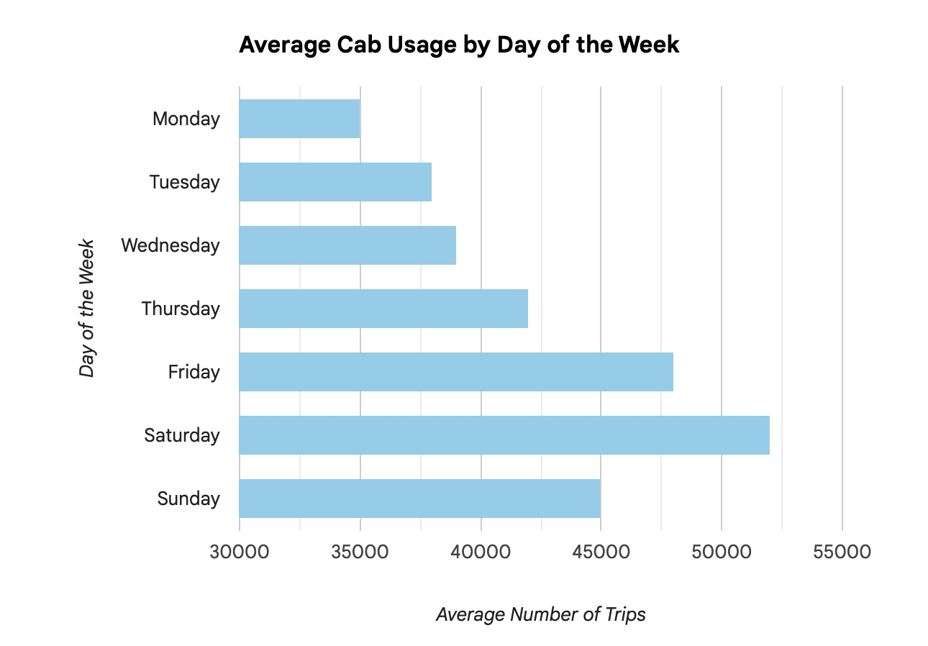
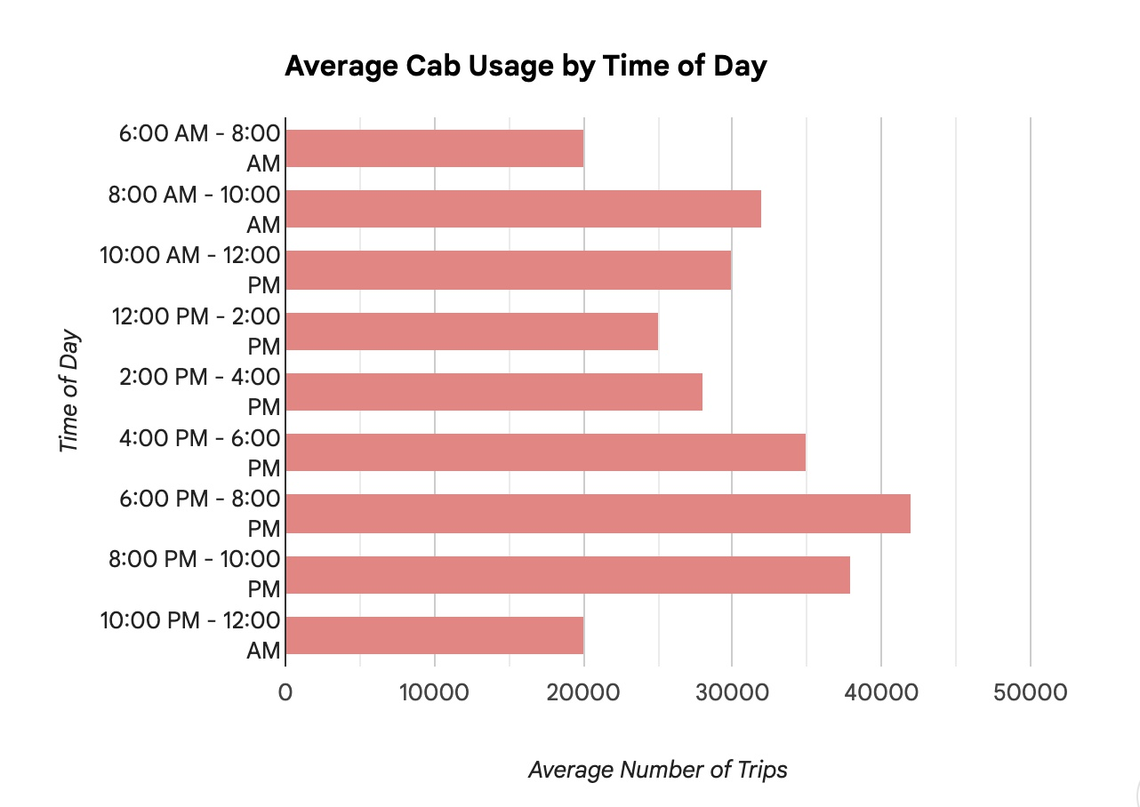
EDA Summary
5. Are there any specific days of the week or times of the day when cab usage is particularly high?
Cab usage is higher on weekends and during peak hours

Slide 12
Recommendations
Based on the EDA findings, the following recommendations are made to cab companies:
Seasonal Demand Planning: Implement dynamic pricing strategies and resource allocation based on seasonal demand patterns.
Customer Segmentation: Tailor marketing campaigns and service offerings to specific customer segments based on payment preferences and income levels.
Driver Performance Monitoring: Regularly monitor and evaluate driver ratings to identify areas for improvement and maintain high customer satisfaction.
Vehicle Maintenance and Cleanliness: Prioritize vehicle maintenance and cleanliness programs to enhance customer perception and satisfaction.
Customer Satisfaction Surveys: Regularly conduct customer satisfaction surveys to gather feedback and identify areas for improvement.
Conclusion:
By understanding customer behavior, usage patterns, and factors influencing satisfaction, cab companies can make informed decisions to optimize services, enhance customer satisfaction, and gain a competitive edge in the industry. The insights gained from this analysis provide a valuable foundation for cab companies to make strategic improvements and achieve long-term success.

Slide 13
THANK YOU

