Slide 1

Hierarchical Data Model: Structure, Advantages, and Limitations
Bharani. R.P
1925L260003
Date:16/10/2026

Slide 2
What is a Data Model?
A way of organizing and structuring data so a computer can store and retrieve it.
1
The hierarchical model is one of the earliest (used in IBM’s IMS system, 1960s–70s).
2

Slide 3
Core Idea: Tree Structure
Data is organized like an upside-down tree.
One “root” record at the top, with “child” records branching below it.
Analogy: a company org chart, or folders and subfolders on your computer.

Slide 4
Key Rule: Parent-Child Relationships
Every child record has exactly one parent.
01
A parent can have many children (this is called a “one-to-many” relationship).
02
No child can have two parents — that’s the defining restriction.
03

Slide 5
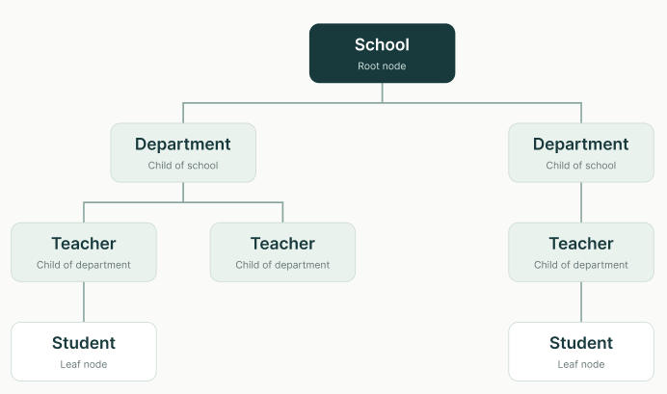
Diagram

Slide 6
How Data is Accessed
To find a record, you start at the root and walk down the tree, level by level.
Example: to find “Student records,” you must go School → Department → Teacher → Student. You can’t jump directly.

Slide 7
Advantages
Simple and fast when relationships are naturally hierarchical (e.g., org charts, file directories)
01
Fast retrieval if you’re searching top-down
02
Easy to understand conceptually — mirrors real-world trees
03

Slide 8
Limitations
Can’t easily represent many-to-many relationships (e.g., a student enrolled in many courses, each course having many students) — this model forces everything into one parent
Redundancy: if a record needs to appear under two different parents, it must be duplicated
Rigid structure — hard to reorganize or query in unexpected ways
Deleting a parent deletes all its children (even if you only wanted to remove the parent)

Slide 9
Summary / Comparison Table
Feature | Hierarchical Model
Structure | Tree (parent-child)
Relationship type | One-to-many only
Access | Top-down, level by level
Strength | Simple, fast for naturally hierarchical data
Weakness | Poor at many-to-many, data redundancy, rigid
Used today? | Mostly replaced by relational/network models, but still seen in XML, file systems, DNS

Slide 10
References
Textbook (e.g., Elmasri & Navathe, Fundamentals of Database Systems — check what your course uses)
Any article/documentation you actually read

Slide 11
THANK YOU

