Slide 1


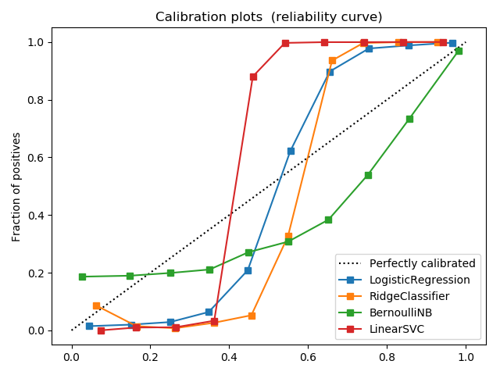
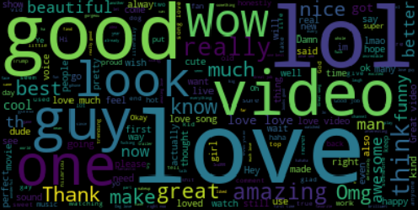
Content Analysis of YouTube Data
cs229,Autumn 2017; Category : Natural Language
Afshin Moin (afshinm), Abhishek Bharani (abharani), and Peng Seng Kuok (pkuok)
Motivation
Motivation
Popularity of social media is increasing rapidly
YouTube is most popular video sharing website
we do:
Sentiment analysis of the comments
Category prediction based on comments
Data
YouTube data from Kaggle competition https://www.kaggle.com/datasnaek/youtube
top 200 videos per day along with their comments, category and tags
Feature Extraction
Generate sentiment labels: TextBlob was used to estimate comment polarity
Comment are vectorized using TF-IDF (Term Frequency – Inverse Document Frequency)
Approach
Train classification methods we used sentiment polarity feature to decide the polarity of new comment. We ran four different classification techniques.
Analyzing the sentiments from comments helped us to separate positive and negative comments and identify most used words.
For category classification, to predict categories from comments we compute the joint distribution of category and comments.
<waiting results from Peng on dimensionality reduction
Results & Analysis
Sentiment Classification Summary
Category Classification Summary
Model | Train Accuracy | Test Accuracy
Logistic Reg. | 95.64 | 94.47
Ridge Classifier | 93.98 | 90.46
Bernoulli NB | 72.15 | 71.53
Linear SVM | 96.89 | 95.14
Logistic regression returns well calibrated results between range 0 to 1. Bernoulli NB tends to push results to 0 or 1 due to independence assumption which does not hold true here. Ridge Classifier and SVM are partially calibrated between range 0 to 1.
Model | Train Accuracy | Test Accuracy
Logistic Reg. | 60.70 | 53.21
Ridge Classifier | 65.77 | 55.91
Bernoulli NB | 45.53 | 41.61
Linear SVM | 68.95 | 57.79
Future work
Category classification based on tags
Automatic generation of tags based on category
Generation of automatic comments given category, sentiment and length
Bag of positive words extracted from comments
References
sklearn, numpy, pandas, TextBlob were used in our development. Our classifiers assumed the default hyperparameters provided by the respective libraries
G. Toderici, H. Aradhye, M. Pasca, L. Sbaiz, and J. Yagnik. Finding meaning on youtube: Tag recom- mendation and category discovery. In Computer Vision and Pattern Recognition, 2010.

Slide 2
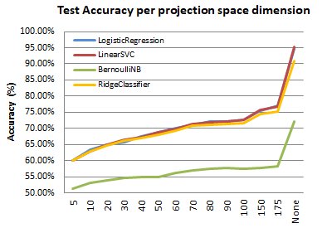
Content Analysis of YouTube Data
CS229, Autumn 2017 Category : Natural Language
Afshin Moin (afshinm), Abhishek Bharani (abharani), and Peng Seng Kuok (pkuok)
Motivation
Sentiment Classification
Effect of Dimensionality Reduction
Popularity of social media is increasing rapidly
YouTube is the most popular video sharing website
We do:
Sentiment analysis of the comments
Category prediction based on comments
Investigate the effect of dimensionality reduction
Model | Train Accuracy | Test Accuracy
Logistic Reg. | 95.64 | 94.47
Ridge Classifier | 93.98 | 90.46
Bernoulli NB | 72.15 | 71.53
Linear SVM | 96.89 | 95.14
Data
Calibration Curves
YouTube data acquired from Kaggle competition
Top 200 videos per day along with their comments, category and tags
2354 videos
691408 comments
Feature Extraction
Truncated SVD was used to project TF-IDF feature vectors to lower dimensional spaces
Generate sentiment labels using TextBlob to estimate comment polarity
Comment were vectorized using TF-IDF (Term Frequency – Inverse Document Frequency)
Future Work
Category classification based on tags
Automatic tag generation given category
Automatic comment generation given category, sentiment and comment length
Common Words in Positive Comments
Calibration curve is computed using two categories
Naïve Bayes Model is not well-calibrated in [0,1]
Logistic Regression is well-calibrated in [0,1]
Category Classification
References
Model | Train Accuracy | Test Accuracy
Logistic Reg. | 60.70 | 53.21
Ridge Classifier | 65.77 | 55.91
Bernoulli NB | 45.53 | 41.61
Linear SVM | 68.95 | 57.79
YouTube Database For Kaggle Competitions. https://www.kaggle.com/datasnaek/youtube
TextBlob Library For Python. https://textblob.readthedocs.io/en/dev
G. Toderici, H. Aradhye, M. Pasca, L. Sbaiz, and J. Yagnik. Finding meaning on youtube: Tag recommendation and category discovery. In Computer Vision and Pattern Recognition, 2010

