Slide 1



RescueGrid India
Intelligent Emergency Rescue and Medical Response Optimisation
PALS Think2Impact · ITPRBLM–B
Nationwide multi-disaster decision support and simulation
College: [add your college name]
Team members: [add names and registration details]
In association with Naandi Foundation
RescueGrid India | PALS ITPRBLM–B | Research simulation 01

Slide 2
Problem and objectives
Coordinate scarce rescue teams, ambulances, routes and receiving facilities.
Model the complete chain from incident reporting to appropriate medical treatment.
Identify delays caused by access, resource availability, rescue work and hospital queues.
Compare response strategies under identical, reproducible scenario conditions.
RescueGrid India | PALS ITPRBLM–B | Research simulation 02
In association with Naandi Foundation

Slide 3

Benefits and research questions
Beneficiaries: response planners, dispatch analysts, rescue coordinators and hospital managers.
When does a farther compatible hospital provide earlier appropriate care?
Which additional resource most reduces the dominant bottleneck?
What does prioritising critical patients cost other patients or supplying regions?
Report time, capacity pressure and unmet demand together.
RescueGrid India | PALS ITPRBLM–B | Research simulation 03
In association with Naandi Foundation

Slide 4
India-wide and multi-disaster scope
36 state/UT resource packages; 612 synthetic assets and 144 synthetic facilities.
Core: road accidents, train accidents, floods and cyclones.
Extensions: collapse, landslide, fire, chemical incidents, tsunami, heatwave and public-health pressure.
12 playbooks across 10 disaster families; configurable regional exercises.
Detailed OSM roads: Chennai and Guwahati; other packages use labelled generated networks.
RescueGrid India | PALS ITPRBLM–B | Research simulation 04

Slide 5

Functional requirements
Record incident location, severity, patient demand and evacuation groups.
Track resources, capabilities, access restrictions and receiving capacity.
Calculate explainable rescue, ambulance and hospital recommendations.
Reserve resources, advance the response and adapt subsequent legs to disruptions.
Compare policies, replay decisions, export results and plan regional assistance.
RescueGrid India | PALS ITPRBLM–B | Research simulation 05
In association with Naandi Foundation

Slide 6
Non-functional requirements
Reproducibility: seeds, input versions, source hashes and recorded decisions.
Reliability: revision checks, exclusive resources and capacity conservation.
Performance: bounded candidate models, cached routing and a separate experiment process.
Usability: map-led workflows and English/Hindi/Tamil interface labels.
Traceability: clear distinction between reference geography and simulated operations.
RescueGrid India | PALS ITPRBLM–B | Research simulation 06

Slide 7
Technical architecture
React + TypeScript → FastAPI → versioned workspace state.
MapLibre renders local reference geometry, road packages and response routes.
NetworkX computes travel paths; OR-Tools allocates and schedules resources.
SimPy executes response events; a bounded process runs controlled experiments.
SQLAlchemy persists state and experiments in SQLite or PostgreSQL.
RescueGrid India | PALS ITPRBLM–B | Research simulation 07
In association with Naandi Foundation

Slide 8
System workflow
Incident → report → specialist rescue assignment → rescue prerequisites.
Rescue / transfer readiness → suitable ambulance → compatible hospital.
Hospital queue → treatment → release of treatment capacity.
Vehicle handover and turnaround → resource available for another mission.
Observe changed conditions → re-optimise pending demand and later legs.
RescueGrid India | PALS ITPRBLM–B | Research simulation 08

Slide 9
Use cases
Dispatcher: enter an incident, inspect a recommendation and commit a response plan.
Coordinator: change resource or facility availability and inspect queued demand.
Planner: request regional assistance while retaining donor coverage.
Researcher: compare three policies with paired seeds and export evidence.
Presenter: load a prepared exercise and replay the response timeline.
RescueGrid India | PALS ITPRBLM–B | Research simulation 09

Slide 10
Detailed design: routing and rescue
Directed shortest-travel-time road graph with explicit blocked edges.
Disaster playbooks define specialist capabilities and sequential service tasks.
Boat / air scenarios include capacity-limited trips and ground transfer points.
Medical and evacuation groups have separate readiness times.
Infeasible access or missing capabilities produce explicit queued demand.
RescueGrid India | PALS ITPRBLM–B | Research simulation 10
In association with Naandi Foundation

Slide 11
Detailed design: allocation
Stage 1: severity-weighted rescue/resource matching using CP-SAT.
Stage 2: candidate patient–ambulance–hospital assignments.
One patient per ambulance; critical patients require ALS capability.
Optional treatment intervals and cumulative constraints enforce hospital capacity.
Bounded candidate model; solver status and fallback use remain visible.
RescueGrid India | PALS ITPRBLM–B | Research simulation 11

Slide 12
Regional coordination
CP-SAT minimises estimated transfer time for a desired receiving-region fleet.
Donor reserve constraints prevent the model from removing configured local coverage.
Mobilisation and road/sea travel consume simulated time.
Transferred resources are unavailable until arrival.
Links are explicit scenario estimates, not nationwide turn-by-turn routing.
RescueGrid India | PALS ITPRBLM–B | Research simulation 12
In association with Naandi Foundation

Slide 13
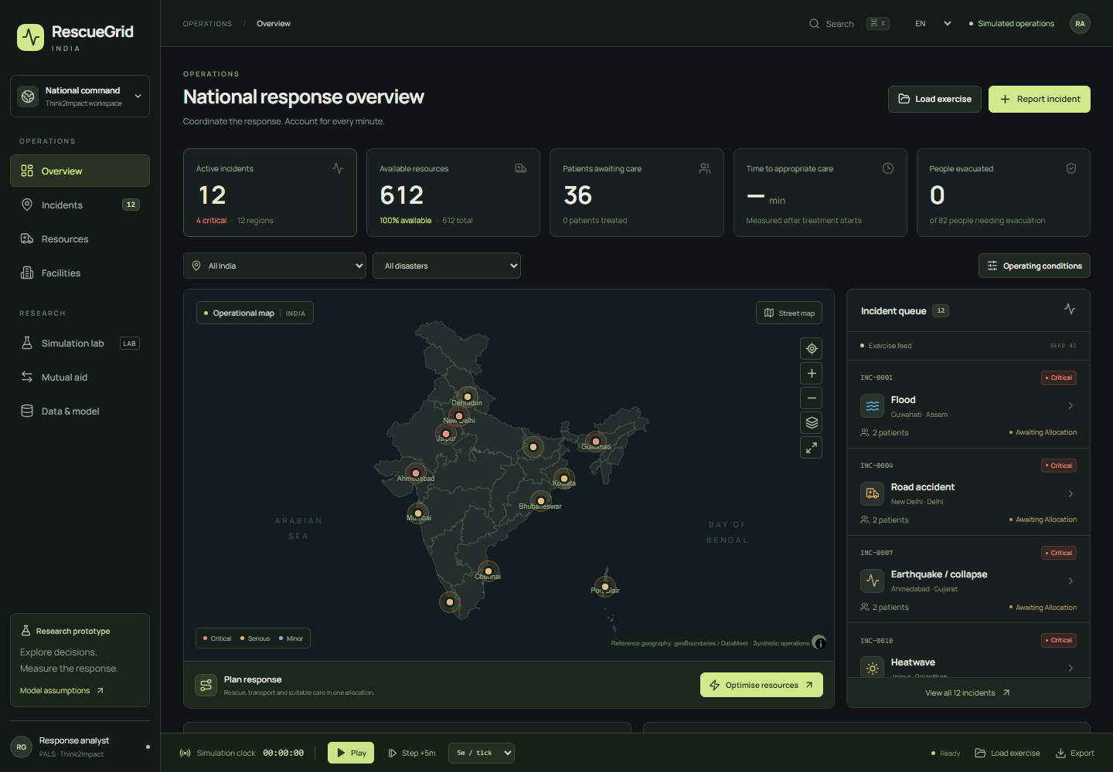
User interface: command centre
RescueGrid India | PALS ITPRBLM–B | Research simulation 13

Slide 14
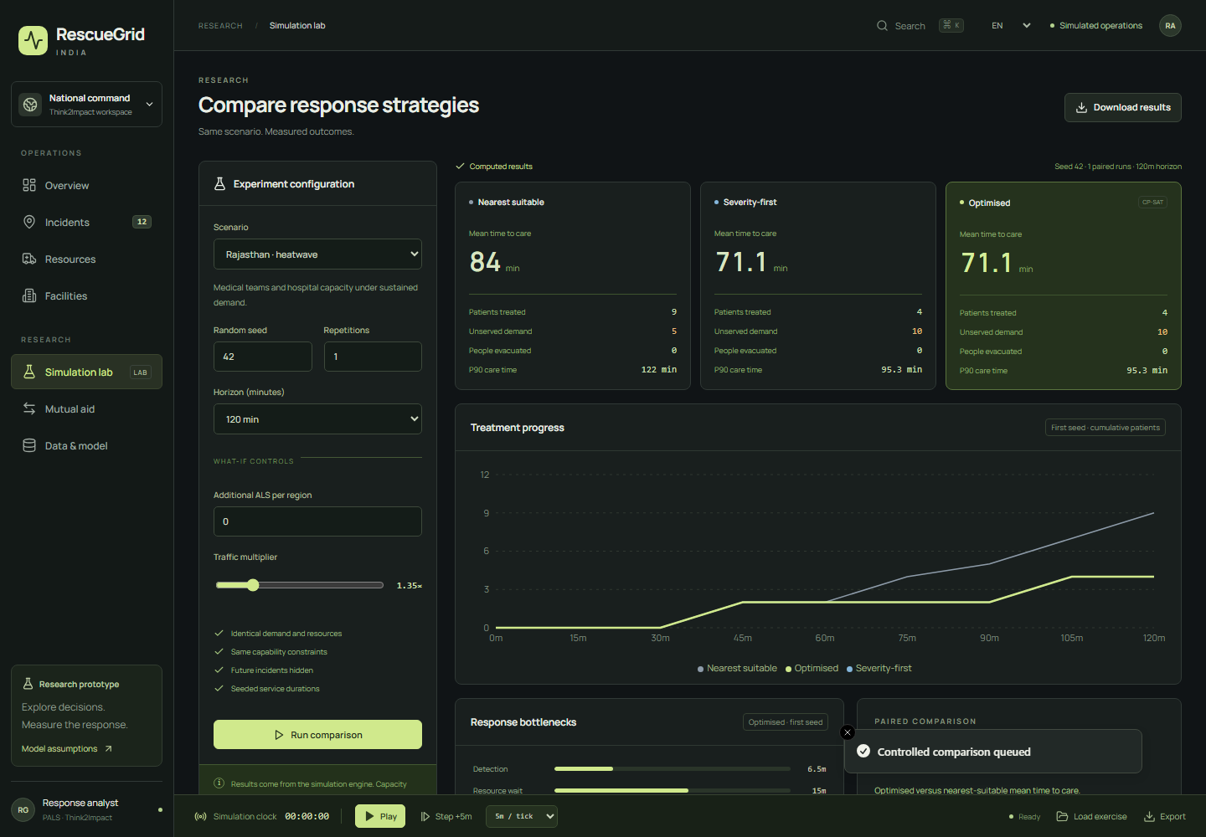
User interface: simulation laboratory
RescueGrid India | PALS ITPRBLM–B | Research simulation 14

Slide 15
Data model and provenance
Region → incident → patients / evacuation demand → missions.
Resource + dedicated crew → mission → receiving facility reservation.
Workspace: configuration, clock, revision, events and decision trace.
Reference boundaries retain source year; the district index has 735 historical records.
Public CAP/USGS observations are separate from synthetic casualty demand.
RescueGrid India | PALS ITPRBLM–B | Research simulation 15

Slide 16
Evaluation method
45 measured runs: five scenarios, three policies, 3 paired seeds.
Each run covers 240 simulated minutes with identical exogenous inputs.
Policies: nearest suitable, severity-first greedy and coordinated optimisation.
Measure mean/P90 care time, response time, unserved patients and evacuation.
Inspect critical-patient outcomes and bottlenecks; no fixed improvement claim.
RescueGrid India | PALS ITPRBLM–B | Research simulation 16

Slide 17
Measured outcomes and trade-offs
Constructed saturation case: mean care 167.1 → 100.8 minutes (nearest → optimised).
Chennai critical-patient mean care: 107.1 → 59.7 minutes across paired runs.
Severity prioritisation can increase the overall mean or leave more lower-priority demand at the horizon.
The optimiser is myopic and staged; results vary by scenario and assumptions.
Full results: docs/EVALUATION.md and benchmark-results.csv / .json.
RescueGrid India | PALS ITPRBLM–B | Research simulation 17

Slide 18
Validation and infrastructure
38 engine/API tests cover workflows, capacity, isolation, stale steps and interrupted jobs.
10 browser tests cover the interface, sustained playback, real server restart and recovery.
Local target: Python 3.11+, Node.js 22/24 and an approximately 8 GB laptop.
Windows launcher; Docker/Compose and hosted-service configuration included.
Native production build tested; Docker execution and hosted publication require their environments.
RescueGrid India | PALS ITPRBLM–B | Research simulation 18

Slide 19
Assumptions and implementation path
All operational availability, casualties and hospital capacity are simulated.
Travel speeds, service times and severity weights are stated research assumptions.
Current travel legs finish; later legs use updated access and facility conditions.
Next validation: current district data, practitioner-reviewed durations and authorised operational integrations.
Research prototype; no real emergency-dispatch or clinical diagnosis integration.
RescueGrid India | PALS ITPRBLM–B | Research simulation 19

Slide 20
Demonstration and discussion
Launch START_RESCUEGRID.bat → http://127.0.0.1:8000
Load saturation exercise → calculate → explain → dispatch → advance.
Compare policies → inspect critical outcomes and unmet demand → export.
Demonstrate flood transfers and reserve-constrained regional assistance.
Which resource change best reduces the limiting delay in this scenario?
RescueGrid India | PALS ITPRBLM–B | Research simulation 20
In association with Naandi Foundation

