Slide 1
Python Basics
Kunal Agarwal
AIDEAS ACADEMY

Slide 2
Why Python?
Python is one of the Top Programming Languages in the world today Known for its simplicity, readability, and a rich ecosystem of libraries and frameworks
Python is used to build: Web Applications, Data Science Applications, Machine Learning Applications And a lot more...
Learning Python can help you become a versatile and in demand developer

Slide 3
Who invented Python?
Python was invented by the Dutch programmer Guido van Rossum.
He began working on the language in December 1989 as a hobby project while at the Centrum Wiskunde & Informatica (CWI) in the Netherlands, and released the first version in February 1991.
Guido van Rossum is a Dutch Programmer, He is the creator of Python Programming Lang.
From 2005 to December 2012, Van Rossum worked at Google, where he spent half of his time developing the Python language

Slide 4
Learning Python can be tricky: Lots of new terminology, concepts and syntax
As time passes, we forget things How do you improve your chances of remembering things?
Active learning - think & make notes Solve Exercises on your and keep coding new problems.
Remember the 1:4 ratio

Slide 5
How to become a great programmer?
PRACTICE, PRACTICE and PRACTICE

Slide 6
Installing Python
https://www.python.org/downloads/
ENV Variables
Voila!

Slide 7
What is Python
Python is a high-level, interpreter programming language that is designed to be easy to read, write, and understand, while still being powerful enough for real-world software development
What is High-level?
What is a Programming Language?

Slide 8
What is Python
What is High-level?
Assembly, Machine Language, COBOL…(Low Level Languages)
Python lets you tell the computer what to do using human-like language instead of complex syntax and that is what high-level means.
What is a Programming Language?
Way to communicate with hardware systems/computers to make it understand and do something.
What is a Interpreter?
An interpreter is a program that reads, translates, and executes code line-by-line, instead of converting the whole program into machine code all at once.

Slide 9
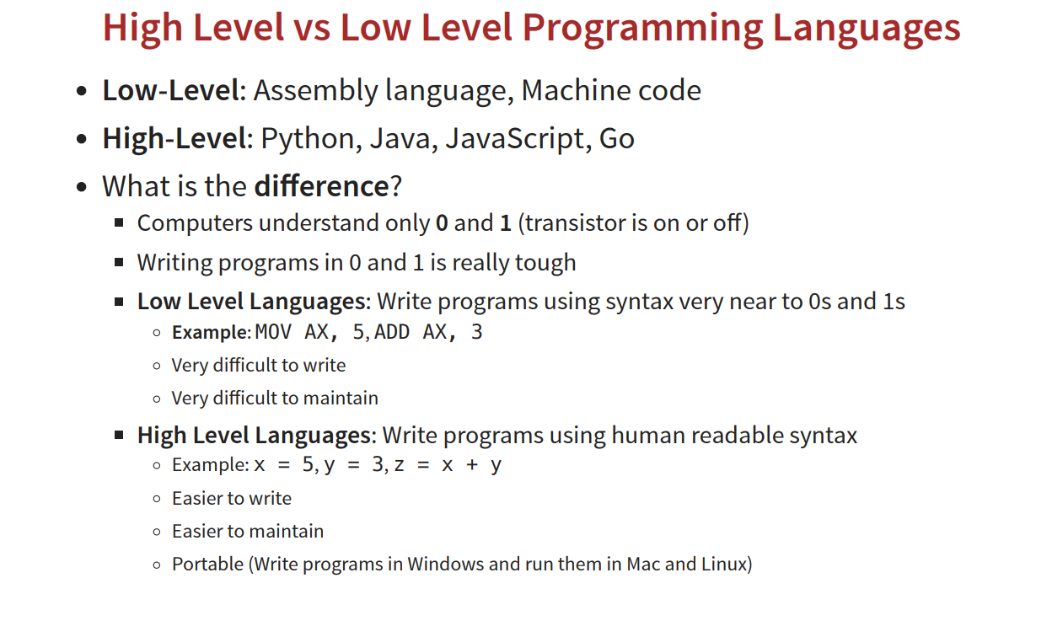

Slide 10
Learn Printing in Python: Using the print() function for output
Understanding the importance of quotes for text data - 'Hello World’
Learn Basic Math Operations: Multiplication (*), addition (+), subtraction (-), division (/), exponentiation (**), and remainder (%)
Learn about Built-in Functions: print(), abs(), pow(), max(), and min()

Slide 11
max(3, 7, 2) # 7 max([10, 5, 20, 3]) # 20 max("apple", "banana") # 'banana'
print("Hello, World!")
print(10)
print("Sum:", 5 + 3)
abs(-10) # 10
abs(3.5) # 3.5
pow(2, 3) # 8 (2³)
pow(5, 2) # 25
min(3, 7, 2) # 2
min([10, 5, 20, 3]) # 3
min("apple", "banana") # 'apple'

