Slide 1
Python Object Oriented Programming
Kunal Agarwal
Aideas Academy

Slide 2
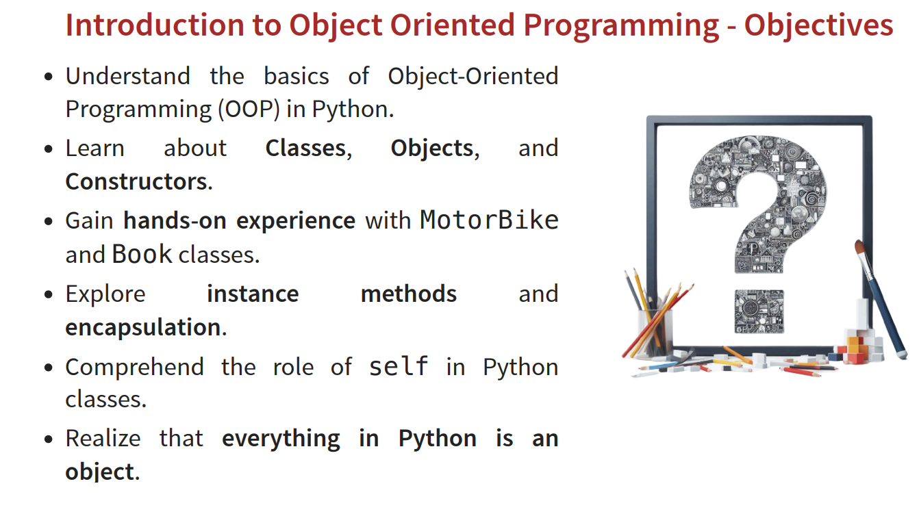

Slide 3
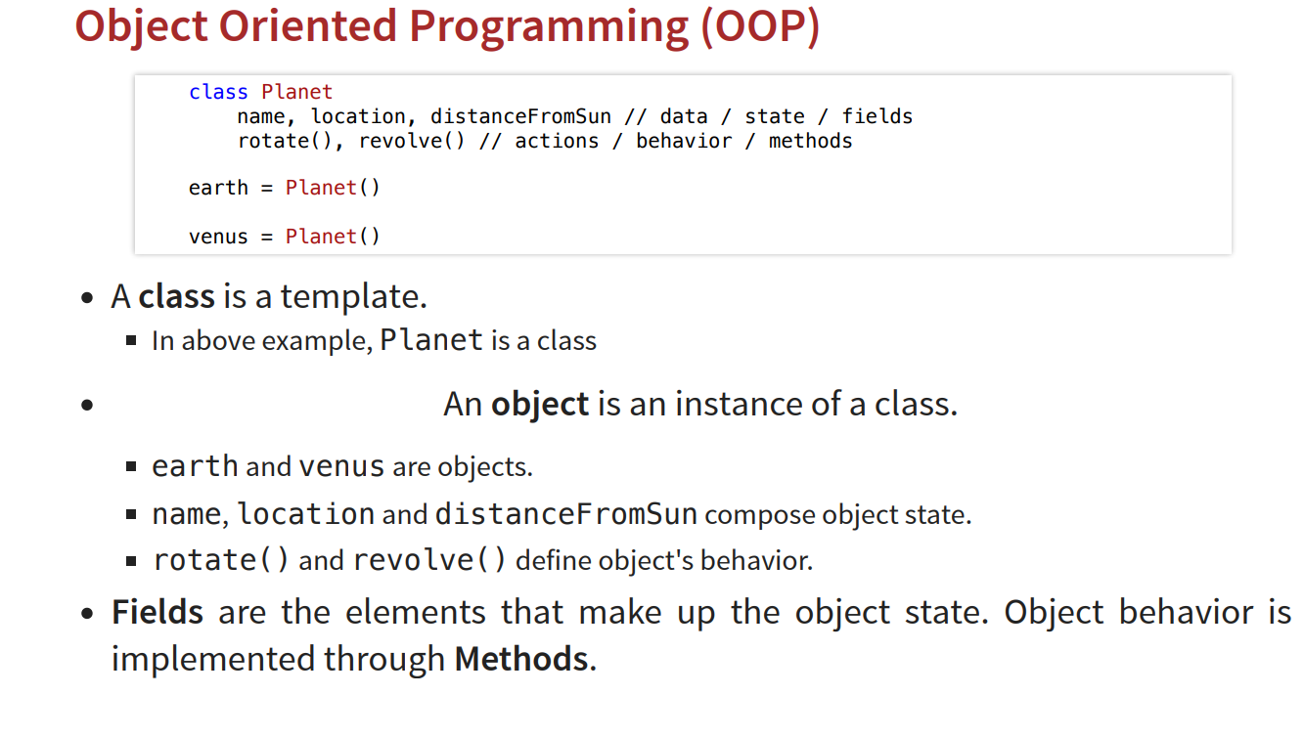
Concept and core functionality : OOP

Slide 4
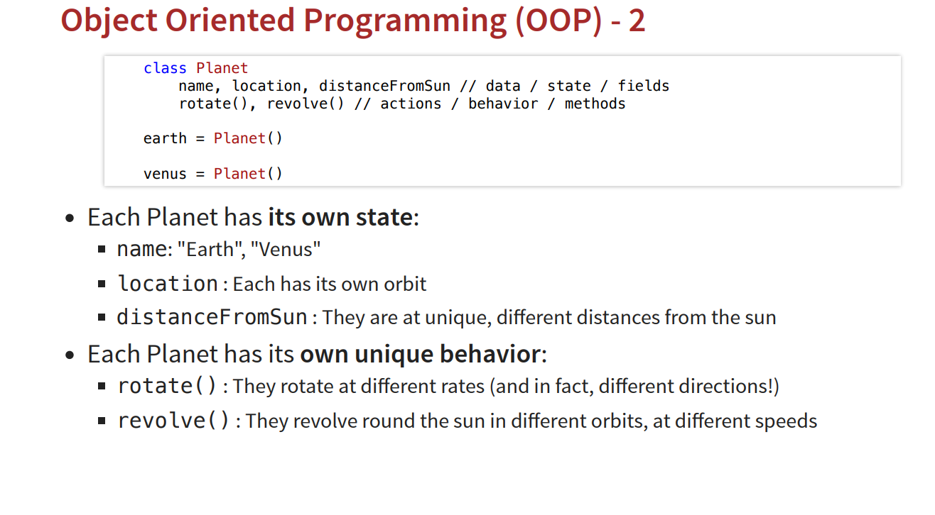
Concept and core functionality : OOP

Slide 5
Concept and core functionality : OOP

Slide 6
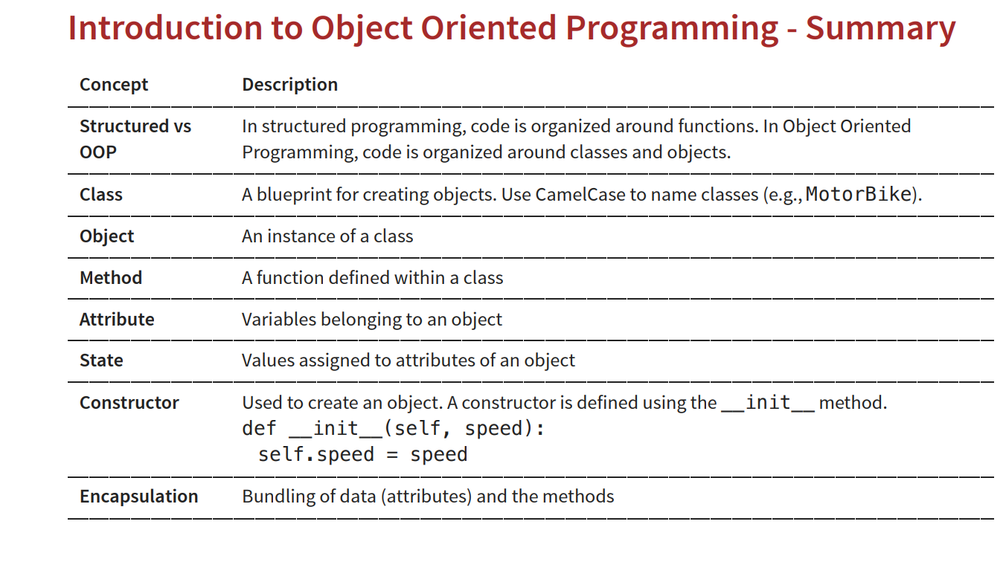

Slide 7
Class Creation
class Planet:
def __init__(self, name, radius, distance_from_sun):
self.name = name
self.radius = radius # in kilometers
self.distance_from_sun = distance_from_sun # in million km
def display_info(self):
print("Planet Name:", self.name)
print("Radius:", self.radius, "km")
print("Distance from Sun:", self.distance_from_sun, "million km")

Slide 8
Object Creation
earth = Planet("Earth", 6371, 149.6)
earth.display_info()

Slide 9
class Planet: → defines the blueprint
__init__() → constructor (initializes object data)
self → refers to the current object
earth → object created from Planet class

Slide 10
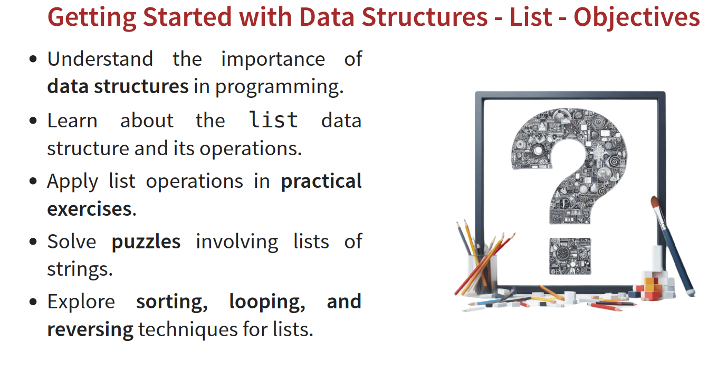

Slide 11
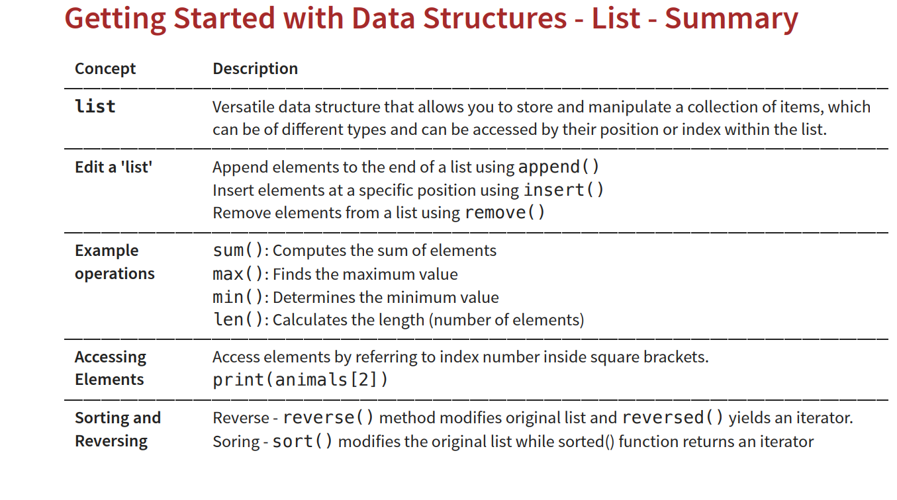

Slide 12
numbers = [40, 10, 30, 20]
numbers.append(50)
print("After Append:", numbers)
print("Length:", len(numbers))
numbers.reverse()
print("Reversed:", numbers)
numbers.sort()
print("Sorted:", numbers)
numbers = [10, 20, 30, 40]
total = sum(numbers)
print("Sum:", total)
numbers = [10, 20, 30, 40]
maximum = max(numbers)
print("Maximum:", maximum)
numbers = [10, 20, 30, 40]
minimum = min(numbers)
print("Minimum:", minimum)

Slide 13
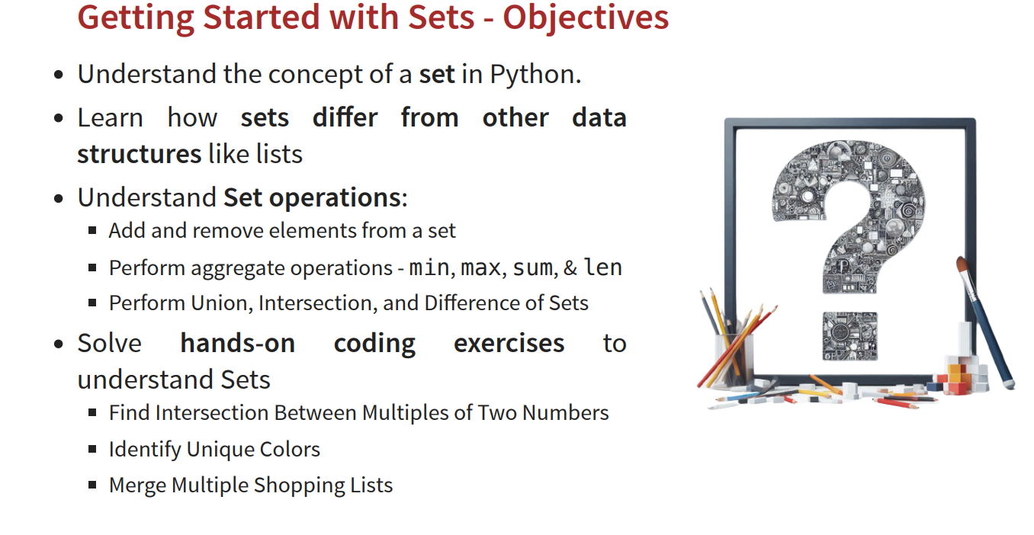

Slide 14
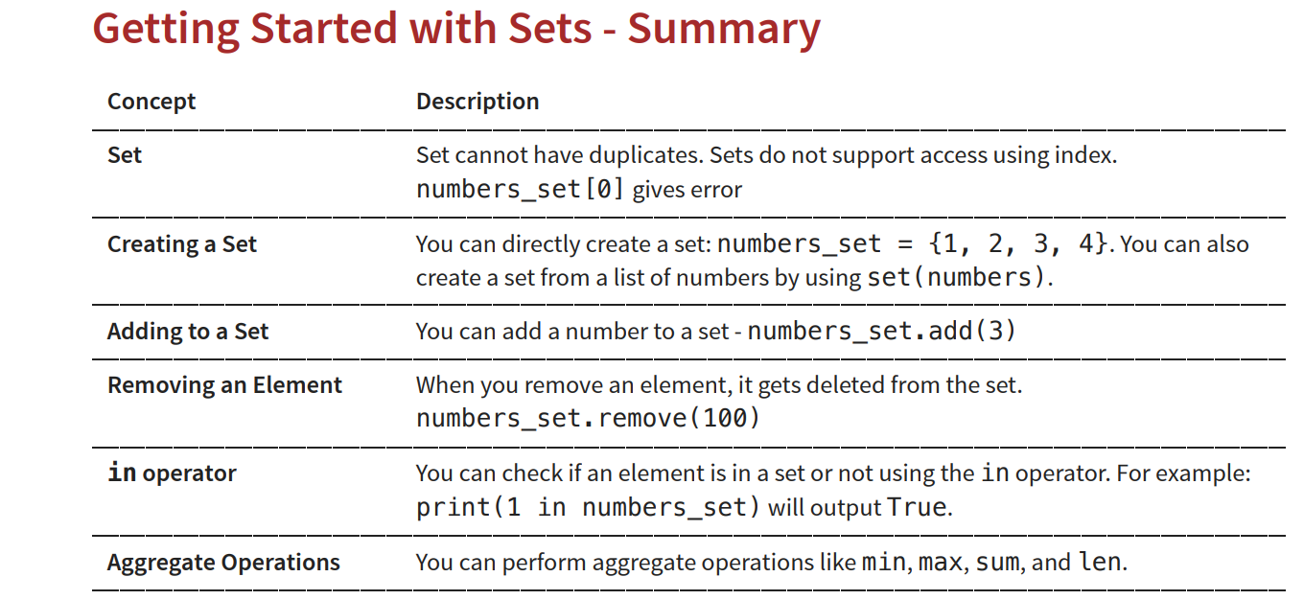

Slide 15
numbers = {40, 10, 30, 20}
print("Sum:", sum(numbers))
print("Max:", max(numbers))
print("Min:", min(numbers))
numbers.add(50)
print("After Add:", numbers)
print("Length:", len(numbers))
numbers.remove(10)
print("After Remove:", numbers)
print("Sorted:", sorted(numbers))

Slide 16
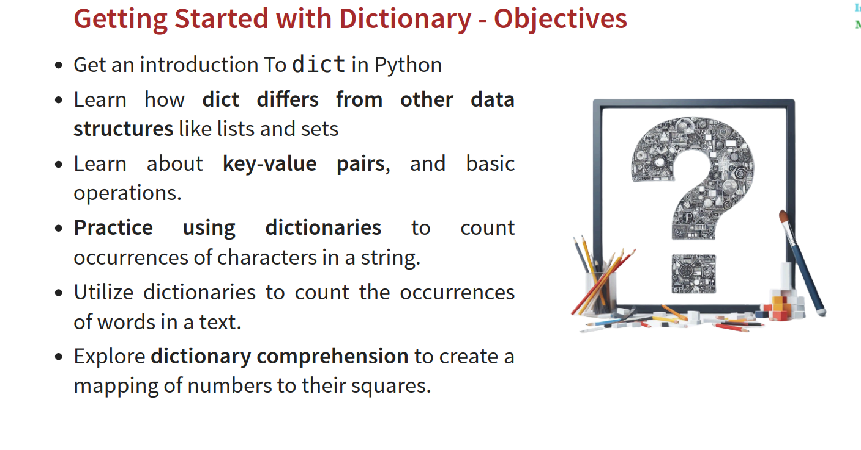

Slide 17
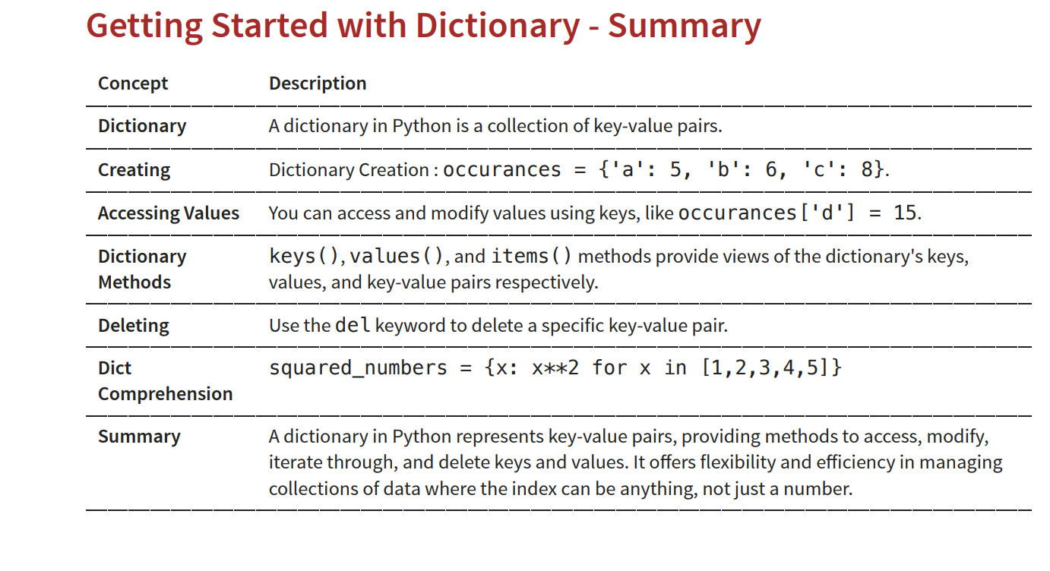

Slide 18
numbers=[1,2,3,5]
Squared_numbers={x:x**2 for x in numbers}
print(Squared_numbers)
for key, value in numbers.items():
print(key, ":", value)
numbers.clear()
print(student)
del numbers[keyname]
print(student)
numbers.popitem()

Slide 19
Data Type | Mutable / Immutable
String (str) :House Address and location | ❌ Immutable
Integer (int) | ❌ Immutable
Float (float) | ❌ Immutable
Tuple (tuple) | ❌ Immutable
List (list) | ✅ Mutable
Dictionary (dict) | ✅ Mutable
Set (set) | ✅ Mutable
Immutable objects cannot be changed once created, while mutable objects can be modified in place

