Slide 1
Python Programming & Data types
Kunal Agarwal
Aideas Academy

Slide 2
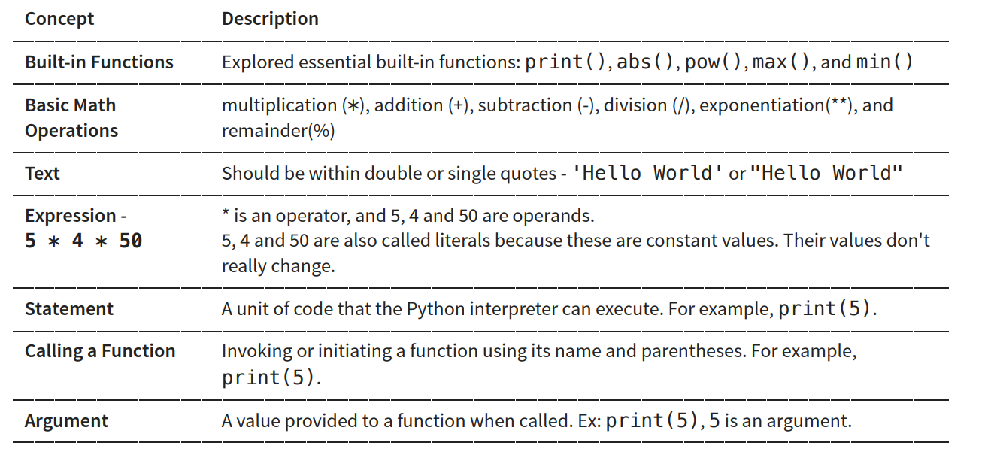
Terminology

Slide 3
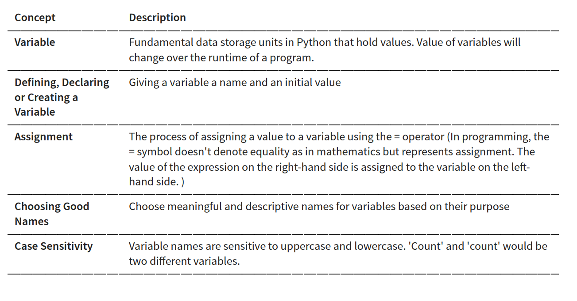
Introduction to Variables and Assignments

Slide 4
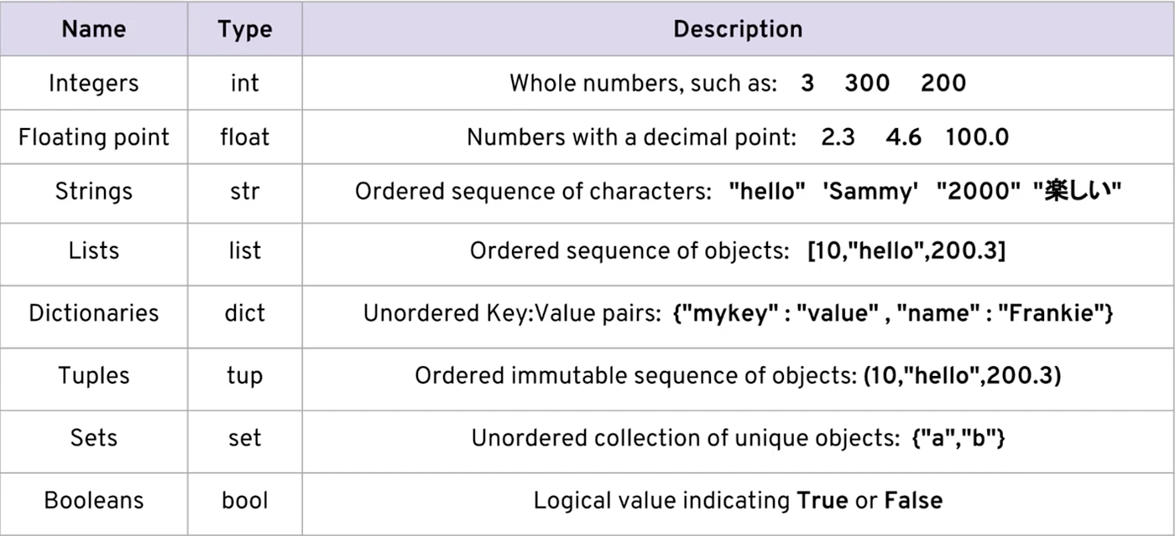
Data Types

Slide 5
Python don’t innately have Arrays built in.
Use Numpy
Np.ARRAY([1,2,3])

Slide 6
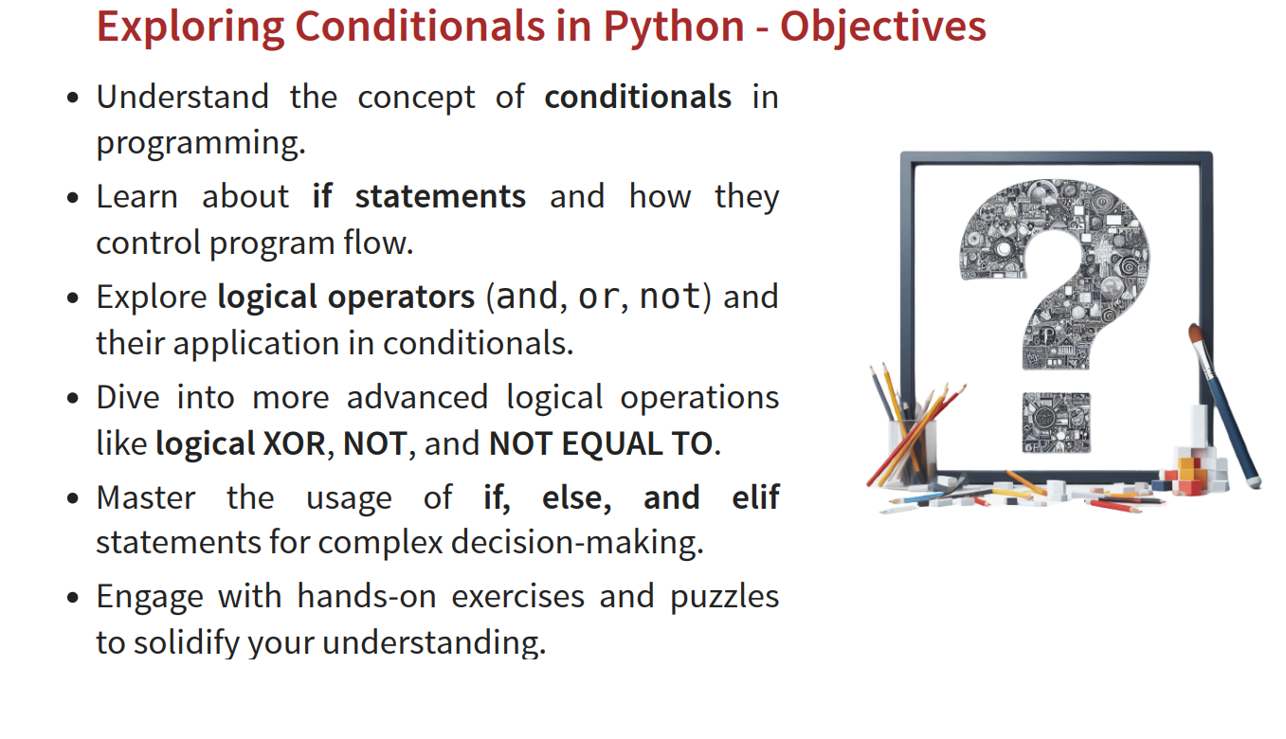
Use Numpy
Np.ARRAY([1,2,3])

Slide 7
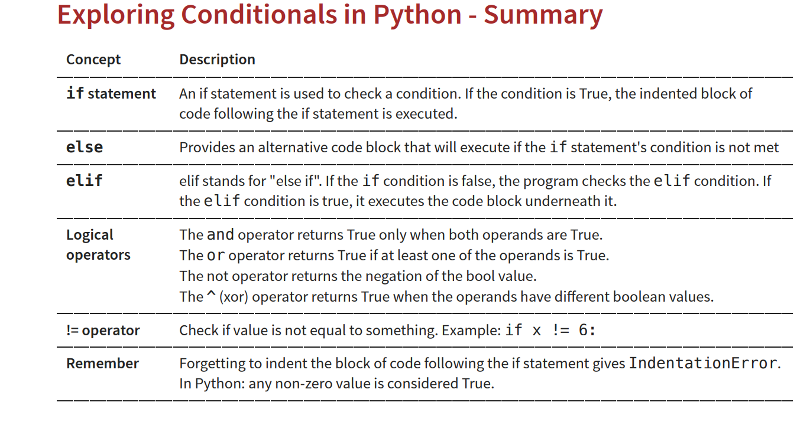

Slide 8
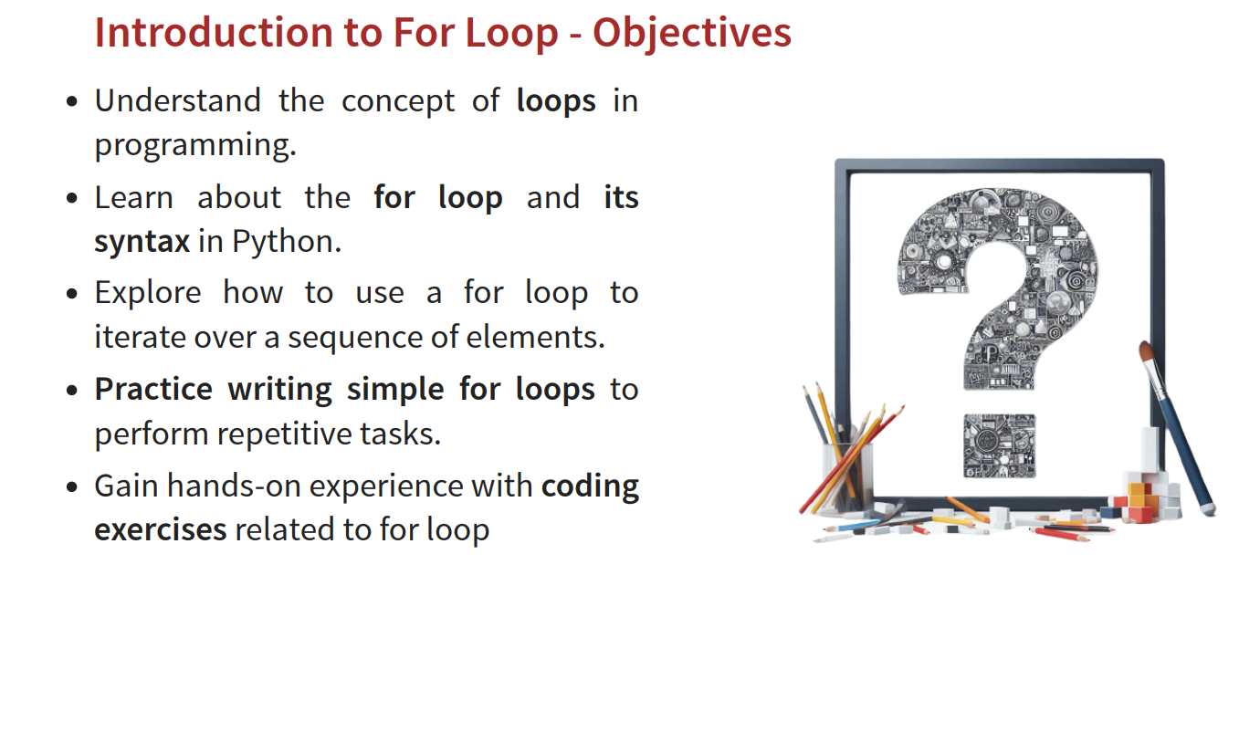

Slide 9
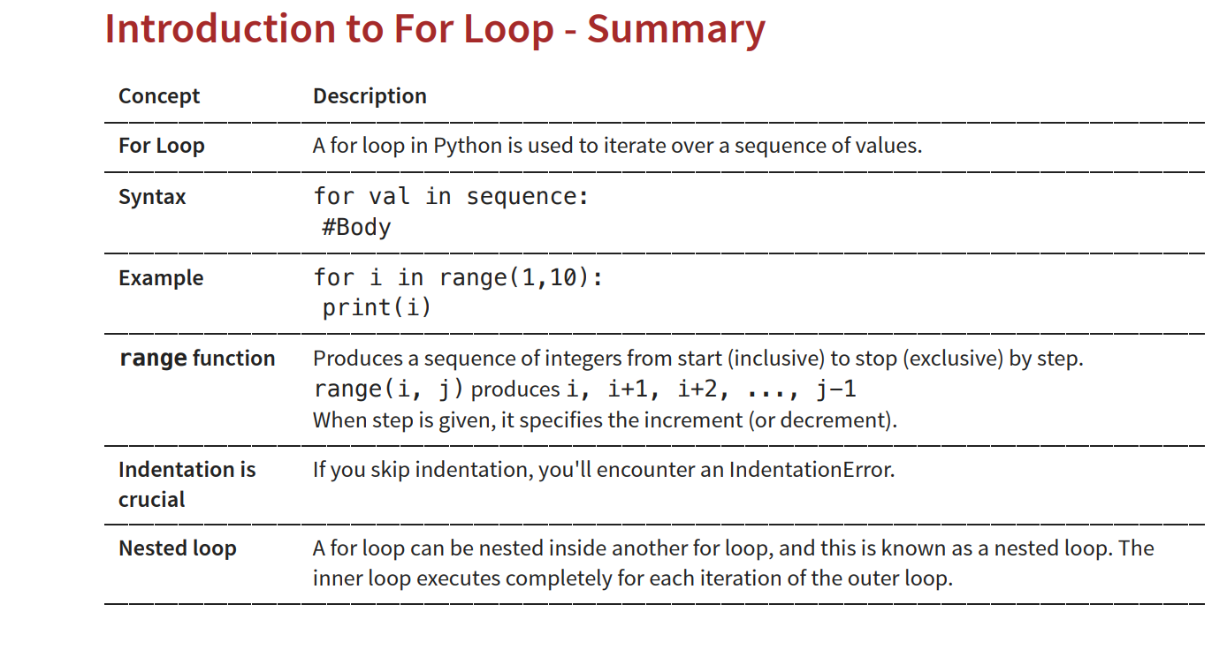

Slide 10
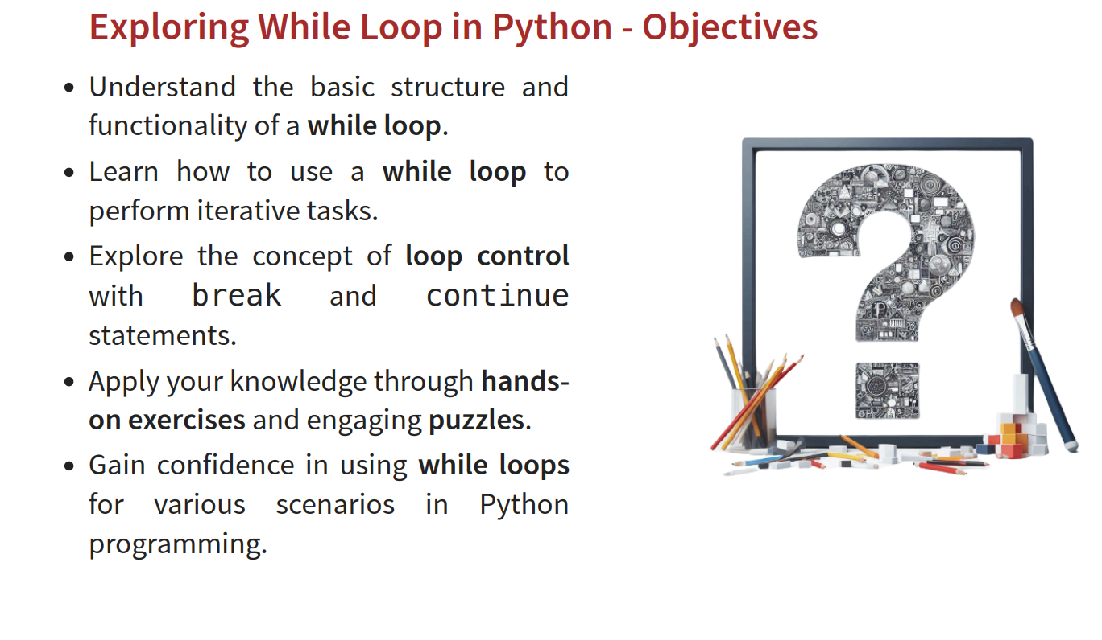

Slide 11
