Slide 1
Python Functions and Strings
Kunal Agarwal
Aideas Academy

Slide 2
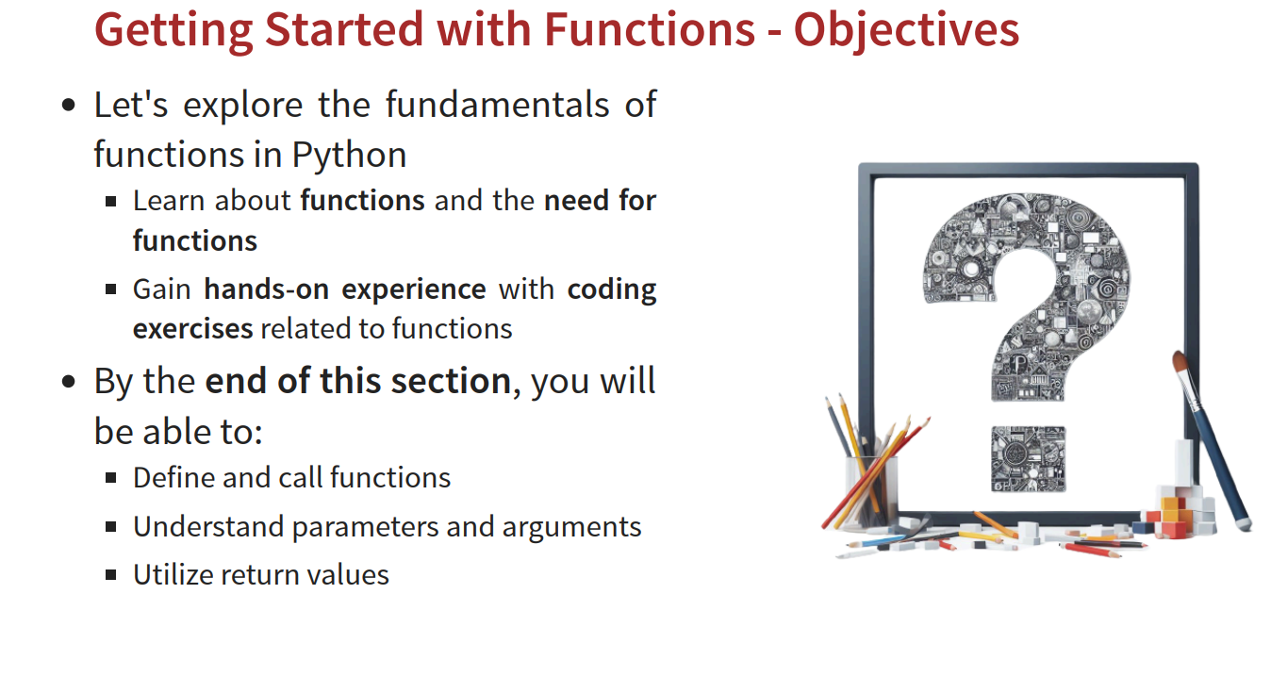
Terminology

Slide 3
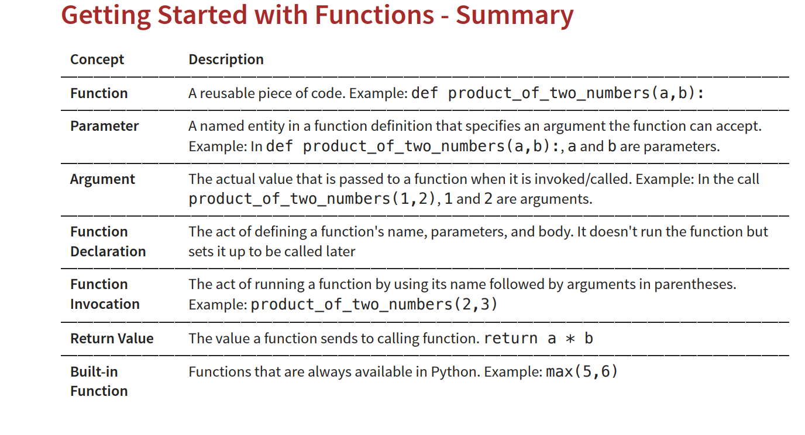
Concept and core functionality : Reusability

Slide 4
Function
A function is a reusable block of code that performs a specific task and runs only when called.
Functions help in:
Code reusability
Modularity
Readability
Easy maintenance

Slide 5
Function architecture:
def function_name(parameters):
"""Optional docstring"""
function_body
return value

Slide 6
Default Params:
def greet(name, country="India"):
print(name, country)
Variable Length :
def add(*args):
return sum(args)

Slide 7
def fibonacci(n):
series = []
a, b = 0, 1
for _ in range(n):
series.append(a)
a, b = b, a + b
return series
1,1,2,3,5,8,13,21,34,55…

Slide 8
def calculator(a, b, operation):
if operation == "add":
return a + b
elif operation == "sub":
return a - b
elif operation == "mul":
return a * b
elif operation == "div":
return a / b if b != 0 else "Cannot divide by zero"
else:
return "Invalid operation"

Slide 9
def is_palindrome(value):
value = str(value)
return value == value[::-1]
print(is_palindrome("madam"))
print(is_palindrome(121))
print(is_palindrome("python"))

Slide 10
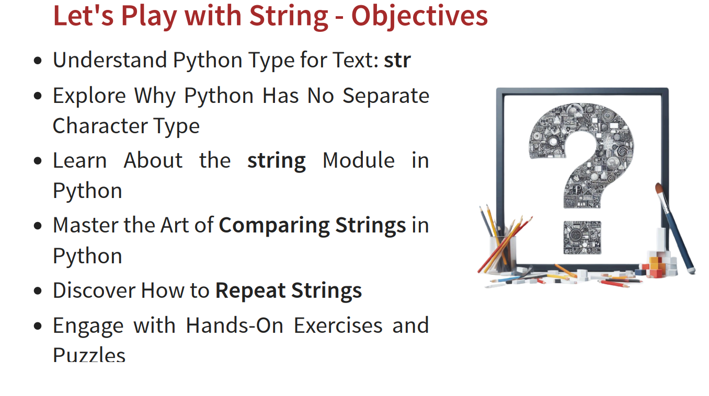

Slide 11
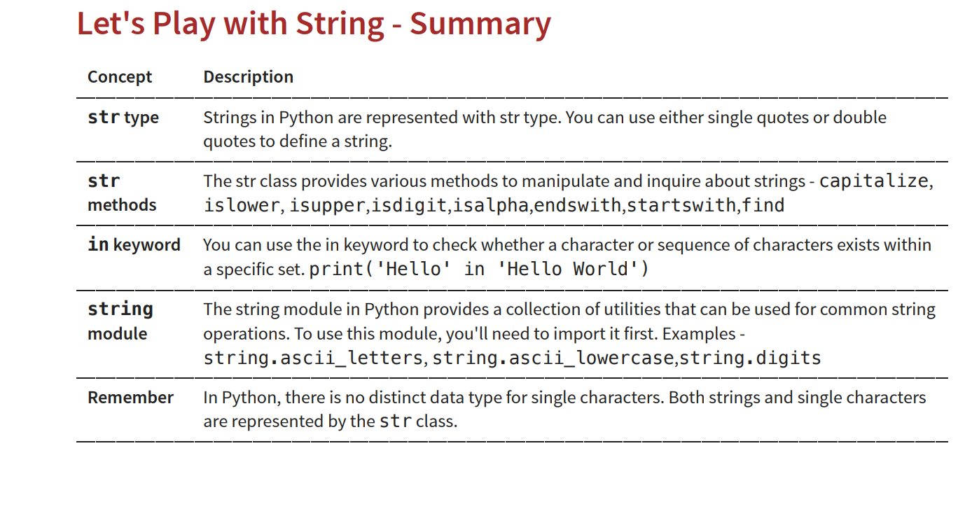

Slide 12
text = "python"
print(text.upper())
text = "PYTHON"
print(text.lower())
text = "python programming"
print(text.capitalize())
text = "python programming"
print(text.title())
text = " hello "
print(text.strip())
text = "I like Java"
print(text.replace("Java", "Python"))

Slide 13
import string
ch = input("Enter a character: ")
if ch in string.ascii_letters:
print("It is an alphabet.")
else:
print("It is not an alphabet.")

Slide 14
import string
import random
password = ""
for i in range(8):
password += random.choice(string.ascii_letters)
print(password)

Slide 15
import string
text = "Hello123@World"
count = 0
for ch in text:
if ch in string.ascii_letters:
count += 1 // count=count+1
print("Letters =", count)

Slide 16
Constant | Value | Example Output
string.ascii_lowercase | Lowercase letters | abcdefghijklmnopqrstuvwxyz
string.ascii_uppercase | Uppercase letters | ABCDEFGHIJKLMNOPQRSTUVWXYZ
string.ascii_letters | Lowercase + Uppercase | abcdefghijklmnopqrstuvwxyzABCDEFGHIJKLMNOPQRSTUVWXYZ
string.digits | Digits | 0123456789

