Slide 2

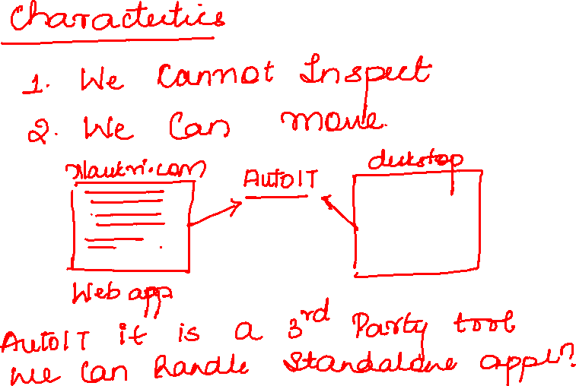

Slide 3
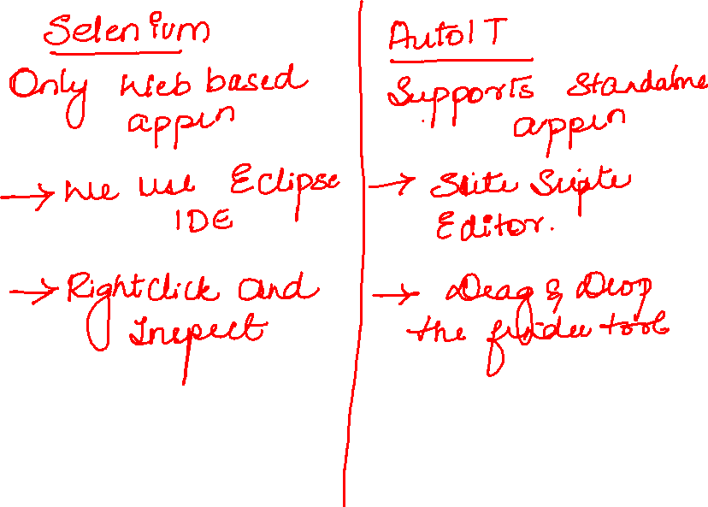

Slide 4
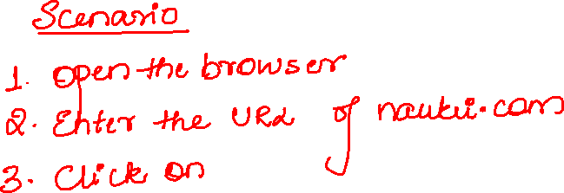
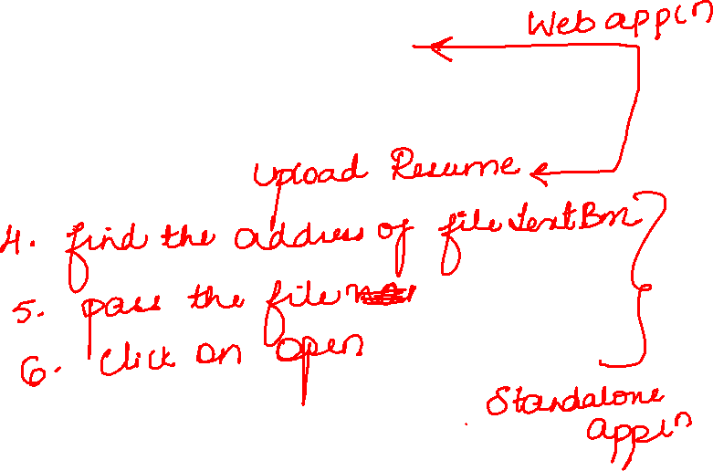

Slide 5
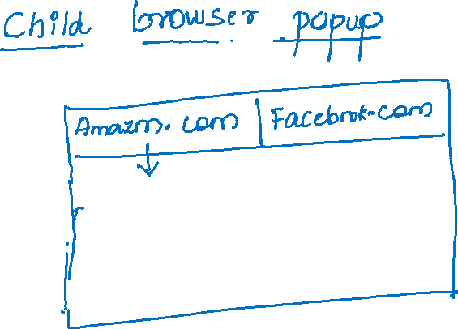
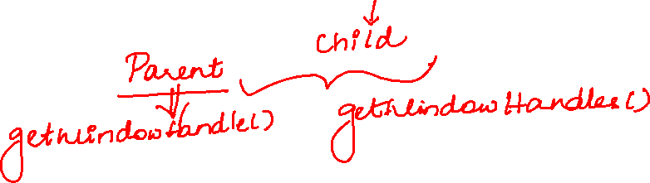

Slide 6
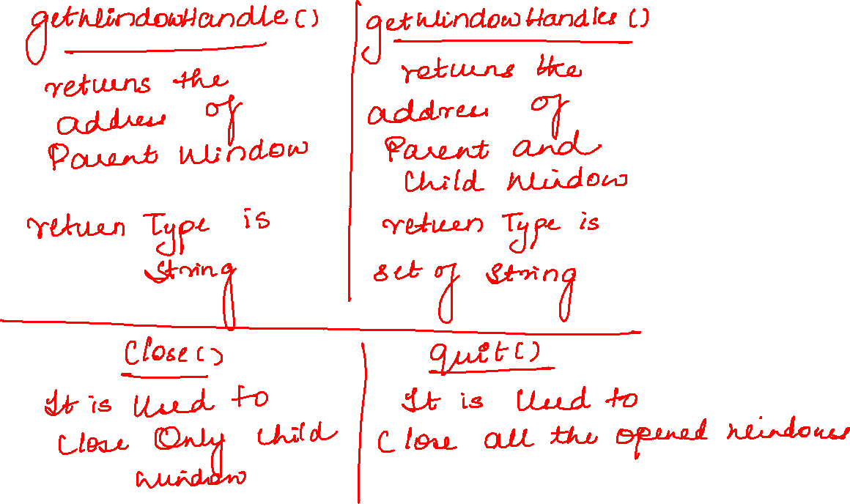

Slide 7
WinWaitActive("Open")
Sleep(3000)
ControlFocus("Open","","Edit1")
Sleep(3000)
Send("C:\Users\Bharanilikith\Downloads\Get_Started_With_Smallpdf.pdf")
Sleep(3000)
ControlClick("Open","&Open","Button1")

